Slide 1
Optimizing Traffic Lights in a Cellular Automaton Model for City Traffic
Elmar Brockfeld, Robert Barlovic, Andreas Schadschneider, Michael Schreckenberg
Physical Review E, Vol. 64, No. 056132, 2001.
Presenter: Shiuan-Wen Chen
Date: Dec. 28, 2006

Slide 2
ABSTRACT
We study the impact of global traffic light control strategies in a recently proposed cellular automaton model for vehicular traffic in city networks. The model combines basic ideas of the Biham-Middleton-Levine model for city traffic and the Nagel-Schreckenberg model for highway traffic. The city network has a simple square lattice geometry. All streets and intersections are treated equally, i.e., there are no dominant streets. Starting from a simple synchronized strategy we show that the capacity of the network strongly depends on the cycle times of the traffic lights.

Slide 3
ABSTRACT
Moreover we point out that the optimal time periods are determined by the geometric characteristics of the network, i.e., the distance between the intersections. In the case of synchronized traffic lights the derivation of the optimal cycle times in the network can be reduced to a simpler problem, the flow optimization of a single street with one traffic light operating as a bottleneck. In order to obtain an enhanced throughput in the model improved global strategies are tested, e.g., green wave and random switching strategies, which lead to surprising results.

Slide 4
I. INTRODUCTION
In this paper we analyze the impact of global traffic light control strategies, in particular synchronized traffic lights, traffic lights with random offset, and with a defined offset in a recently proposed CA model for city traffic.
Chowdhury and Schadschneider [10,11] combine basic ideas from the Biham-Middleton-Levine (BML) [12] model of city traffic and the Nagel-Schreckenberg (NaSch) [13] model of highway traffic.
This extension of the BML model will be denoted ChSch model in the following.

Slide 5
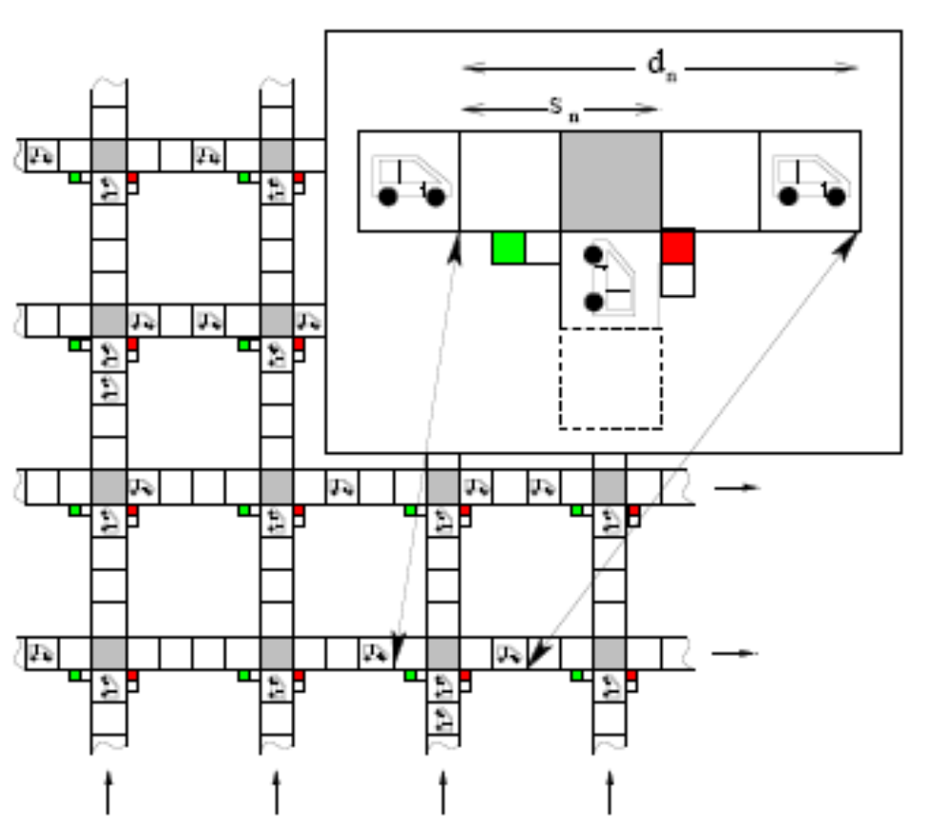
II. DEFINITION OF THE MODEL
The network of streets builds
a N × N square lattice.
The number of intersections is
set to N × N = 16.
The total number of cells on
every street is L = N × D.
The length of the streets
between two intersections is
chosen to D − 1 = 4.
No streets or directions are
dominant.
The average densities,
traffic light periods for all
streets are assumed to be equal.
The length of a single cell is set to 7.5 m.

Slide 6
II. DEFINITION OF THE MODEL
The traffic lights are chosen to switch simultaneously after a fixed time period T. Additionally all traffic lights are synchronized. The “green light” periods are equal to the “red light” periods.
The strategy described above will be called “synchronized strategy”.
In analogy to the NaSch model the speed v of the vehicles can take one of the v_{max}+1 integer values in the range v = 0, 1, ..., v_{max}.
The state of the network at time t+1 can be obtained from that at time t by applying the following rules to all cars at the same time (parallel dynamics):

Slide 7
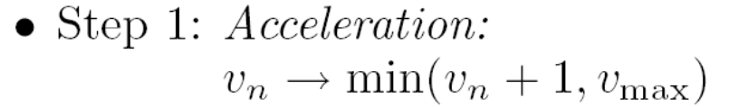
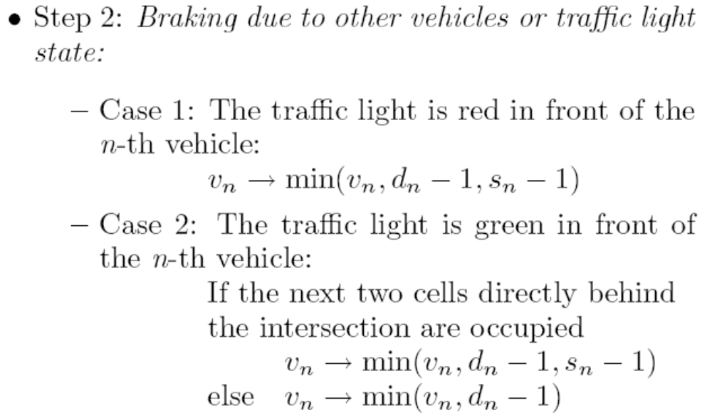
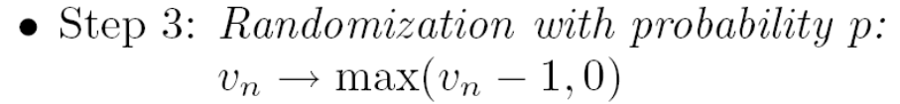

II. DEFINITION OF THE MODEL
v_{max} = 5

Slide 8

II. DEFINITION OF THE MODEL
In the initial state of the system, N_{v} vehicles are distributed among the streets.
The global density then is defined by
since in the initial state the N² intersections are left empty.
Moreover we compared the original formulation of the ChSch model and the modified one by simulations and found no differences except for the gridlock situations which appear in the original formulation due to the stronger interactions between intersections and roads.

Slide 9
III. STRATEGIES
We first study the dependence between traffic light periods and aggregated dynamical quantities like flow.
It is shown that investigating the simpler problem of a single road with one traffic light (i.e., N = 1) operating as a defect is sufficient to give appropriate results concerning the overall network behavior.
The results can be used as a guideline to adjust the optimal traffic light periods in respect to the model and network parameters.

Slide 10
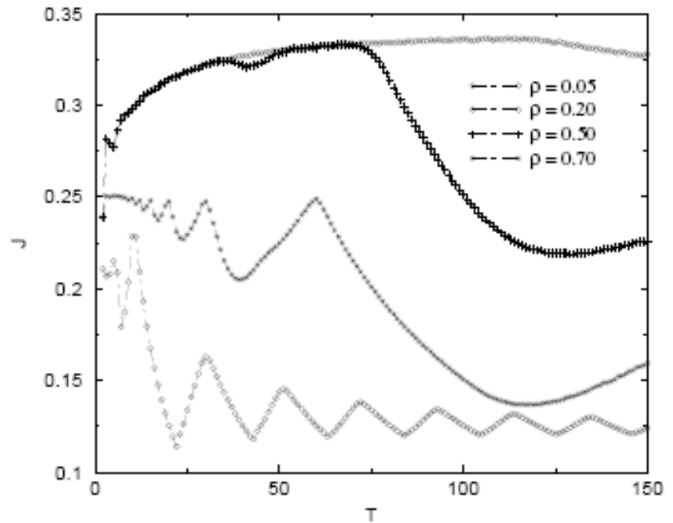
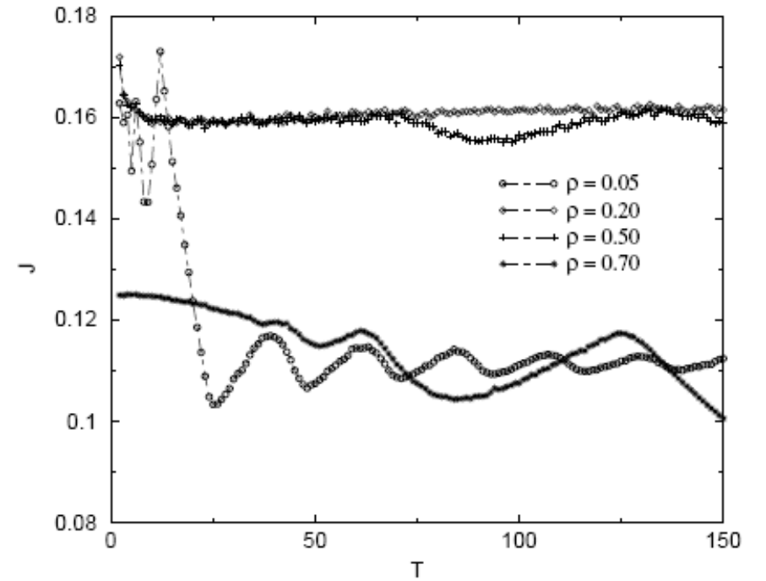
A. Synchronized Traffic Lights
The mean flow J of the smallest network segment(one single intersection, N = 1) is plotted for different global densities as a function of the cycle length T.
p= 0.1 p= 0.5

Slide 11
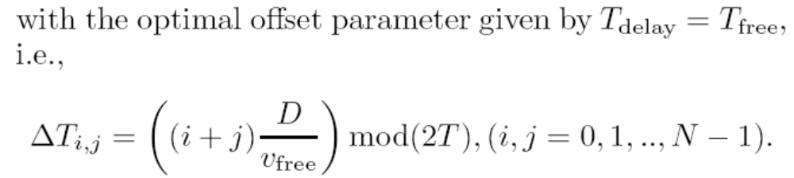
B. Green Wave Strategy
The intersections are denoted with indices i, j where i = 0, 1, ..,N − 1 represents the rows and j = 0, 1, ..,N − 1 the columns of the quadratic network.
In addition, an individual offset parameter ∆T_{i,j} is introduced and assigned to every intersection.
If N=3, T_{delay}= 3
6 9 12
3 6 9
0 3 6
2
1
0
i
j 0 1 2

Slide 12
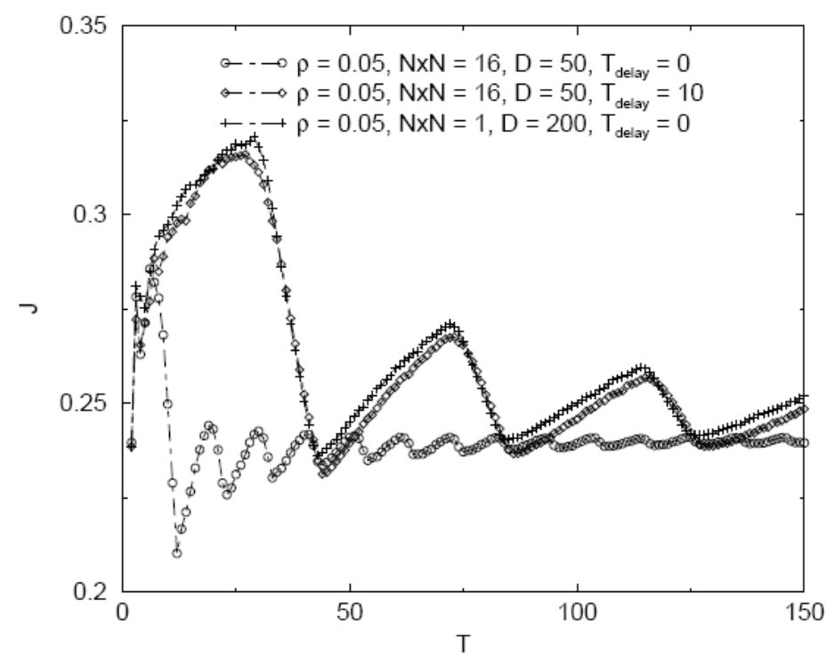
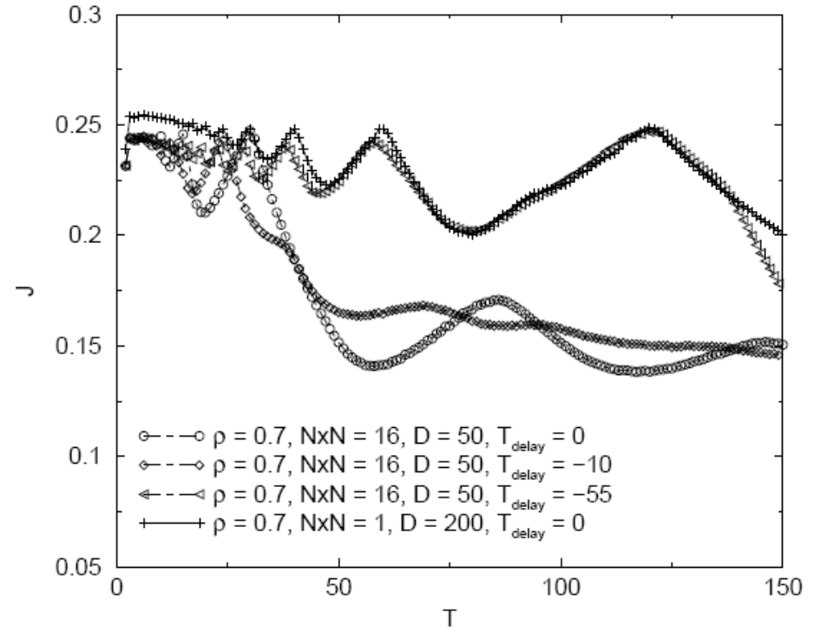
B. Green Wave Strategy
The randomization parameter is p = 0.1 and the maximum velocity is v_{max} = 5

Slide 13
C. Random Offset Strategy
Switching successive traffic lights with a random shift instead of a fixed time delay can lead to a more flexible strategy, e.g., without oscillations.
The offset parameter itself can take values between T_{i,j} = 0, ..., 2T which are chosen in the following from an equally distributed random distribution.
The random offset strategy leads to a smoothed curve which is very useful adjusting the optimal cycle times in a network.

Slide 14
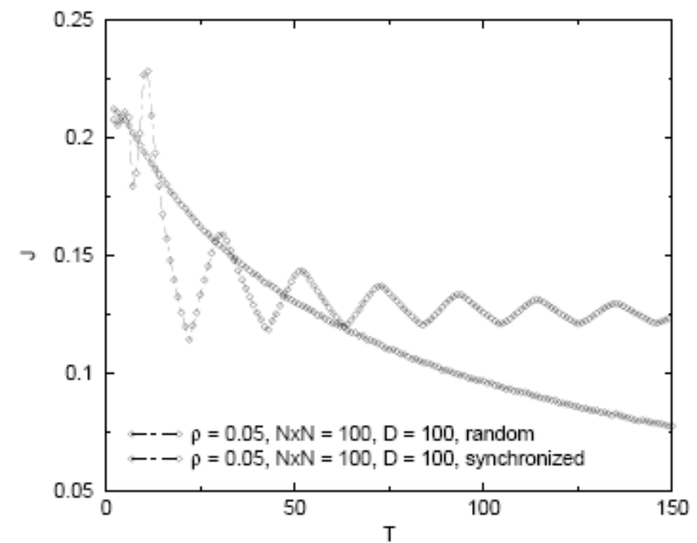
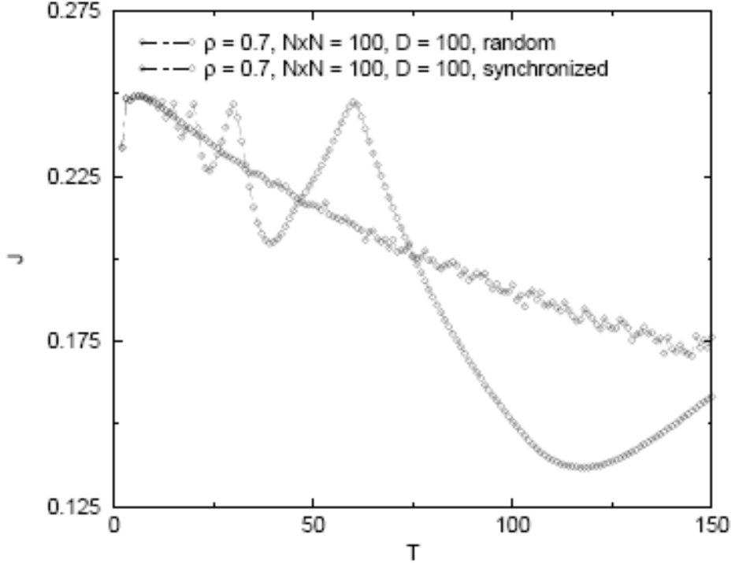
C. Random Offset Strategy
The network consists of N × N = 100 intersections with 2N² street segments each of length D = 100 cells.
p=0.1

Slide 15
IV. SUMMARY AND DISCUSSION
Thus we want to point out that among the analyzed global strategies the “green wave” strategy leads to the highest global flow in the network for free-flow densities as well as for high density states while the “random offset” strategy provides the greatest flexibility hence the oscillations are suppressed.
Thus the random offset strategy can be very useful if a control strategy is required which is not very sensitive to the adjustment of the cycle times.

