Slide 1
Efficient Sequence Alignment Algorithms
Michael S. Waterman
Journal of Theoretical Biology, Vol.108, pp.333-337, 1984
Presenter: Shiou-Zong Chiou
Date:2016/04/19

Slide 2
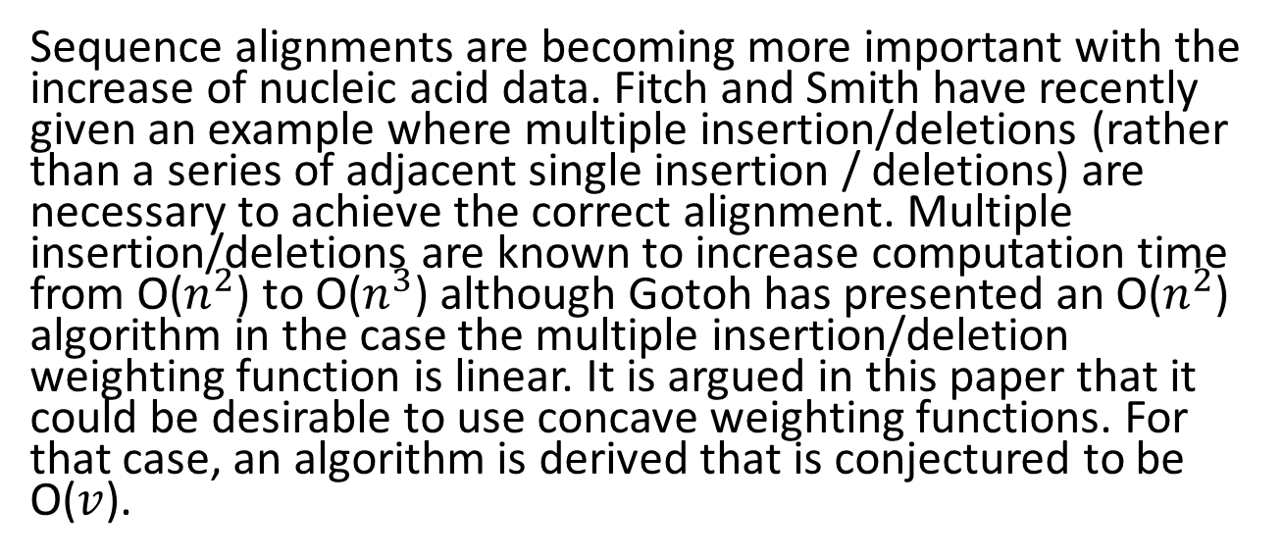
Abstract
Sequence alignments are becoming more important with the increase of nucleic acid data. Fitch and Smith have recently given an example where multiple insertion/deletions (rather than a series of adjacent single insertion / deletions) are necessary to achieve the correct alignment. Multiple insertion/deletions are known to increase computation time from O($n^{2}$) to O($n^{3}$) although Gotoh has presented an O($n^{2}$) algorithm in the case the multiple insertion/deletion weighting function is linear. It is argued in this paper that it could be desirable to use concave weighting functions. For that case, an algorithm is derived that is conjectured to be O($v$).

Slide 3

Insertion/Deletions
$$D_{i,j}=\min\left\{\begin{matrix}D_{i−1,j−1}+d(a_{i},b_{j}) \\ \min{\{D_{i,j−k}+w\left(k\right):1≤k≤j\}} \\ \min{\{D_{i−l,j}+w\left(l\right):1≤l≤i\}}\end{matrix}\right\}\begin{matrix} \\ …E_{i,j} \\ {…F}_{i,j}\end{matrix}$$

Slide 4
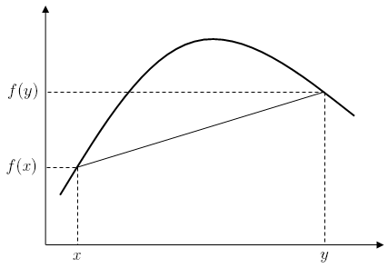
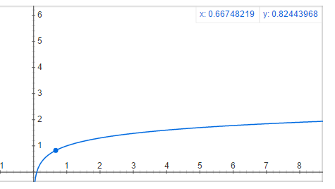

Concave Insertion/Deletions
$$f\left(x+y\right)≤f\left(x\right)+f\left(y\right)$$

Slide 5
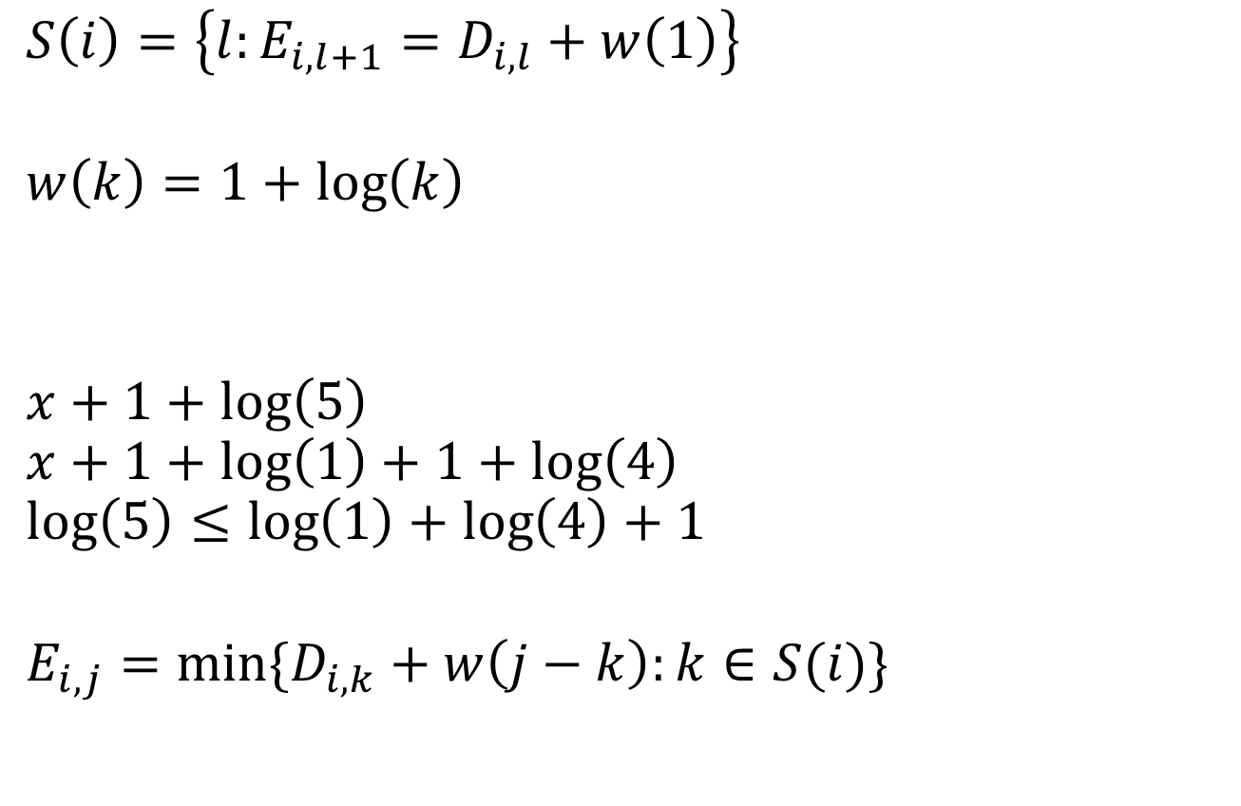
Concave Insertion/Deletions
$$S\left(i\right)=\left\{l:E_{i,l+1}=D_{i,l}+w\left(1\right)\right\}$$
$$w\left(k\right)=1+\log\left(k\right)$$
$$x+1+\log\left(5\right)$$
$$x+1+\log\left(1\right)+1+\log\left(4\right)$$
$$\log\left(5\right)≤\log\left(1\right)+\log\left(4\right)+1$$
$$E_{i,j}=min⁡\{D_{i,k}+w\left(j−k\right):k∈S(i)\}$$
x | x+1+log(1) | x+1+log(2)

Slide 6

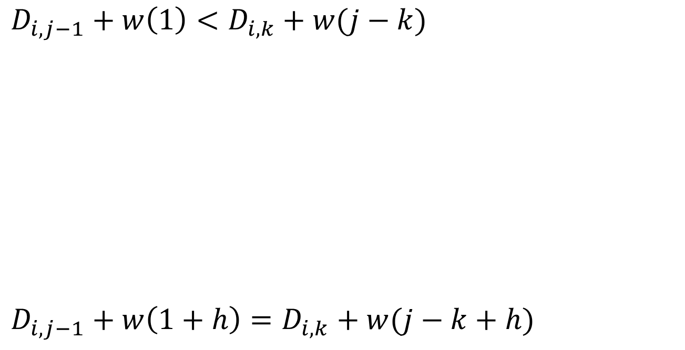
Concave Insertion/Deletions
$$D_{i,j−1}+w\left(1\right)<D_{i,k}+w(j−k)$$
$$D_{i,j−1}+w\left(1+h\right)=D_{i,k}+w(j−k+h)$$
 |  | a | b | c | c | a | b | a
 | 0 | 1 | 1.3 | 1.48 | 1.6 | 1.7 | 1.78 | 1.85
a | 1 | 0 | 1 | 1.3 | 1.48 | 1.6 | 1.7 | 1.78
b | 1.3 | 1 | 0 | 1 | 1.3 | 1.48 | 1.6 | 1.7
a | 1.48 | 1.3 | 1 | 2 | 2.3 | 1.3 | 2.3
a
While we cannot establish the computational complexity of this last result
on first principles, the practical implication is an O($n^{2}$) algorithm.

