Slide 1
Identification of Common Molecular Subsequences
T.F. Smith
Northern Michigan University U.S.A.
M.S. Waterman
Los Alamos Scientific Laboratory
J. Mol. Biol, Vol. 147 pp. 195-197 (1981)
Presenter：Siang-Huai Hung
Date：2016/04/19

Slide 2
Abstract
The identification of maximally homologous subsequences among sets of long sequences is an important problem in molecular sequence analysis. The problem is straightforward only if one restricts consideration to contiguous subsequences (segments) containing no internal deletions or insertions. The more general problem has its solution in an extension of sequence metrics developed to measure the minimum number of “events” required to convert one sequence into another.

Slide 3
Abstract
In this letter we extend the above ideas to find a pair of segments, one from each of two long sequences, such that there is no other pair of segments with greater similarity (homology). The similarity measure used here allows for arbitrary length deletions and insertions.

Slide 4

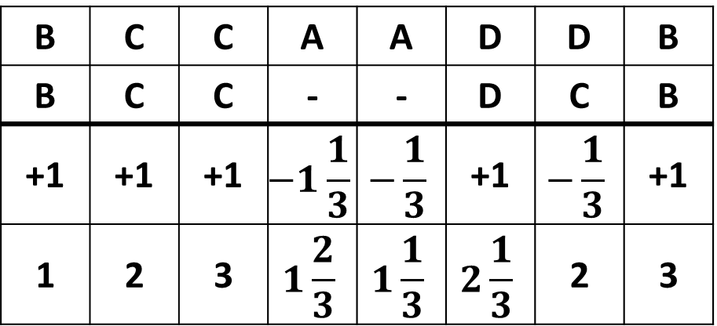

Algorithm
1, match
s={
-1/3, mismatch

Slide 5
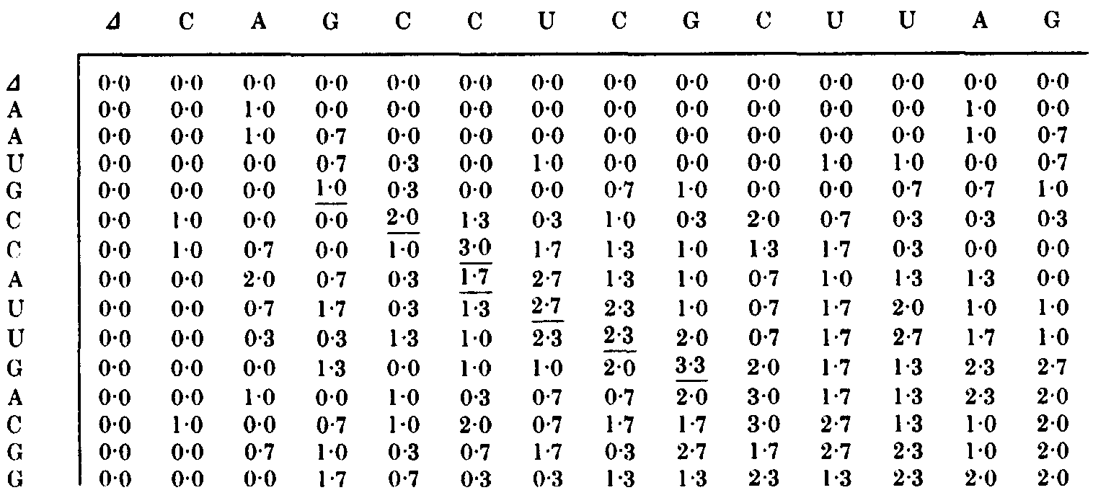
Example
GCCAUUG
GCC--UCG

Slide 6
Thanks for listening

