Slide 1
Sequence Comparison with Concave Weighting Functions
Webb Miller and Eugene W. Myers
Bulletin of Mathematical Biology Vol. 50, No. 2, pp. 97-120, 1988.
Presenter: Bi-Shiang Lin
Date:2016/4/19

Slide 2
Abstract(1/3)
We consider efficient methods for computing a difference metric between two sequences of symbols, where the cost of an operation to insert or delete a block of symbols is a concave function of the block’s length. Alternatively, sequences can be optimally aligned when gap penalties are a concave function of the gap length.

Slide 3
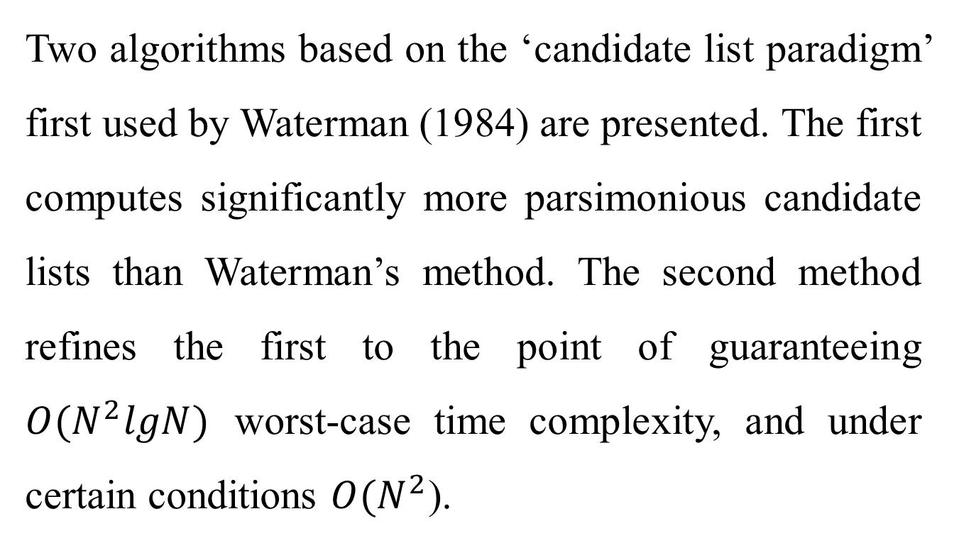
Abstract(2/3)
Two algorithms based on the ‘candidate list paradigm’ first used by Waterman (1984) are presented. The first computes significantly more parsimonious candidate lists than Waterman’s method. The second method refines the first to the point of guaranteeing $O(N^{2}lgN)$ worst-case time complexity, and under certain conditions $O(N^{2}$).

Slide 4
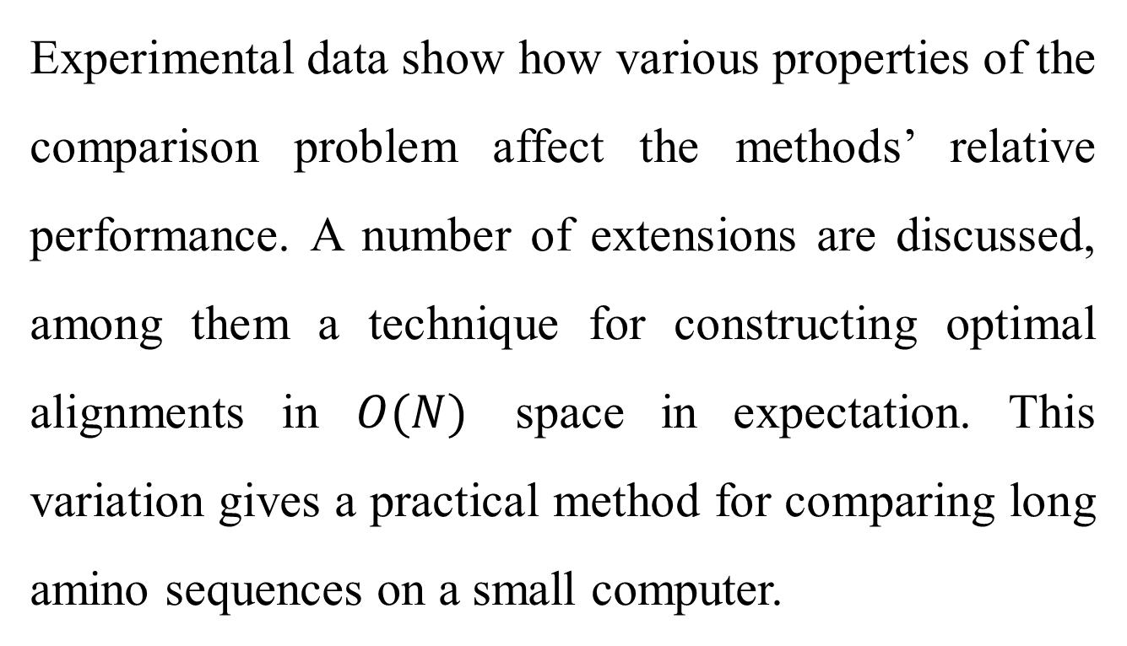
Abstract(3/3)
Experimental data show how various properties of the comparison problem affect the methods’ relative performance. A number of extensions are discussed, among them a technique for constructing optimal alignments in $O(N)$ space in expectation. This variation gives a practical method for comparing long amino sequences on a small computer.

Slide 5
Concave function

Slide 6
Sequence comparison
 |  | A | T | T | T | C
 | 0 | 5 | 9 | 11 | 12 | 10
T | 5 | 10 | 5 | 9 | 11 | 15
A | 9 | 5 | 10 | 14 | 16 | 17
C | 11 | 10 | 14 | 18 | 20 | 16
C | 12 | 14 | 16 | 20 | 22 | 20
String : a=“TACC” and b=“ATTTC”
Substitution Cost : 10
Concave Weighting Cost : 5 9 11 12 10

Slide 7

WSB Algorithm
Time complexity : $O((M+N)MN)$
14 = min ( 10+5, 5+9, 9+11, 5+10, 9+5, 11+9 )
 |  | A | T | T | T | C
 | 0 | 5 | 9 | 11 | 12 | 10
T | 5 | 10 | 5 | 9 | 11 | 15
A | 9 | 5 | 10 | 14
C | 11
C | 12

Slide 8
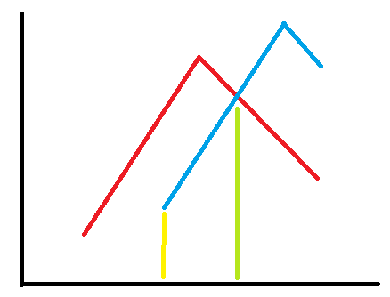
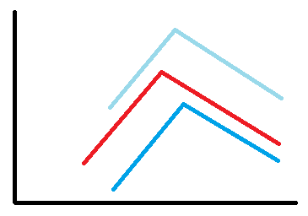
Candidate list

Slide 9
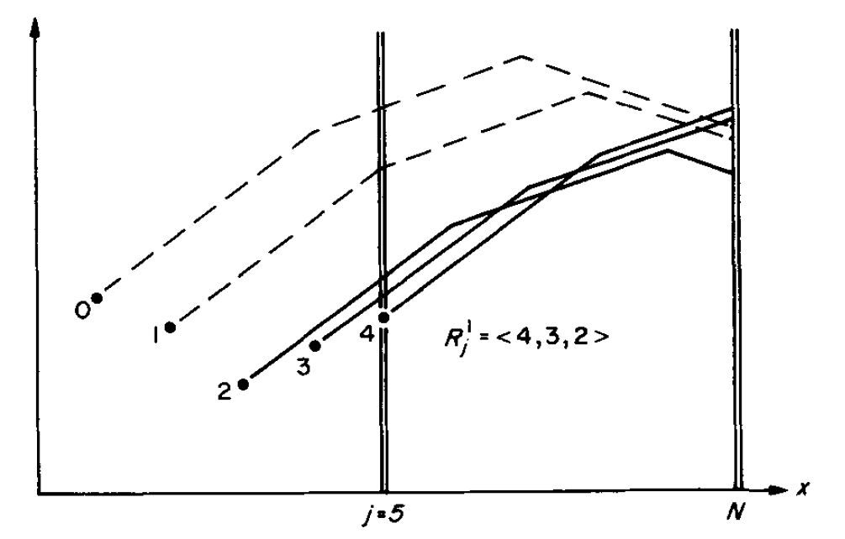
Candidate list ( for method 1 )

Slide 10
Method 1(1/5)
 |  | A | T | T | T | C
 | 0 | 5 | 9 | 11 | 12 | 10
T | 5 | 10
A | 9
C | 11
C | 12
藍

Slide 11
Method 1(2/5)
 |  | A | T | T | T | C
 | 0 | 5 | 9 | 11 | 12 | 10
T | 5 | 10 | 5
A | 9
C | 11
C | 12
橘
藍
藍

Slide 12
Method 1(3/5)
 |  | A | T | T | T | C
 | 0 | 5 | 9 | 11 | 12 | 10
T | 5 | 10 | 5 | 9
A | 9
C | 11
C | 12
灰
藍
灰
藍

Slide 13
Method 1(4/5)
 |  | A | T | T | T | C
 | 0 | 5 | 9 | 11 | 12 | 10
T | 5 | 10 | 5 | 9 | 11
A | 9
C | 11
C | 12
黃
灰
藍
灰
藍

Slide 14

Method 1(5/5)
 |  | A | T | T | T | C
 | 0 | 5 | 9 | 11 | 12 | 10
T | 5 | 10 | 5 | 9 | 11 | 15
A | 9
C | 11
C | 12
??
灰
藍
藍
Time complexity :
$$O(\overline{T}MN)$$

Slide 15
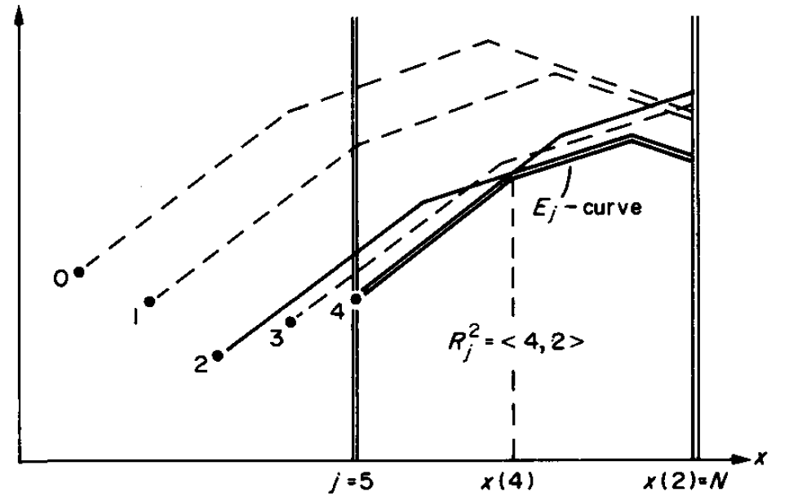
Candidate list ( for method 2 )

Slide 16
Method 2(1/5)
 |  | A | T | T | T | C
 | 0 | 5 | 9 | 11 | 12 | 10
T | 5 | 10
A | 9
C | 11
C | 12
藍 | 5

Slide 17
Method 2(2/5)
 |  | A | T | T | T | C
 | 0 | 5 | 9 | 11 | 12 | 10
T | 5 | 10 | 5
A | 9
C | 11
C | 12
藍 | 5

Slide 18
Method 2(3/5)
 |  | A | T | T | T | C
 | 0 | 5 | 9 | 11 | 12 | 10
T | 5 | 10 | 5 | 9
A | 9
C | 11
C | 12
灰 | 4
藍 | 5

Slide 19
Method 2(4/5)
 |  | A | T | T | T | C
 | 0 | 5 | 9 | 11 | 12 | 10
T | 5 | 10 | 5 | 9 | 11
A | 9
C | 11
C | 12
灰 | 4
藍 | 5

Slide 20
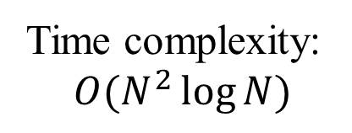
Method 2(5/5)
 |  | A | T | T | T | C
 | 0 | 5 | 9 | 11 | 12 | 10
T | 5 | 10 | 5 | 9 | 11 | 15
A | 9
C | 11
C | 12
藍 | 5
Time complexity:
$$O(N^{2}\log{N)}$$

Slide 21
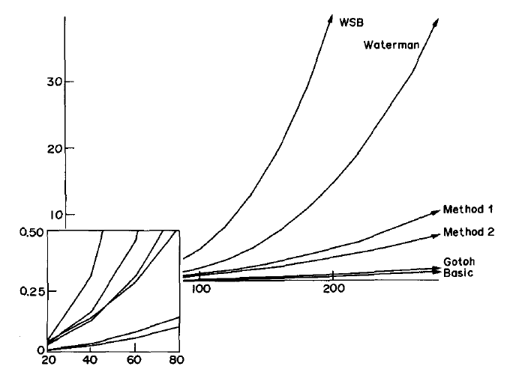
analysis

Slide 22
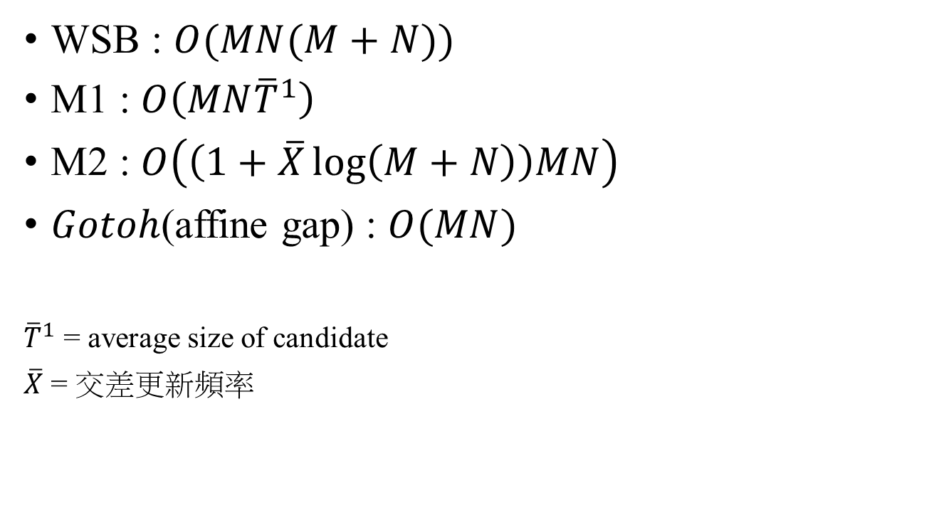
Time complexity analysis
WSB : $O(MN(M+N))$
M1 : $O\left(MN{\overline{T}}^{1}\right)$
M2 : $O\left(\left(1+\overline{X}\log\left(M+N\right)\right)MN\right)$
$Gotoh$(affine gap) : $O(MN)$
${\overline{T}}^{1}$ = average size of candidate
$\overline{X}$ = 交差更新頻率

