Slide 1
Sequence Comparison with Mixed Convex and Concave Costs
David Eppstein
JOURNAL OF ALGORITHMS, Vol 11, pp.85-101 (1990)
Presenter: Shian-Liang Lin
Notes:
聖地牙哥加利福尼亞大學，是美國一所著名公立學府，為美國全國性第一級 的大學

Slide 2
Abstract
Recently a number of algorithms have been developed for solving the minimum weight edit sequence problem with non-linear costs for multiple insertions and deletions.
We extend these algorithms to cost functions that are neither convex nor concave, but a mixture of both. We also apply this technique to related dynamic programming algorithms.
Notes:
i,e –in other words

Slide 3
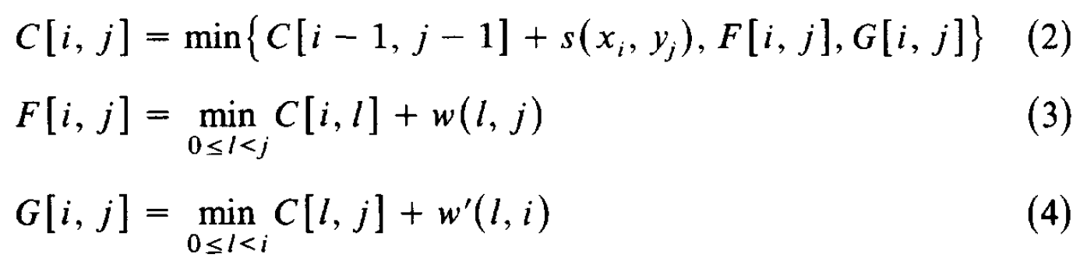
Minimum weight edit sequence problem for multiple insertions and deletions
C[i,j] | a | b | c | b
a |  |  |  | C[i-2,j]
c |  |  | C[i-1, j-1] | C[i-1,j]
b | C[i, j-3] | C[i, j-2] | C[i, j-1] | C[i, j]
+ w(i-2,i)
G[i, j]
(deletion)
+ w(i-1,i)
+
w(j-3,j)
+
w(j-2,j)
+
w(j-1,j)
F[i, j]
(insertion)
The obvious dynamic program to solve this recurrence takes time O(mn . max(m, n)).

Slide 4
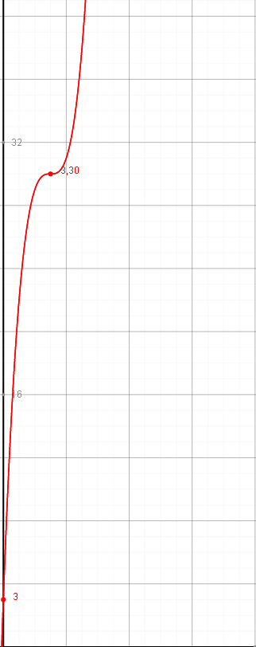
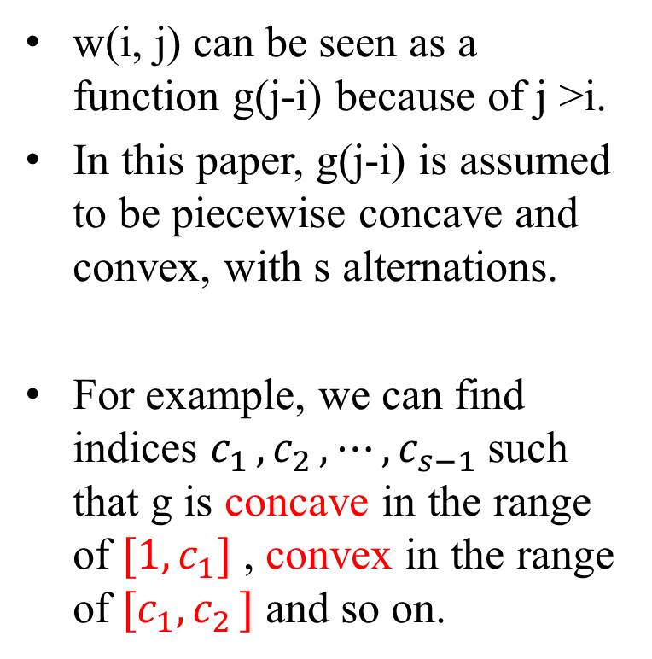


Cost function
w(i, j) can be seen as a function g(j-i) because of j >i.
In this paper, g(j-i) is assumed to be piecewise concave and convex, with s alternations.
For example, we can find indices $c_{1 },c_{2 },⋯,c_{s−1}$such that g is concave in the range of $[1,c_{1}]$ , convex in the range of ${[c}_{1},c_{2 }]$ and so on.
g(x)
x
$[1,c_{1}]$
${[c}_{1},c_{2 }]$

Slide 5
Reducing DP formula
Each row of F in (3) and Each column of (4) can be solved as a separate case of the recurrence:
Example:
For row r of recurrence (3), D[i] = C[r, i] and E[j] = F[r, j].

Slide 6
Reducing DP formula
Example:
For row r=3 of recurrence (3),
D[i] = C[r, i] and E[j] = F[r, j].
T[i,j] is the matrix used to calculated E[j].
C[i,j] | a | b | c | b
a
c
b | C[3, 1] | C[3, 2] | C[3, 3] | C[3,4]
T[i, j] | 1 | 2 | 3 | 4
1 |  | D[1]+ w(1,2) | D[1]+ w(1,3) | D[1]+ w(1,4)
2 |  |  | D[2]+ w(2,3) | D[2]+ w(2,4)
3 |  |  |  | D[3]+ w(3,4)
+
w(1,4)
+
w(2,4)
+
w(3,4)
C[i,j] | a | b | c | b
a
c
b | C[3, 1] | C[3, 2] | C[3, 3]
E[3] is the column minimum of T[i,3]
E[4] is the column minimum of T[i,4]
+
w(1,3)
+
w(2,3)

Slide 7

Concave case
In the concave case, the gap length cost function w satisfies the quadrangle inequality,
whenever $i≤i′≤j≤j′$.
Example:
For row r=3 of recurrence (3),
T[i, j] | 1 | 2 | 3 | 4
1 |  | D[1]+ g(1) | D[1]+ g(2) | D[1]+ g(3)
2 |  |  | D[2]+ g(1) | D[2]+ g(2)
3 |  |  |  | D[3]+ g(1)
 | j | j’
i | D[i] + w(i, j) | D[i] + w(i,j’)
i’ | D[i’] + w(I’, j) | D[i’] + w(i’ ,j’)

Slide 8
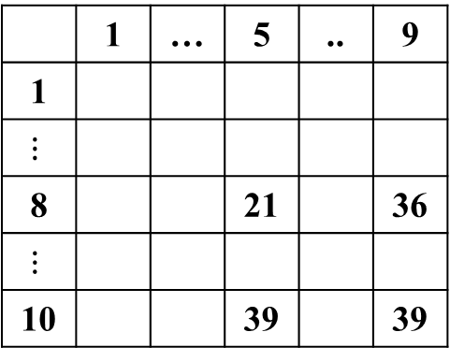
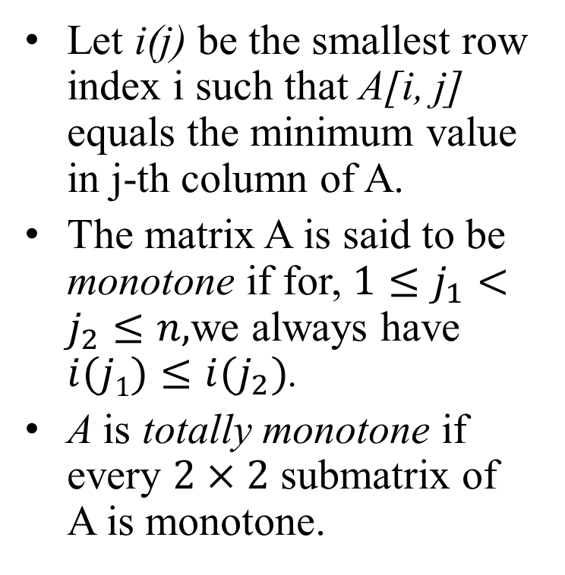
Totally monotone matrix
T[i, j] | 1 | 2 | 3 | 4
1 |  | D[1]+ g(1) | D[1]+ g(2) | D[1]+ g(3)
2 |  |  | D[2]+ g(1) | D[2]+ g(2)
3 |  |  |  | D[3]+ g(1)
Let i(j) be the smallest row index i such that A[i, j] equals the minimum value in j-th column of A.
The matrix A is said to be monotone if for, $1≤j_{1}<j_{2}≤n,$we always have $i(j1)≤i(j_{2})$.
A is totally monotone if every $2×2$ submatrix of A is monotone.
 | 1 | … | 5 | .. | 9
1
$$⋮$$
8 |  |  | 21 |  | 36
$$⋮$$
10 |  |  | 39 |  | 39

Slide 9
SMAWK Algorithm
SMAWK algorithm is used to find all row(column) maximum(minimum) in a totally monotone matrix.
Alok Aggarwal, et al. Geometric applications of a matrix-searching algorithm, Algorithmica, Volume 2, Issue 1, pp 195-208(1987)
Time complexity: O(n).

Slide 10
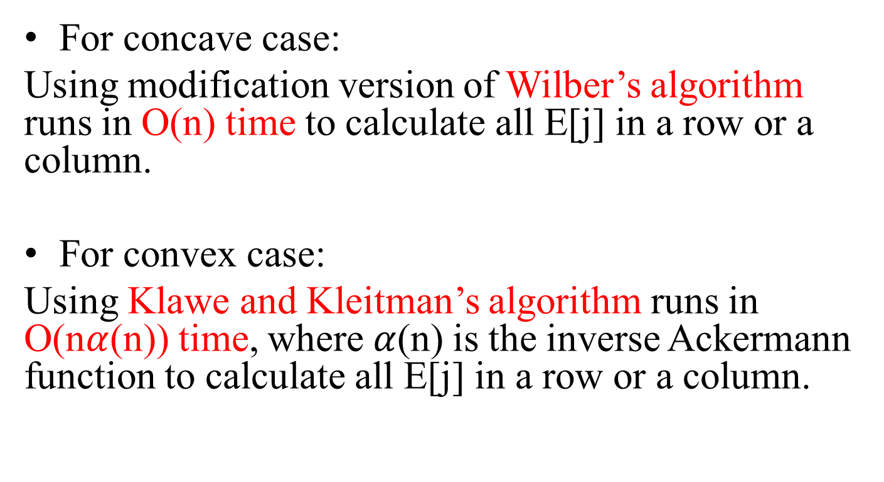
Algorithm
For concave case:
Using modification version of Wilber’s algorithm runs in O(n) time to calculate all E[j] in a row or a column.
For convex case:
Using Klawe and Kleitman’s algorithm runs in O(n$α$(n)) time, where$α$(n) is the inverse Ackermann function to calculate all E[j] in a row or a column.
WILBER, The concave least weight subsequence problem revisited, J. Algorithms 9, No.3, pp.418-425(1988).
M. M. KLAWE AND D. KLEITMAN, An almost linear algorithm for generalized matrix searching, SIAM J. Discrete Math., 3(1), pp.81–97(1987)

Slide 11
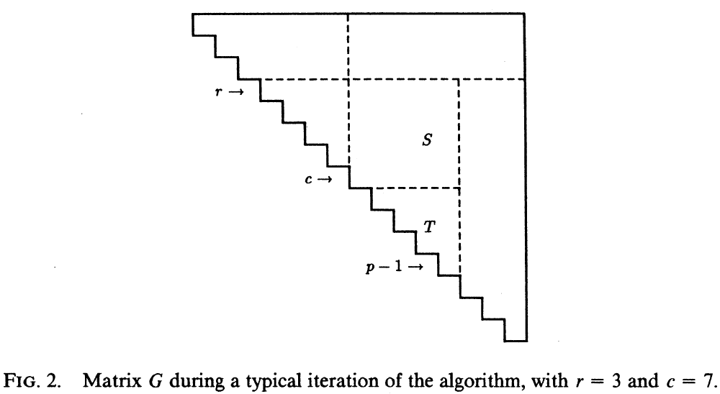
Wilber’s algorithm
T[i, j] | 1 | 2 | 3 | 4
1 |  | D[1]+ g(1) | D[1]+ g(2) | D[1]+ g(3)
2 |  |  | D[2]+ g(1) | D[2]+ g(2)
3 |  |  |  | D[3]+ g(1)

Slide 12
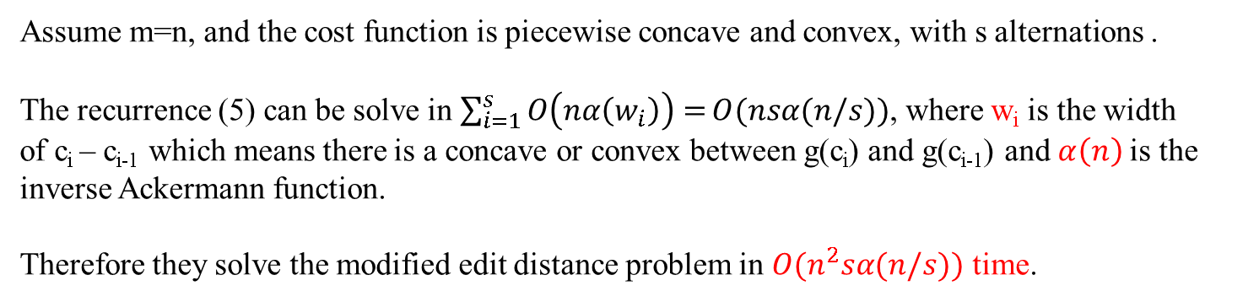
Time complexity
Assume m=n, and the cost function is piecewise concave and convex, with s alternations .
The recurrence (5) can be solve in $\sum_{i=1}^{s}{O\left(nα\left(w_{i}\right)\right)=}O(nsα(n/s))$, where w_{i} is the width
of c_{i} – c_{i-1} which means there is a concave or convex between g(c_{i}) and g(c_{i-1}) and$α\left(n\right)$ is the inverse Ackermann function.
Therefore they solve the modified edit distance problem in $O(n^{2}sα(n/s))$ time.

Slide 13
Thanks for listening.

Slide 14
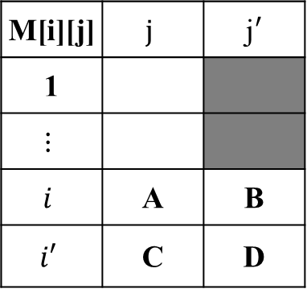
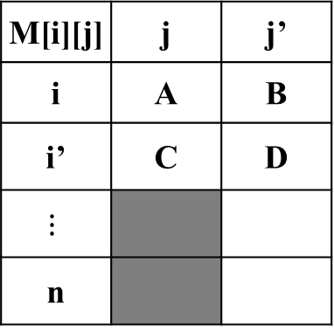


Example of SMAWK Algorithm (find all rows minimum)
Monotonicity
$$⇒A+D≤C+B$$
Case 1. C$≤D$
D isn’t minimum in row $i′$.
All M[r][j’] isn’t the minimum
in row r, where $1≤r≤i.$
Case 2. $A>B$
A isn’t minimum in row $i$.
All M[r][j] isn’t the minimum
in row r, where $i′≤r≤n.$
M[i][j] | $$j$$ | j$′$
1
$$⋮$$
$$i$$ | A | B
$$i′$$ | C | D
M[i][j] | j | j’
i | A | B
i’ | C | D
$$⋮$$
n

