Slide 1
ImageNet Classification with Deep Convolutional Neural Networks
Advances in Neural Information Processing Systems, 2012
Alex Krizhevsky, Ilya Sutskever, Geoffrey E. Hinton
  Presenter：Fu Wei Hao
  Date：105/ 04/ 26

Slide 2
Abstract(1/2)
We trained a large, deep convolutional neural network to classify the 1.2 million high-resolution images in the ImageNet LSVRC-2010 contest into the 1000 different classes.
On the test data, we achieved top-1 and top-5 error rates of 37.5% and 17.0% which is considerably better than the previous state-of-the-art.
The neural network, which has 60 million parameters and 650,000 neurons, consists of five convolutional layers, some of which are followed by max-pooling layers, and three fully-connected layers with a final 1000-way softmax.

Slide 3
Abstract(2/2)
To make training faster, we used non-saturating neurons and a very efficient GPU implementation of the convolution operation.
To reduce overfitting in the fully-connected layers we employed a recently-developed regularization method called “dropout” that proved to be very effective.
We also entered a variant of this model in the ILSVRC-2012 competition and achieved a winning top-5 test error rate of 15.3%, compared to 26.2% achieved by the second-best entry.

Slide 4
Neural Network
Input
Hidden
Output

Slide 5
Convolutional Neural Network
Input
Hidden
Output

Slide 6
Why to use CNN?
Fewer connections and parameters
  Weight sharing
  Local receptive field

Slide 7
Dataset
Subset of ImageNet dataset
  1.2 million training images, 50,000 validation images, and 150,000 testing images
  Roughly 1000 images in each of 1000 categories
Down-sample
  Rescale images and cropped out
  256*256 pixels
RGB mode

Slide 8
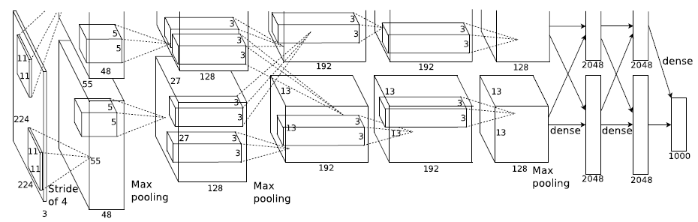
Architecture(1/5)
Fully-
connected
Input
Convolutional layer

Slide 9
Architecture(2/5)
Training on Multiple GPUs
  GTX 580 GPU with 3GB of memory
  Spread the net across two GPUs
  The GPUs communicate only in certain layers(e.g., layer-3 and layer-2)
  Five to six days

Slide 10
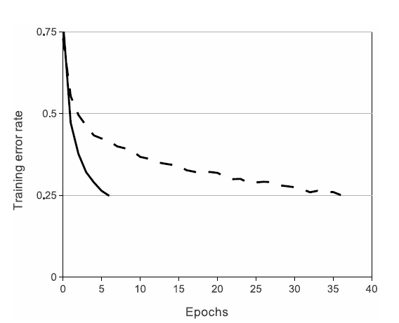
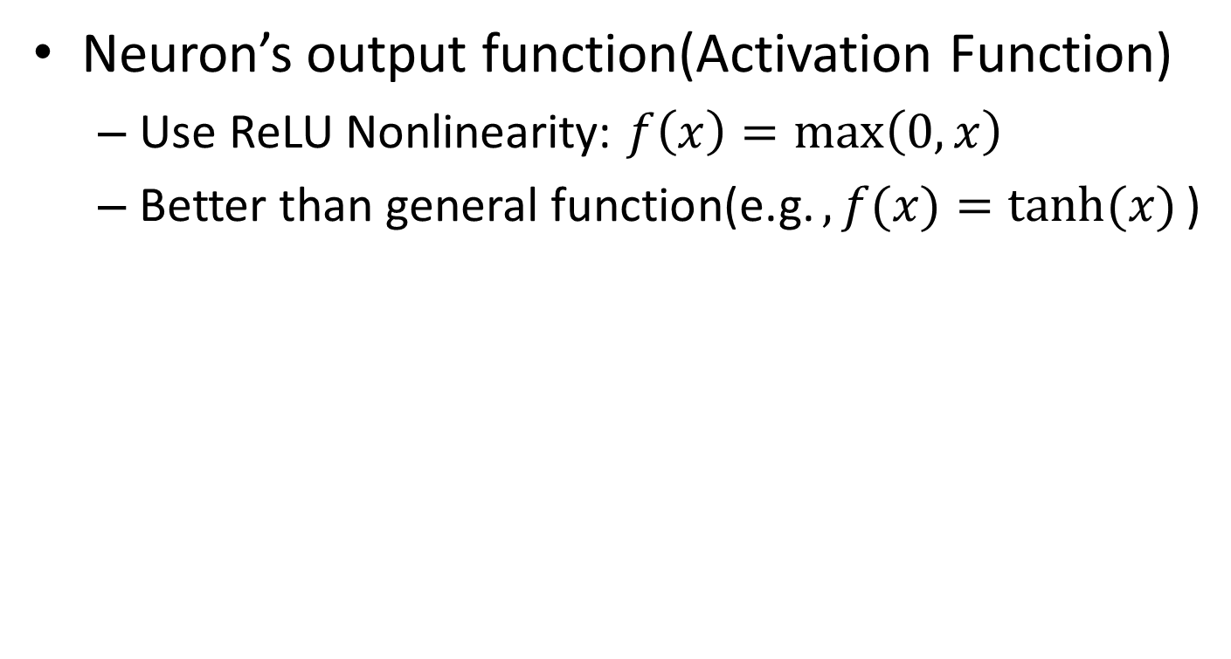
Architecture(3/5)
Neuron’s output function(Activation Function)
  Use ReLU Nonlinearity: $f\left(x\right)=\max\left(0, x\right)$
  Better than general function(e.g.$, f(x)=tanh⁡(x)$)

Slide 11
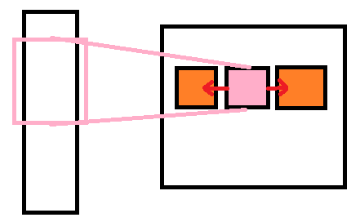
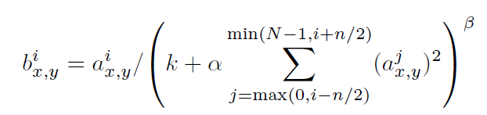

Architecture(4/5)
Input data
Feature map
Local Response Normalization
  ReLUs don’t need normalization to prevent them from saturating
  But LRN still gives great effect
$$k=2, n=5, α={10}^{−4}, β=0.75$$

Slide 12
Architecture(5/5)
Overlapping Pooling
  The size of pooling unit is z*z, and spaced s pixel apart
    If s=z, we obtain traditional local pooling
    If s<z, we obtain overlapping pooling
  Set s=2, z=3

Slide 13
Reducing Overfitting
The neural network architecture has 60 million parameters -> too large!
Reduce overfitting method
  Data augmentation
  Dropout
    Don’t contribute to the forward pass and don’t participate in back-propagation
    Probability=0.5

Slide 14
Weight
Weights are initialized in each layer from zero-mean Gaussian distribution with standard deviation 0.01
Bias=1
  2, 3, 5 and fully-connected layers
Bias=0
  others

Slide 15
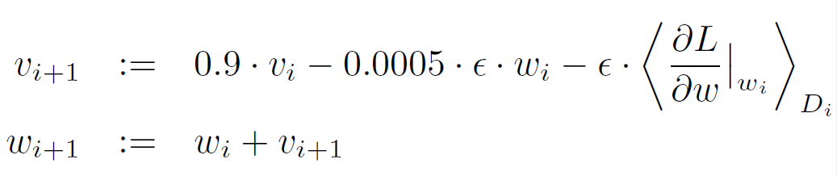
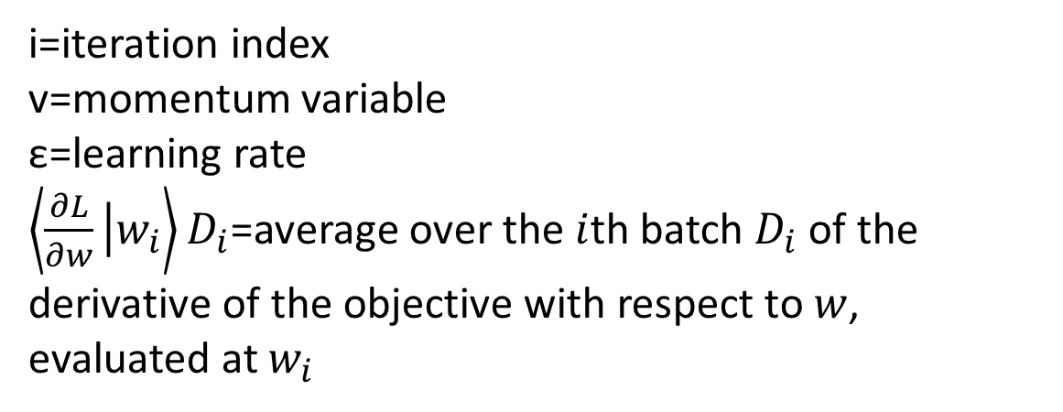
Update weights
i=iteration index
v=momentum variable
ε=learning rate
$\left\langle \frac{∂L}{∂w}\left|w_{i}\right.\right\rangle D_{i}$=average over the $i$th batch $D_{i}$ of the derivative of the objective with respect to $w$, evaluated at $w_{i}$

Slide 16
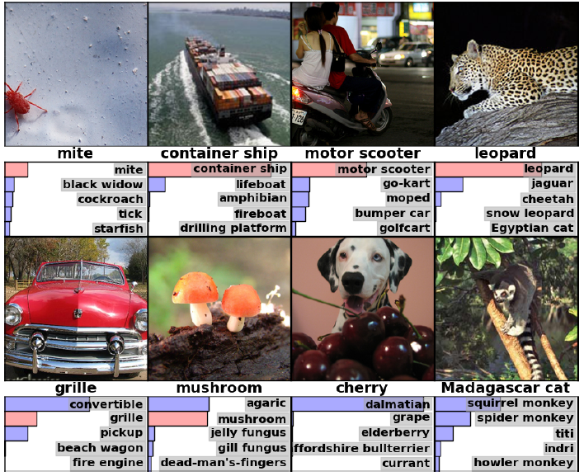
Result

