Slide 1
Time Series Classification in Dissimilarity Spaces
Brijnesh J. Jain and Stephan Spiegel
Berlin Institute of Technology, Germany
Proceedings 1st International Workshop on Advanced Analytics and Learning on Temporal Data AALTD 2015
Presenter: Shu-Kai Hung Date:2015/12/15
Notes:
柏林工業大學

Slide 2
Abstract
Time series classification in the dissimilarity space combines
the advantages of the dynamic time warping and the rich mathematical
structure of Euclidean spaces. We applied dimension reduction using
PCA followed by support vector learning on dissimilarity representations to 43 UCR datasets. Results indicate that time series classification in
dissimilarity space has potential to complement the state-of-the-art.

Slide 3


dynamic time warping
Two times series:
X = (1,1,2,3,2,0)
Y = (0,1,1,2,3,2,1)
 | 1 | 1 | 2 | 3 | 2 | 0
0 | 1 | 1 | 4 | 9 | 4 | 0
1 | 0 | 0 | 1 | 4 | 1 | 1
1 | 0 | 0 | 1 | 4 | 1 | 1
2 | 1 | 1 | 0 | 1 | 0 | 4
3 | 4 | 4 | 1 | 0 | 1 | 9
2 | 1 | 1 | 0 | 1 | 0 | 4
1 | 0 | 0 | 1 | 4 | 1 | 1

Slide 4
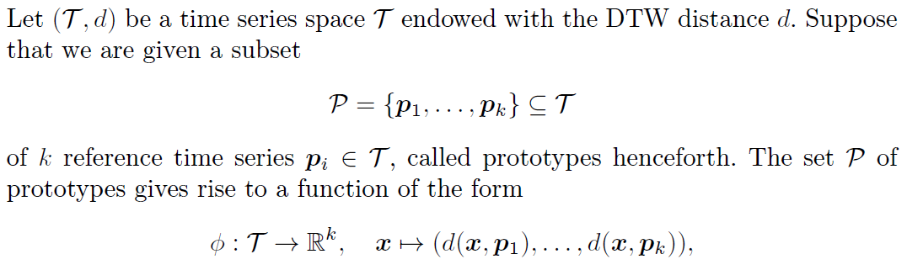
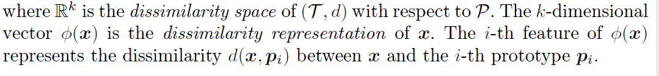
Dissimilarity representation
.

Slide 5
Experiments
1. Prototype selection: construct a set of prototypes P from the training set X.
2. Dimension reduction: perform dimension reduction in the dissimilarity space.
The goal of this experiment is to assess the performance of the following classifiers in dissimilarity space:
nearest neighbor using the Euclidean distance (EDDS)
(2) support vector machine (SVM)
(3) principal component analysis on dissimilarity representations followed by support vector machine (PCA+SVM).

Slide 6
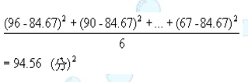
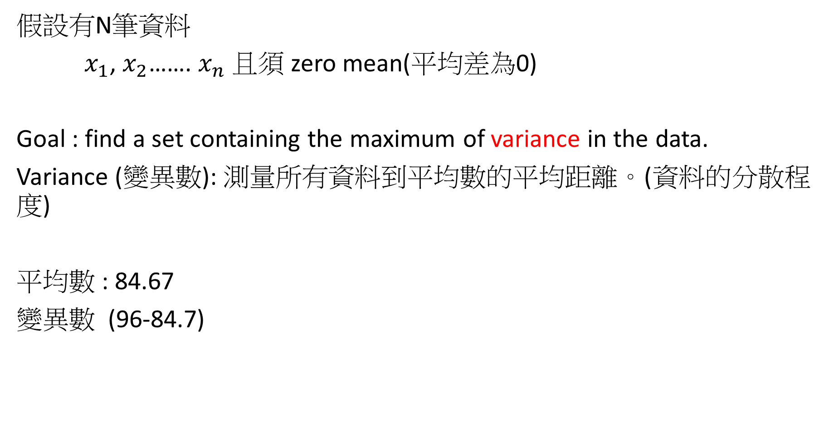
PCA(Principle Component Analysis)
假設有N筆資料
$x_{1}$, $x_{2}$……. $x_{n}$ 且須 zero mean(平均差為0)
Goal : find a set containing the maximum of variance in the data.
Variance (變異數): 測量所有資料到平均數的平均距離。(資料的分散程度)
平均數 : 84.67
變異數 (96-84.7)
小成第一次的段考成績為國文96分、數學90分、英文85分 、
地理78分、 歷史92分、理化67分?

Slide 7
y
0
variance
X

Slide 8
