Slide 1
The substring inclusion constraint longest common subsequence problem can be solved in quadratic time
Muhammad Rashed Alam, M. Sohel Rahman
AEDA Group, Department of CSE, BUET, Dhaka-1000, Bangladesh
Journal of Discrete Algorithms 17, 67–73, 2012
Presenter：Siang-Huai Hung
Date：2016/05/03

Slide 2
Abstract(1/2)
In this paper, we study some variants of the Constrained Longest Common Subsequence (CLCS) problem, namely, the substring inclusion CLCS (Substring-IC-CLCS) problem and a generalized version thereof. In the Substring-IC-CLCS problem, we are to find a longest common subsequence (LCS) of two given strings containing a third constraint string (given) as a substring. Previous solution to this problem runs in cubic time, i.e, O(nmk) time, where n,m and k are the length of the 3 input strings.

Slide 3
Abstract(2/2)
In this paper, we present simple O(nm) time algorithms to solve the Substring-IC-CLCS problem. We also study the Generalized Substring-IC-LCS problem where we are given two strings of length n and m respectively and an ordered list of p strings and the goal is to find an LCS containing each of them as a substring in the order they appear in the list. We present an O(nmp) algorithm for this generalized version of the problem.

Slide 4
Constraint LCS(CLCS)
X = a t c a t c t a g g
Y = a t c a t a t g c g
S = t t c g
C為 X 與 Y 的common subsequence，若S為C的子序列，則S為對應到 C 的 X 與 Y 之 constrained LCS。在這例子中就不是 a t c a t t a g，而是a t c a t c g

Slide 5
Substring-IC-LCS Problem
X = a a t g c c t a g g c
Y = c g a t c t g g a c
S = g t a c
C為 X 與 Y 的common substring，若S為C的子字串，則S為對應到 C 的 X 與 Y 之 Substring-IC-LCS 。在這例子中就不是 a t c t g g c，而是g t a c

Slide 6
Generalized Substring-IC-LCS Problem(1/3)
X = f a b c f g b d a
Y = f a b g c f b g d a
ordered list of two strings S = {abc,bda}
Generalized Substring-IC-LCS C = f a b c f b d a, C_{2…4}=abc and C_{6…8}=bda

Slide 7
Generalized Substring-IC-LCS Problem(2/3)
X = d a b d c f e d b g c e f
Y = d a b c d e g f e
ordered list of two strings S = {abc,bce}
Generalized Substring-IC-LCS C = d a b c e g f e, C_{2…4}=abc and C_{3…5}=bce

Slide 8
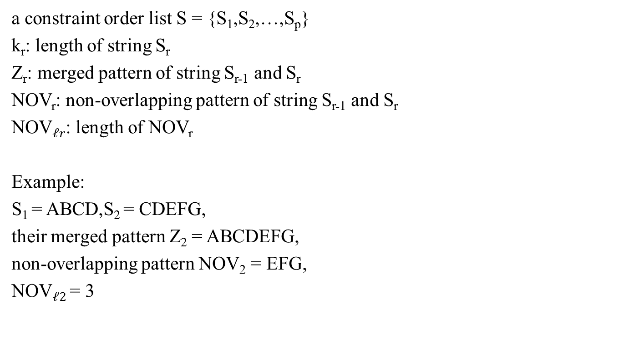
Generalized Substring-IC-LCS Problem(3/3)
a constraint order list S = {S₁,S₂,…,S_{p}}
k_{r}: length of string S_{r}
Z_{r}: merged pattern of string S_{r-1} and S_{r}
NOV_{r}: non-overlapping pattern of string S_{r-1} and S_{r}
NOV$ℓr$: length of NOV_{r}
Example:
S₁ = ABCD,S₂ = CDEFG,
their merged pattern Z₂ = ABCDEFG,
non-overlapping pattern NOV₂ = EFG,
NOV$ℓ2$ = 3

Slide 9
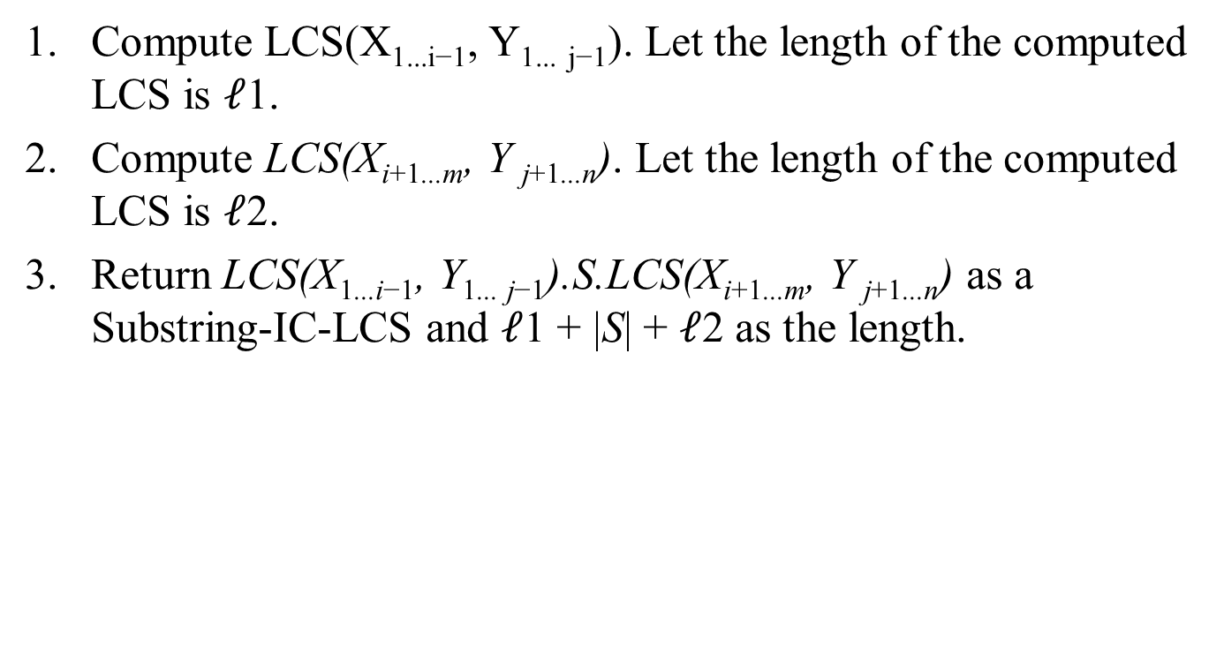
A simple algorithm for Substring-IC-LCS(1/2)
Compute LCS(X_{1...i−1}, Y_{1...} _{j−1}). Let the length of the computed LCS is $ℓ$1.
Compute LCS(X_{i+1...m}, Y _{j+1...n}). Let the length of the computed LCS is $ℓ$2.
Return LCS(X_{1...i−1}, Y_{1... j−1}).S.LCS(X_{i+1...m}, Y _{j+1...n}) as a Substring-IC-LCS and $ℓ$1 + |S| + $ℓ$2 as the length.

Slide 10
A simple algorithm for Substring-IC-LCS(2/2)
1. Compute S_{X} [i] for 1 ≤ i ≤ m.
2. Compute S_{Y} [i] for 1 ≤ i ≤ n.
3. For each pair (i, j) such that S_{X} [i] ≠ 0 and S_{Y} [ j] ≠ 0, compute
LCS(X_{1...SX [i]−1}, Y_{1...SY [ j]−1}) and LCS(X_{i+1...m}, Y _{j+1...n}).

Slide 11
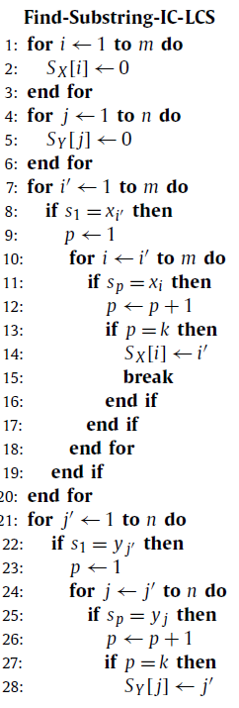
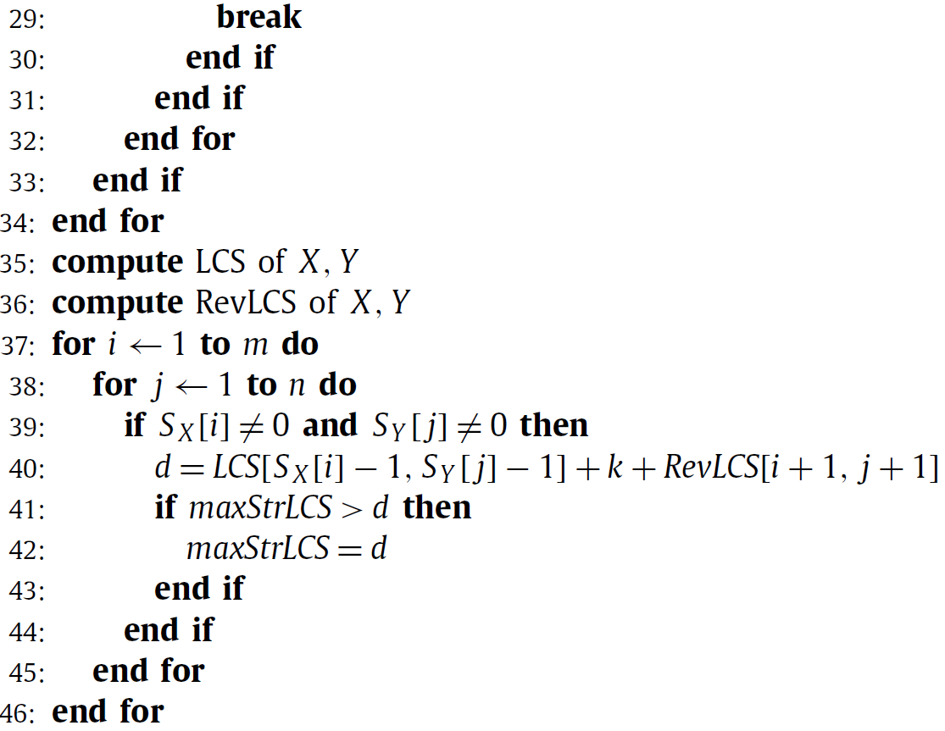

Slide 12
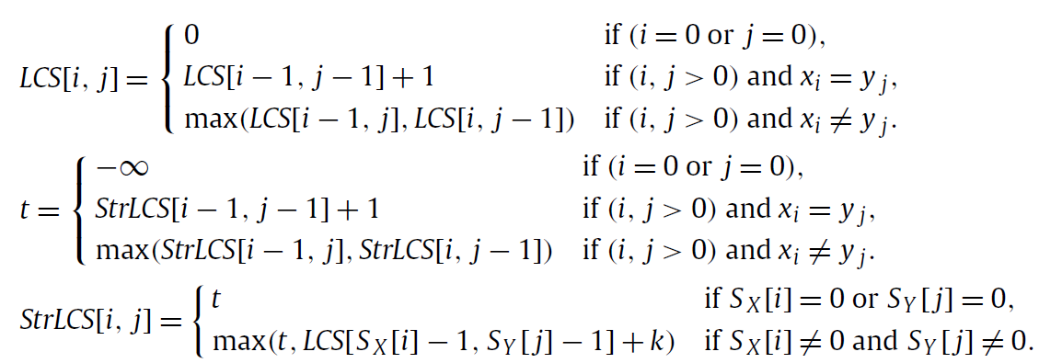
A dynamic programming algorithm

Slide 13
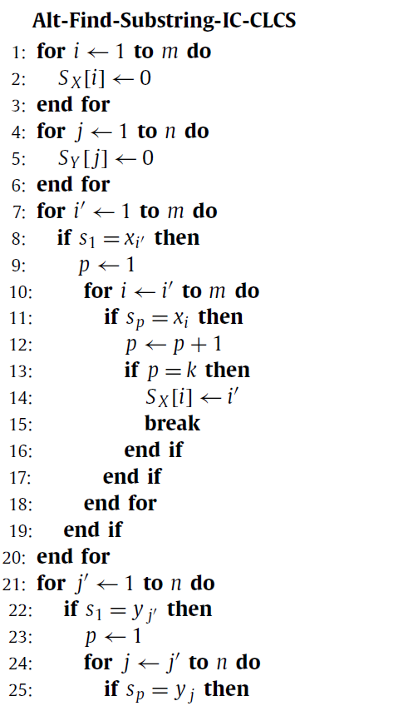
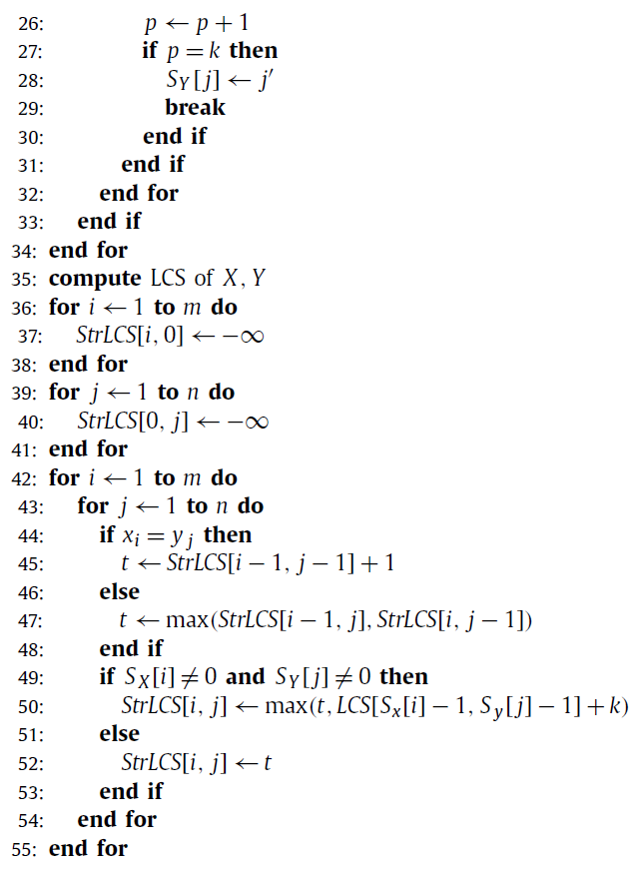

Slide 14
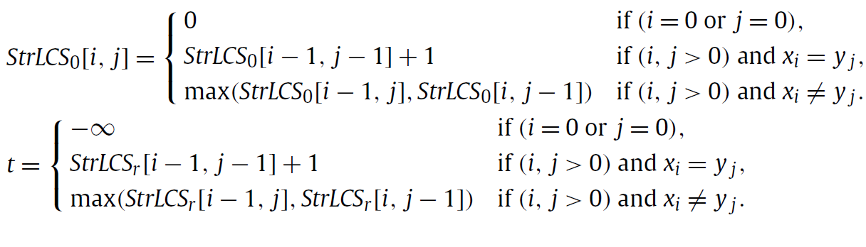
Algorithm for generalized Substring-IC-LCS

Slide 15
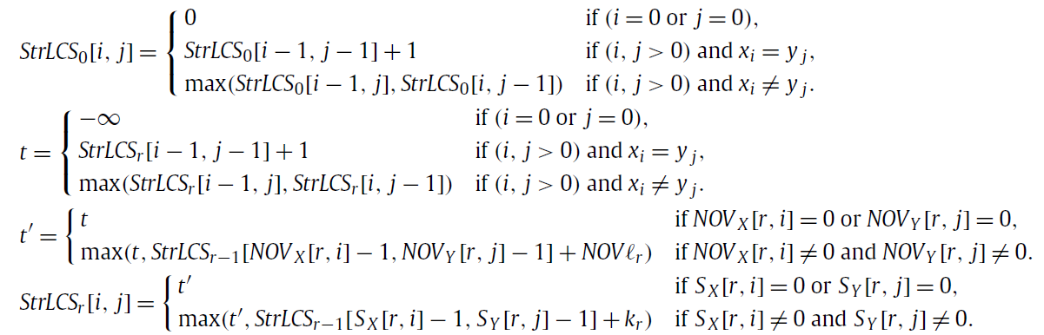

Slide 16
Thanks for listening

