Slide 1
Mining Association Rules in Big Data for E-healthcare Information System
N. Rajkumar, R. Vimal Karthick, M. Nathiya and K. Silambarasan
Research Journal of Applied Sciences, Engineering and Technology 8(8): 1002-1008, 2014
Presenter: Chong-Xuan Lo
Date:2016/5/3

Slide 2
Abstract(1/2)
Big data related to large volume, multiple ways of growing data sets and autonomous sources. Now the big data is quickly enlarged in many advanced domains, because of rapid growth in networking and data collection. The study is defining the E-Healthcare Information System, which needs to make logical and structural method of approaching the knowledge. And also effectually preparing and controlling the data generated during the diagnosis activities of medical application through sharing information among E -Healthcare Information System devices.

Slide 3
Abstract(2/2)
The main objective is, A E-Healthcare Information System which is extensive, integrated knowledge system designed to control all the views of a hospital operation, such as medical data’s, administrative, financial, legal information’s and the corresponding service processing. At last the analysis of result will be generated using Association Mining Techniques which processed from big data of hospital information datasets. Finally mining techniques result could be evaluated in terms of accuracy, precision, recall and positive rate.

Slide 4
Association rule
Let I = {i 1 , i 2 , … , i n } be a set of items.
Let D = {t 1 , t 2 , … , t m } be a set of transactions called the database.
Each transaction in D has a unique transaction ID and contains a subset of the items in I.

Slide 5
Association rule
A rule is defined as an implication of the form X ⇒ Y where X, Y ⊆ I and X∩Y = ∅ .
X and Y are called antecedent (Left-Hand-Side or LHS) and consequent (Right-Hand-Side or RHS) of the rule, respectively.

Slide 6
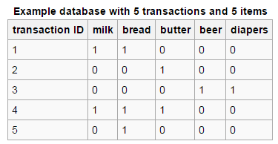
Association rule
I= {milk, bread, butter, beer, diapers}
{butter, bread} => {milk}
The support value of a rule =P(X ∩ Y) has a support of 1/5=0.2.
The confidence value of a rule = P ( Y | X) has a confidence of 1/1=1.0.

Slide 7
Association rule
Association rules are usually required to satisfy a
user-specified minimum support and a user-specified
minimum confidence at the same time.

Slide 8
Association rule
Association rule generation is usually split up into two separate steps:
First, minimum support is applied to find all frequent item sets(large itemsets) in a database.
Second, these frequent item sets and the minimum confidence constraint are used to form rules.

Slide 9
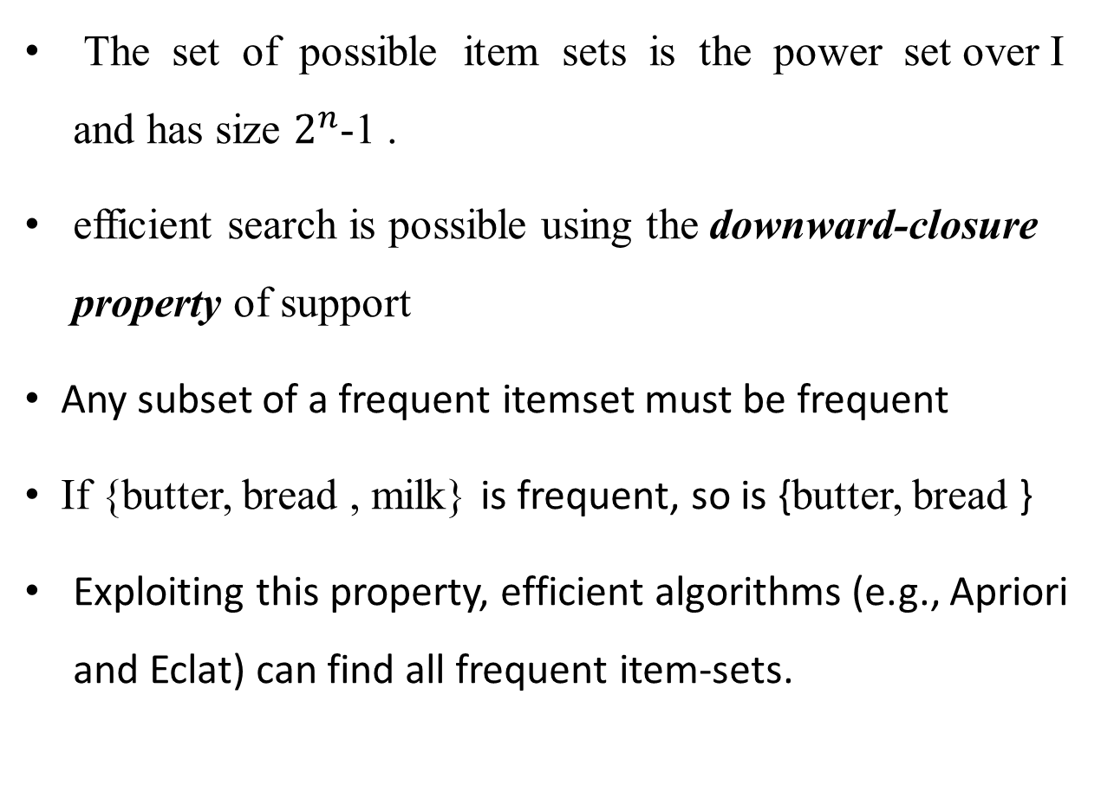
Association rule
The set of possible item sets is the power set over I and has size $2^{n}$-1 .
efficient search is possible using the downward-closure property of support
Any subset of a frequent itemset must be frequent
If {butter, bread , milk} is frequent, so is {butter, bread }
Exploiting this property, efficient algorithms (e.g., Apriori and Eclat) can find all frequent item-sets.

Slide 10
Apriori algorithm
Let the database of transactions consist of following itemsets:
If minimum support =2
1.
TID | Items
T1 | I1,I3,I4
T2 | I2,I3,I5
T3 | I1,I2,I3,I5
T4 | I2,I5
item | support
{I1} | 2
{I2} | 3
{I3} | 3
{I4} | 1
{I5} | 3
item | support
{I1} | 2
{I2} | 3
{I3} | 3
{I5} | 3

Slide 11
Apriori algorithm
2.
3.
item | support
{I1,I2} | 1
{I1,I3} | 2
{I1,I5} | 1
{I2,I3} | 2
{I2,I5} | 3
{I3,I5} | 2
item | support
{I1,I3} | 2
{I2,I3} | 2
{I2,I5} | 3
{I3,I5} | 2
item | support
{I1,I2,I3} | 1
{I1,I2,I5} | 1
{I1,I3,I5} | 1
{I2,I3,I5} | 2
item | support
{I2,I3,I5} | 2

Slide 12
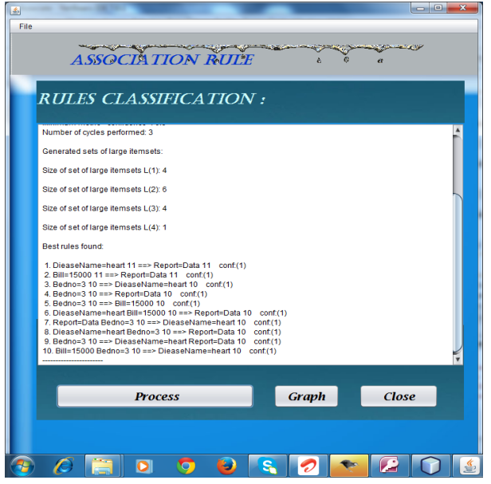
E-healthcare information system
The analysis of result will be generated using Association Mining Techniques which processed from big data of hospital information datasets.

Slide 13
Conclusion
Based on our proposal system, it achieves an effective data analysis for heterogeneous type of data and Fast response and real time classification for big data.

