Slide 1
The maximum edge biclique problem is NP-complete
René Peeters
Discrete Applied Mathematics, Vol.131, pp.651-654(2003)
Presenter: Shiou-Zong Chiou
Date:2016/05/10

Slide 2
Abstract
We prove that the maximum edge biclique problem in bipartite graphs is NP-complete.

Slide 3
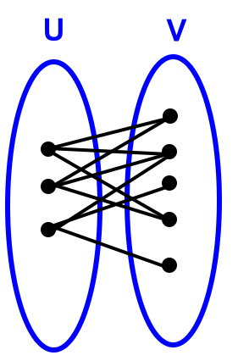
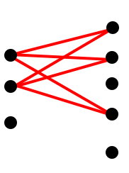
Biclique

Slide 4
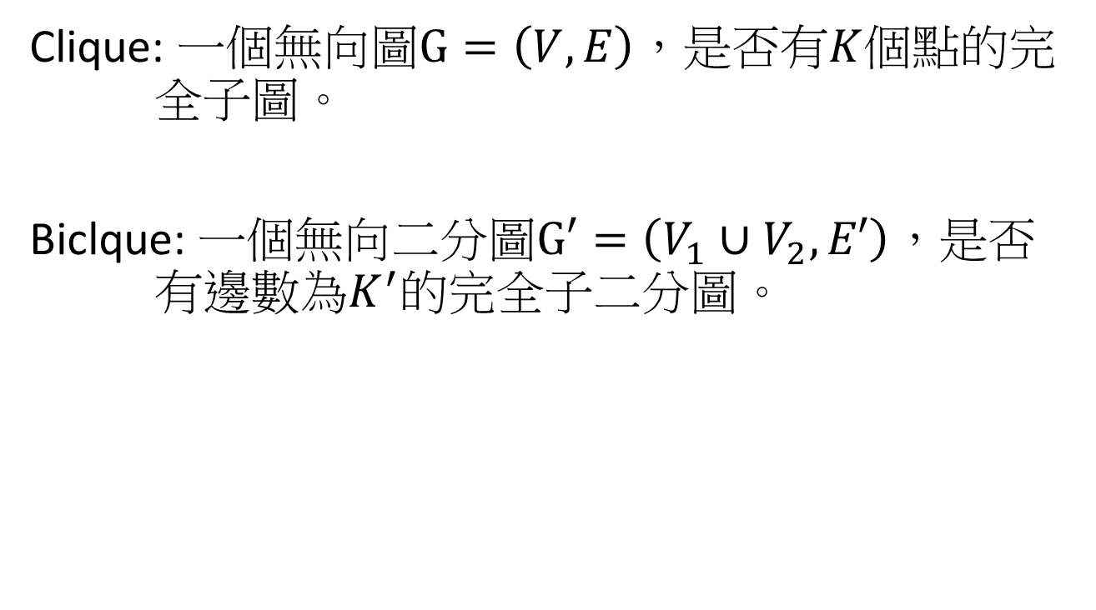

Clique $∝$ Biclique
Clique: 一個無向圖$G=\left(V,E\right)$，是否有$K$個點的完 全子圖。
Biclque: 一個無向二分圖$G′=\left(V_{1}∪V_{2},E′\right)$，是否 有邊數為$K^{′}的$完全子二分圖。

Slide 5
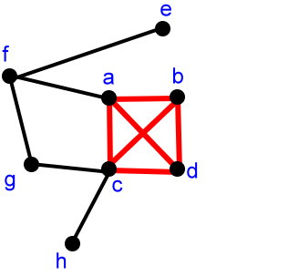
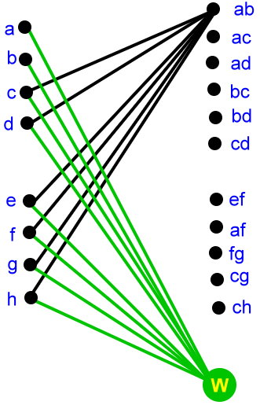
Transform 1/2

Slide 6
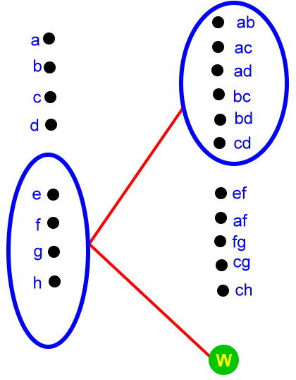
Transform 2/2

Slide 7
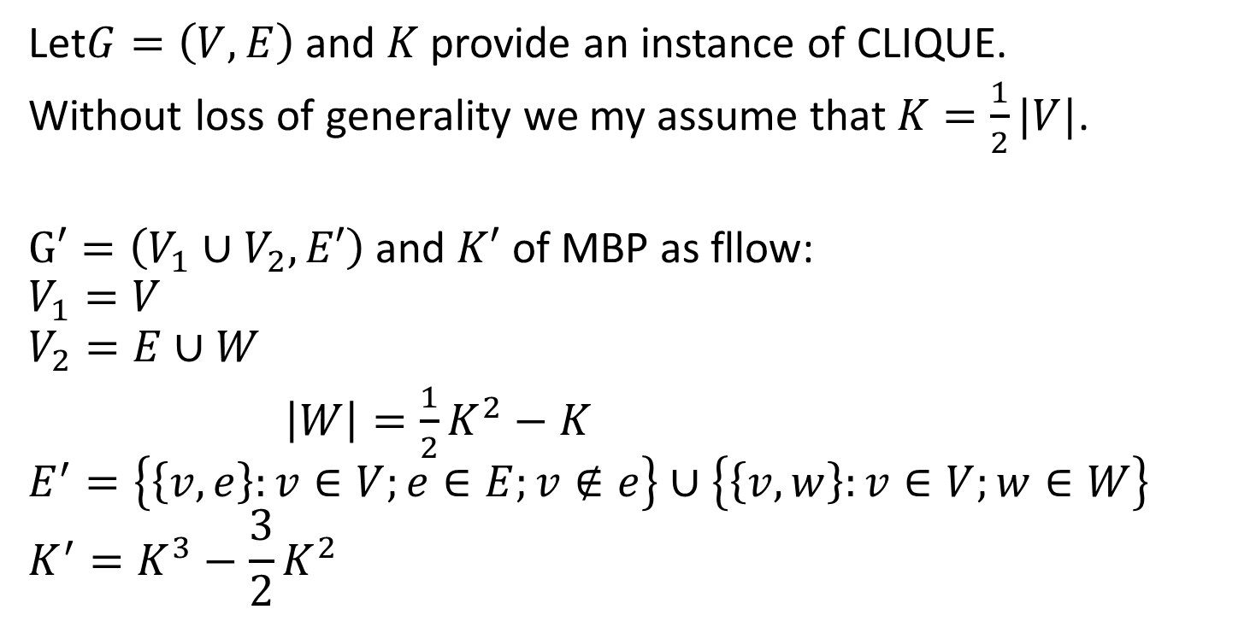
Proof 1/3
Let$G=\left(V,E\right)$ and $K$ provide an instance of CLIQUE.
Without loss of generality we my assume that $K=\frac{1}{2}|V|$.
$G′=\left(V_{1}∪V_{2},E′\right)$ and $K′$ of MBP as fllow:
$$V_{1}=V$$
$$V_{2}=E∪W$$
$\left|W\right|={\frac{1}{2}K}^{2}−K$
$$E^{′}=\left\{\left\{v,e\right\}:v∈V;e∈E;v∉e\right\}∪\left\{\left\{v,w\right\}:v∈V;w∈W\right\}$$
$$K^{′}=K^{3}−\frac{3}{2}K^{2}$$

Slide 8
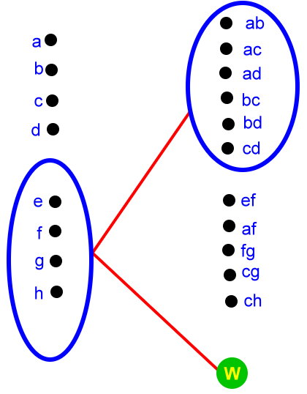
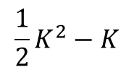


Proof 2/3
$$\left|A\right|×\left|B\right|=K×\left(\left({\frac{1}{2}K}^{2}−K\right)+\frac{1}{2}K(K−1) \right)=K^{3}−\frac{3}{2}K^{2}=K′$$
$$A$$
$$\frac{1}{2}K^{2}−K$$

Slide 9
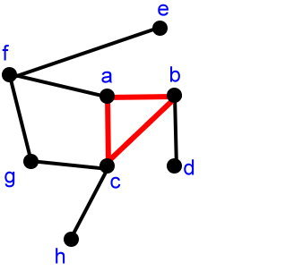
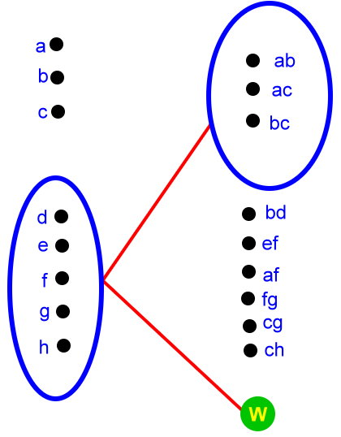

Proof 3/3
$$5×\left(3+\left(\frac{1}{2}K^{2}−K\right)\right)=35<K^{3}−\frac{1}{2}K^{2}=40$$

