Slide 1
A stock market portfolio recommender system based on association rule mining
Preeti Paranjape-Voditela, Umesh Deshpandeb
Applied Soft Computing 13, pp. 1055–1063 (2013)
Presentor : Shih-jhan Huang

Slide 2
Abstract(1/2)
We propose a stock market portfolio recommender system based on association rule mining (ARM) that analyzes stock data and suggests a ranked basket of stocks. The objective of this recommender system is to support stock market traders, individual investors and fund managers in their decisions by suggesting investment in a group of equity stocks when strong evidence of possible profit from these transactions is available.
Our system is different compared to existing systems because it finds the correlation between stocks and recommends a portfolio. Existing techniques recommend buying or selling a single stock and do not recommend a portfolio.
We have used the support confidence framework for generating association rules. The use of traditional ARM is infeasible because the number of association rules is exponential and finding relevant rules from this set is difficult. Therefore ARM techniques have been augmented with domain specific techniques like formation of thematical sectors, use of cross-sector and intra-sector rules to overcome the disadvantages of traditional ARM.

Slide 3
Abstract(2/2)
We have implemented novel methods like using fuzzy logic and the concept of time lags to generate datasets from actual data of stock prices.
Thorough experimentation has been performed on a variety of datasets like the BSE-30 sensitive Index, the S&P CNX Nifty or NSE-50, S&P CNX-100 and DOW-30 Industrial Average. We have compared the returns of our recommender system with the returns obtained from the top-5 mutual funds in India. The results of our system have surpassed the results from the mutual funds for all the datasets.
Our approach demonstrates the application of soft computing techniques like ARM and fuzzy classification in the design of recommender systems.

Slide 4
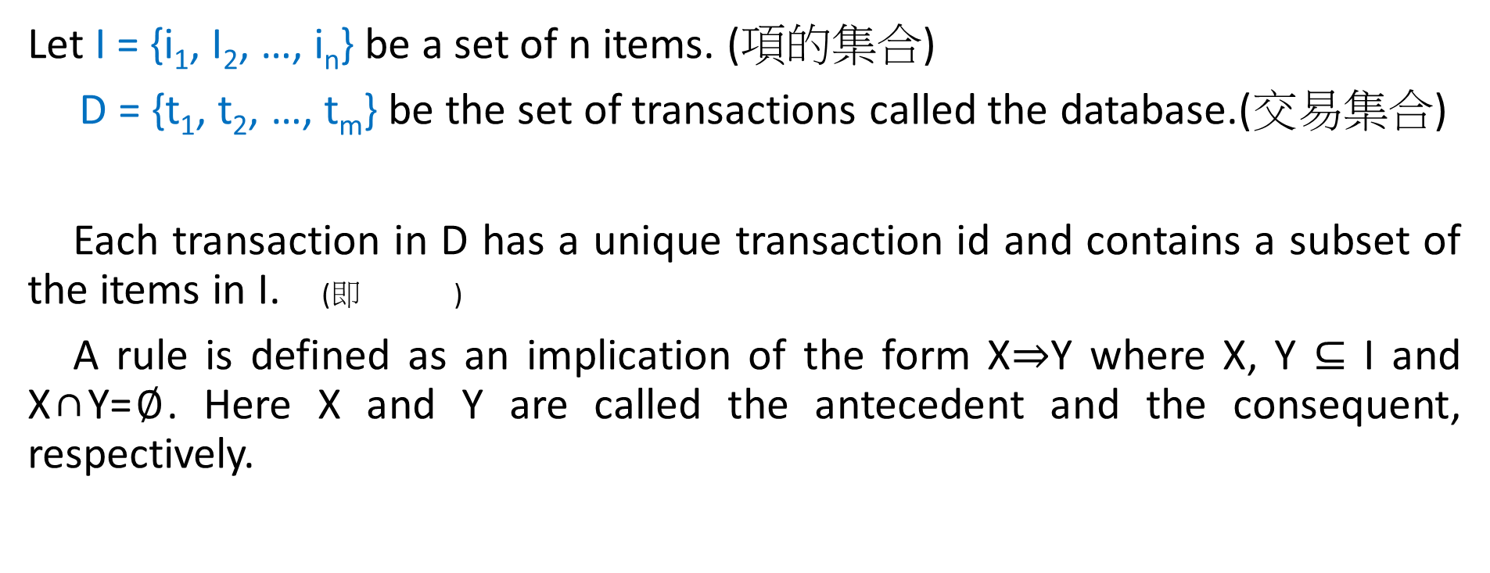
Association Rule
Let I = {i₁, I₂, …, i_{n}} be a set of n items. (項的集合)
D = {t₁, t₂, …, t_{m}} be the set of transactions called the database.(交易集合)
Each transaction in D has a unique transaction id and contains a subset of the items in I. (即 )
A rule is defined as an implication of the form X⇒Y where X, Y ⊆ I and X∩Y=$∅$. Here X and Y are called the antecedent and the consequent, respectively.

Slide 5
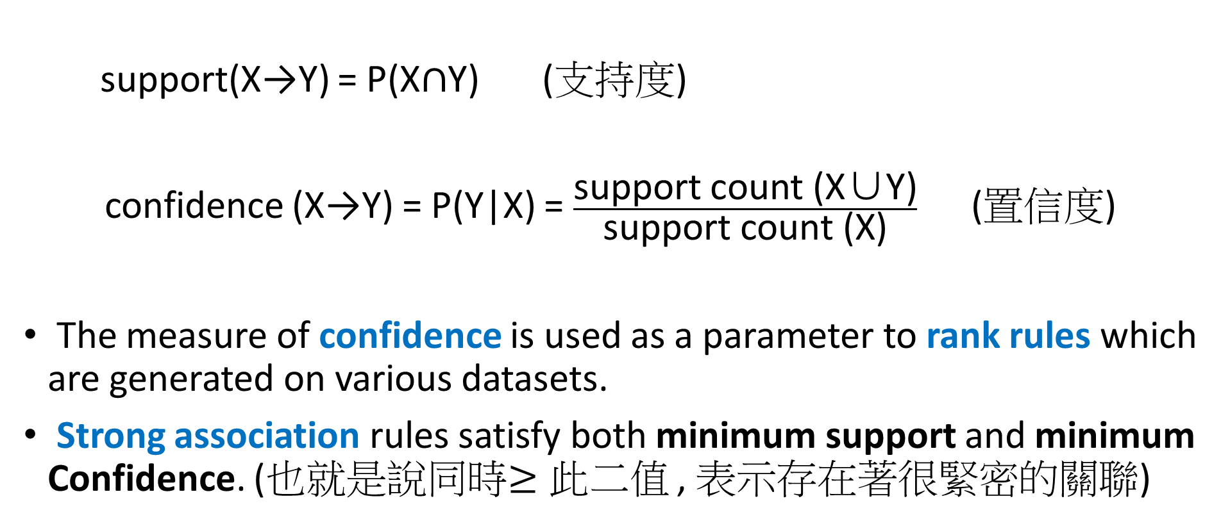
support(X→Y) = P(X$∩$Y) (支持度)
confidence (X→Y) = P(Y|X) = $\frac{\text{support} \text{count}\text{ (}\text{X}\text{∪}\text{Y}\text{)}}{\text{support} \text{count}\text{ (}\text{X}\text{)}}$ (置信度)
The measure of confidence is used as a parameter to rank rules which are generated on various datasets.
Strong association rules satisfy both minimum support and minimum Confidence. (也就是說同時$≥此$二值 , 表示存在著很緊密的關聯)

Slide 6
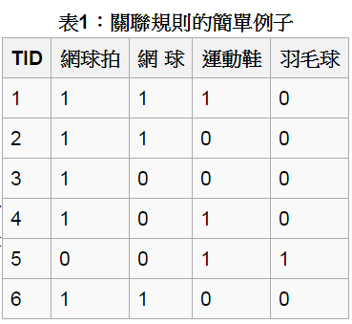


Example
表1是顧客購買記錄的資料庫，包含6個事務(Transaction)。
項集I={網球拍,網球,運動鞋,羽毛球}。
考慮關聯規則：網球拍 網球，事務1,2,3,4,6包含網球拍，事務1,2,6同時包含網球拍和網球，支持度(網球拍 網球):
，置信度 。
若給定最小支持度 ，最小置信度 ，則可得關聯規則網球拍、網球是有趣的，認為購買網球拍和購買網球之間存在強關聯。

Slide 7
The use of traditional ARM is infeasible for stock market predictions since the number of association rules generated for the stock data is exponential to the number of itemsets and finding relevant rules from this set is difficult.
所以此篇作者提出使用分群的方法，且只挑取適當的關聯規則，此可降低關聯規則之間的運算量，使得更容易找出有意義的關聯性。

Slide 8
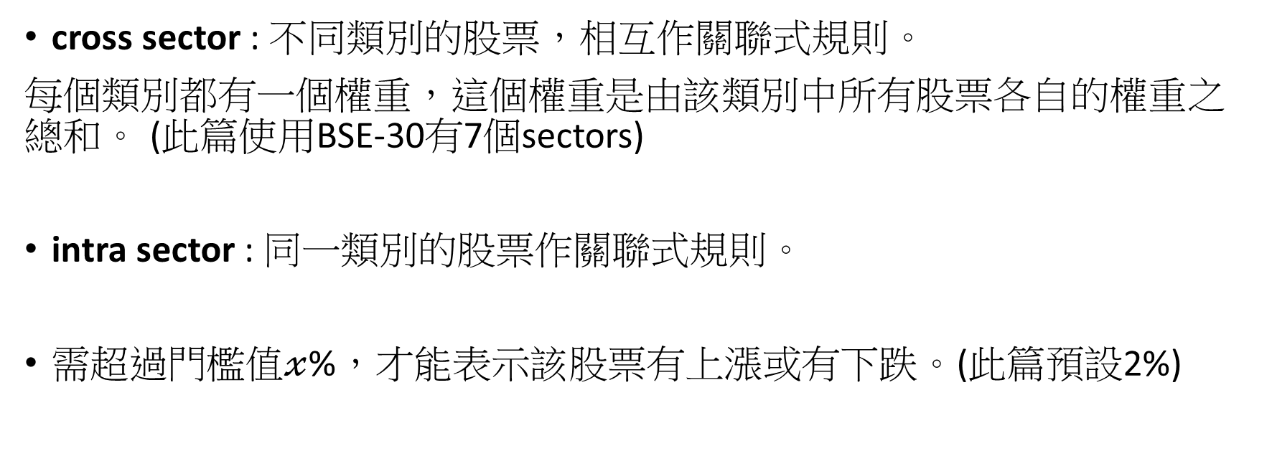
以分群方式計算關聯式規則
Step1 : 分群
cross sector : 不同類別的股票，相互作關聯式規則。
每個類別都有一個權重，這個權重是由該類別中所有股票各自的權重之總和。 (此篇使用BSE-30有7個sectors)
intra sector : 同一類別的股票作關聯式規則。
需超過門檻值$𝓍$%，才能表示該股票有上漲或有下跌。(此篇預設2%)

Slide 9
Three types of rules are generated :
positively correlated rising sectors or stocks are those which rise together. (同漲)
positively correlated falling sectors or stocks are those which fall together. (同跌)
negatively correlated sectors or stocks are such that if one falls the other rises.(一漲一跌)

Slide 10
Step2 : find cross sector rules
使用frequent itemset generation algorithm(like Apriori/Dynamic Itemset Counting)在cross sector dataset上找出frequent sectors，並且找出這些不同類別frequent sectors之間的漲跌關係。
在這邊只討論同漲關係的sectors
負相關關係之後可用來做rebalance
最後，取這些關係值的top-k，前k好的關聯式規則。
(此篇使用BSE-30的k預設為3)

Slide 11
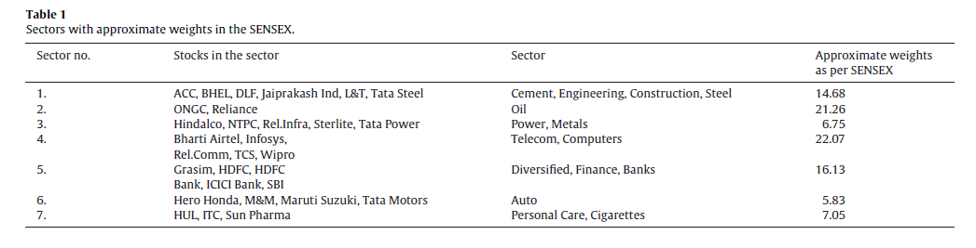
Example for step2
Portfolio formation on BSE-30 :
Each of these stocks has a certain weight in the SENSEX, leading to each sector having a particular weight in the SENSEX. We have formed the sectors as shown in Table 1.

Slide 12
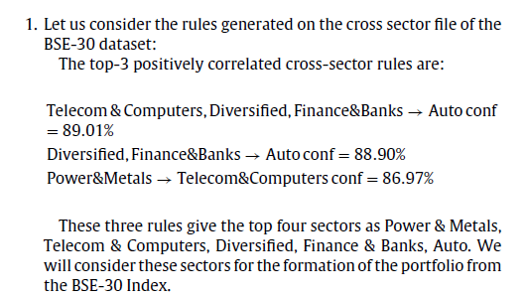

Slide 13
Step3 : find intra sector rules
在各自的sector中再跑一次frequent itemset generation algorithm，產生frequent stocks，並且對這些同類別frequent stocks作關聯式規則估量，找出這些股票之間的漲跌關係。
一樣地只討論同漲關係的sectors
負相關關係之後可用來做rebalance
最後，取這些關係值的top-k’ (此篇使用BSE-30的k’預設為2)

Slide 14
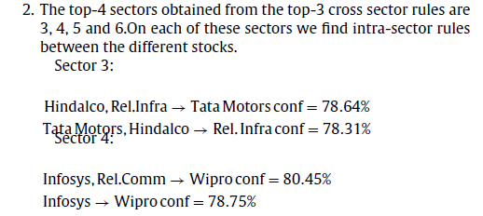
Example for step3

Slide 15
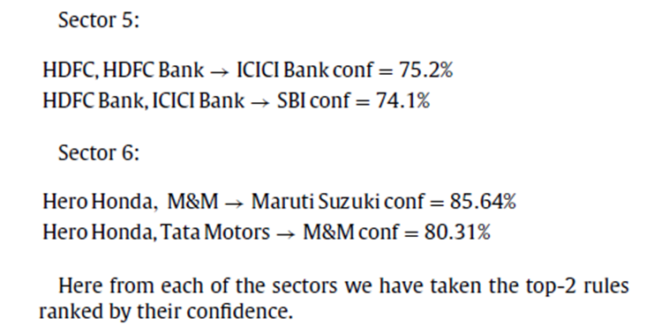

Slide 16
Step4 : Combine, and find relative order.
將之前兩個步驟得到的關係(結果)拿來排整個dataset中股票之間的相關順序(關聯強度愈強則排序愈前面)。
取top-k”,最後可得portfolio要投資的數量。
(p.s.視資金數量，如果足夠則可一次大量買入投資組合中全部股票；如果資金有限，則從愈前面排序的股票投注，依序以最小單位買入，遵循此規則，不特別偏向哪支股票。)

Slide 17
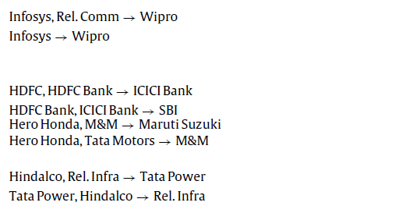
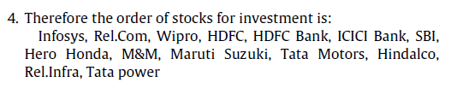

Slide 18
Rebalancing the portfolio
對於長期投資者來說，經過一段期間，重新檢視投資報酬率(Return)，調整投資組合可使得Return提高，可修正預測失準的情況。
此篇論文預設一年rebalance一次。

Slide 19
Step1 : Check for the rise/fall in the portfolio.
Step2 : Check for the rise/fall of the individual stocks.
Step3 : Check for the negatively performing stocks.
(一漲一跌關係)
Step4 : 將這一年資料加入產生新關係規則。
尋找投資組合中正在下跌股票對應到cross、intra sector中正在上漲股票的關係。

Slide 20
Step5 : 將投資組合中下跌的股票替換掉，如果下跌的股票該類別的其它股票一樣都下跌，那麼認為該類別受到自然或外來因素影響，所以轉而選取cross sector中具有正相關的股票。
如果呈現股票全部上漲的情況，則不需更換。

Slide 21
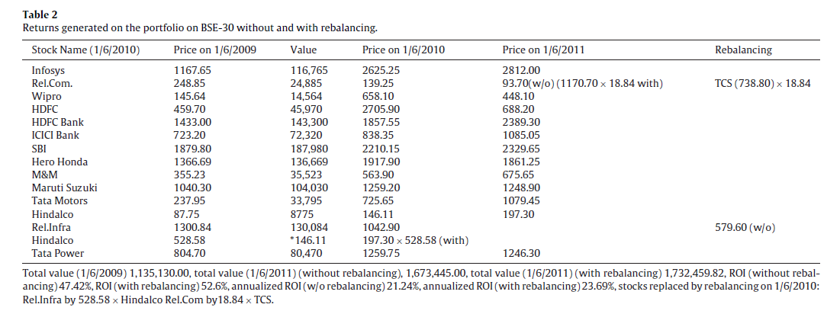
Replace by TCS
Replace by Hindalco

Slide 22
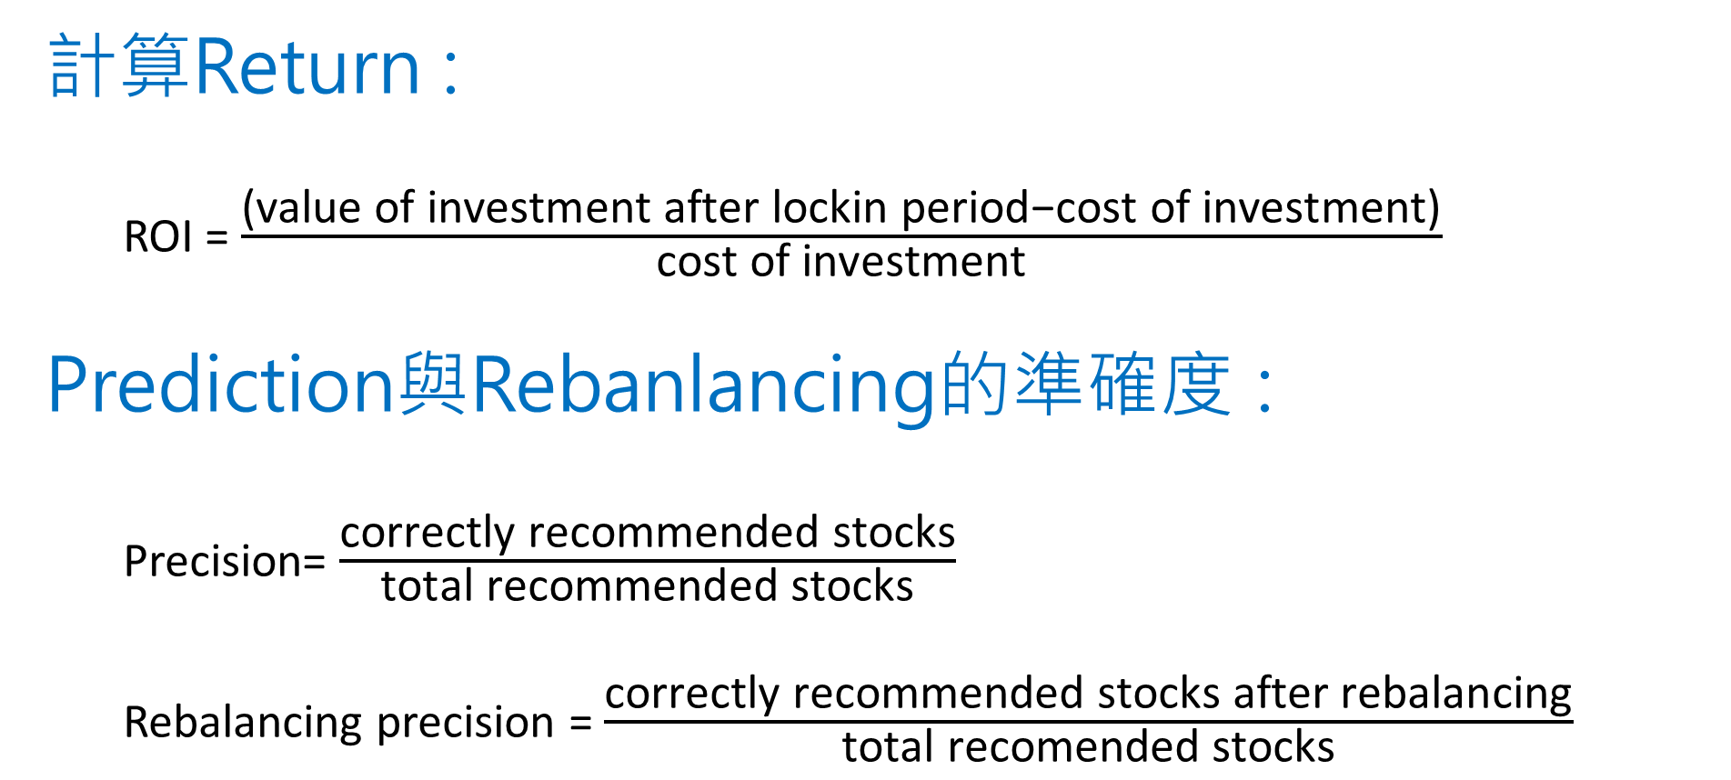
計算Return :
ROI = $\frac{\text{(}\text{value} \text{of} \text{investment} \text{after} \text{lockin} \text{period}\text{−}\text{cost} \text{of} \text{investment}\text{)}}{\text{cost} \text{of} \text{investment}}$
Prediction與Rebanlancing的準確度 :
Precision= $\frac{\text{correctly} \text{recommended} \text{stocks}}{\text{total} \text{recommended} \text{stocks}}$
Rebalancing precision = $\frac{\text{correctly} \text{recommended} \text{stocks} \text{after} \text{rebalancing}}{\text{total} \text{recomended} \text{stocks}}$

Slide 23
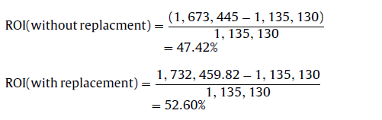
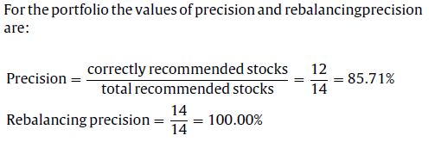

Slide 24
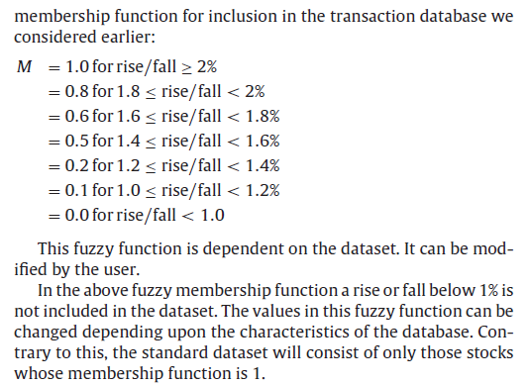
The fuzzy technique for portfolio creation

Slide 25
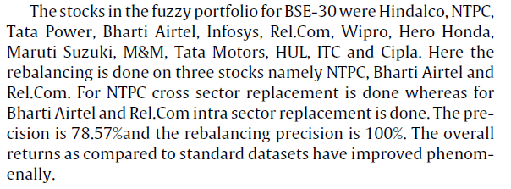
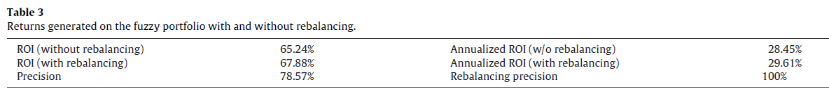

Slide 26
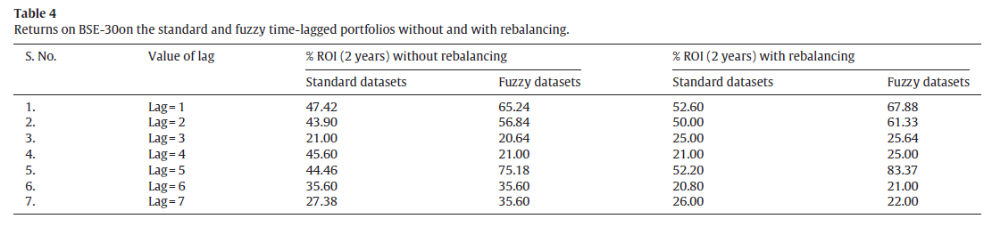
Time-lagged

Slide 27
