Slide 1
Resequencing a Set of Strings Based on a Target String
Chih-En Kuo, Yue-Li Wang, Jia-Jie Liu, Ming-Tat Ko
Algorithmica, Vol. 72, No. 2, pp. 430-449, 2015.
Presenter: Bi-Shiang Lin
Date:2016/5/18

Slide 2
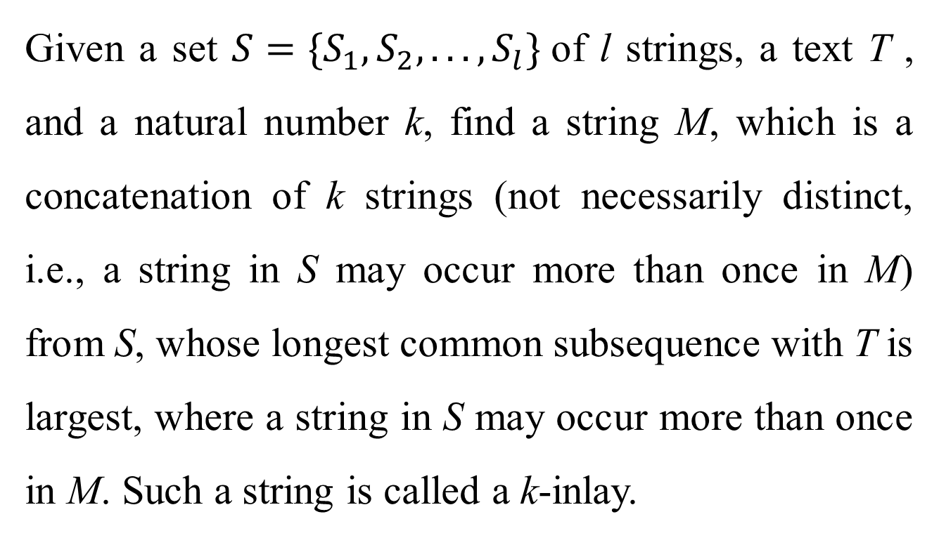
Abstract(1/3)
Given a set $S=\{S_{1},S_{2}, . . . ,S_{l}\}$of l strings, a text T , and a natural number k, find a string M, which is a concatenation of k strings (not necessarily distinct, i.e., a string in S may occur more than once in M) from S, whose longest common subsequence with T is largest, where a string in S may occur more than once in M. Such a string is called a k-inlay.

Slide 3
Abstract(2/3)
The resequencing longest common subsequence problem (resequencing LCS problem for short) is to find a k-inlay for each query with parameter k after T and S are given.

Slide 4
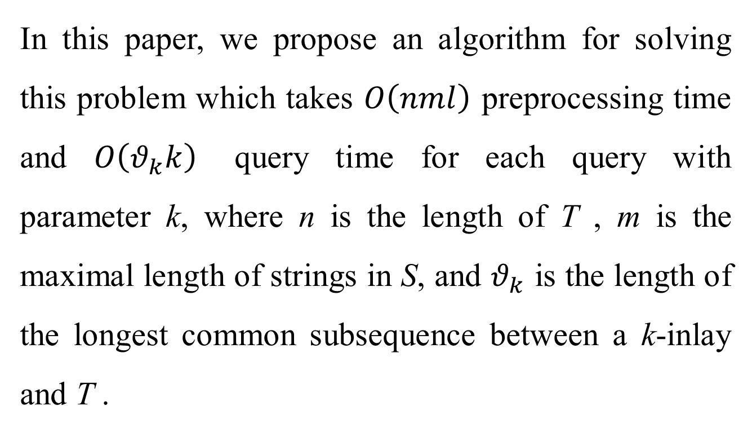
Abstract(3/3)
In this paper, we propose an algorithm for solving this problem which takes $O\left(nml\right)$ preprocessing time and $O\left(θ_{k}k\right)$ query time for each query with parameter k, where n is the length of T , m is the maximal length of strings in S, and $θ_{k}$ is the length of the longest common subsequence between a k-inlay and T .

Slide 5
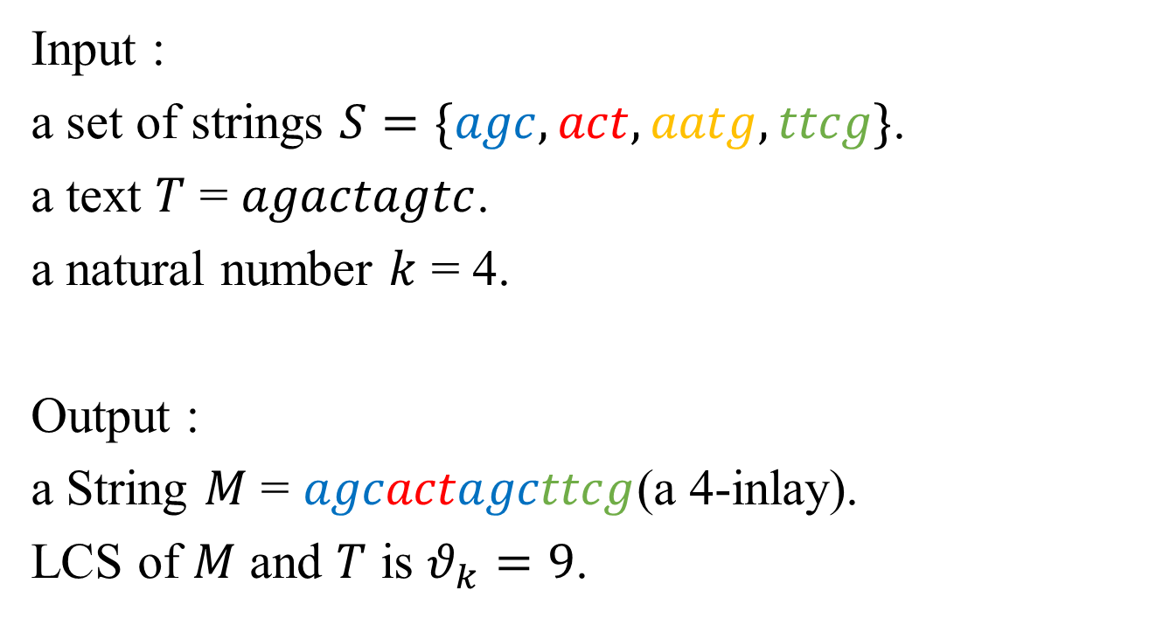
Mosaic(Resequencing) LCS prob.
Input :
a set of strings $S=\{agc, act, aatg, ttcg\}$.
a text $T$ = $agactagtc$.
a natural number $k$ = 4.
Output :
a String $M$ = $agcactagcttcg$(a 4-inlay).
LCS of $M$ and $T$ is $θ_{k}=9$.

Slide 6
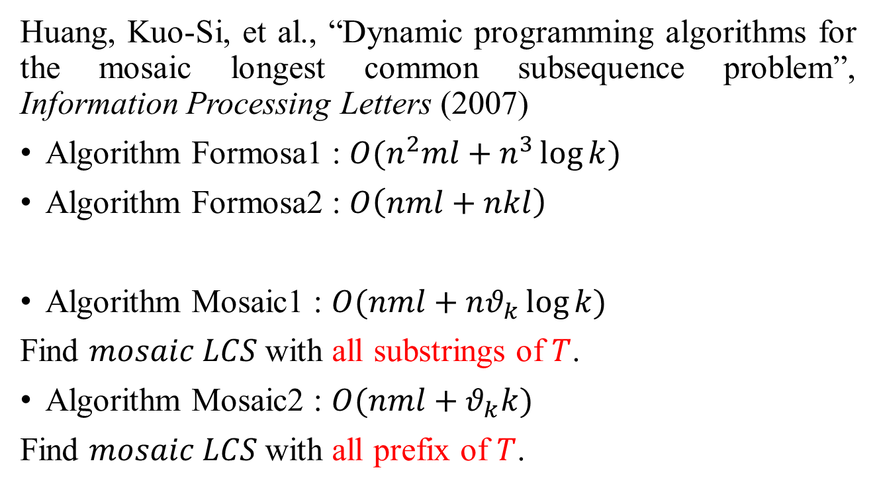
Time complexity
Huang, Kuo-Si, et al., “Dynamic programming algorithms for the mosaic longest common subsequence problem”, Information Processing Letters (2007)
Algorithm Formosa1 : $O(n^{2}ml+n^{3}\log{k})$
Algorithm Formosa2 : $O\left(nml+nkl\right)$
Algorithm Mosaic1 : $O(nml+nθ_{k}\log{k})$
Find $mosaic LCS$with all substrings of $T$.
Algorithm Mosaic2 : $O(nml+θ_{k}k)$
Find $mosaic LCS$with all prefix of $T$.

Slide 7
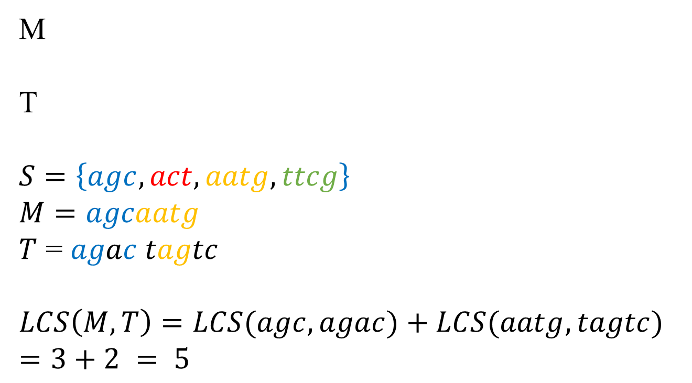
Review Algorithm Formosa1(1/3)
M
T
$$S=\left\{agc, act, aatg, ttcg\right\}$$
$$M=agcaatg$$
$T$ = $agac tagtc$
$$LCS\left(M,T\right)=LCS(agc,agac)+LCS(aatg,tagtc)=3+2 = 5$$

Slide 8
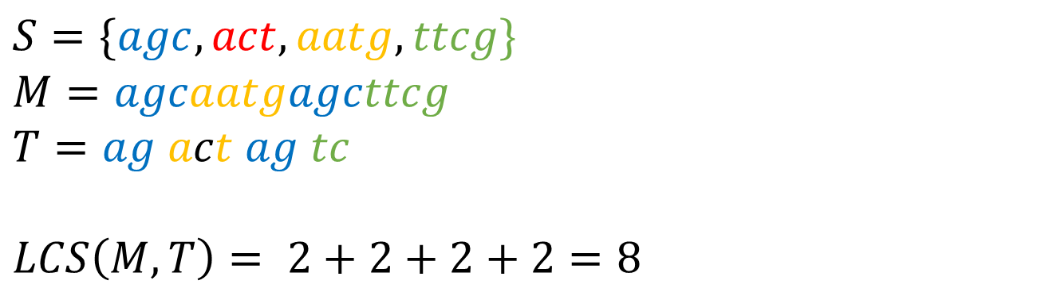
Review Algorithm Formosa1(2/3)
$$S=\{agc, act, aatg, ttcg\}$$
$$M=agcaatgagcttcg$$
$$T=ag act ag tc$$
$$LCS\left(M,T\right)= 2+2+2+2=8$$
M
T

Slide 9
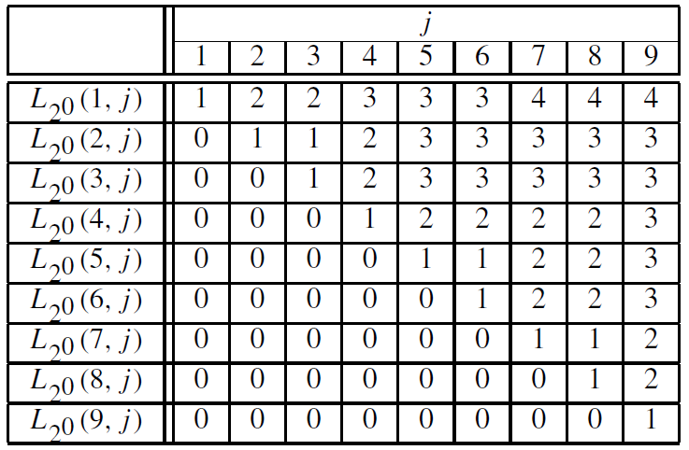
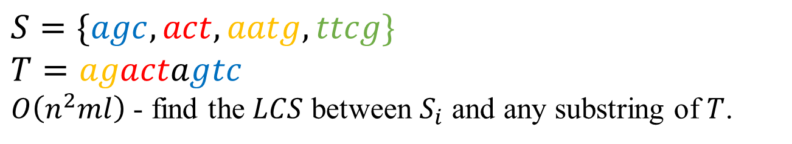
Review Algorithm Formosa1(3/3)
$$S=\{agc, act, aatg, ttcg\}$$
$$T=agactagtc$$
$O\left(n^{2}ml\right)$ - find the $LCS$ between $S_{i}$ and any substring of $T$.

Slide 10
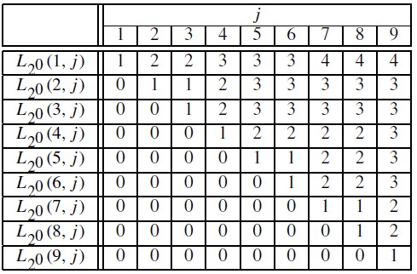
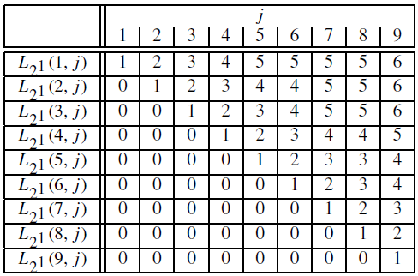
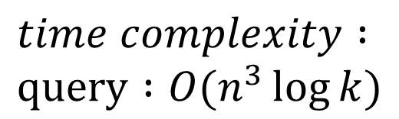
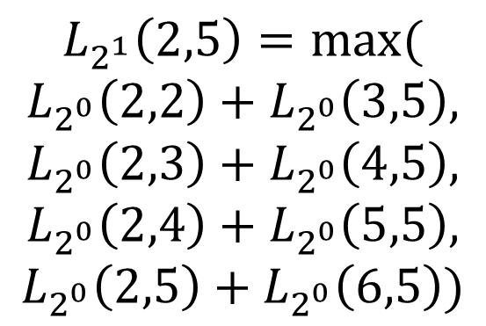
$$L_{2^{1}}\left(2,5\right)=max⁡($$
$$L_{2^{0}}\left(2,2\right)+L_{2^{0}}\left(3,5\right),$$
$$L_{2^{0}}\left(2,3\right)+L_{2^{0}}\left(4,5\right),$$
$$L_{2^{0}}\left(2,4\right)+L_{2^{0}}\left(5,5\right),$$
$$L_{2^{0}}\left(2,5\right)+L_{2^{0}}\left(6,5\right))$$
$$time complexity : \\ query :O(n^{3}\log{k})$$

Slide 11

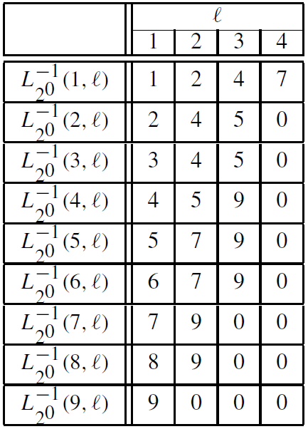

Algorithm mosaic1(1/4)
Preprocessing : produce $L_{2^{0}}$ table in $O\left(mnl\right)$ time.
An all-substrings common subsequence algorithm.(2008)

Slide 12
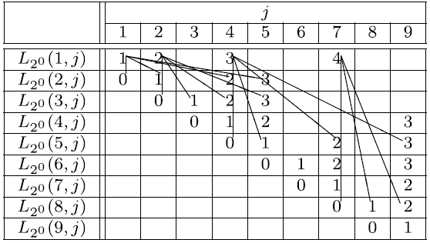
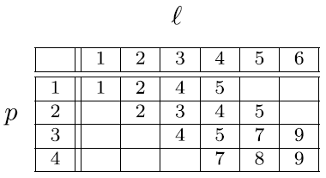
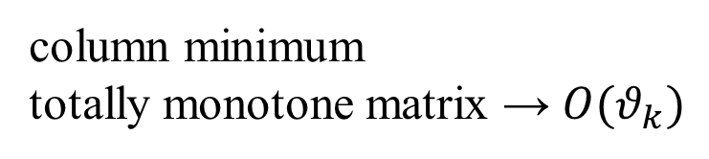
Algorithm mosaic1(2/4)
1 | 2 | 3 | 4 | 5 | 9
column minimum
totally monotone matrix → $O(θ_{k})$

Slide 13
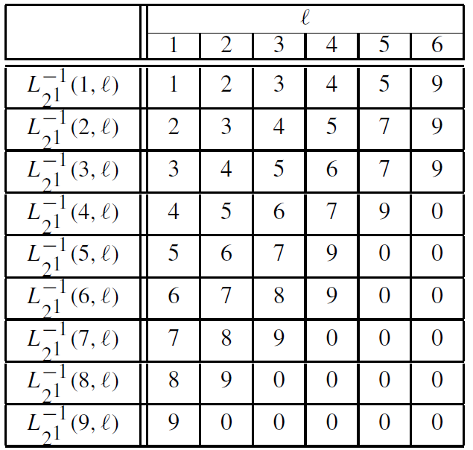

Algorithm mosaic1(3/4)
$$O(nθ_{k})$$

Slide 14
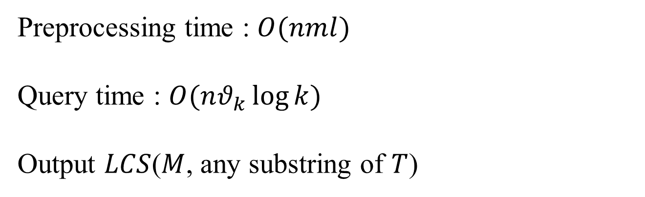
Algorithm mosaic1(4/4)
Preprocessing time : $O(nml)$
Query time : $O(nθ_{k}\log{k})$
Output $LCS$($M$, any substring of $T$)

Slide 15
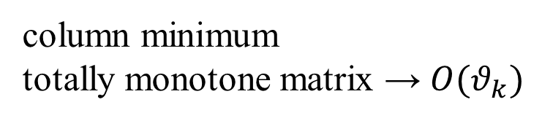
Algorithm mosaic2(1/2)
1 | 2 | 3 | 4 | 5 | 9
column minimum
totally monotone matrix → $O(θ_{k})$

Slide 16
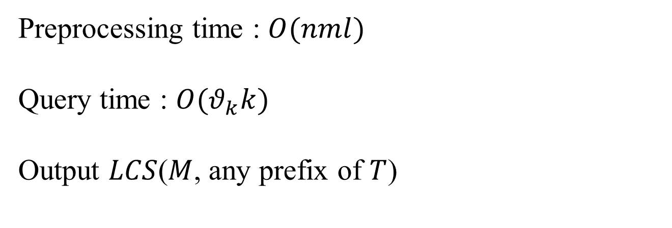
Algorithm mosaic2
Preprocessing time : $O(nml)$
Query time : $O(θ_{k}k)$
Output $LCS$($M$, any prefix of $T$)

Slide 17
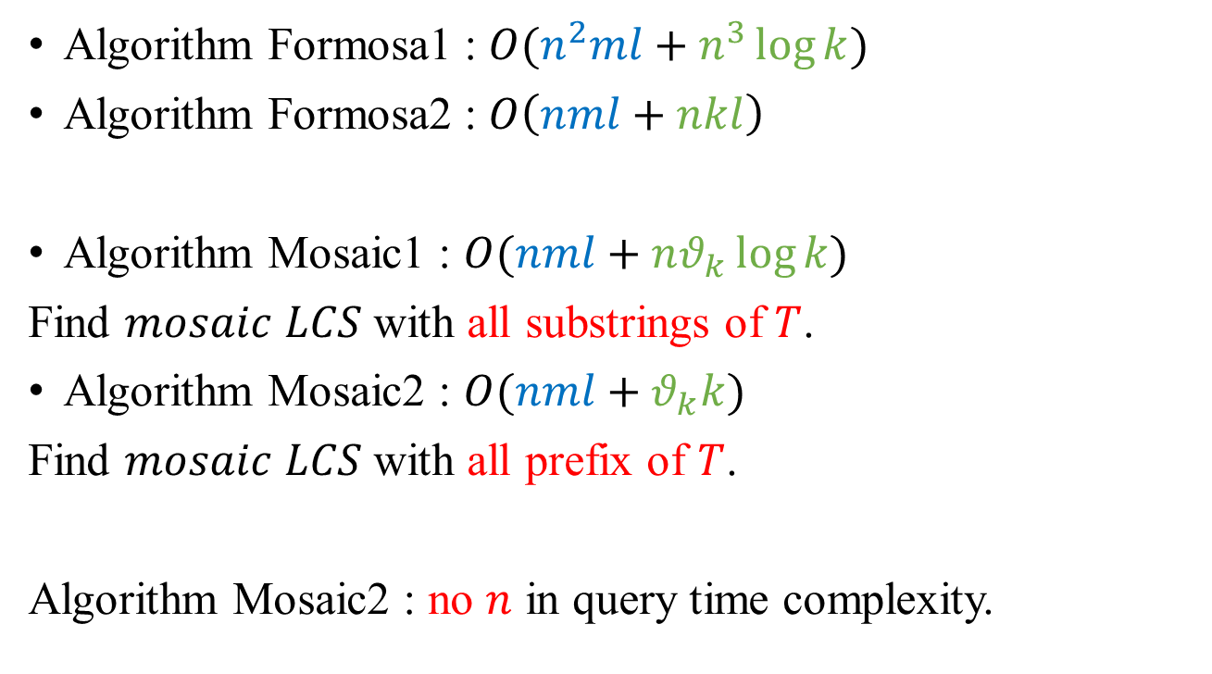
Conclusion
Algorithm Formosa1 : $O(n^{2}ml+n^{3}\log{k})$
Algorithm Formosa2 : $O\left(nml+nkl\right)$
Algorithm Mosaic1 : $O(nml+nθ_{k}\log{k})$
Find $mosaic$ $LCS$ with all substrings of $T$.
Algorithm Mosaic2 : $O(nml+θ_{k}k)$
Find $mosaic$ $LCS$ with all prefix of $T$.
Algorithm Mosaic2 : no $n$ in query time complexity.

