Slide 1
Efficient Two-Dimensional Pattern Matching in the Presence of Errors
Kamala Krithivasan, R. Sitalakshmi
Information Sciences
Volume 43, Issue 3, December 1987, Pages 169–184
Presenter: Huang-Ting Chan
Date:2015/7/7

Slide 2
Abstract
We give an algorithm for two-dimensional pattern matching in the presence of errors. We find that the complexity of our algorithm is O(kn₁n₂ log n₂ + n₁²n₂ + kn₁m₁m₂), where the pattern is an n₁ × n₂ array, the text is an m₁ × m₂ array and k is the number of mismatches allowed.

Slide 3
The problem
Text: bcdefghi
Pattern: bxdyegh
bcd efghi
bxdye gh
c match to x
y match to $∅$ (Pattern deletion)
f match to $∅$ (Text deletion)

Slide 4
The problem
c match to x
c match to x
y match to $∅$
f match to $∅$
String matching with k mismatch
Find all occurrences of the
pattern in the text with at most
k mismatch
String matching with k differences
Find all occurrences of the
pattern in the text with at most
k differences

Slide 5
Text Analysis
Input
Pattern: $A=a_{1}a_{2}…a_{m}$ length=m
Text: $T=t_{1}t_{2}…t_{n}$ length = n
Pattern analysis:
A 2D array $PM[1,…,m−1;1,…,2K+1]$
Output
A 2D array $TM[1,…,n−m;1,…,K+1]$

Slide 6
Pattern analysis:
$PM\left[i,v\right]=f$ means that $a_{i+f}≠a_{f}$ and the mismatch number is $v$
Text analysis:
$TM\left[i,v\right]=f$ means that $t_{i+f}≠a_{f}$ and the mismatch number is $v$

Slide 7
Example
Pattern = abaacaa
$$PM\left[2,1\right]=2$$
$$PM\left[2,2\right]=3$$
$$PM\left[2,3\right]=5$$
abaacaa
| | | | |
abaacaa

Slide 8
Example
Pattern = abaacaa
Text = aaaabaccaaccaaa
$$TM\left[2,1\right]=2$$
$$TM\left[2,2\right]=3$$
$$TM\left[2,3\right]=6$$
aaaabaccaaccaaa
| | | | | | |
abaacaa

Slide 9
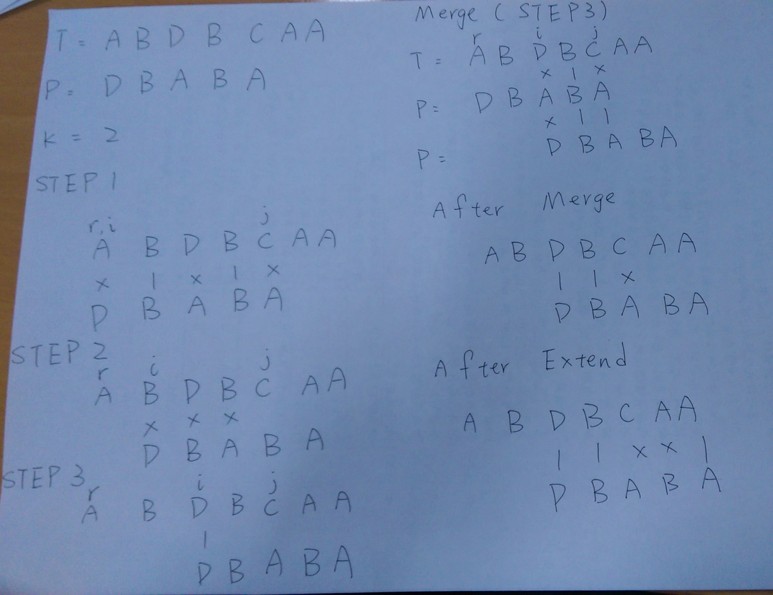
Example

Slide 10
Example
$r+TM[0,2]=3 r+TM[0,3]=5$
$i+PM[2,1]=3$

Slide 11
2D problem
Text
A | B | C | A
C | A | B | D
A | B | A | C
C | D | C | C
A | C | B | D
Pattern
A | D | A
C | D | A
A | B | C | A
C | A | B | D
A | B | A | C
C | D | C | C
A | C | B | D
K=2

Slide 12
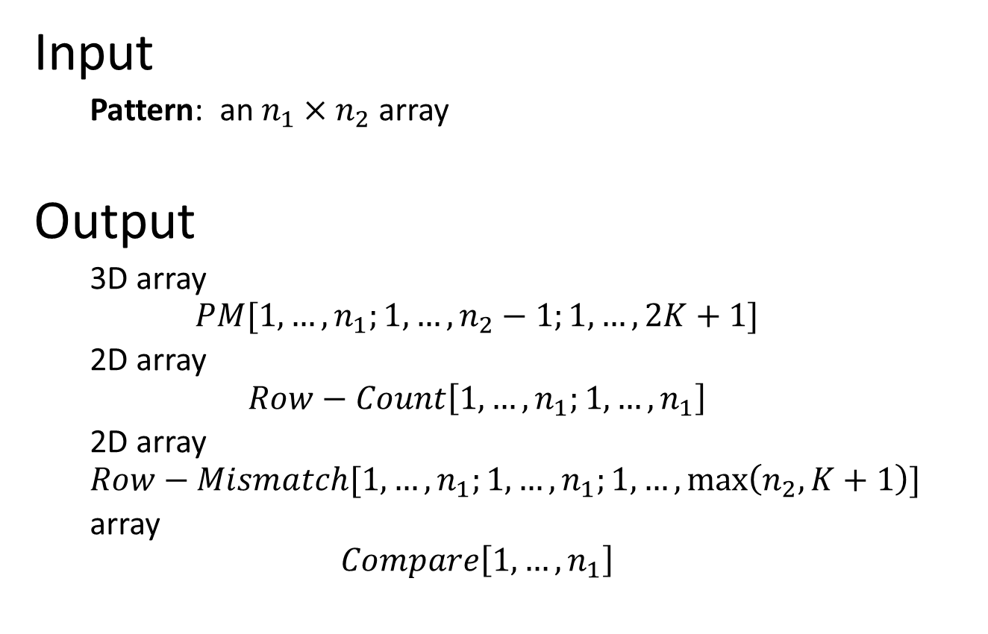
Pattern Analysis
Input
Pattern: an $n_{1}×n_{2}$ array
Output
3D array
$$PM[1,…,n_{1};1,…,n_{2}−1;1,…,2K+1]$$
2D array
$$Row−Count\left[1,…,n_{1};1,…,n_{1}\right]$$
2D array
$$Row−Mismatch[1,…,n_{1};1,…,n_{1};1,…,\max\left(n_{2},K+1\right)]$$
array
$$Compare\left[1,…,n_{1}\right]$$

Slide 13
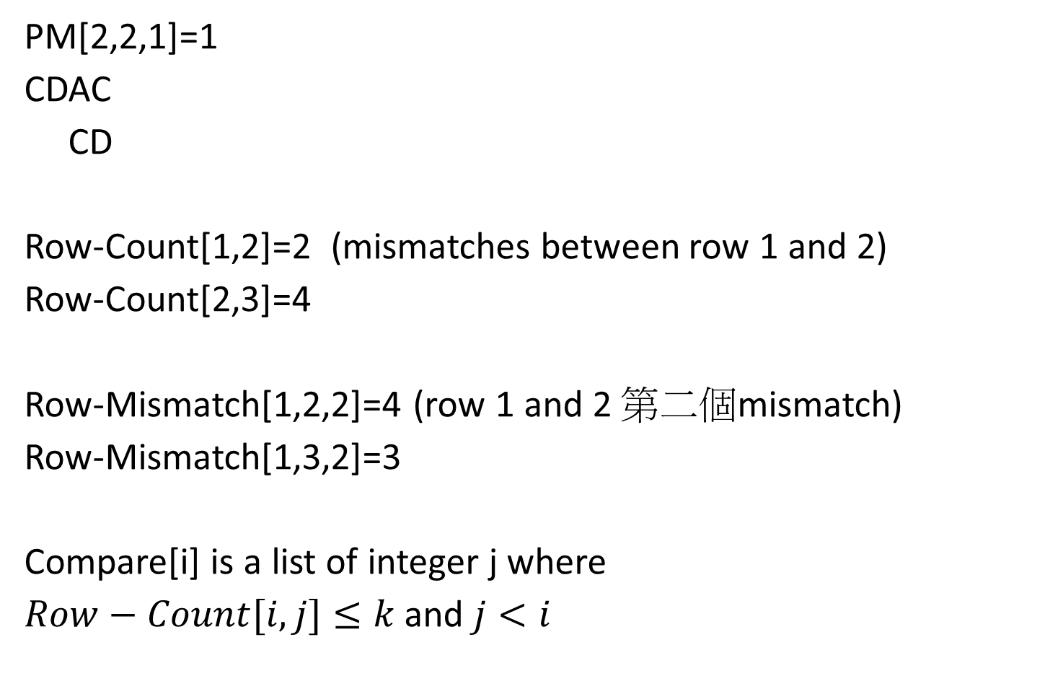
Example
PM[2,2,1]=1
CDAC
CD
Row-Count[1,2]=2 (mismatches between row 1 and 2)
Row-Count[2,3]=4
Row-Mismatch[1,2,2]=4 (row 1 and 2 第二個mismatch)
Row-Mismatch[1,3,2]=3
Compare[i] is a list of integer j where
$Row−Count[i,j]≤k$ and $j<i$
Pattern
A | D | A | B
C | D | A | C
A | B | C | D

Slide 14

Text Analysis
Input
Pattern: an $n_{1}×n_{2}$ array
Text: an $m_{1}×m_{2}$ array
Pattern Analysis ouput
Output
$TM[1,…,n_{1};0,…,m_{2}−n_{2};1,…,K+1]$

Slide 15
Example
K=2
Text
A | B | C | A
C | A | B | D
A | B | A | C
C | D | C | C
A | C | B | D
Pattern
A | B | A
C | D | A

Slide 16
Compute TM Stage 1
Extend
A | B | C
A | B | A
Mismatch=2
A[1,0]=2
Row match=1

Slide 17
Compute TM Stage 1
Merge
 | B | C | A
A | D | A
Mismatch=2
A[1,1]=2
Row match=1

Slide 18
Compute TM Stage 2
C | A | B
Extend
C | D | A
Mismatch=2
A[1,0]+2>k
A[2,0]=2
Row match=1

Slide 19
Compute TM Stage 2
C | A | B
Merge
A | D | A
Mismatch=3
A[1,0]=0
Row match=0

Slide 20
Compute TM Stage 2
C | A | B
A | D | A
之前已經算過
C | A | B
C | D | A

Slide 21
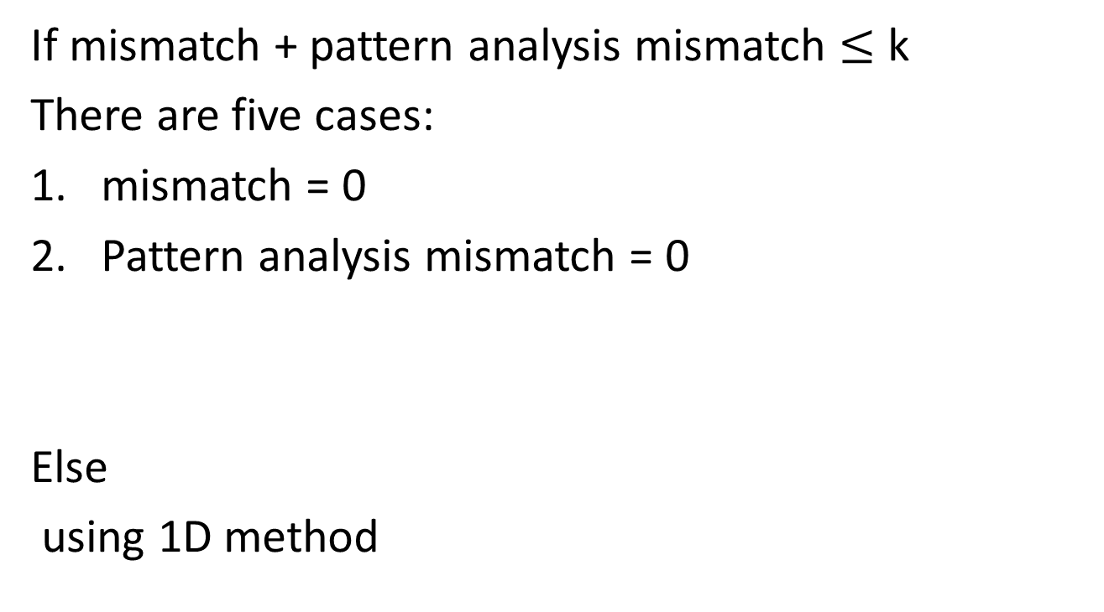
If mismatch + pattern analysis mismatch $≤$ k
There are five cases:
mismatch = 0
Pattern analysis mismatch = 0
Else
using 1D method

Slide 22
Pattern CBA (Before)
Text CAB
Pattern ADA (Now)
TM[2,0,1]=2 Row-Mismatch[1,2,1]=1
TM[2,0,2]=3 Row-Mismatch[1,2,2]=2

Slide 23
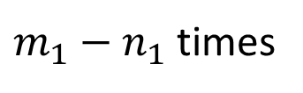
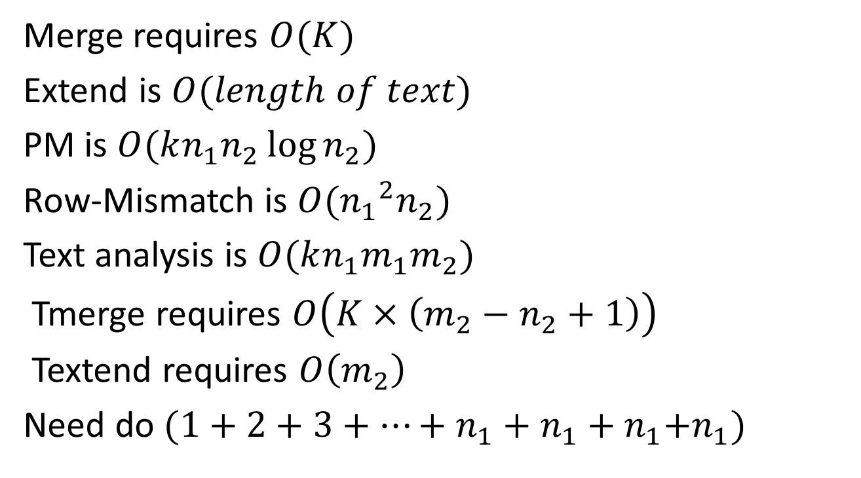
Time Complexity
Merge requires $O(K)$
Extend is $O(length of text)$
PM is $O(kn_{1}n_{2}\log{n_{2}})$
Row-Mismatch is $O({n_{1}}^{2}n_{2})$
Text analysis is $O(kn_{1}m_{1}m_{2})$
Tmerge requires $O\left(K×\left(m_{2}−n_{2}+1\right)\right)$
Textend requires $O\left(m_{2}\right)$
Need do $(1+2+3+…+n_{1}+n_{1}+n_{1}{+n}_{1})$
$m_{1}−n_{1}$ times

Slide 24

Time Complexity
Total
$$O(kn_{1}m_{1}m_{2}+{n_{1}}^{2}n_{2}+kn_{1}n_{2}\log{n_{2}})$$

