Slide 1
Efficient Time Series Matching by Wavelets
Kin-pong Chan ,Ada Wai-chee Fu, Proceedings of the 15th International Conference on Data ,1999. P.126 – P.133
Reporter: Wen-Chuan Ho
Date:2015/07/28

Slide 2
Abstract(1/2)
Time series stored as feature vectors can be indexed by multidimensional index trees like R-Trees for fast retrieval. Due to the dimensionality curse problem, transformations are applied to time series to reduce the number of dimensions of the feature vectors. Different transformations like Discrete Fourier Transform (DFT), Discrete Wavelet Transform (DWT), Karhunen-Loeve (KL) transform or Singular Value Decomposition (SVD) can be applied. While the use of DFT and K-L transform or SVD have been studied in the literature, to our knowledge, there is no in-depth study on the application of DWT.

Slide 3
Abstract(2/2)
In this paper, we propose to use Haar Wavelet Transform for time series indexing. The major contributions are: (1) we show that Euclidean distance is preserved in the Haar transformed domain and no false dismissal will occur, (2) we show that Haar transform can outperform DFT through experiments, (3) a new similarity model is suggested to accommodate vertical shift of time series, and (4) a two-phase method is proposed for efficient -nearest neighbor query in time series databases.

Slide 4
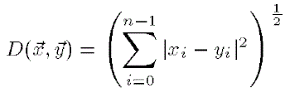
Similarity
= {x₀, x₁, x₂, …, x_{n-1}}
= {y₀, y₁, y₂, …, y_{n-1}}
Ex:
= {4, 5, 6, 7, 8 } = {2, 4, 6, 8}
= {4, 6, 6, 7 ,8 } = {0, 2, 4, 6}
D( , ) = 1 D( , ) = 4

Slide 5
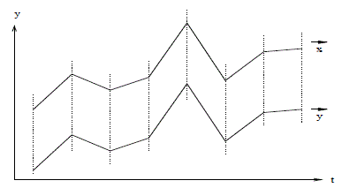
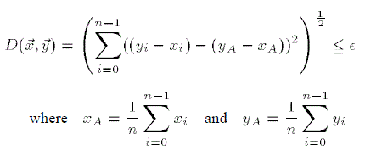
V-shift similar
= {2, 4, 6, 8}
= {0, 2, 4, 6}
D( , ) = 0

Slide 6
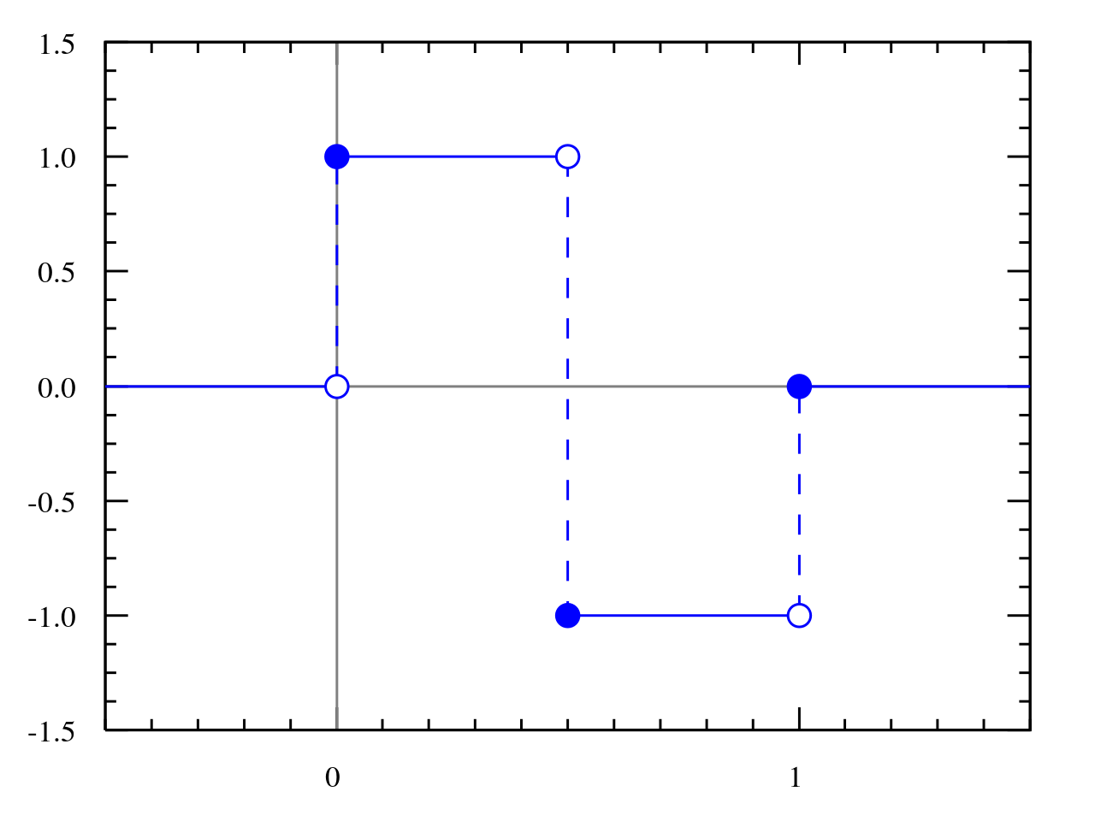
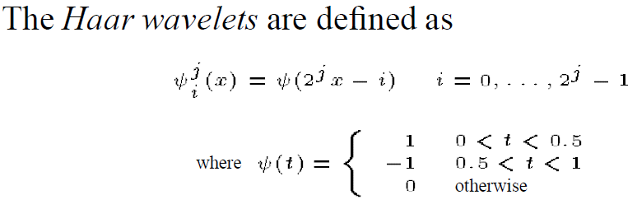
Haar Wavelets (1/3)
Advantage
It allows good approximation with a subset of coefficients.
It can be computed quickly and easily.
It preserves Euclidean distance.

Slide 7

Haar Wavelets (2/3)
f(x) = (9 7 3 5) H(f(x)) = (6 2 1 -1)
= 1/2 X
 | a
 | b
 | c
 | d
1 | 1 | 0 | 0
1 | -1 | 0 | 0
0 | 0 | 1 | 1
0 | 0 | 1 | -1
 | X₀
 | X₁
 | X₂
 | X₃
Complexity O(n)

Slide 8
Haar Wavelets (3/3)
f(x) = (9 7 3 5) H(f(x)) = (6 2 1 -1)
=1/2 X
=1/2 X
 | 8
 | 1
 | 4
 | -1
1 | 1 | 0 | 0
1 | -1 | 0 | 0
0 | 0 | 1 | 1
0 | 0 | 1 | -1
 | 9
 | 7
 | 3
 | 5
 | 6
 | 0
 | 0
 | 0
1 | 1 | 0 | 0
1 | -1 | 0 | 0
0 | 0 | 1 | 1
0 | 0 | 1 | -1
 | 8
 | 4
 | 0
 | 0

Slide 9
Pre - Preprocessing
Step 1 Similarity Model Selection
simple Euclidean distance
v-shift similarity
Step 2 Index Construction
obtain ω-point Haar transform
use h_{c} to build index structure such as an R-Tree

Slide 10
Range Query
Similar sequences with distances ≤ ԑ from the query are looked up in the index and returned.
A post processing step is applied on these sequences to find the true distances in time domain to remove all false alarms

Slide 11



Nearest Neighbor Query
Phase 1:
Find n nearest neighbors in R-Tree index.
Compute the Euclidean distances between the query sequence and all nearest neighbors
Phase 2:
A range query evaluation is then performed on the same index by setting ԑ = .
Keep a list of n nearest sequences so far
Keep a list of their Euclidean distances with query

Slide 12
Performance Evaluation(1/6)
Experiments data :
Synthetic random walk data
30k time sequences
sliding window size ω = 1024
Real data :1990/12/7~1996/7/11Hong Kong stock
Totally 10k feature vectors
sliding window size ω = 512

Slide 13

Performance Evaluation(2/6)
S_{time} : the number of time sequences qualified in time domain
S_{transform} : the number of time sequences qualified in the transformed domain

Slide 14
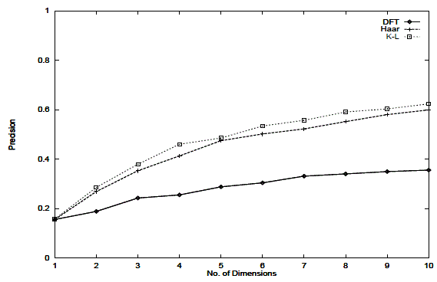
Performance Evaluation(3/6)
Precision of Range query

Slide 15
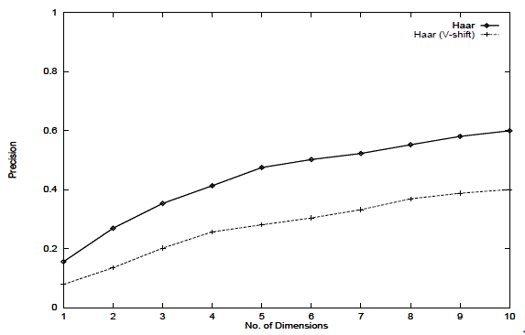
Performance Evaluation(4/6)
Precision of Range query (V-shift model)

Slide 16
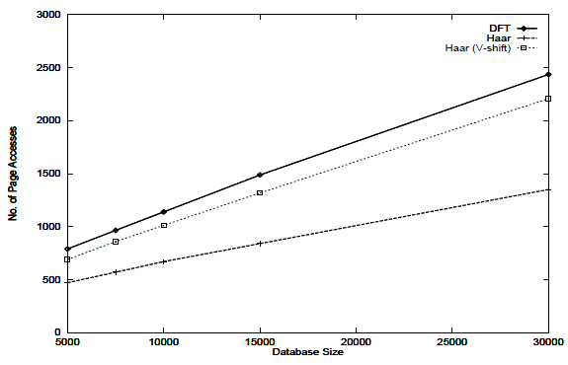
Performance Evaluation(5/6)
Scalability in database size of NN query

Slide 17
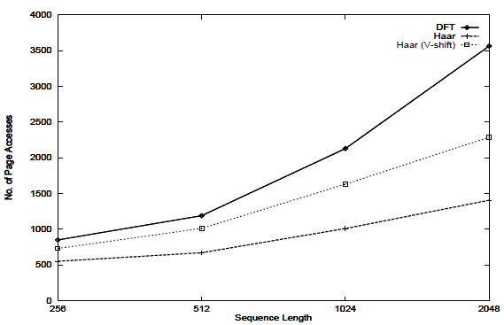
Performance Evaluation(6/6)
Scalability in sequence length of NN query

