Slide 1
Fast Robust Logistic Regression for Large Sparse Datasets with Binary Outputs
Paul R. Komarek, Andrew W. Moore
Ninth International Workshop on Artificial intelligence and Statistics ,January 3-6, 2003
Presenter: Chen Yun-Shiuan
Date:2012/1/9

Slide 2
Abstract
Although popular and extremely well established in mainstream statistical data analysis, logistic regression is strangely absent in the field of data mining. There are two possible explanations of this phenomenon. First, there might be an assumption that any tool which can only produce linear classification boundaries is likely to be trumped by more modern nonlinear tools. Second, there is a legitimate fear that logistic regression cannot practically scale up to the massive dataset sizes to which modern data mining tools are applied. This paper consists of an empirical examination of the first assumption, and surveys, implements and compares techniques by which logistic regression can be scaled to data with millions of attributes and records. Our results, on a large life sciences dataset, indicate that logistic regression can perform surprisingly well, both statistically and computationally, when compared with an array of more recent classification algorithms.

Slide 3
Introduction
This paper asks a simple question:
Given the wide variety of recent classification algorithms (such as support vector machines) how does one of the oldest—logistic regression — measure up?

Slide 4
Logistic Regression (LR)
An explanation of logistic regression begins with an explanation of the logistic function, which, like probabilities, always takes on values between zero and one:

Slide 5
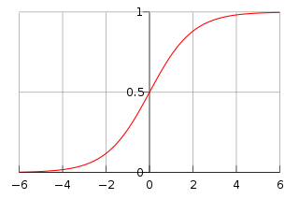
Logistic Regression (LR)

Slide 6
Logistic Regression (LR)
z represents the exposure to some set of independent variables, while ƒ(z) represents the probability of a particular outcome, given that set of explanatory variables.
The variable z is a measure of the total contribution of all the independent variables used in the model and is known as the logit.
The variable z is usually defined as
Notes:
X是表示獨立事件，Beta是表示這些事件的系數
最後的得出的z帶入logistic function
即可得到一個介於0~1的機率
但是分類問題只有是或者不是兩種答案
這邊的做法是 將機率由高到低做排列 直到遇到一個較低值被分到另外一類 他就說比這個值低的都是另外一類

Slide 7
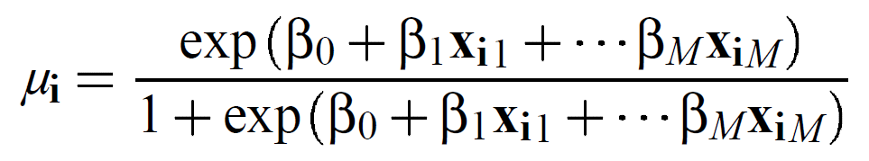
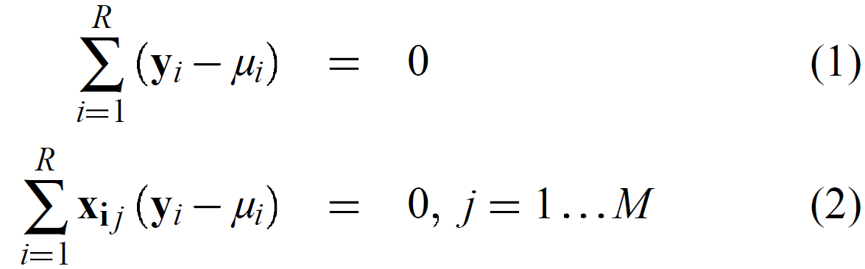
Logistic Regression
Logistic curve:
The maximum likelihood equations:
M: number of attributes

Slide 8
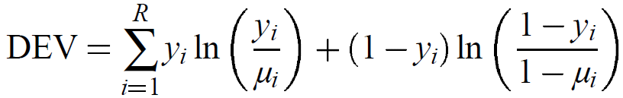
Iteratively Re-weighted Least Squares (IRLS)
We can compute η_{i} and update Β by the following two equations:
The stop condition:

Slide 9
Simple Algorithm
1. Remove linear dependencies from the data X
2. Rewrite equation (3) as X^{T}WXB=X^{T}Wη
3. In each outer loop iteration, compute the Cholesky factorization LL^{T} of X^{T}WX
4. Solve for b using an efficient back-substitution.
Time complexity: O(min(M²RF+M³))
The second term, M³, represents a standard Cholesky decomposition.

Slide 10
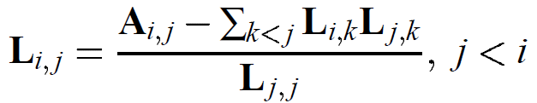
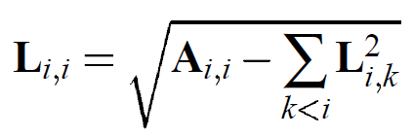
Robust Cholesky Algorithm
The off-diagonal entries of the Cholesky factor L may be written in closed form as:
while the diagonal entries may be written as

Slide 11
Robust Cholesky Algorithm
Our modification to the standard Cholesky decomposition, above, is nearly as simple as discarding rows and columns from the input matrix A when the associated diagonal entry is zero or not defined.
Note that discarding row i and column i of A or L is equivalent to discarding attribute i from the data X.
The time complexity of this method is similar to that of the Simple Algorithm.

Slide 12
Stepwise Logistic Regression
This procedure wraps LR’s outer loop with a basis-choosing loop.
The basis-choosing step creates a subset X’₀ of the data X, runs the LR outer loop on this subset, and uses the result to choose a new data subset X’₁.
This repeats until the basis-choosing loop has met some termination criterion.
The Stepwise Algorithm is attractive because no preconditioning of the data is needed, and numerical problems are handled dynamically by the basis-choosing loop.
The basis-choosing step can make use of prior knowledge about the attributes, or use generic measures like information gain.

Slide 13
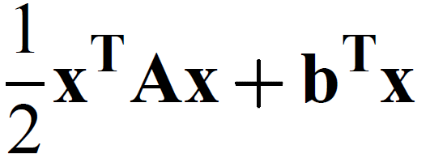
Conjugate Gradient as an Inner Loop
By using a conjugate gradient (CG) iterative linear solver , we avoid construction of A=X^{T}WX altogether.
Briefly, solving a linear system Ax=b, where A is SPD, using conjugate gradient is smimilar to minimizing the quadratic expression:
The time complexity of the CG Algorithm is O(MRF*maxiters), where maxiters iss a upper bound placed on the number of CG interations.

Slide 14
Testing Data
In this paper we report results on two large and significant datasets being used in the life sciences.
Within this paper these dataset are referred to as ds1 and ds2.
ds1 has approximately 6,000 binary-valued attributes and 27,000 rows
ds2 has approximately 1,000,000 binaryvalued attributes and 90,000 rows. Both datasets are sparse.
ds1.100pca and ds1.10pca are linear projections of ds1 to 100 and 10 dimensions, using principle component analysis (PCA).

Slide 15
Testing Data
Experiments with ds1, ds1.100pca and ds1.10pca were performed on tux, a somewhat typical modern desktop.

Slide 16
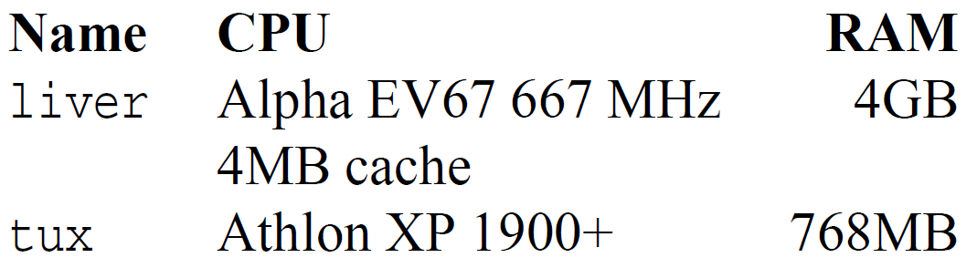
Computer Specification

Slide 17
Analysis
To visualize the predictive performance, we use Receiver Operating Characteristic (ROC) curves.
To construct these curves, we sort the dataset rows according to the probability a row is in the positive class under the logistic model. Then, starting at the graph origin, we step through the rows in order of decreasing probability, moving up one unit if the row is positive and right one unit otherwise.

Slide 18
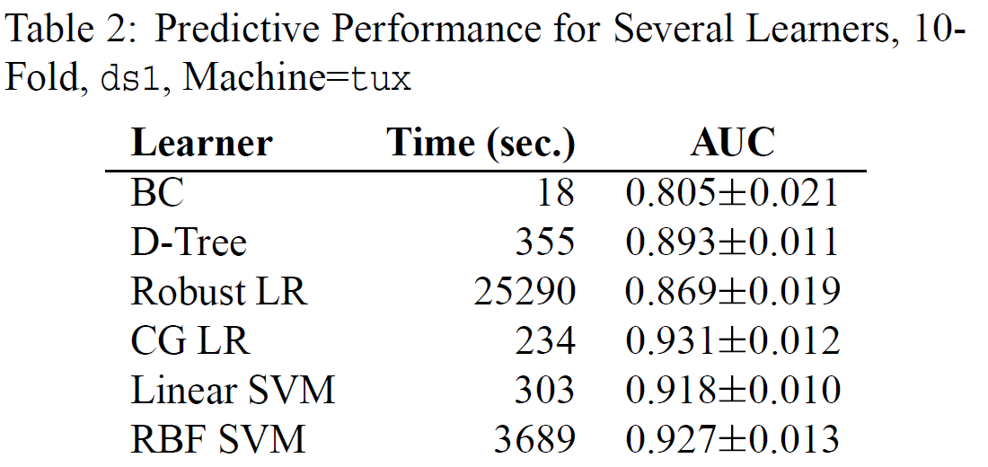
Experimental Result (1)

Slide 19
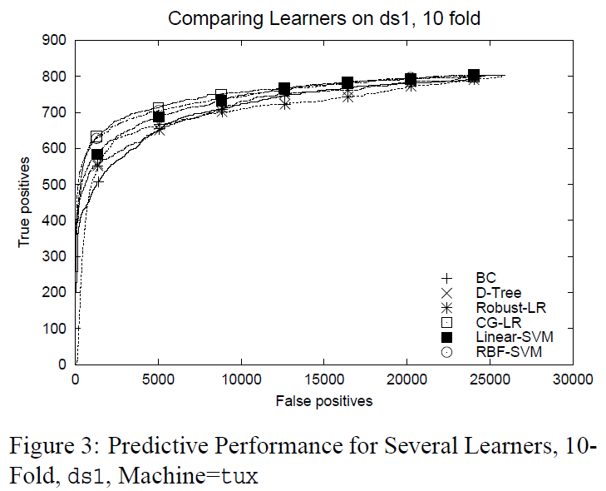
Experimental Result (1)

Slide 20
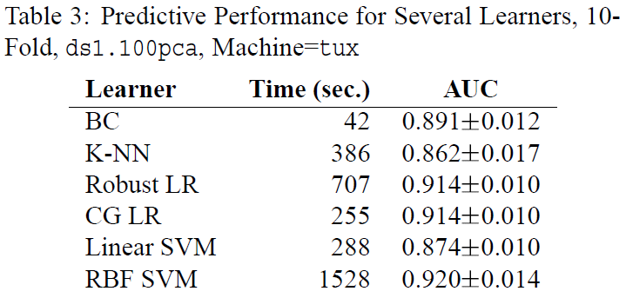
Experimental Result (2)
Notes:
Linear SVM suffer significantly with the projection, but BC, RBF SVM and the LR methods are less affected. From this we conclude that ds1.100pca contains useful information.

Slide 21
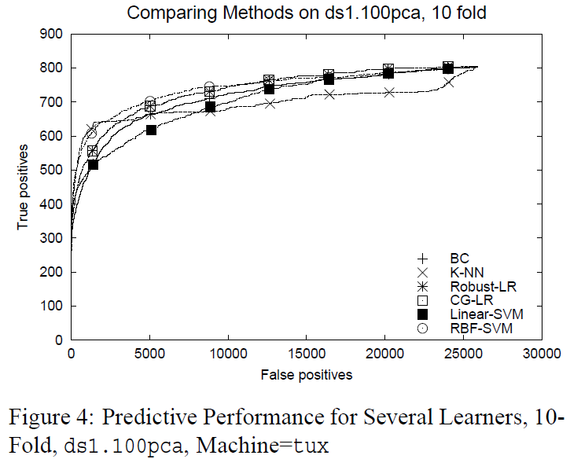
Experimental Result (2)

Slide 22
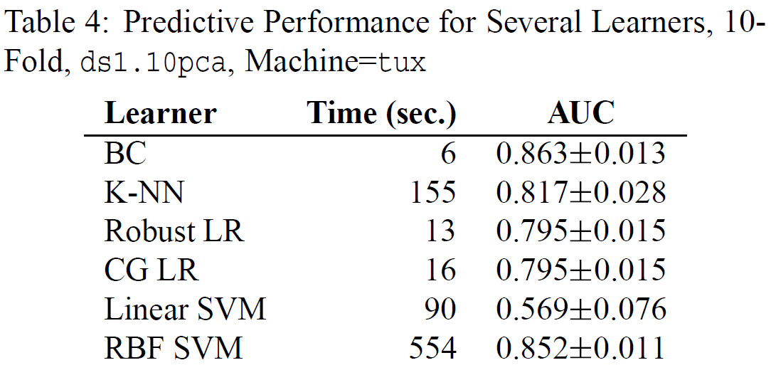
Experimental Result (3)

Slide 23
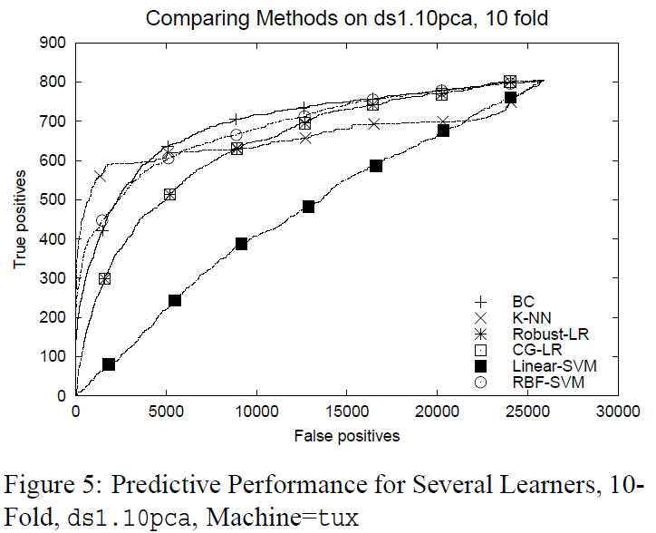
Experimental Result (3)

Slide 24
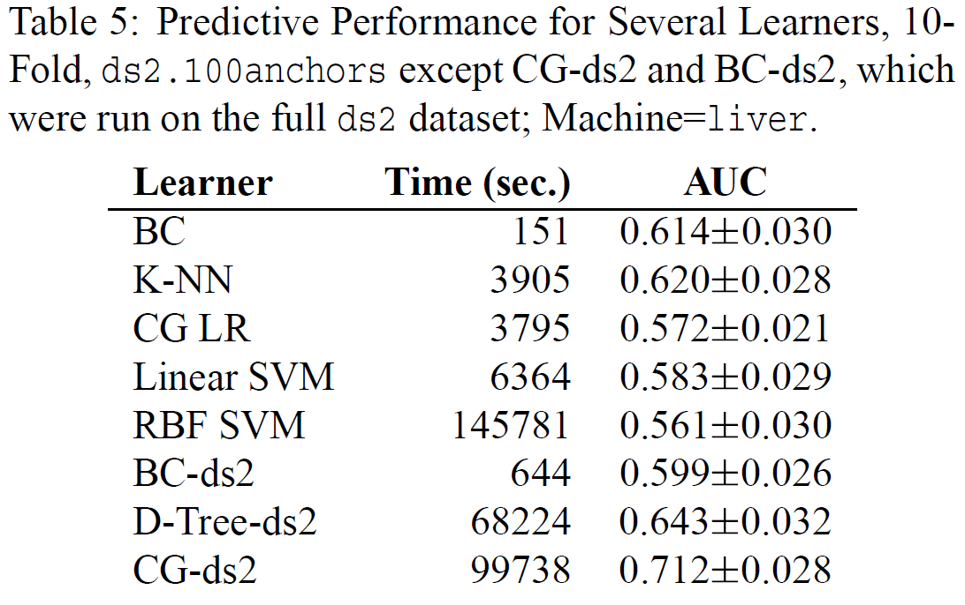
Experimental Result (4)

Slide 25
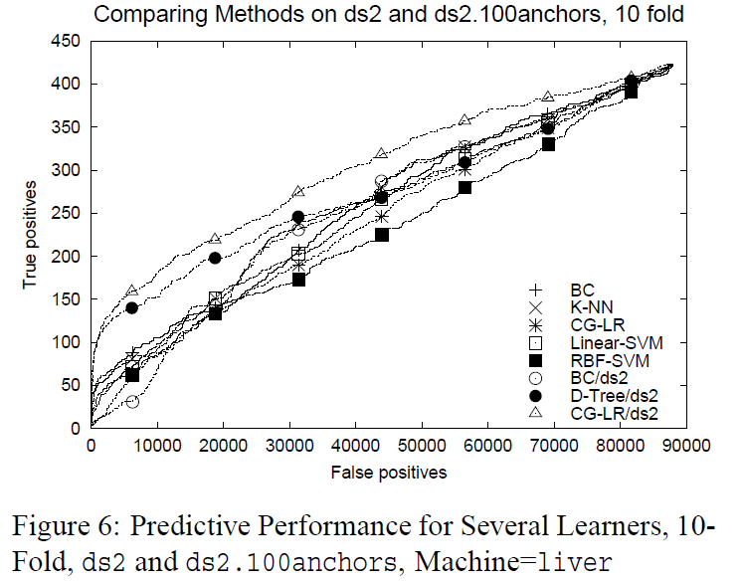
Experimental Result (4)

Slide 26
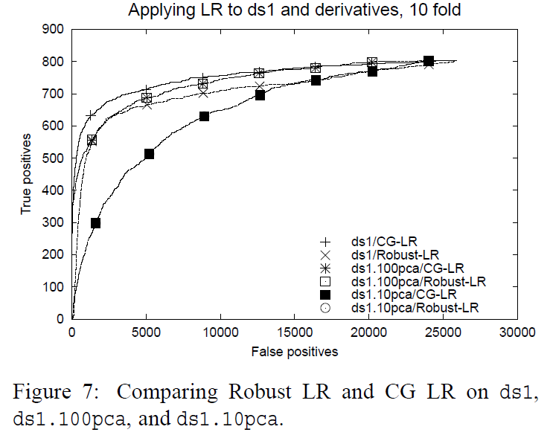

Slide 27
Thanks for listening!!!

