Slide 1
Prediction of Disulfide Connectivity from Protein Sequences Yu-Ching Chen (陳玉菁) and Jenn-Kang Hwang (黃鎮剛) 國立交通大學生物資訊所博士論文, 2007
Presenter: Hong-Yu Chen
Date: Jan. 9, 2012

Slide 2
Abstract
The disulfide bonds have great influences in stabilizing protein structures and regulating protein functions. At present there is a gap between protein sequences and protein structures; therefore, it would be a great help to predict disulfide connectivity from protein sequences. However, the difficulties in predicting disulfide connectivity from protein sequences lie in the nonlocal properties of the disulfide bridges that involve cysteine pairs at large sequence separation. Although many scientists develop various methods to solve this problem; it is still a challenge. These methods are limited by the number of disulfide bonds should equal or less than five, because as the increase of disulfide bonds in proteins the number of disulfide connectivity grows rapidly, and it is more difficult to predict disulfide connectivity.

Slide 3
Abstract
In this research, I developed a method to predict disulfide connectivity and named S-S predictor; it combines sequence alignment method and machine learning method. The searching dataset of sequence alignment are disulfide proteins with known structures; therefore, the advantages of this method integrate sequence and structure information to predict disulfide connectivity. On the other hand, when homologs of query protein can not be found, the support vector machines are used to solve problem. I found some useful feature vectors in this research; such as the coupling evolutionary information between the local sequence environments of cysteine pairs, the cysteines sequence separations, and the global sequence descriptor, amino acid content.

Slide 4
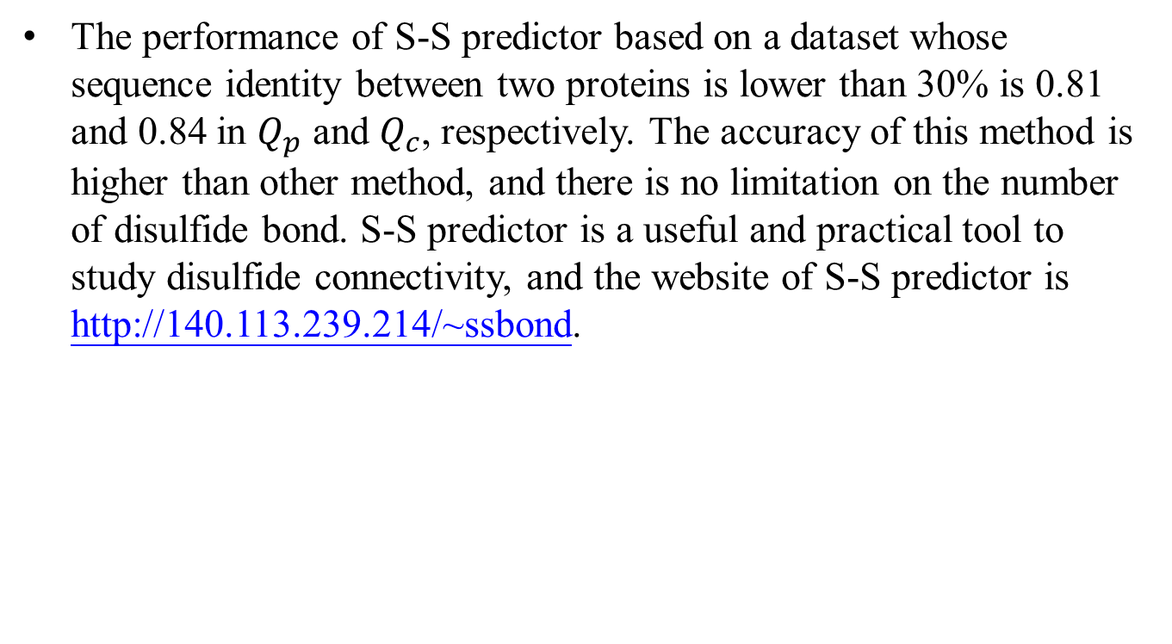
Abstract
The performance of S-S predictor based on a dataset whose sequence identity between two proteins is lower than 30% is 0.81 and 0.84 in $Q_{p}$ and $Q_{c}$, respectively. The accuracy of this method is higher than other method, and there is no limitation on the number of disulfide bond. S-S predictor is a useful and practical tool to study disulfide connectivity, and the website of S-S predictor is http://140.113.239.214/~ssbond.

Slide 5
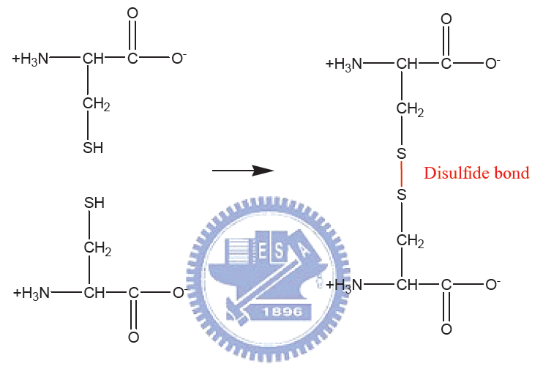
The formation of a disulfide bond

Slide 6
Outline
Prediction of disulfide connectivity using blast method
Prediction of disulfide connectivity from protein sequences
S-S Predictor: a disulfide prediction server

Slide 7
Prediction of disulfide connectivity using blast method
Sequence-to-structure mapping techniques can be used to identify potential disulfide bonds.
The purpose of this research is to take the advantages of huge PDB data, and extracts abundant information from it.
Homologous search tool, PSI-BLAST, was used to search evolutionarily related disulfide proteins with PDB structure.
Three kinds of methods
Disulfide pair method
Disulfide pattern method
Hybrid method

Slide 8
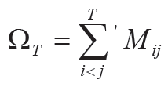
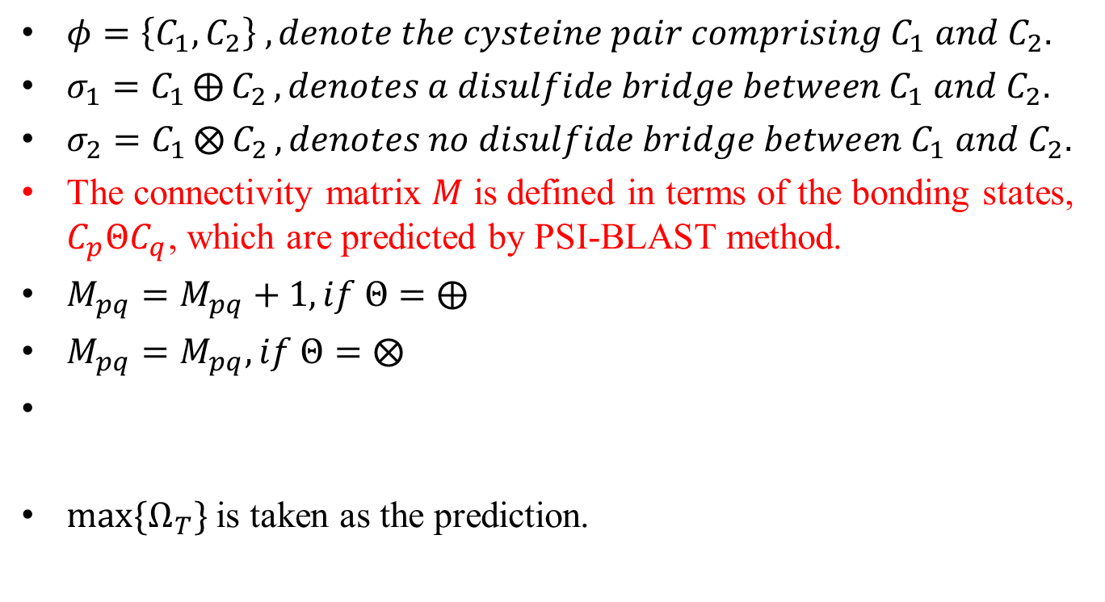
Disulfide pair method
$φ=\left\{C_{1}, C_{2}\right\} ,denote the cysteine pair comprising C_{1} and C_{2}.$
$σ_{1}=C_{1}⨁{C_{2}}, denotes a disulfide bridge between C_{1} and C_{2}.$
$σ_{2}=C_{1}⨂{C_{2}}, denotes no disulfide bridge between C_{1} and C_{2}.$
The connectivity matrix $M$ is defined in terms of the bonding states, $C_{p}ΘC_{q}$, which are predicted by PSI-BLAST method.
$M_{pq}=M_{pq}+1, if Θ=⨁$
$M_{pq}=M_{pq}, if Θ=⨂$
$max⁡\{Ω_{T}\}$ is taken as the prediction.

Slide 9
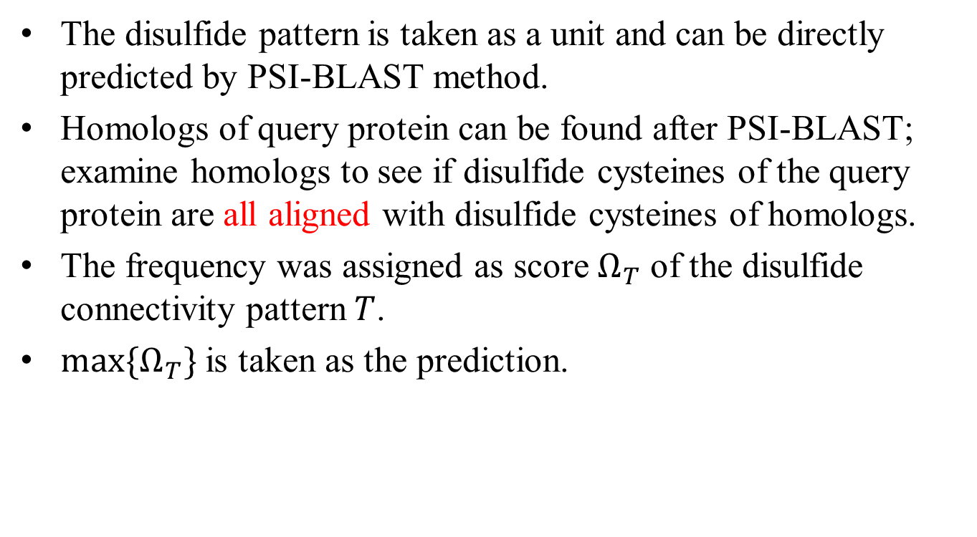
Disulfide pattern method
The disulfide pattern is taken as a unit and can be directly predicted by PSI-BLAST method.
Homologs of query protein can be found after PSI-BLAST; examine homologs to see if disulfide cysteines of the query protein are all aligned with disulfide cysteines of homologs.
The frequency was assigned as score $Ω_{T}$ of the disulfide connectivity pattern $T$.
$max⁡\{Ω_{T}\}$ is taken as the prediction.

Slide 10
Hybrid method
When the disulfide connectivity of a query protein can be predicted from disulfide pattern method, the disulfide pair method will be neglected.
If whole disulfide cysteines of the query protein are not totally aligned with homologs, the pair method uses disulfide pairs to present and predict disulfide connectivity.

Slide 11
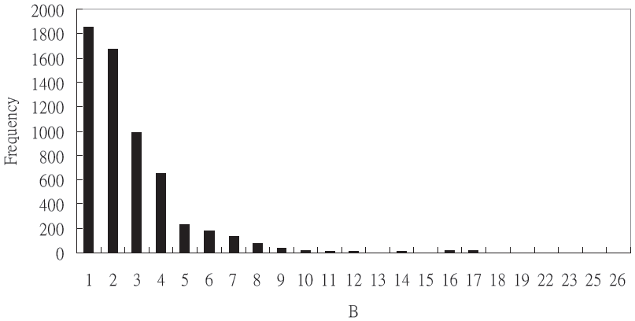
Dataset
SP39-ID30 – 482 sequences
CYS040307-NR – 5913 disulfide proteins

Slide 12
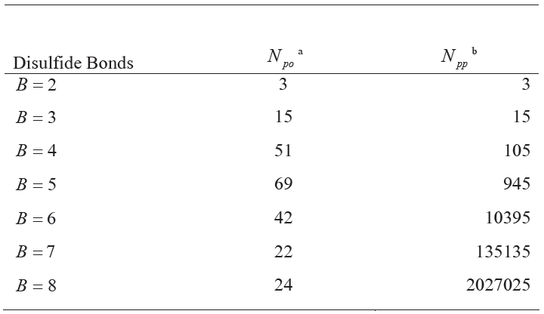
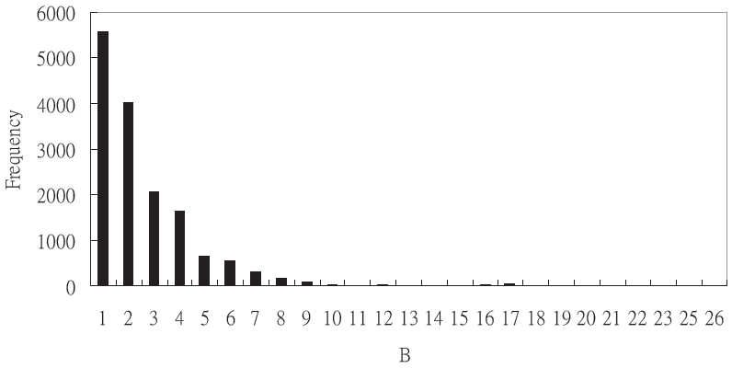
Dataset
CYS090506 – 15252 disulfide proteins
CYS090506(w) – in order to explore the influence of residues nearby cysteines

Slide 13
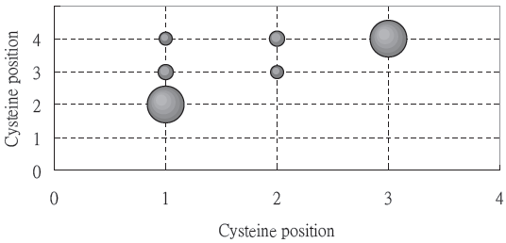
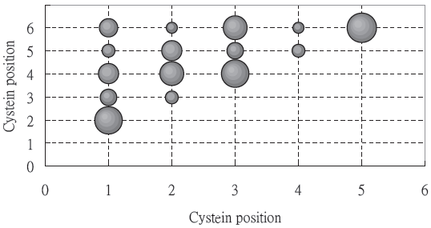
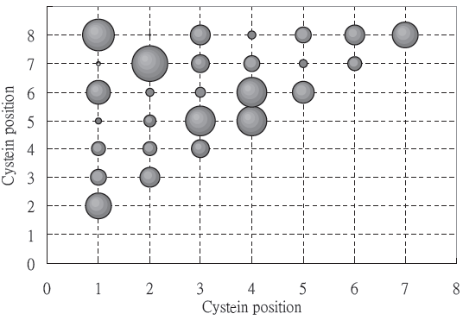
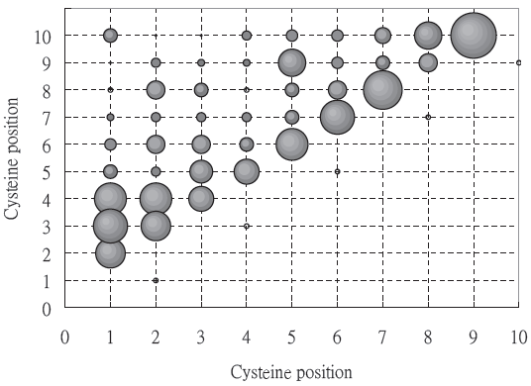
CYS090506

Slide 14
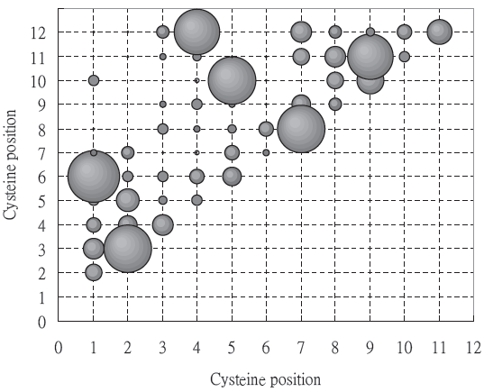
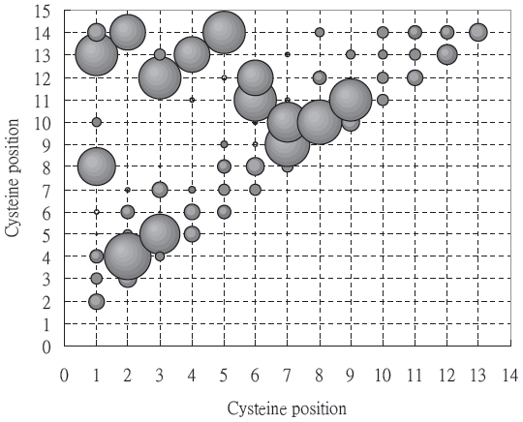
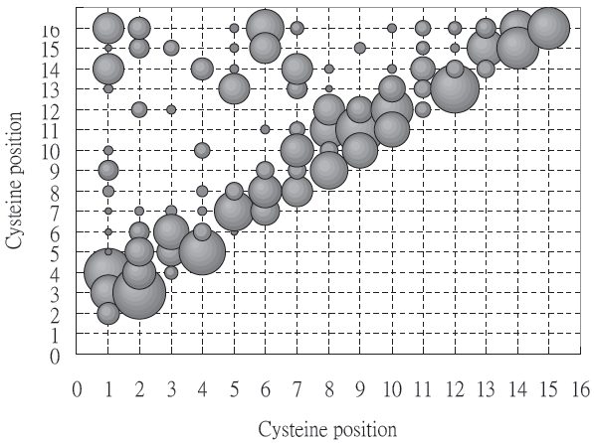
CYS090506

Slide 15
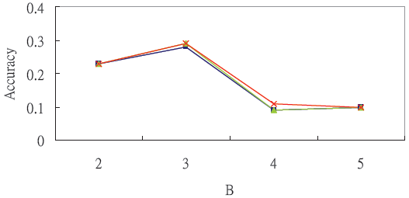
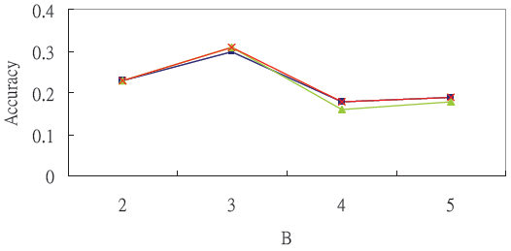

The performance of three methods
SP39-ID30, the disulfide bond number in searching dataset is the same with query protein.
Square (■) represents disulfide pair method, triangle (▲) represents disulfide pattern method, and cross (×) represents hybrid method.
$Q_{p} Q_{c}$

Slide 16
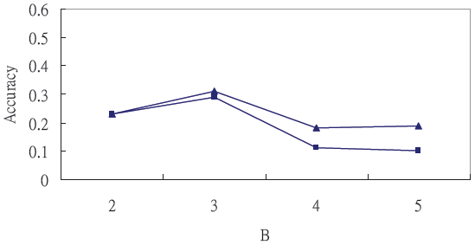
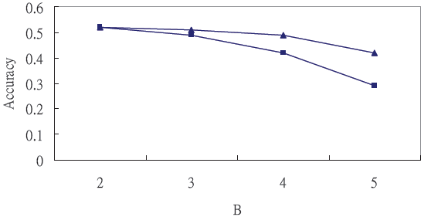
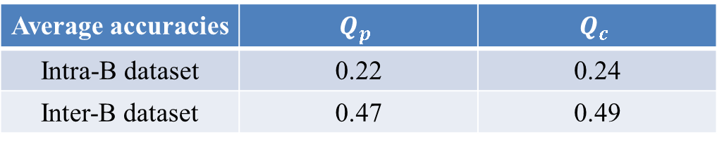

The disulfide number in searching dataset
Intra-B dataset and inter-B dataset.
Implying the existence of sub patterns in disulfide connectivity.
SP39-ID30. $Q_{p}$ (■) and $Q_{c}$ (▲).
Intra-B dataset Inter-B dataset
Average accuracies | $$Q_{p}$$ | $$Q_{c}$$
Intra-B dataset | 0.22 | 0.24
Inter-B dataset | 0.47 | 0.49

Slide 17
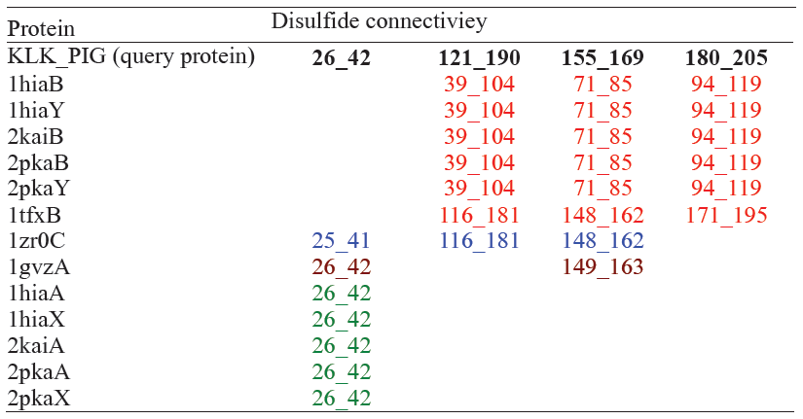
Sub patterns of KLK_PIG

Slide 18
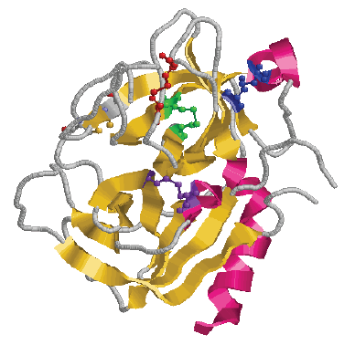
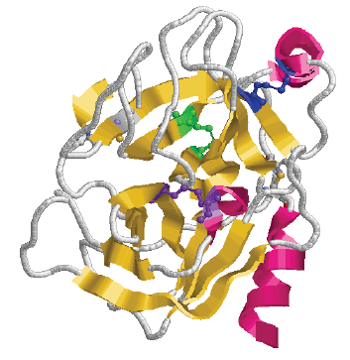
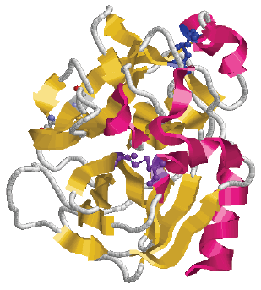
KLK_PIG 26_42 121_190 155_169 180_205
2kaiA:26_42 2kaiB:39_104 71_85 94_119
1zr0C:7_137 25_41 109_207 116_181 148_162
1gvzA:7_138 26_42 149_163

Slide 19
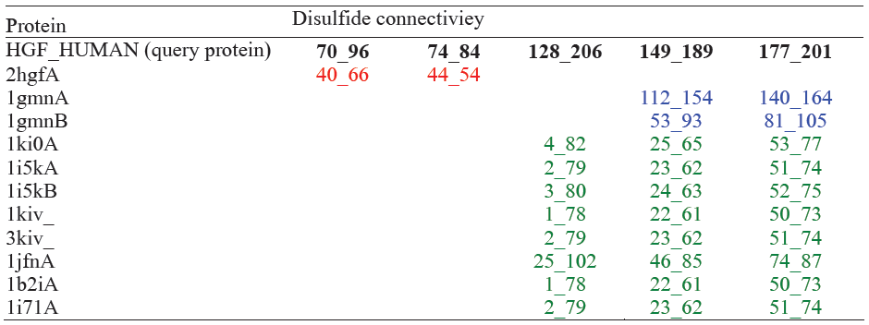
Sub patterns of HGF_HUMAN

Slide 20
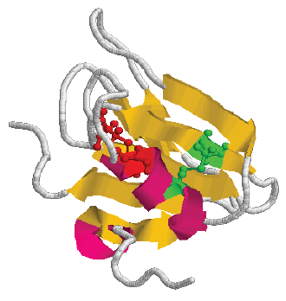
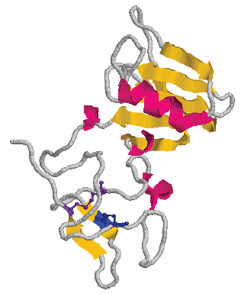
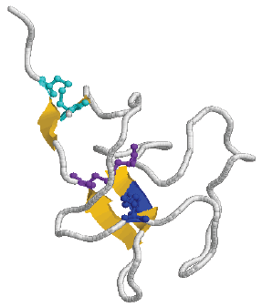
HGF_HUMAN 70_96 74_84 128_206 149_189 177_201
2hgfA:40_66 44_54
1gmnA:112_152 140_164
1i71A:2_79 23_62 51_74

Slide 21
Discussion of sub patterns
Although the number of disulfide bonds and the locations of these disulfide bonds within these four protein chains are different, their protein structures are similar.
It also implies that disulfide connectivity might be modified during evolution to maintain the protein structure to keep protein function.
Sub patterns of specific disulfide connectivity might carry their own structure, be modified during evolution.

Slide 22
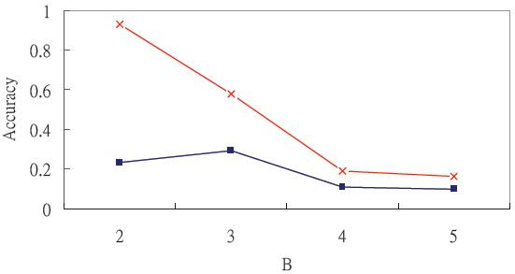
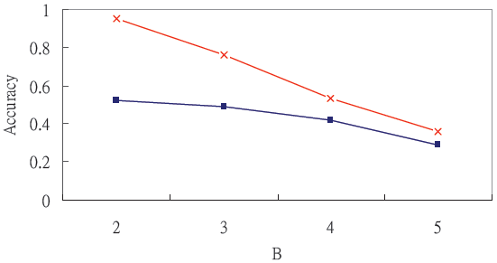

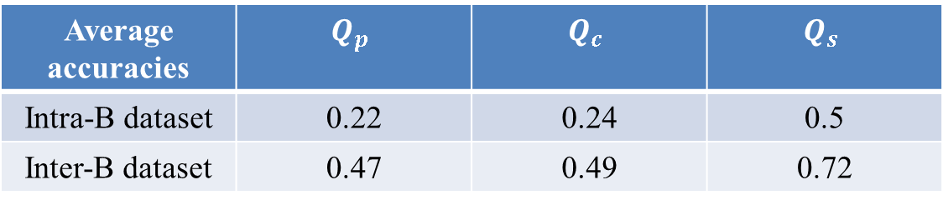
SP39-ID30. Protein-based assessment index $Q_{p}$ (■), and the accuracy $Q_{s}$ (×)
Intra-B dataset Inter-B dataset
Average accuracies | $$Q_{p}$$ | $$Q_{c}$$ | $$Q_{s}$$
Intra-B dataset | 0.22 | 0.24 | 0.5
Inter-B dataset | 0.47 | 0.49 | 0.72

Slide 23
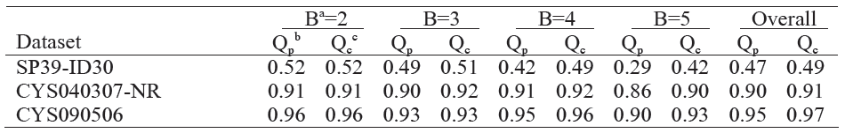
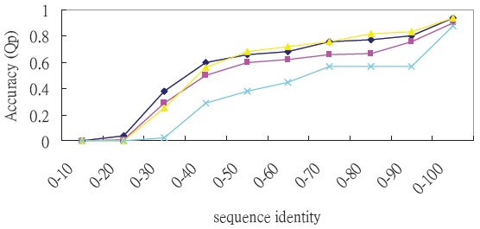
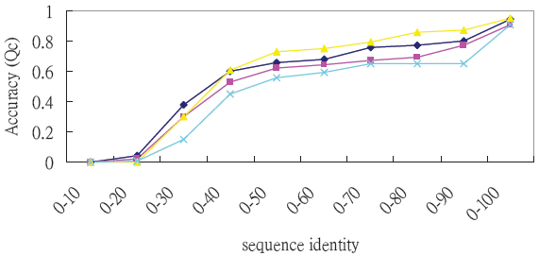
Performance of PSI-BLAST method
The performance of PSI-BLAST method on different dataset.
CYS090506, B=2 (◆), B=3 (■), B=4 (▲), B=5 (×).

Slide 24
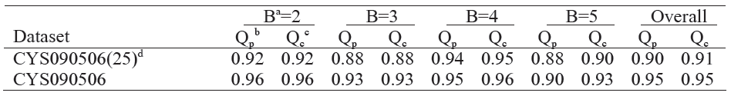
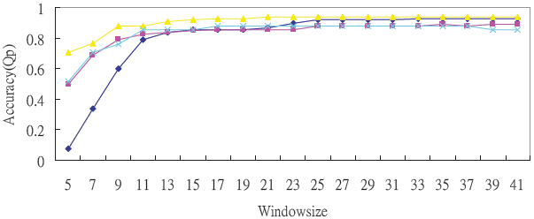
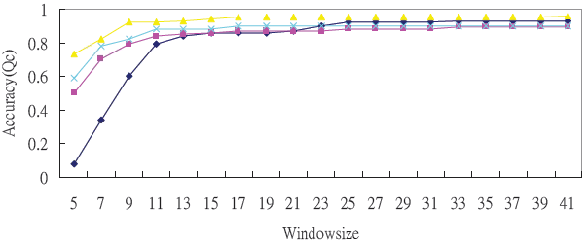
The performance of PSI-BLAST method according to different window size.
CYS090506(w), B=2 (◆), B=3 (■), B=4 (▲), B=5 (×).

Slide 25
Residues nearby disulfide cysteines contain sufficient information and play an important role in disulfide bonds forming.
Other residues carry less related information.
Therefore, the formation of disulfide connectivity is mostly determined on the local residues around disulfide cysteines, the suitable windowsize is 25.

Slide 26
Conclusion
The accuracy of PSI-BLAST method using inter- B searching dataset is better than using intra- B searching dataset; it reveals that there might exist sub patterns of specific disulfide connectivity.
Local resides and non-local residues possess different information, and these information are complementary.
Notes:
Inspiration: local residues and non-local residues may use different score matrices in sequence alignment method.

Slide 27
Outline
Prediction of disulfide connectivity using blast method
Prediction of disulfide connectivity from protein sequences
S-S Predictor: a disulfide prediction server

Slide 28
Prediction of disulfide connectivity from protein sequences
Support vector machine (SVM)
Data sets: SP39-ID30
Feature vectors
The cysteine-cysteine coupling (S)
Cysteine-spacing patterns (D)
Amino acid content (A)

Slide 29




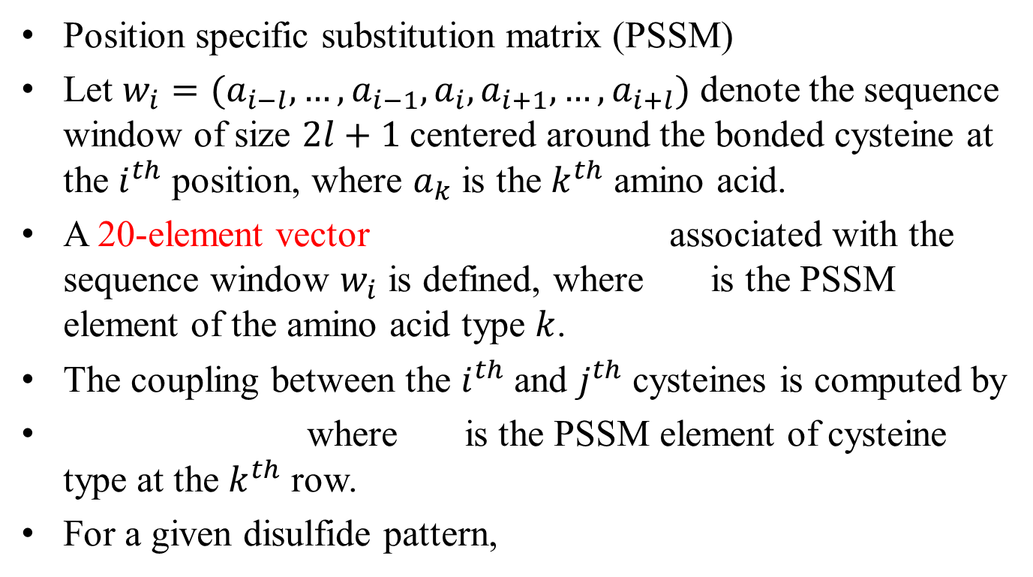
The cysteine-cysteine coupling (S)
Position specific substitution matrix (PSSM)
Let $w_{i}=(a_{i−l},…,a_{i−1},a_{i},a_{i+1},…,a_{i+l})$ denote the sequence window of size $2l+1$ centered around the bonded cysteine at the $i^{th}$ position, where $a_{k}$ is the $k^{th}$ amino acid.
A 20-element vector associated with the sequence window $w_{i}$ is defined, where is the PSSM element of the amino acid type $k$.
The coupling between the $i^{th}$ and $j^{th}$ cysteines is computed by
where is the PSSM element of cysteine type at the $k^{th}$ row.
For a given disulfide pattern,

Slide 30

Cysteine-spacing patterns (D)
For a given disulfide pattern $(c_{i}c_{j},c_{i′}c_{j′},…)$, there is an associated cysteine spacing pattern given by $(d_{ji}{, d}_{j^{′}i′},…)$, where $d_{ji}$ is the sequence spacing $c_{i}$ and $c_{j}$.
$C_{1}=(c_{1}c_{2}, c_{3}c_{4})$, $D_{1}=(d_{12}, d_{34})$

Slide 31
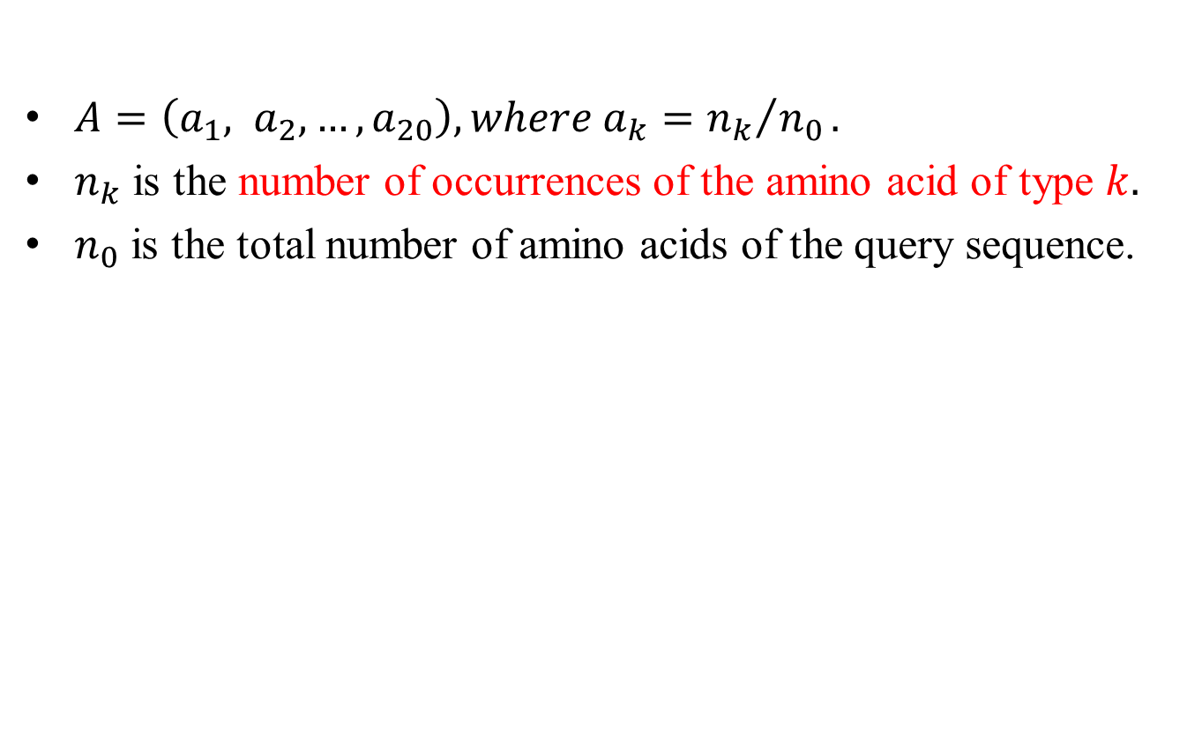
Amino acid content (A)
$A=\left(a_{1}, a_{2}, …,a_{20}\right), where a_{k}={n_{k}}/{n_{0}}.$
$n_{k}$ is the number of occurrences of the amino acid of type $k.$
$n_{0}$ is the total number of amino acids of the query sequence.

Slide 32
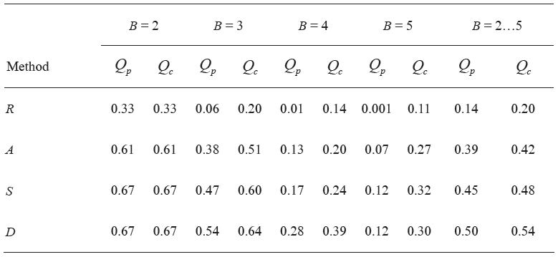
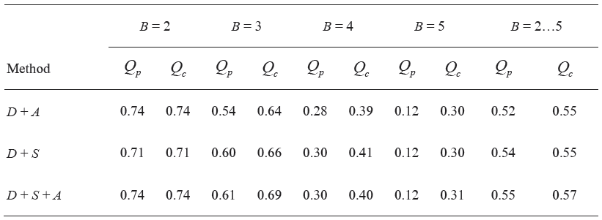

Slide 33
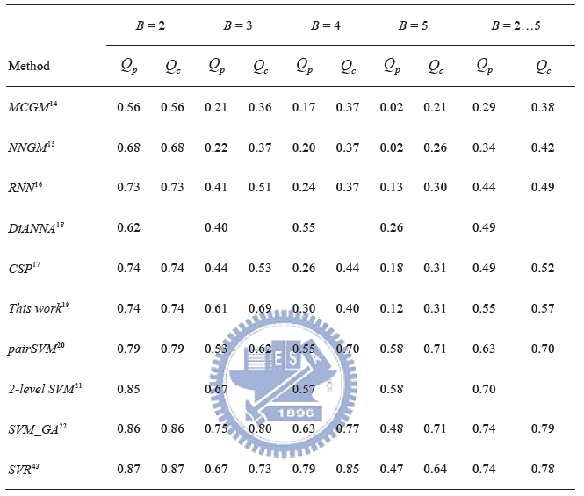

Slide 34
Outline
Prediction of disulfide connectivity using blast method
Prediction of disulfide connectivity from protein sequences
S-S Predictor: a disulfide prediction server

Slide 35
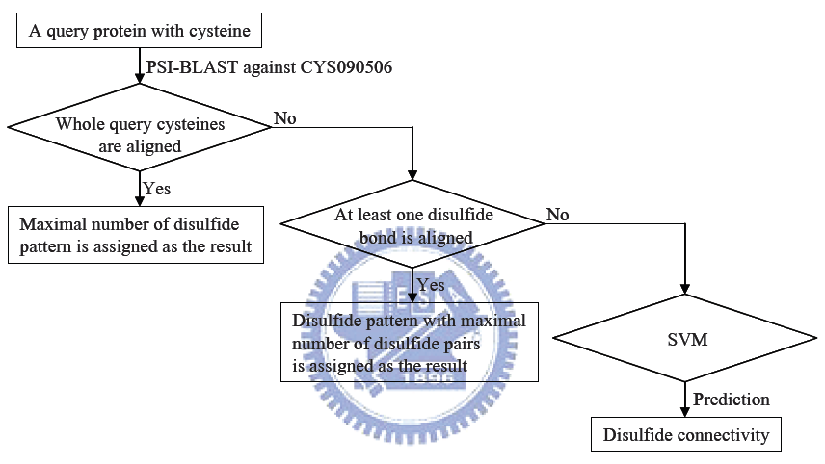
The flowchart of S-S Predictor

Slide 36
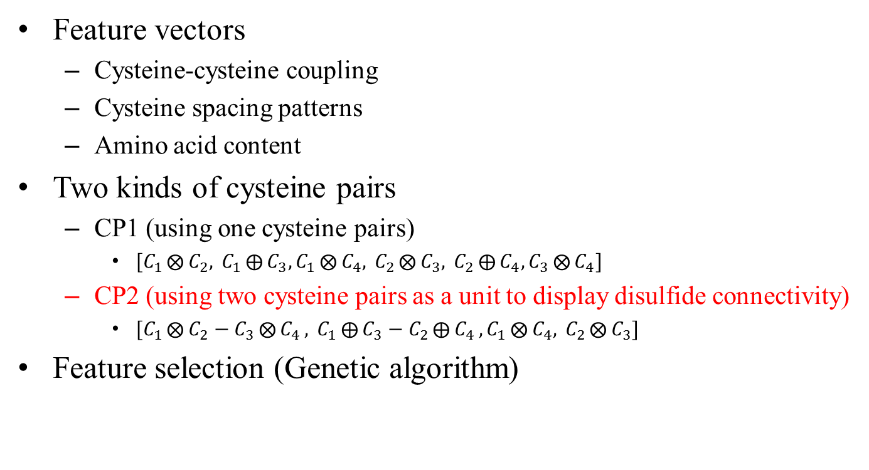
SVM_GA
Feature vectors
Cysteine-cysteine coupling
Cysteine spacing patterns
Amino acid content
Two kinds of cysteine pairs
CP1 (using one cysteine pairs)
$[C_{1}⨂{C_{2}, }C_{1}⨁{C_{3},}C_{1}⨂{C_{4}, }C_{2}⨂{C_{3}, }C_{2}⨁{C_{4},}C_{3}⨂{C_{4}}]$
CP2 (using two cysteine pairs as a unit to display disulfide connectivity)
$[C_{1}⨂{C_{2}−C_{3}⨂{C_{4}}, }C_{1}⨁{C_{3}−C_{2}⨁{C_{4}},}C_{1}⨂{C_{4}, }C_{2}⨂{C_{3}}]$
Feature selection (Genetic algorithm)

Slide 37
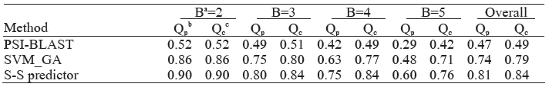

Slide 38
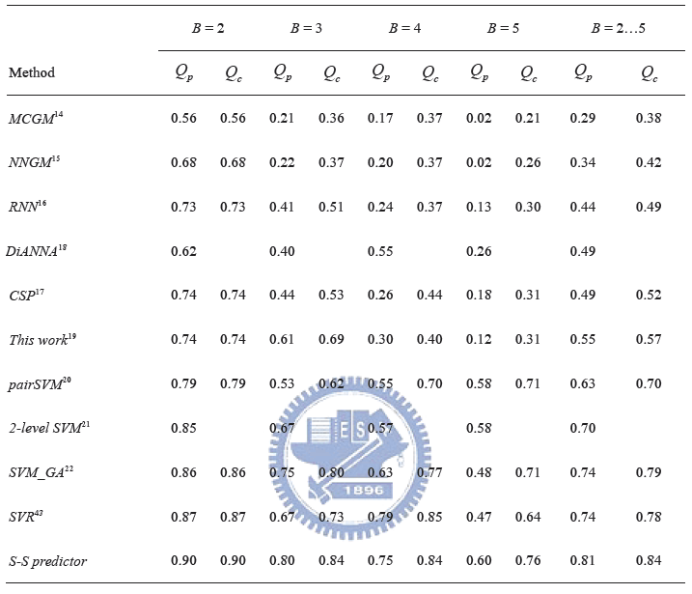

Slide 39


S-S Predictor

Slide 40


