Slide 1

Journal of computer and system sciences volume 70 p128-p144
Michael H. Goldwasser, Ming- Yang Kao, Hseuh- I Lu
Presenter: Bamfa Ceesay
February 13th 2012

Slide 2

One of the fundamental problems involving DNA sequences is to ﬁnd high density segments of certain widths, for example, those regions with intensive guanine and cytosine (GC). Formally, given a sequence, each element of which has a value and a width, the maximum-density segment problem asks for the segment with the maximum density while satisfying minimum and possibly maximum width constraints. While several linear-time sequential algorithms have emerged recently due to its primitive-like utility, to our knowledge, no nontrivial parallel algorithm has yet been proposed for this topical problem. A study of an abstract optimization problem arising from biomolecular sequence analysis was carried out. For a sequence A of pairs (a_{i} , w_{i}) for i from 1 to n and w_{i} > 0; a segment A(i, j) is a consecutive subsequence of A starting with index i and ending with index j. The width of A(i , j) is w(i, j) =∑_{i≤k≤j}w_{k}, and the density is μ=((∑_{i≤k≤j} a_{k}))/w(i,j).

Slide 3

The maximum –density problem takes sequence A, value L (lower bound) and value U (upper bound) as input and output a segment of A that have the largest possible density among all the other segments with a width at least L and at most U. In this paper, we study the above abstraction of the problem. This generalizes a previously studied model, which we term the uniform model, in which w_{i} =1 for all i values .
In its most basic form, the sequence A corresponds to the given DNA sequence where a_{i}= 1 if the corresponding nucleotide in the DNA sequence is G or C; and a_{i} =0 otherwise. In the previous work, sequence entries took on values of p and 1-p for some real number value 0 ≤ p ≤ 1.

Slide 4
Further natural application of this problem can be designed for sophisticated sequence analysis such as mismatch density, ungapped local alignment and annotated multiple sequence alignments

Slide 5

A sequence of n objects, A, where A can be express as:
A₁A₂A₃……A_{m.}
A₁ ={(a₁, w₁), (a₂, w₂),…,(a_{n}, w_{n}) }
A(i , j), a consecutive subsequence of (a_{i}, w_{i}), (a_{i+1}, w_{i+1}), …, (a_{j}, w_{j}).
  A(i , j) ={(a_{i}, w_{i}), (a_{i+1}, w_{i+1}),…,(a_{j}, w_{j}) }
w(i, j)=∑_{i≤k≤j} w_{k}
Density μ(i,j) =(∑_{i≤k≤j} a_{k})/w(i, j).

Slide 6
Given an index i and L_{i} the minimum index such that w(i,L_{i})≥L, U_{i} the maximum index such that w(i, U_{i})≤U. The consequence result of the following assumption are:
  For indices i < j, U_{i} ≤ U_{j}, and if both L_{i} and L_{j} are define then L_{i} ≤ L_{j}.

Slide 7

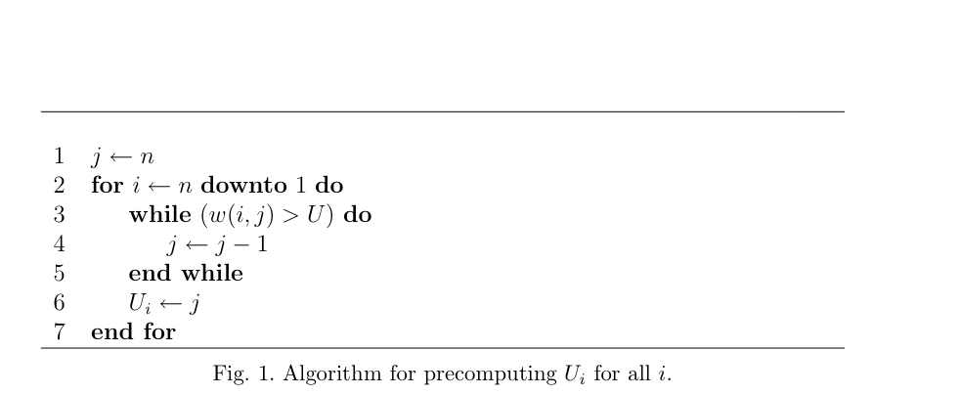

Slide 8
For indices i < j, U_{i} ≤ U_{j}, and if both L_{i} and L_{j} are define then L_{i} ≤ L_{j}.
i | 1 | 2 | 3 | 4 | 5 | 6 | 7 | 8
W_{i} | 6 | 2 | 7 | 4 | 10 | 8 | 2 | 6
L_{i} | 3 | 4 | 4 | 5 | 5 | 7 | - | -
U_{i} | 4 | 4 | 5 | 6 | 7 | 8 | 8 | 8
L=10, U =23

Slide 9

Segment A(i, K) is a right skew segment if and only if μ(i ,j)≤ μ(j+1, k) for all i≤j<k.
a_{i} | 1 | 4 | 2 | 5 | 3
J | μ(1, j) | μ(j+1, 5)
1 | 1 | 3.5
2 | 2.5 | 3.33
3 | 2.33 | 4
4 | 3 | 3
Index i =1 and k=5.
w_{i} =1 for i = 1 to 5

Slide 10
.
i | 1 | 2 | 3 | 4 | 5 | 6 | 7 | 8
a_{i} | 9 | 6 | 14 | 20 | 5 | 20 | 2 | 27
W_{i} | 6 | 2 | 7 | 10 | 10 | 8 | 2 | 6
j | μ (1, j) | μ (j+1,k)
1 | 1.5 | 2.089
2 | 1.875 | 2.046
3 | 1.933 | 2.056
4 | 1.96 | 2.077
5 | 1.543 | 3.375
6 | 1.721 | 3.625
7 | 1.689 | 4.50
L=10, U =23
For index i=1 and k=8

Slide 11
For index i=2, k=5.
Consecutive segments are not always a right skew.
a_{i} | 1 | 4 | 2 | 5 | 3
J | μ(2, j) | μ(j+1, 5)
1
2 | 4 | 3.33
3 | 3 | 4
4 | 3.67 | 3

Slide 12

A partition of a sequence A into segment A₁A₂…..A_{m} is a decreasing right skew partition if it is the case that each Ai is a right skew, and that μ(A_{x})>μ(A_{y}) for any x<y.

Slide 13

The DRSP can be built and maintained in a folds. The following diagram depicts how the DRSP for the list of areas [1,4,2,5,3] can be built by adding elements from the left one by one (which eventually results in one big partition).

Slide 14

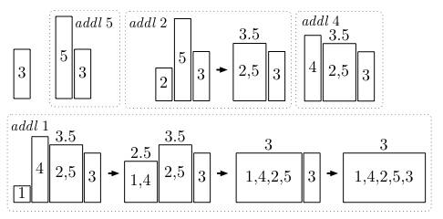
W_{i}=1, for i=1 to n

Slide 15

For a given j, assume A(j,j’) is a maximum density segment of those starting with with index j, having L≤w(j,j’)≤U, and ending with index in a given range [x,y]. For a given i<j, assume A(i,i’) is a maximum density segment of those starting with index i, having L ≤w(i,i’)≤U and ending in range [x,y]. If i’>j’, then μ(j,j’)≥μ(i,i’).
i | 1 | 2 | 3 | 4 | 5 | 6 | 7 | 8 | 9 | 10 | 11 | 12 | 13 | 14
a_{i} | 1 | 4 | 1 | 5 | 4 | 5 | 4 | 3 | 4 | 1 | 4 | 2 | 5 | 3

Slide 16
i
j
j’
i’
i | 1 | 2 | 3 | 4 | 5 | 6 | 7 | 8 | 9 | 10 | 11 | 12 | 13 | 14
a _{i} | 1 | 4 | 1 | 5 | 4 | 5 | 4 | 3 | 4 | 1 | 4 | 2 | 5 | 3
i | j | j’ | i’ | μ (j,j’) | μ (i,i’)
1 | 4 | 6 | 8 | 4.67 | 3.375
2 | 6 | 8 | 10 | 4 | 3.44
3 | 8 | 10 | 12 | 3.30 | 2.67
4 | 11 | 13 | 14 | 3.67 | 3.64

Slide 17

Finding a segment with maximum possible density among those of width at least L but not subjected to any explicit upper bound.

Slide 18
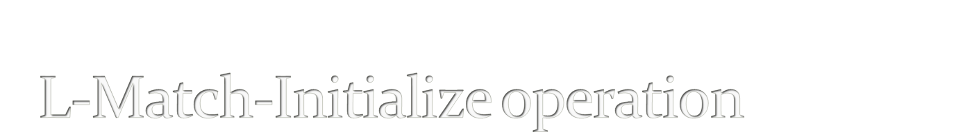
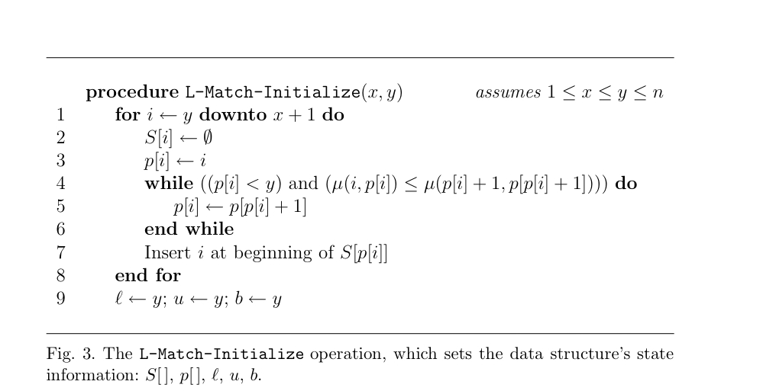

Slide 19
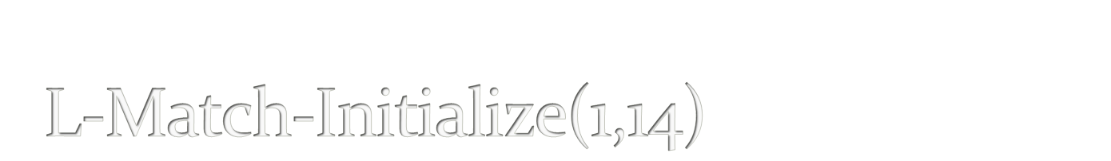
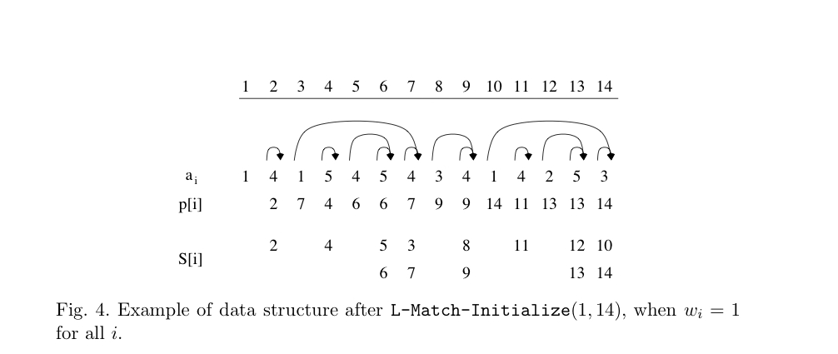

Slide 20

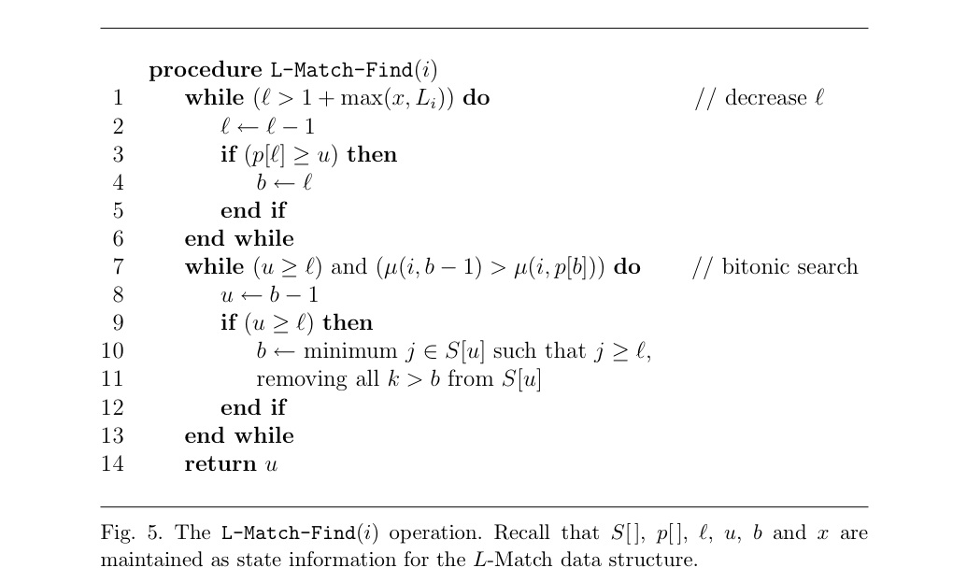

Slide 21

The U-Match is used to locate segments beginning with i, ending in [x,y] and subject to an upper bound on the resulting segment width, but with no explicit lower bound.

Slide 22

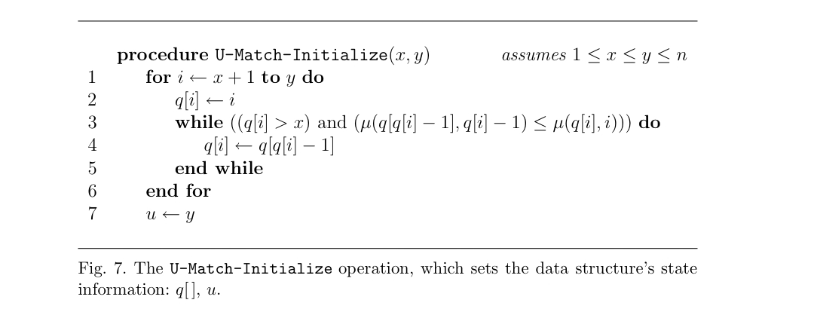

Slide 23
In U-Match, we choose to represent the decreasing right skew partitions for all prefixes of A(x+1,y), rather than all the suffixes as with the L-Match structure.

Slide 24

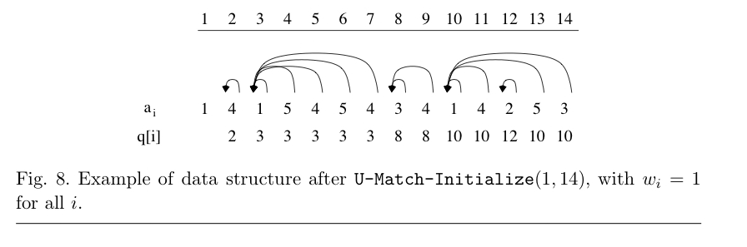

Slide 25

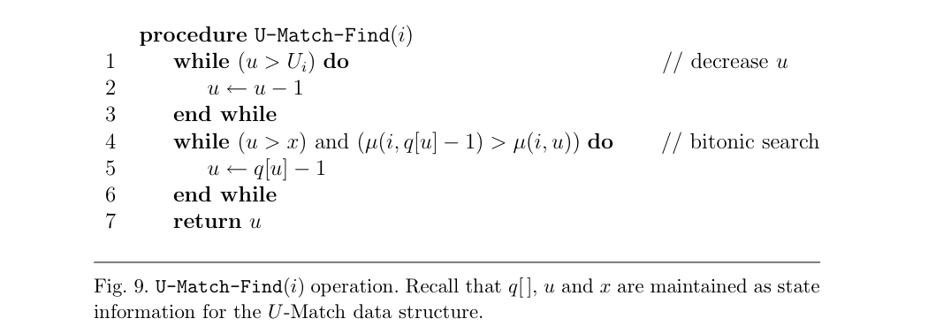

Slide 26








u_{k}
u₁
u₂
u₃
u₄
u₅
u₆
ι₁
ι₂
ι₃
ι₄
ι₅
ι₆
U_{k} is not included in the partition due to the atomicity:
Let B, C and the D be sequences with μ(B)≤ μ (C) ≤ μ (D). Then μ(BC) ≤ μ(BCD)

Slide 27

For a maximum segment subjected to both lower bound L and upper bound U (L<U), can partition the segments into disjoint block maintaining the L-Match and U-Match data structures.
Given i₀ as maximum index such that L_{i0} defined, we partition the range [L₁, U_{i0} ] into a collection of disjoint blocks.

Slide 28
Initialization:
  [x₁,y₁] =[L₁, U₁]
  While y_{c-1} ≠ U_{i0}
    Then add the block [x_{c}, y_{c}] to the collection of blocks; where x_{c}=y_{c-1} +1 and y_{c}= U_{i.}
  i is the minimum index such that L_{i}≥x_{c.}

Slide 29
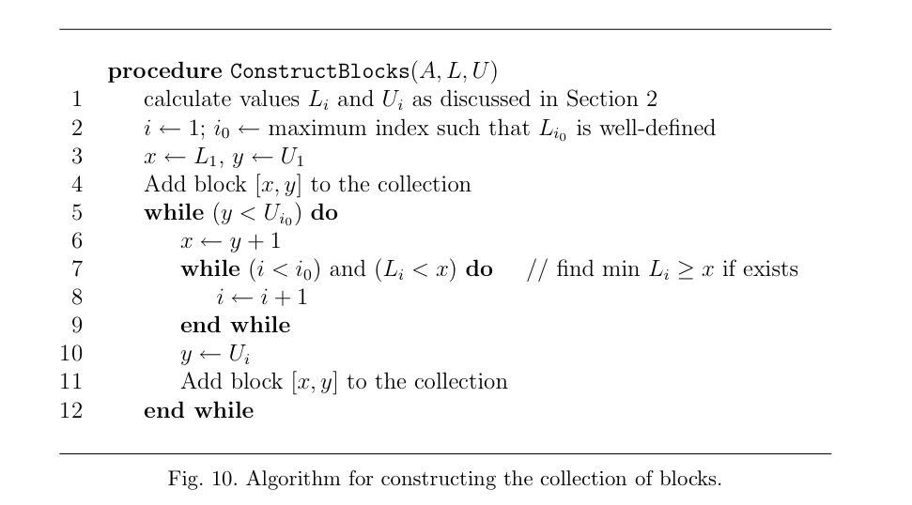

Slide 30
L_{i0} =7, U_{i0} =8, i₀ =6
i | 1 | 2 | 3 | 4 | 5 | 6 | 7 | 8
a_{i} | 9 | 6 | 14 | 20 | 5 | 20 | 2 | 27
L_{i} | 3 | 4 | 4 | 5 | 5 | 7 | - | -
U_{i} | 4 | 4 | 5 | 6 | 7 | 8 | 8 | 8
L=10, U =23

Slide 31
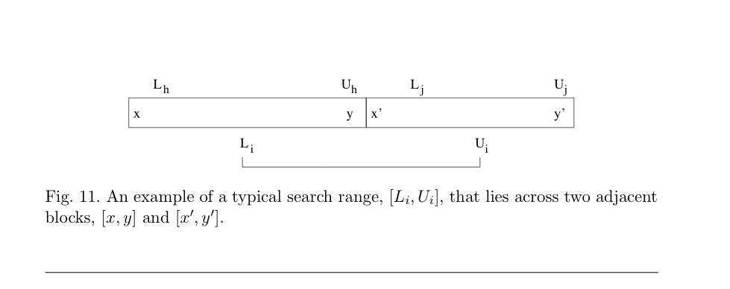
For a given range, [L_{i}, U_{i}], let [x,y] be the block containing L_{i}. Then it is either the case that U_{i}=y or that U_{i} is contained in the adjacent block, [x’,y’].

Slide 32

i | 1 | 2 | 3 | 4 | 5 | 6 | 7 | 8 | 9 | 10 | 11 | 12 | 13 | 14
a_{i} | 1 | 4 | 1 | 5 | 4 | 5 | 4 | 3 | 4 | 1 | 4 | 2 | 5 | 3
L_{i} | 4 | 4 | 5 | 6 | 7 | 8 | 9 | 11 | 12 | 13 | 13 | - | - | -
U _{i} | 7 | 8 | 9 | 10 | 11 | 12 | 13 | 14 | 14 | 14 | 14 | 14 | 14 | 14
x
y
x’
y’
1
4
1
5
4
5
4
3
4
1
4
2
5
3
L₇
U₇

Slide 33
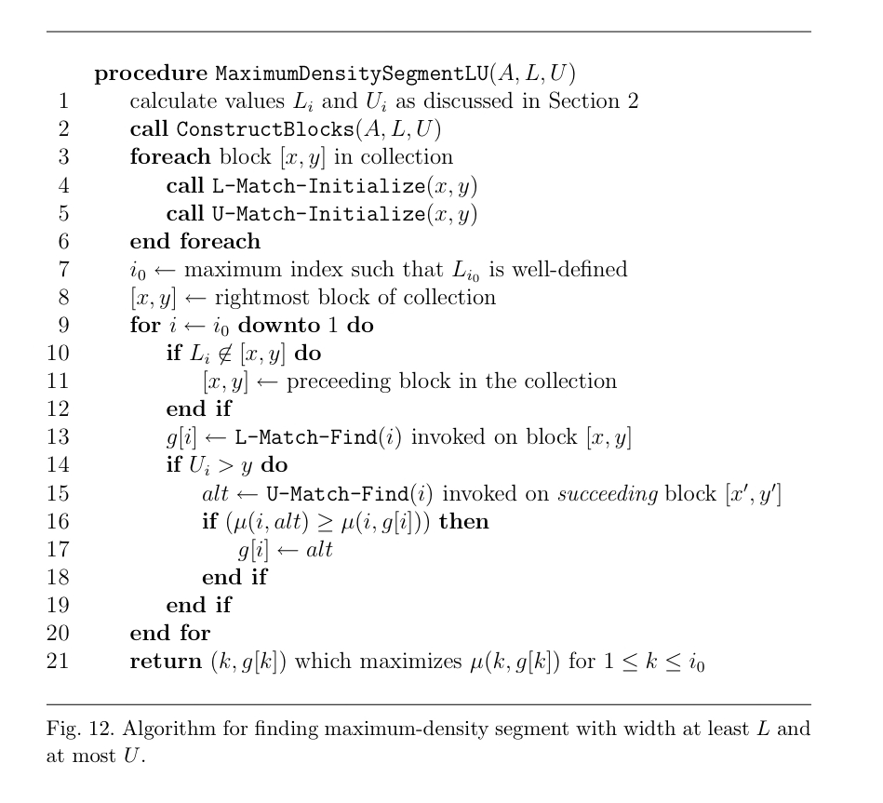

Slide 34

THANK YOU!

