Slide 1
Improving the prediction of protein binding sites by combining heterogeneous data and Voronoi diagrams
Joan Segura, Pamela F Jones and Narcis Fernandez-Fuentes
BMC Bioinformatics 2011
Presenter: Cheng-Han Lee
February 13, 2012

Slide 2
Abstract
Background: Protein binding site prediction by computational means can yield valuable information that complements and guides experimental approaches to determine the structure of protein complexes. Predictions become even more relevant and timely given the current resolution of protein interaction maps, where there is a very large and still expanding gap between the available information on: (i) which proteins interact and (ii) how proteins interact. Proteins interact through exposed residues that present differential physicochemical properties, and these can be exploited to identify protein interfaces.

Slide 3
Abstract
Results: Here we present VORFFIP, a novel method for protein binding site prediction. The method makes use of broad set of heterogeneous data and defined of residue environment, by means of Voronoi Diagrams that are integrated by a two-steps Random Forest ensemble classifier. Four sets of residue features (structural, energy terms, sequence conservation, and crystallographic B-factors) used in different combinations together with three definitions of residue environment (Voronoi Diagrams, sequence sliding window, and Euclidian distance) have been analyzed in order to maximize the performance of the method.

Slide 4
Abstract
Conclusions: The integration of different forms information improves the performance of binding site prediction. Including the information of neighbouring residues also improves the prediction of protein interfaces. Among the different approaches that can be used to define the environment of exposed residues, Voronoi Diagrams provide the most accurate description. Finally, VORFFIP compares favourably to other methods reported in the recent literature.

Slide 5
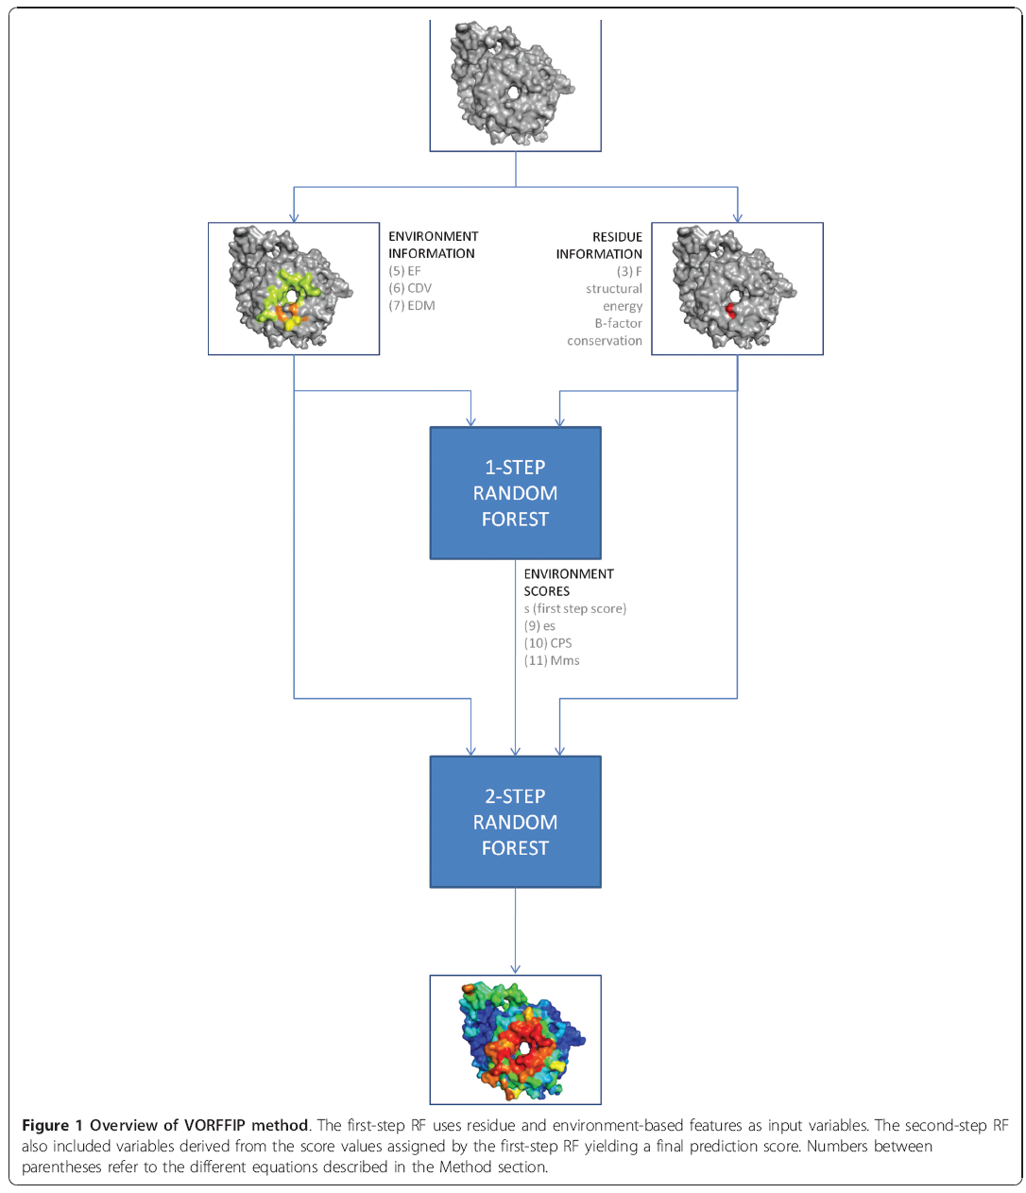

Slide 6
VORFFIP
First-step Random Forest
  Input:
  Residue-based features
    structure-based、energy-based、evolutionary-based、experimental B-factors
  Environment-based features
    EF、CDV、EDM
Second-step Random Forest
  Input result from first-step RF
    s、es、csv
Notes:
evolutionary-based: residue conservation 受保護的區域，可能是對生物而言較重要的部份; B factor 是蛋白質結構 (尤指 X-ray 晶體繞射) 重要的參數。晶體中每個原子都擁有一個 b factor，代表其電子雲的擴散程度 (attenuation)。擴散程度愈高表示該原子在晶體中的位置愈不固定，或是該原子震動 (mobility) 的程度愈高。換句話說，b factor 高代表晶體中結構不穩定的部分。

Slide 7
Structure-based
Structure-based features include the residue type, secondary structures as defined by DSSP(Kabsch and Sander, 1983) and a set of structural attributes as defined by PSAIA(Mihel, et al., 2008) that includes:
  Hydrophobicity
  ASA (accessible surface area)
  Relative ASA
  Backbone ASA
  Relative backbone ASA
  Side chain ASA
  Relative side chain ASA
  Non-polar ASA
  Relative non-polar ASA
  Polar ASA
  Relative polar ASA
  DPX (depth index)
  Maximal DPX
  CX (protrusion index)
  Minimal CX
  Maximal CX

Slide 8
Energy-based
FoldX(Guerois, et al., 2002) was used to compute the different residue-based energy terms that include:
  Polar solvent exposure energy
  Hydrophobic solvent exposure energy
  Van der Waals energy
  Side chain entropy
  Backbone entropy
  Side chain occupancy
  Backbone occupancy
  Side chain hydrogen bond energy
  Backbone hydrogen bond energy
  Electrostatic energy

Slide 9
Evolutionary-based & B-factors
Evolutionary-based
  residue conservation 可能是對生物而言較重要的部份，有具有較高的機率為binding site
B-factor
  晶體中每個原子都擁有一個 B-factor，代表其電子雲的擴散程度 (attenuation)。B-factor 高代表晶體中結構不穩定的部分。

Slide 10
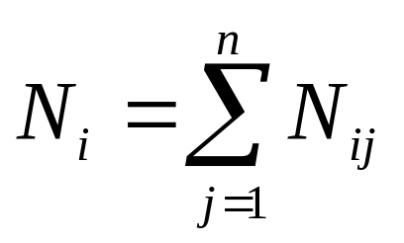
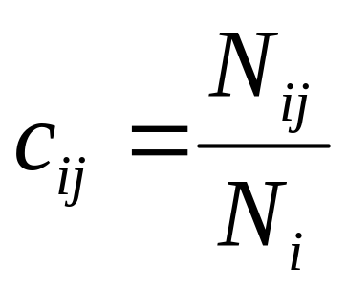
Environment-based features
Let N_{ij} be number shared edges or contact pairs between residue a_{i} and a_{j}
The strength of the contact c_{ij} between the amino acids a_{i} and a_{j} is defined as:

Slide 11
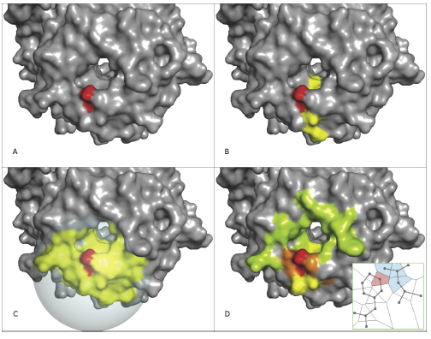
Defining the environment of exposed
Notes:
orange:residues sharing more than 16 edges with residue of interest;
yellow: between 8 to 16;
green: less than 8.

Slide 12
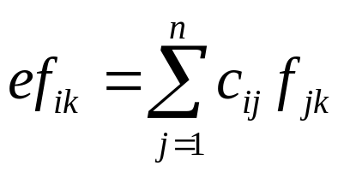
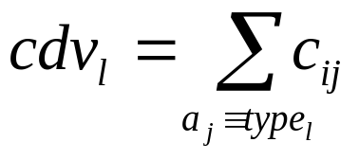
EF、CDV、EDM
EF(f為factors，k為index of factors)
CDV(l為胺基酸的類別)
EDM is a 20 by 20 matrix where the component edm_{lk} represents the normalised number of contacts between residues of type type_{l} and type_{k} resulting from any pair of residues in the environment.

Slide 13
Defining the environment of exposed
The underlying principle is to consider neighbouring residues as those that are visible to the given residue, i.e. share a common edge in the VD.
VDs were calculated using the qvoroni application of the Qhull package

Slide 14
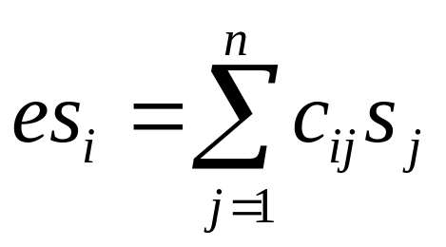
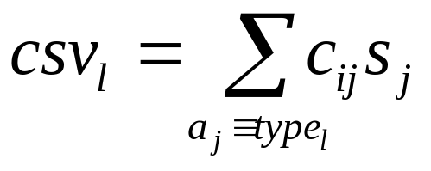
s、es、csv
s_{j} is the score assigned by the first-step RF to the neighbouring residue a_{j}.

Slide 15
Improving predictive power by combining heterogeneous data and using Voronoi Diagrams
A total of 60 combinations of features (structure, energy, conservation and crystallographic B-factors) and environment definitions (VDs, sliding window as in Sikic et al., Euclidian distances as in Porollo and Meller and no-environment) were explored.
Useing B100 dataset derived from benchmark 3.0
5-fold cross validation

Slide 16
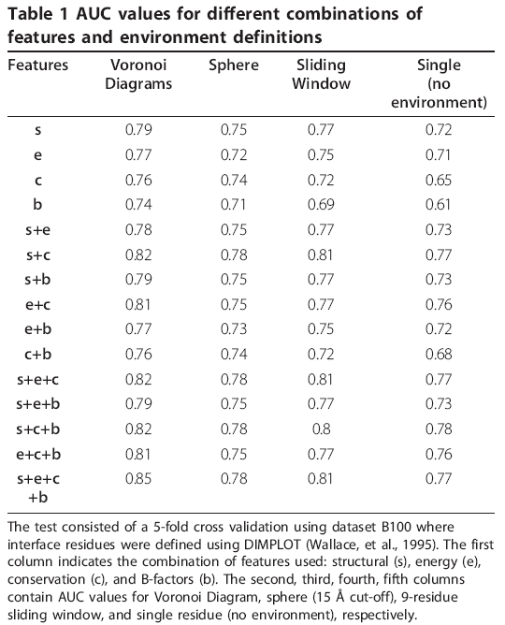

Slide 17
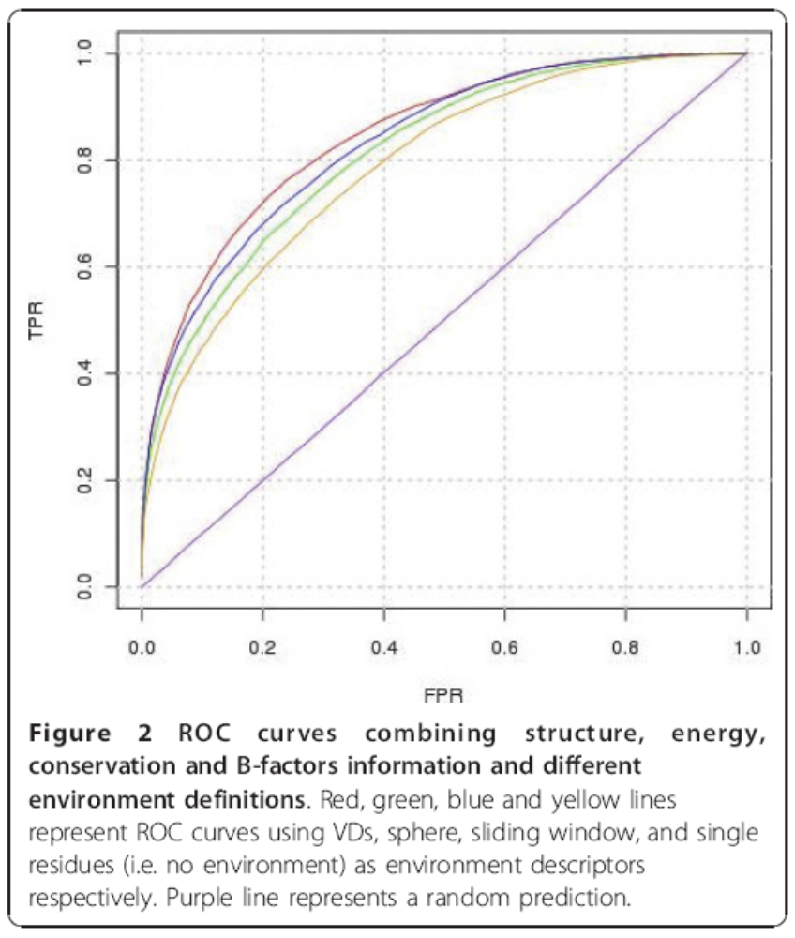

Slide 18
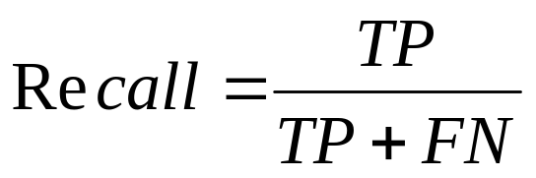
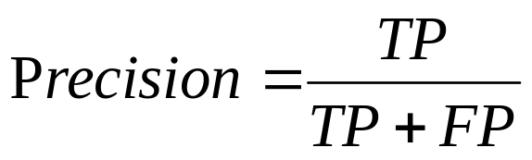
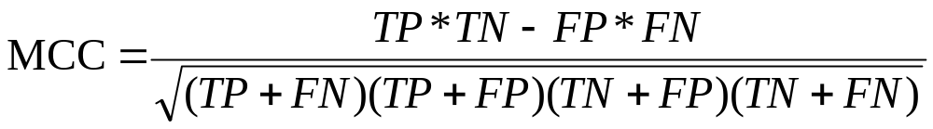
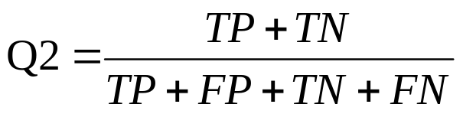
Comparing VORFFIP with previous studies

Slide 19
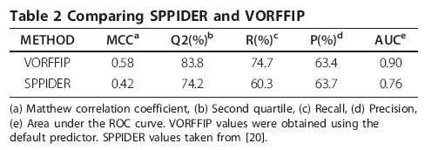
Comparing VORFFIP with previous studies

Slide 20
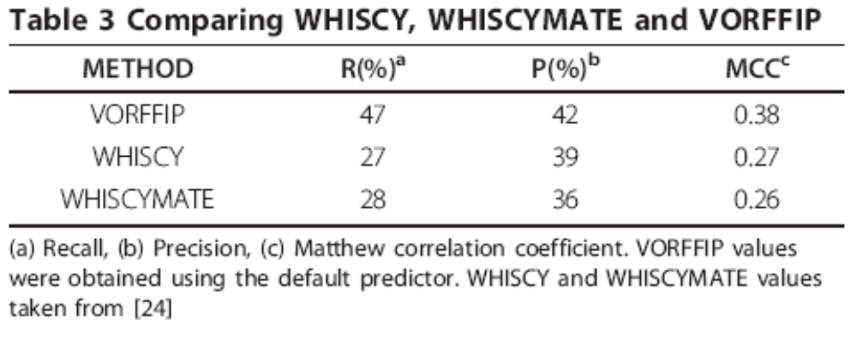
Comparing VORFFIP with previous studies

Slide 21
THE END

