Slide 1
Estimating misclassification error with small samples via bootstrap cross-validation
Wenjiang J. Fu, Raymond J. Carroll and Suojin Wang
BIOINFORMATICS
Vol. 21, no. 9, 2005, pp. 1979–1986

Slide 2
Abstract
Results: A bootstrap cross-validation method is studied. It achieves accurate error estimation through a simple procedure with bootstrap re-sampling and only costs computer CPU time. Simulation studies and applications to microarray data demonstrate that it performs consistently better than its competitors. This method possesses several attractive properties: (1) it is implemented through a simple procedure; (2) it performs well for small samples with sample size, as small as 16; (3) it is not restricted to any particular classification rules and thus applies to many parametric or non-parametric methods.

Slide 3
Abstract
Motivation: Estimation of misclassification error has received increasing attention in clinical diagnosis and bioinformatics studies, especially in small sample studies with microarray data. Current error estimation methods are not satisfactory because they either have large variability (such as leave-one-out cross-validation) or large bias (such as resubstitution and leave-one-out bootstrap). While small sample size remains one of the key features of costly clinical investigations or of microarray studies that have limited resources in funding, time and tissue materials, accurate and easy-to-implement error estimation methods for small samples are desirable and will be beneficial.

Slide 4
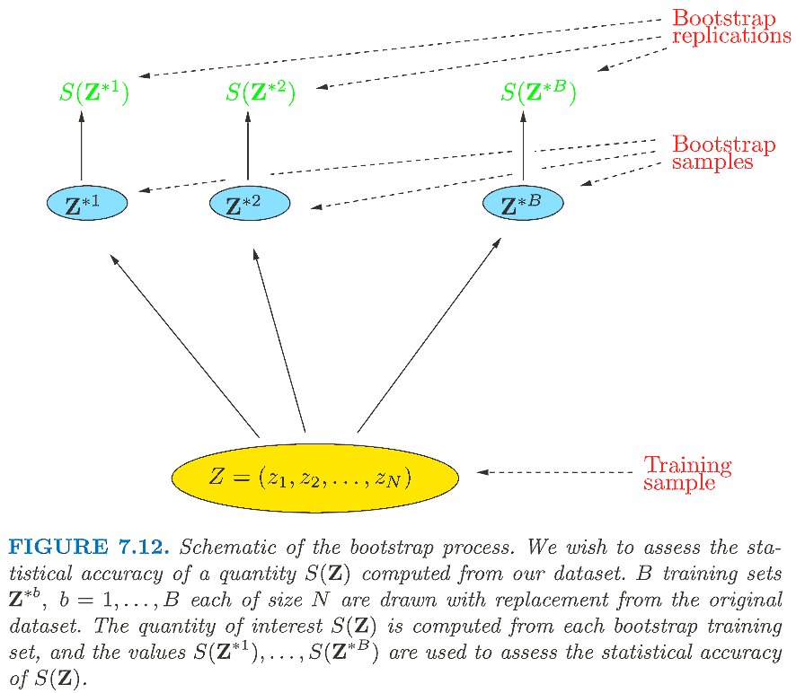
Bootstrap methods
Trevor Hastie et al., “The elements of statistical learning"

Slide 5
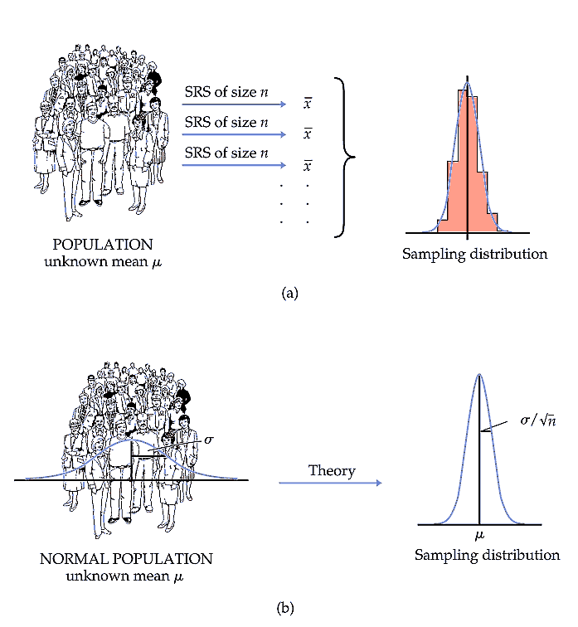
Moore et al., “The practice of business statistics"

Slide 6
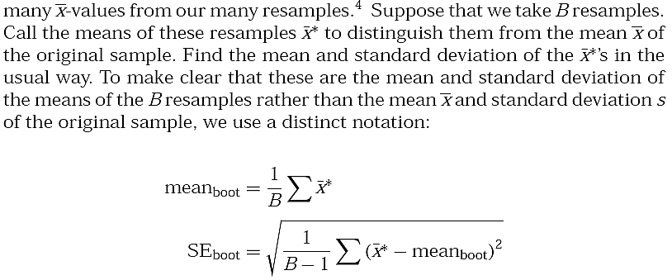
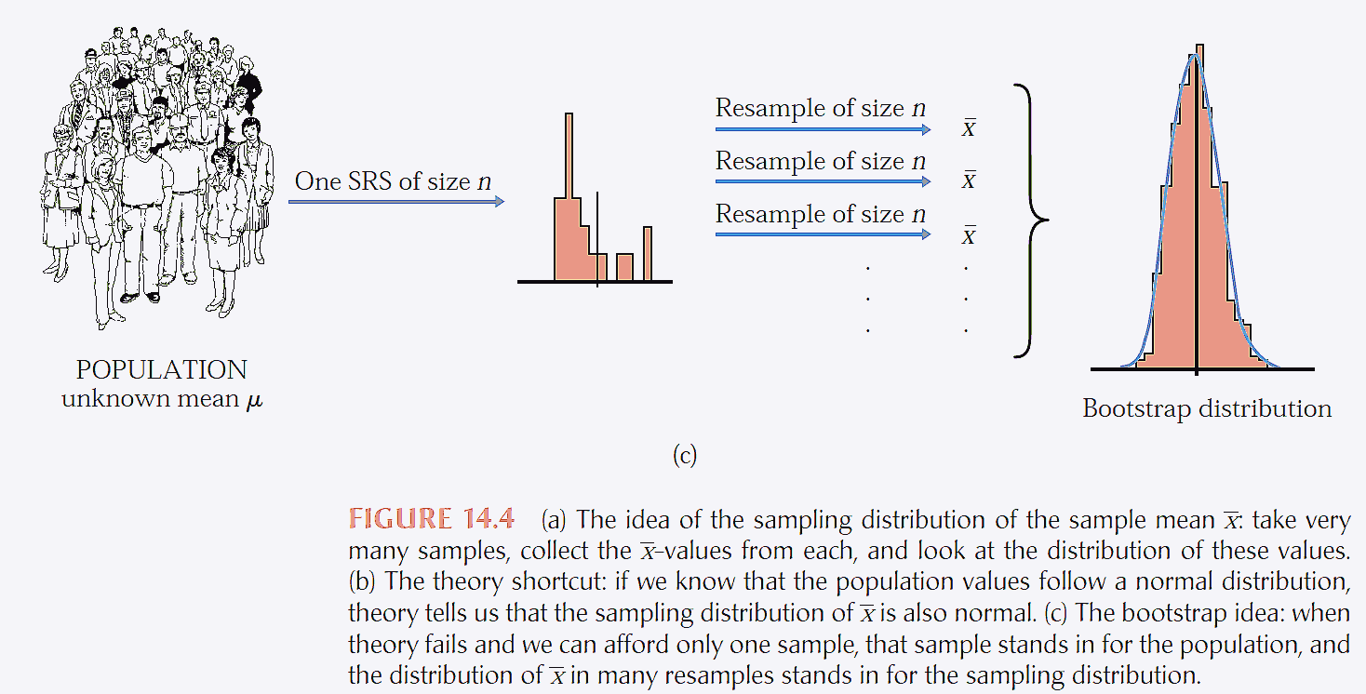
Moore et al., “The practice of business statistics"

Slide 7
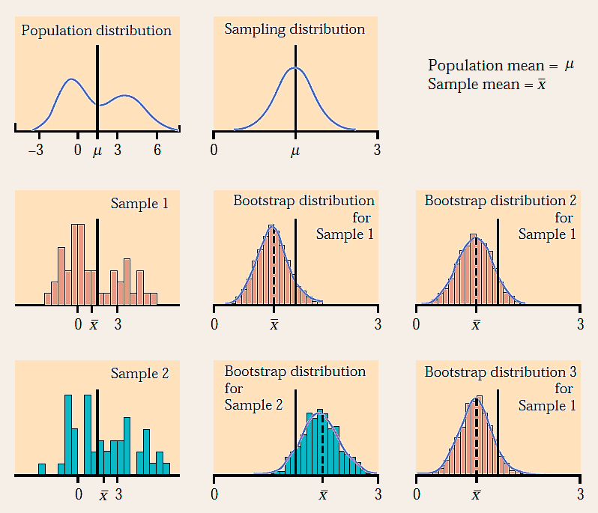
Moore et al., “The practice of business statistics"

Slide 8
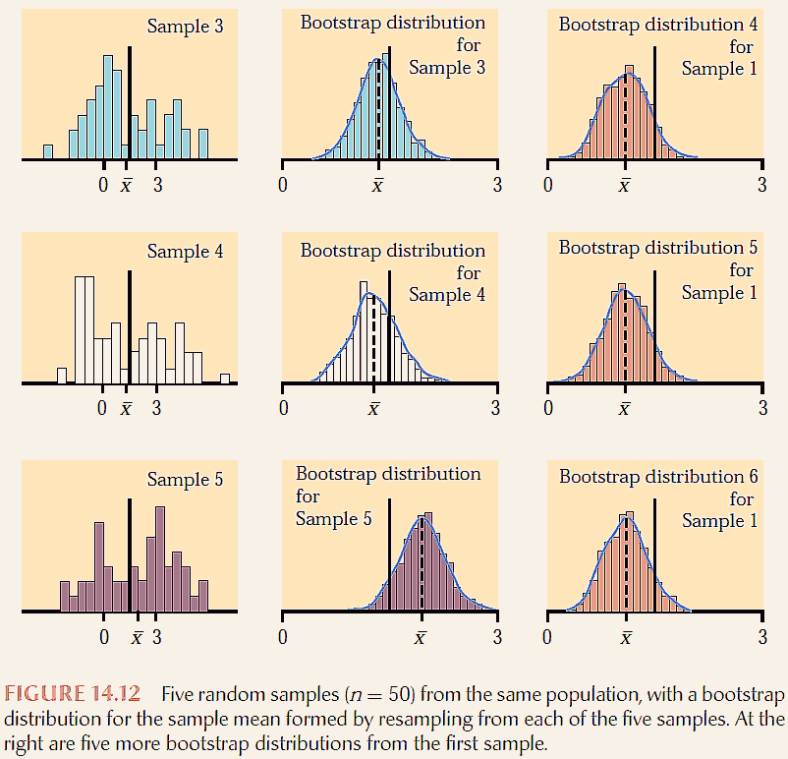
Moore et al., “The practice of business statistics"

Slide 9
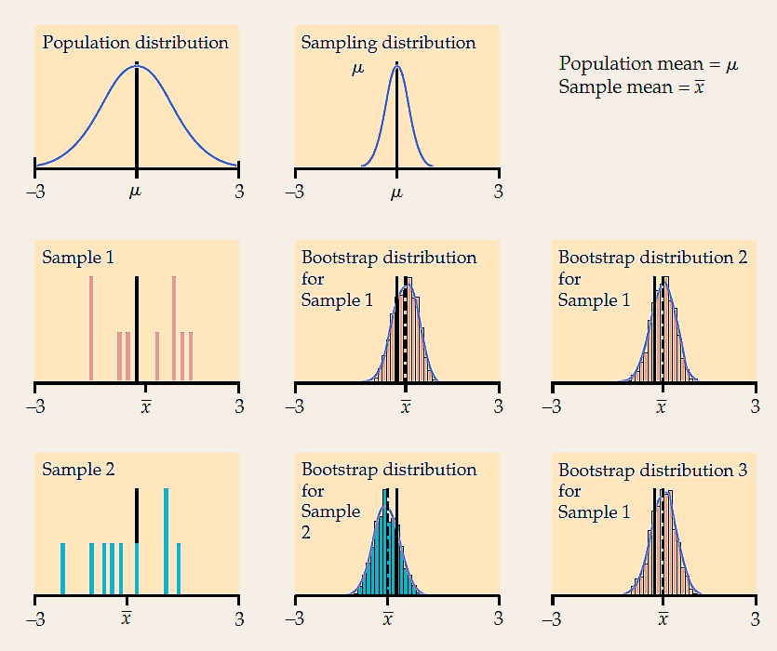
Moore et al., “The practice of business statistics"

Slide 10
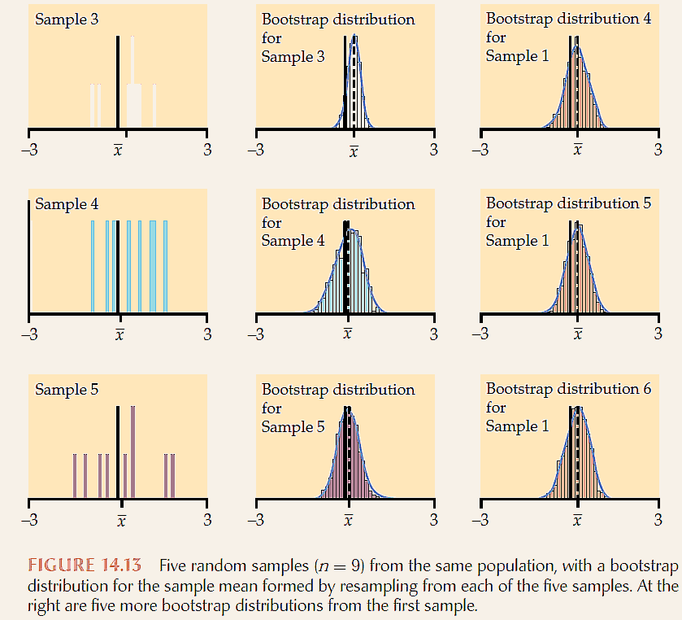
Moore et al., “The practice of business statistics"

Slide 11
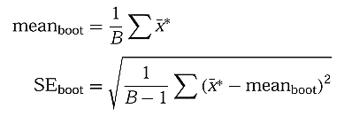
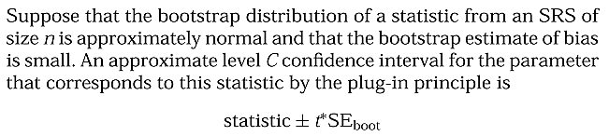

Bootstrap t confidence intervals
Moore et al., “The practice of business statistics"

Slide 12
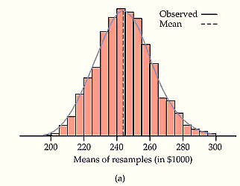
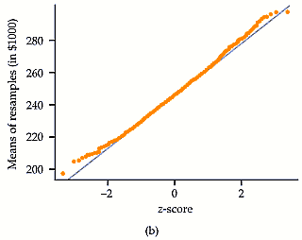
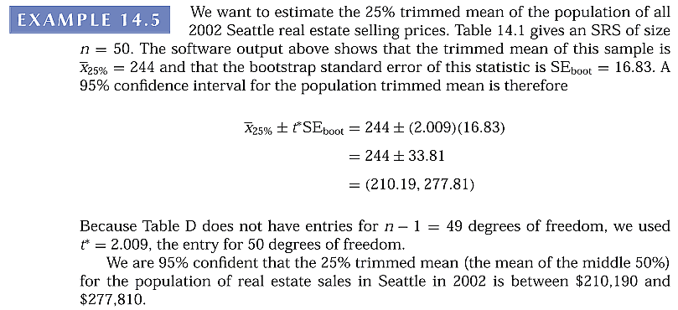

Bootstrap t confidence intervals
Moore et al., “The practice of business statistics"

Slide 13
n
0.25
0.2
0.15
0.1
0.05
0.025
0.01
0.005
0.0025
0.001
0.0005
1
1.000
1.376
1.963
3.078
6.314
12.71
31.82
63.66
127.3
318.3
636.6
2
0.816
1.061
1.386
1.886
2.920
4.303
6.965
9.925
14.09
22.33
31.60
3
0.765
0.978
1.250
1.638
2.353
3.182
4.541
5.841
7.453
10.21
12.92
4
0.741
0.941
1.190
1.533
2.132
2.776
3.747
4.604
5.598
7.173
8.610
5
0.727
0.920
1.156
1.476
2.015
2.571
3.365
4.032
4.773
5.893
6.869
6
0.718
0.906
1.134
1.440
1.943
2.447
3.143
3.707
4.317
5.208
5.959
7
0.711
0.896
1.119
1.415
1.895
2.365
2.998
3.499
4.029
4.785
5.408
8
0.706
0.889
1.108
1.397
1.860
2.306
2.896
3.355
3.833
4.501
5.041
9
0.703
0.883
1.100
1.383
1.833
2.262
2.821
3.250
3.690
4.297
4.781
10
0.700
0.879
1.093
1.372
1.812
2.228
2.764
3.169
3.581
4.144
4.587
11
0.697
0.876
1.088
1.363
1.796
2.201
2.718
3.106
3.497
4.025
4.437
12
0.695
0.873
1.083
1.356
1.782
2.179
2.681
3.055
3.428
3.930
4.318
13
0.694
0.870
1.079
1.350
1.771
2.160
2.650
3.012
3.372
3.852
4.221
14
0.692
0.868
1.076
1.345
1.761
2.145
2.624
2.977
3.326
3.787
4.140
15
0.691
0.866
1.074
1.341
1.753
2.131
2.602
2.947
3.286
3.733
4.073
16
0.690
0.865
1.071
1.337
1.746
2.120
2.583
2.921
3.252
3.686
4.015
17
0.689
0.863
1.069
1.333
1.740
2.110
2.567
2.898
3.222
3.646
3.965
18
0.688
0.862
1.067
1.330
1.734
2.101
2.552
2.878
3.197
3.610
3.922
19
0.688
0.861
1.066
1.328
1.729
2.093
2.539
2.861
3.174
3.579
3.883
20
0.687
0.860
1.064
1.325
1.725
2.086
2.528
2.845
3.153
3.552
3.850
21
0.686
0.859
1.063
1.323
1.721
2.080
2.518
2.831
3.135
3.527
3.819
22
0.686
0.858
1.061
1.321
1.717
2.074
2.508
2.819
3.119
3.505
3.792
23
0.685
0.858
1.060
1.319
1.714
2.069
2.500
2.807
3.104
3.485
3.767
24
0.685
0.857
1.059
1.318
1.711
2.064
2.492
2.797
3.091
3.467
3.745
25
0.684
0.856
1.058
1.316
1.708
2.060
2.485
2.787
3.078
3.450
3.725
26
0.684
0.856
1.058
1.315
1.706
2.056
2.479
2.779
3.067
3.435
3.707
27
0.684
0.855
1.057
1.314
1.703
2.052
2.473
2.771
3.057
3.421
3.690
28
0.683
0.855
1.056
1.313
1.701
2.048
2.467
2.763
3.047
3.408
3.674
29
0.683
0.854
1.055
1.311
1.699
2.045
2.462
2.756
3.038
3.396
3.659
30
0.683
0.854
1.055
1.310
1.697
2.042
2.457
2.750
3.030
3.385
3.646
40
0.681
0.851
1.050
1.303
1.684
2.021
2.423
2.704
2.971
3.307
3.551
50
0.679
0.849
1.047
1.299
1.676
2.009
2.403
2.678
2.937
3.261
3.496
60
0.679
0.848
1.045
1.296
1.671
2.000
2.390
2.660
2.915
3.232
3.460
80
0.678
0.846
1.043
1.292
1.664
1.990
2.374
2.639
2.887
3.195
3.416
100
0.677
0.845
1.042
1.290
1.660
1.984
2.364
2.626
2.871
3.174
3.390
http://fysh.blog.sohu.com/137331912.html
120
0.677
0.845
1.041
1.289
1.658
1.980
2.358
2.617
2.860
3.160
3.373
infty
0.674
0.842
1.036
1.282
1.645
1.960
2.326
2.576
2.807
3.090
3.291

Slide 14
Almost all of the variation among bootstrap distributions for a statistic is due to the selection of the original random sample from the population. Re-sampling introduces little additional variation.
Bootstrap distributions based on small samples (observations) can be quite variable. Their shape and spread reflect the characteristics of the sample and may not accurately estimate the shape and spread of the sampling distribution. Bootstrap inference from a small sample may therefore be unreliable.
Bootstrap inference based on samples of moderate size is unreliable for statistics like the median and quartiles that are calculated from just a few of the sample observations.
Moore et al., “The practice of business statistics"

Slide 15
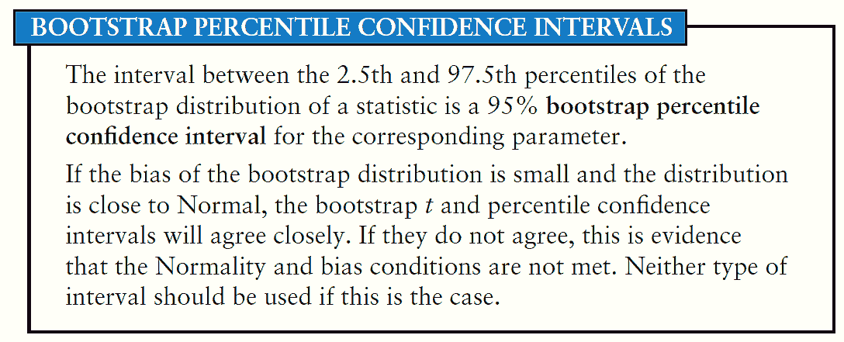
Bootstrap intervals work well only when the bootstrap distribution tells us that
  the sampling distribution is approximately Normal
  small bias
Moore et al., “The practice of business statistics"

Slide 16
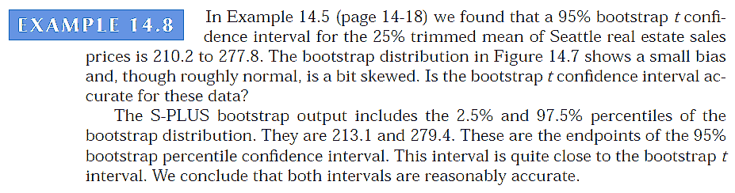
Moore et al., “The practice of business statistics"

Slide 17
Better methods for confidence intervals
The bootstrap bias-corrected accelerated (BCa) interval is a modification of the percentile method that adjusts the percentiles to correct for bias and skewness.
The bootstrap tilting interval adjusts the process of randomly forming re-samples (though a clever implementation allows use of the same re-samples as other bootstrap methods).
BCa and tilting confidence intervals should be used cautiously when sample sizes are small, because there are not enough data to accurately determine the necessary corrections for bias and skewness.
Moore et al., “The practice of business statistics"

Slide 18
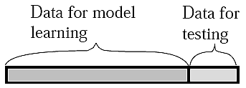
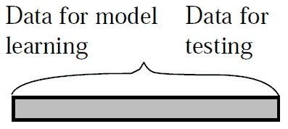
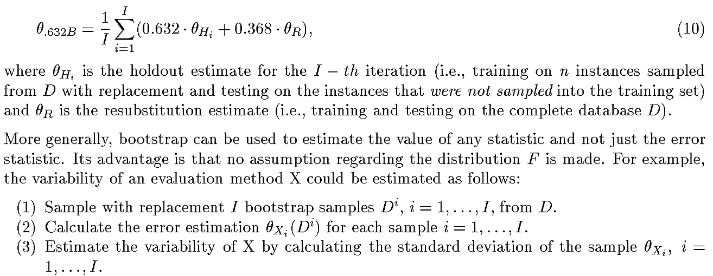
Bootstrap methods
Yoram Reich et al., “Evaluating Machine Learning Models for Engineering Problems"

Slide 19
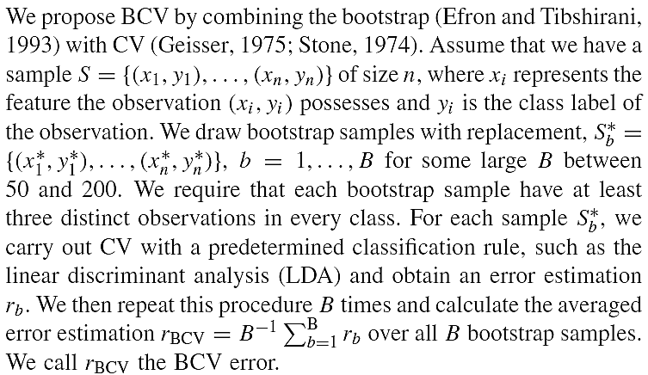
Bootstrap cross-validation (BCV)

Slide 20
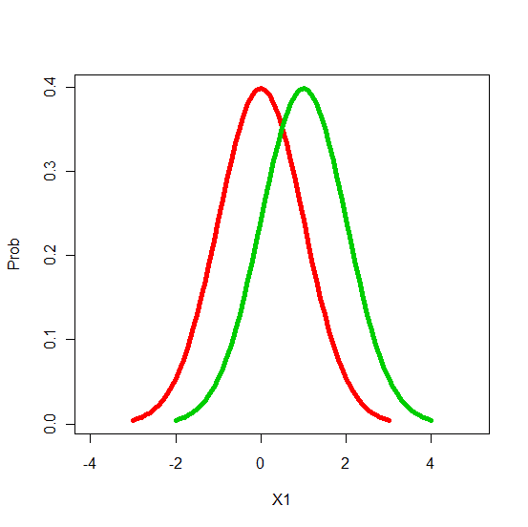
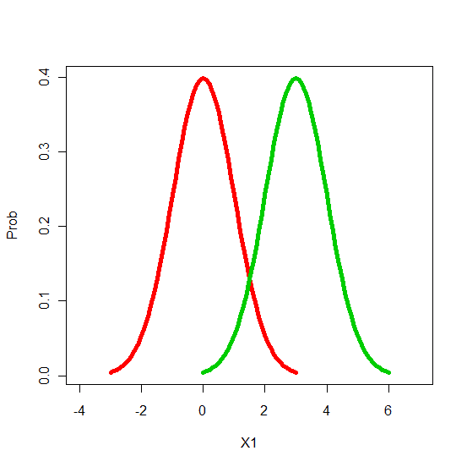



1D normal, 2-class, equal-number samples
Class 1: 5000 data from Normal(0, 1)
Class 2: 5000 data from Normal(Δ, 1), Δ>0
Learning algorithm
  Quadratic discriminate analysis (QDA)
Si: i'th randomly generated samples
R(S): relative deviation
Ř(S): averaged relative deviation
MSRE: mean squared relative error
Notes:
X1=seq(-3,3,0.1); Y1=dnorm(X1,mean=0)
X2=seq(-2,4,0.1); Y2=dnorm(X2,mean=1)
plot(X1,Y1,type='l',col=2,xlim=c(min(X1,X2)-1, max(X1,X2)+1),ylab='Prob',lwd=5)
lines(X2,Y2,col=3,lwd=5)
X11()
X1=seq(-3,3,0.1); Y1=dnorm(X1,mean=0)
X2=seq(0,6,0.1); Y2=dnorm(X2,mean=3)
plot(X1,Y1,type='l',col=2,xlim=c(min(X1,X2)-1, max(X1,X2)+1),ylab='Prob',lwd=5)
lines(X2,Y2,col=3,lwd=5)

Slide 21
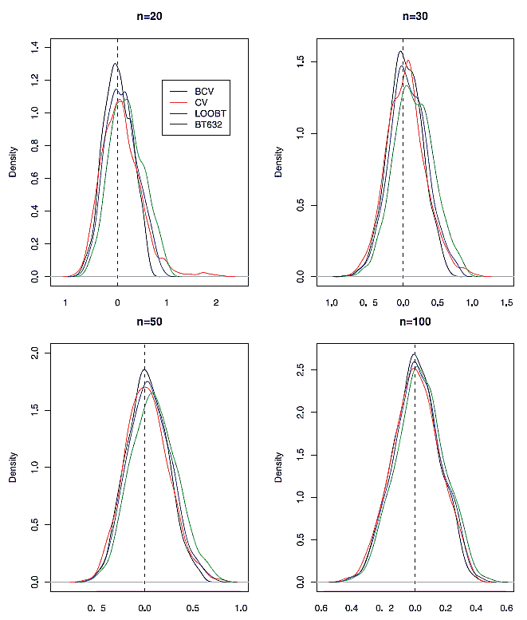
1D normal, 2-class, equal-number samples
Densities of conditional misclassification errors in relative scale estimated by different methods from 1000 simulation runs with data generated from distributions Normal (0, 1) and Normal (1, 1).

Slide 22
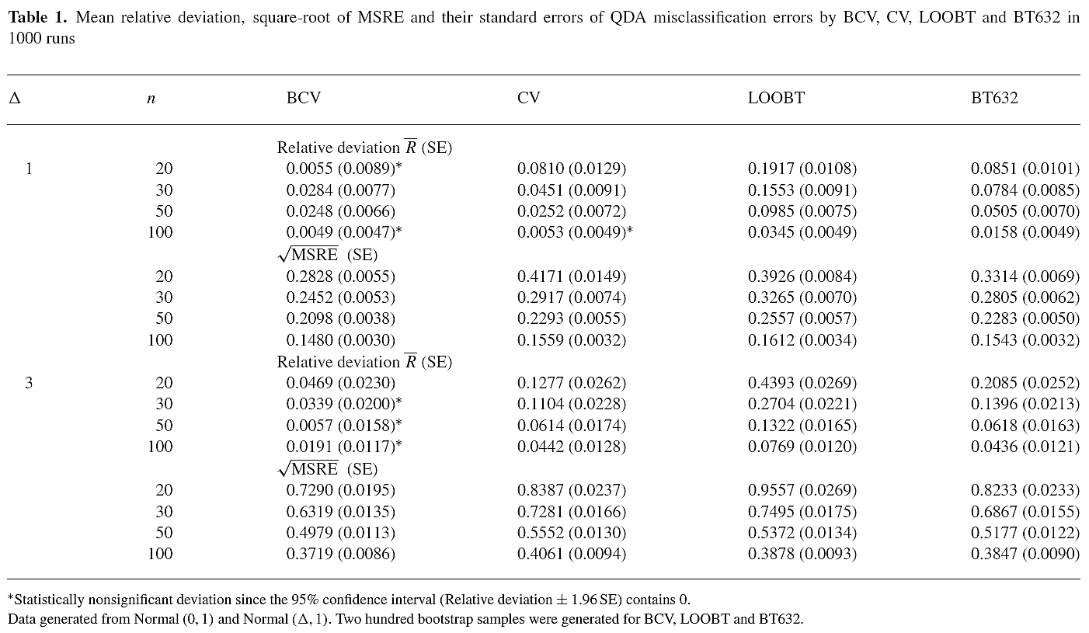
1D normal, 2-class, equal-number samples

Slide 23
1D normal, 2-class, nonequal-number samples
Class 1: <21 data from Normal(0, 1)
Class 2: 5000 data from Normal(Δ, 1), Δ>0
Learning algorithm
  Quadratic discriminate analysis (QDA)
Si: i'th randomly generated samples
R(S): relative deviation
Ř(S): averaged relative deviation
MSRE: mean squared relative error

Slide 24
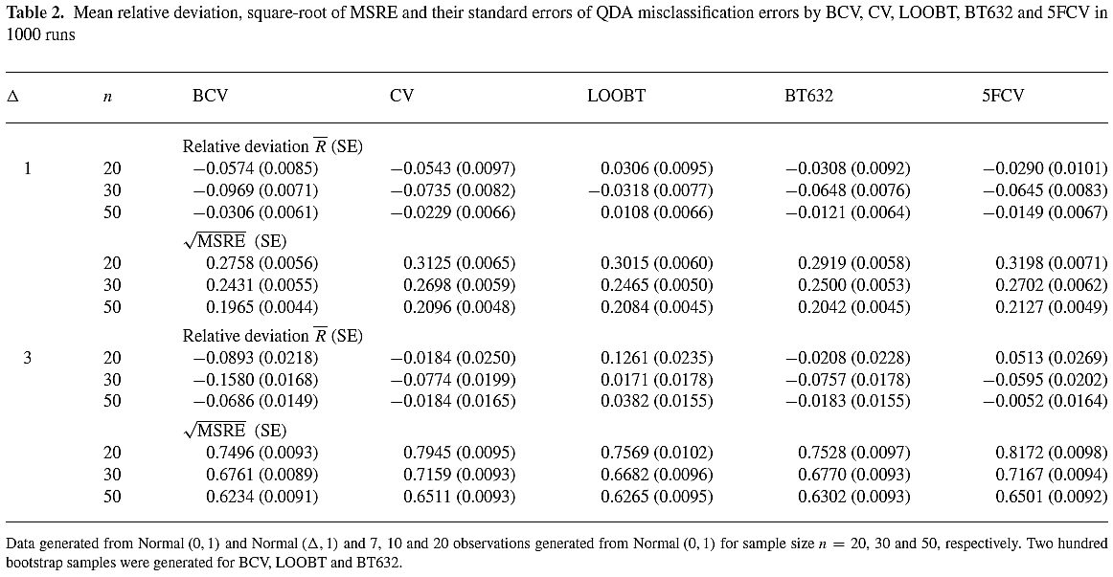
1D normal, 2-class, nonequal-number samples

Slide 25
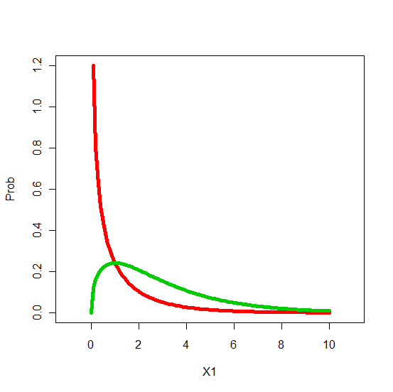
1D χ², 2-class, equal-number samples
Class 1: χ², df=1
Class 2: χ², df=3, 5
Learning algorithm
  Quadratic discriminate analysis (QDA)
Si: i'th randomly generated samples
R(S): relative deviation
Ř(S): averaged relative deviation
MSRE: mean squared relative error
Notes:
X1=seq(0,10,0.1); Y1=dchisq(X1,df=1)
X2=seq(0,10.1); Y2 =dchisq(X2,df=3)
plot(X1,Y1,type='l',col=2,xlim=c(min(X1,X2)-1, max(X1,X2)+1),ylab='Prob',lwd=5)
lines(X2,Y2,col=3,lwd=5)
X11()
X1=seq(0,10,0.1); Y1 =dchisq(X1,df=1)
X2=seq(0,10,0.1); Y2 =dchisq(X2,df=3)
plot(X1,Y1,type='l',col=2,xlim=c(min(X1,X2)-1, max(X1,X2)+1),ylab='Prob',lwd=5)
lines(X2,Y2,col=3,lwd=5)

Slide 26
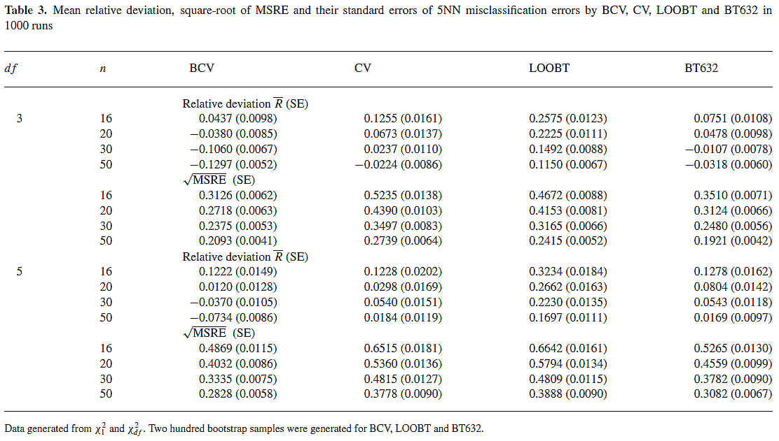
1D χ², 2-class, equal-number samples
Notes:
X1=seq(0,10,0.1); Y1=dchisq(X1,df=1)
X2=seq(0,10.1); Y2 =dchisq(X2,df=3)
plot(X1,Y1,type='l',col=2,xlim=c(min(X1,X2)-1, max(X1,X2)+1),ylab='Prob',lwd=5)
lines(X2,Y2,col=3,lwd=5)
X11()
X1=seq(0,10,0.1); Y1 =dchisq(X1,df=1)
X2=seq(0,10,0.1); Y2 =dchisq(X2,df=3)
plot(X1,Y1,type='l',col=2,xlim=c(min(X1,X2)-1, max(X1,X2)+1),ylab='Prob',lwd=5)
lines(X2,Y2,col=3,lwd=5)

Slide 27
q-D normal, 2-class, equal-number samples
(q, Δ) = (1, 5), (0.8, 10)
Learning algorithm: 3 nearest neighbor
Si: i'th randomly generated samples
R(S): relative deviation
Ř(S): averaged relative deviation
MSRE: mean squared relative error
Notes:
X1=seq(-3,3,0.1); Y1=dnorm(X1,mean=0)
X2=seq(-2,4,0.1); Y2=dnorm(X2,mean=1)
plot(X1,Y1,type='l',col=2,xlim=c(min(X1,X2)-1, max(X1,X2)+1),ylab='Prob',lwd=5)
lines(X2,Y2,col=3,lwd=5)
X11()
X1=seq(-3,3,0.1); Y1=dnorm(X1,mean=0)
X2=seq(0,6,0.1); Y2=dnorm(X2,mean=3)
plot(X1,Y1,type='l',col=2,xlim=c(min(X1,X2)-1, max(X1,X2)+1),ylab='Prob',lwd=5)
lines(X2,Y2,col=3,lwd=5)

Slide 28
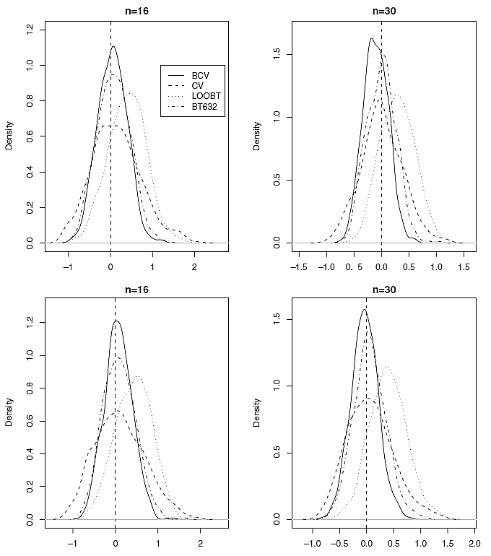
q-D normal, 2-class, equal-number samples
Densities of conditional misclassification errors in relative scale estimated by different methods from 500 simulation runs with data generated from distributions [Normal (0, 1)]^{q} and [Normal (, 1)]^{q} . Upper panels: Δ = 1 and q = 5; Lower panels: Δ = 0.8 and q = 10.
Notes:
X1=seq(-3,3,0.1); Y1=dnorm(X1,mean=0)
X2=seq(-2,4,0.1); Y2=dnorm(X2,mean=1)
plot(X1,Y1,type='l',col=2,xlim=c(min(X1,X2)-1, max(X1,X2)+1),ylab='Prob',lwd=5)
lines(X2,Y2,col=3,lwd=5)
X11()
X1=seq(-3,3,0.1); Y1=dnorm(X1,mean=0)
X2=seq(0,6,0.1); Y2=dnorm(X2,mean=3)
plot(X1,Y1,type='l',col=2,xlim=c(min(X1,X2)-1, max(X1,X2)+1),ylab='Prob',lwd=5)
lines(X2,Y2,col=3,lwd=5)

Slide 29
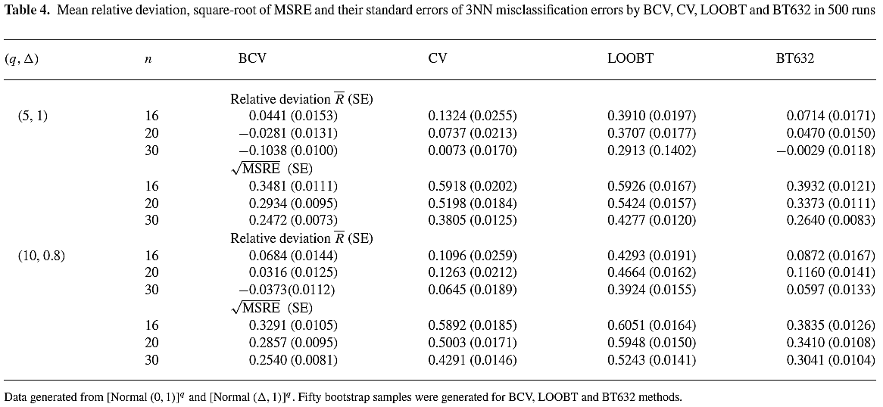
q-D normal, 2-class, equal-number samples
Notes:
X1=seq(-3,3,0.1); Y1=dnorm(X1,mean=0)
X2=seq(-2,4,0.1); Y2=dnorm(X2,mean=1)
plot(X1,Y1,type='l',col=2,xlim=c(min(X1,X2)-1, max(X1,X2)+1),ylab='Prob',lwd=5)
lines(X2,Y2,col=3,lwd=5)
X11()
X1=seq(-3,3,0.1); Y1=dnorm(X1,mean=0)
X2=seq(0,6,0.1); Y2=dnorm(X2,mean=3)
plot(X1,Y1,type='l',col=2,xlim=c(min(X1,X2)-1, max(X1,X2)+1),ylab='Prob',lwd=5)
lines(X2,Y2,col=3,lwd=5)

Slide 30
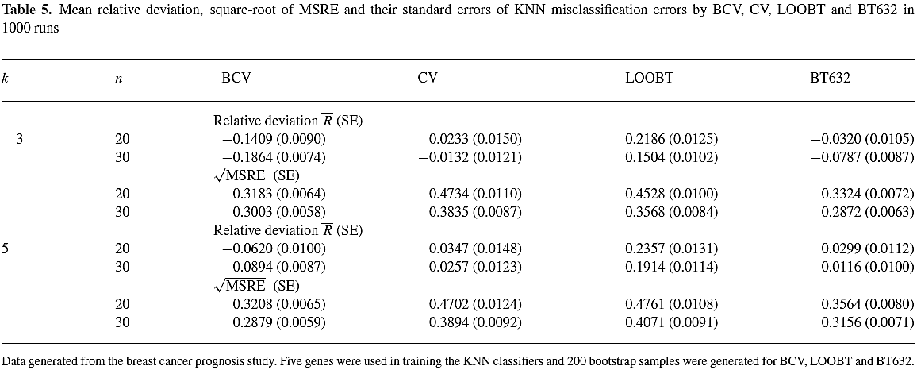
5-D micro-array data
breast cancer data based on 70 genes (van’t Veer et al., 2002; van de Vijver et al., 2002) with 5 most relevant features preserved
Learning algorithm: 3 or 5 nearest neighbor
Notes:
X1=seq(-3,3,0.1); Y1=dnorm(X1,mean=0)
X2=seq(-2,4,0.1); Y2=dnorm(X2,mean=1)
plot(X1,Y1,type='l',col=2,xlim=c(min(X1,X2)-1, max(X1,X2)+1),ylab='Prob',lwd=5)
lines(X2,Y2,col=3,lwd=5)
X11()
X1=seq(-3,3,0.1); Y1=dnorm(X1,mean=0)
X2=seq(0,6,0.1); Y2=dnorm(X2,mean=3)
plot(X1,Y1,type='l',col=2,xlim=c(min(X1,X2)-1, max(X1,X2)+1),ylab='Prob',lwd=5)
lines(X2,Y2,col=3,lwd=5)

Slide 31
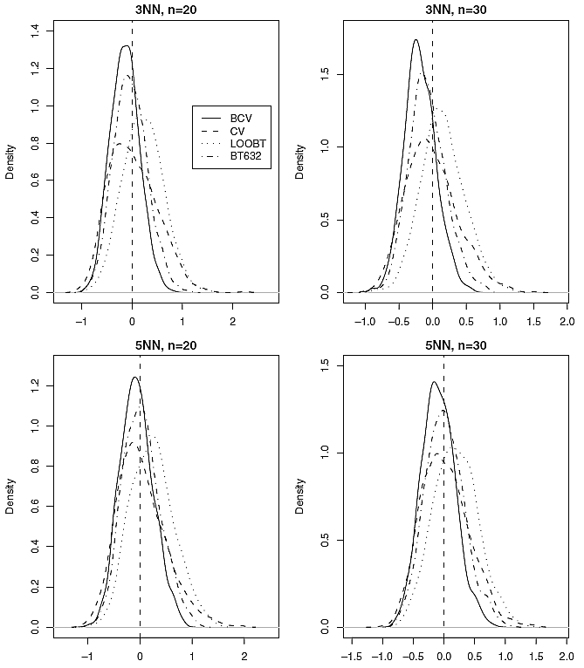
5-D micro-array data
Densities of conditional misclassification errors in relative scale estimated by different methods from 1000 runs of generating random sample S of size n from the breast cancer prognosis data and testing on the remaining data. Upper panels: 3NN classifier; Lower panels: 5NN classifier.
Notes:
X1=seq(-3,3,0.1); Y1=dnorm(X1,mean=0)
X2=seq(-2,4,0.1); Y2=dnorm(X2,mean=1)
plot(X1,Y1,type='l',col=2,xlim=c(min(X1,X2)-1, max(X1,X2)+1),ylab='Prob',lwd=5)
lines(X2,Y2,col=3,lwd=5)
X11()
X1=seq(-3,3,0.1); Y1=dnorm(X1,mean=0)
X2=seq(0,6,0.1); Y2=dnorm(X2,mean=3)
plot(X1,Y1,type='l',col=2,xlim=c(min(X1,X2)-1, max(X1,X2)+1),ylab='Prob',lwd=5)
lines(X2,Y2,col=3,lwd=5)

Slide 32
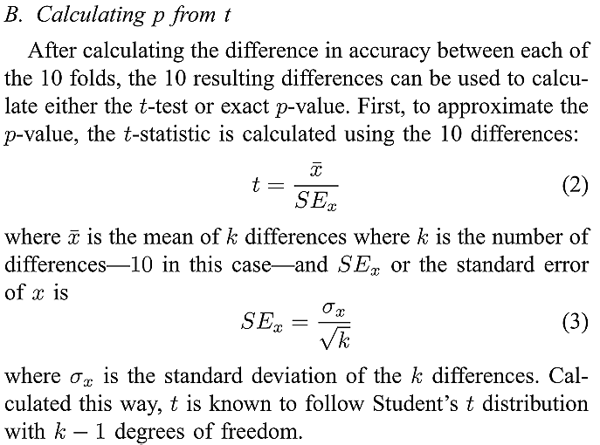
CV paired t test by permutation
Joshua Menke and Tony R. Martinez, “Using Permutations Instead of Student’s t Distribution for p-values in Paired-Difference Algorithm Comparisons"

Slide 33
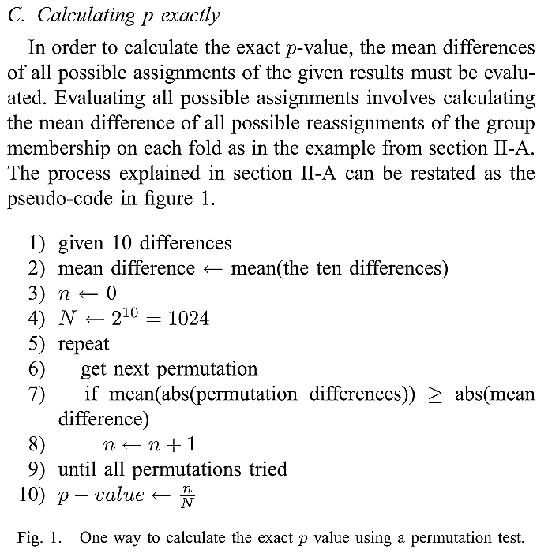
CV paired t test by permutation
Joshua Menke and Tony R. Martinez, “Using Permutations Instead of Student’s t Distribution for p-values in Paired-Difference Algorithm Comparisons"

Slide 34
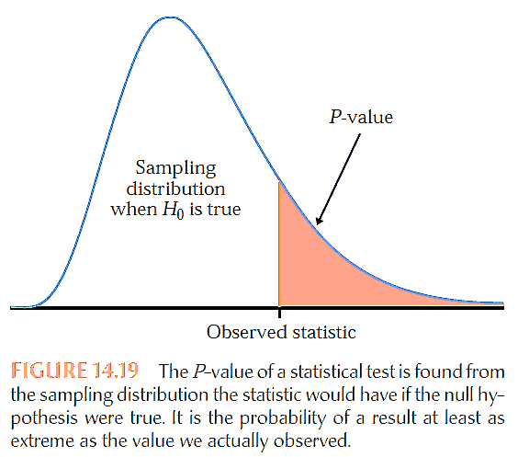
The statement that the effect we seek is not present in the population is the null hypothesis, H₀. The probability, calculated taking the null hypothesis to be true, that we would observe a statistic value as extreme or more extreme than the one we did observe is the P-value. Figure 14.19 illustrates the idea of a P-value. Small P-values are evidence against the null hypothesis and in favor of a real effect in the population.
To estimate the P-value for a test of significance, estimate the sampling distribution of the test statistic when the null hypothesis is true by re-sampling in a manner that is consistent with the null hypothesis.
Moore et al., “The practice of business statistics"

Slide 35
The two-sample t test starts from the condition that the sampling distribution of x1 − x2 is normal. This is the case if both populations have normal distributions, and it is approximately true for large samples from non-normal populations because of the central limit theorem. The central limit theorem helps explain the robustness of the two-sample t test.
The permutation test completely removes the normality condition. But re-sampling in a way that moves observations between the two groups requires that the two populations are identical when the null hypothesis is true—not only are their means the same, but also their spreads and shapes.
Moore et al., “The practice of business statistics"

Slide 36
Fortunately, the permutation test is robust. That is, it gives accurate P-values when the two population distributions have somewhat different shapes, say, when they have slightly different standard deviations.
For most purposes, 999 resamples are sufficient.
If stakes are high or P-values are near a critical value, increase the number of resamples. If the true (one-sided) P-value is p, the standard deviation of the estimated P-value is approximately [p(1 − p)/B]^½, where B is the number of resamples. You can choose B to obtain a desired level of accuracy.
Moore et al., “The practice of business statistics"

Slide 37
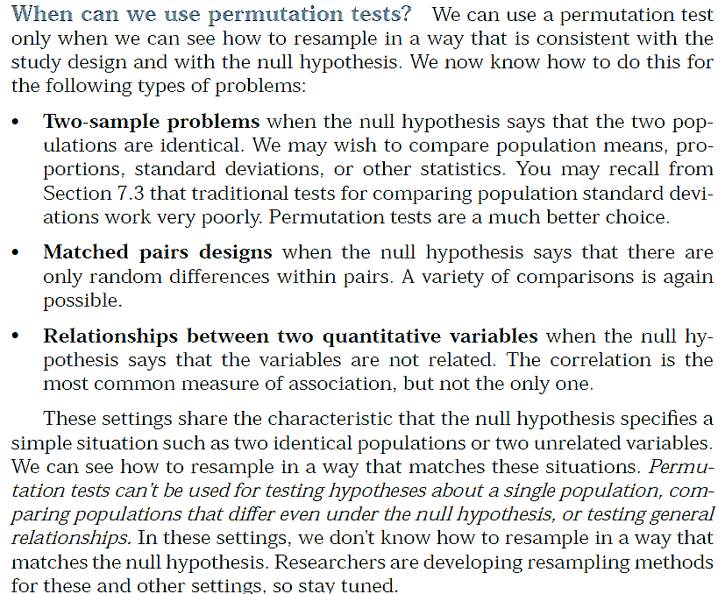
Moore et al., “The practice of business statistics"

Slide 38
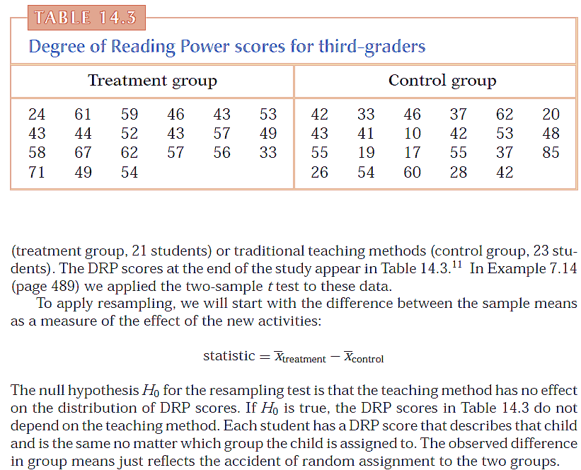
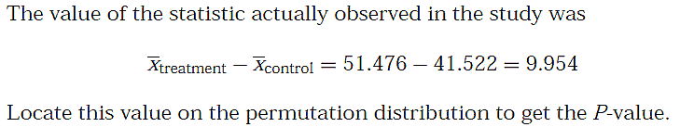
Moore et al., “The practice of business statistics"

Slide 39
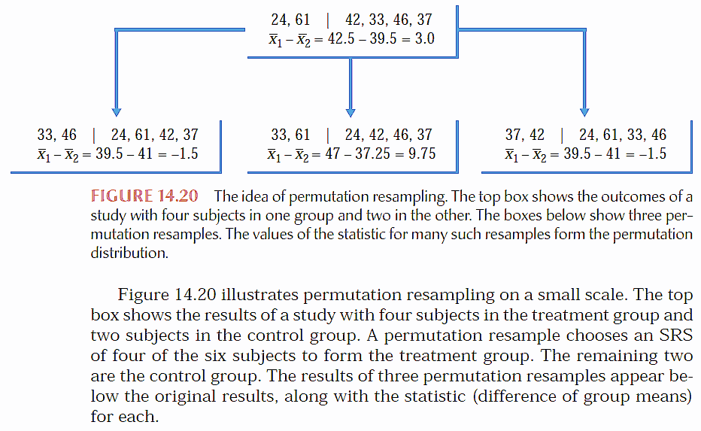
Moore et al., “The practice of business statistics"

Slide 40
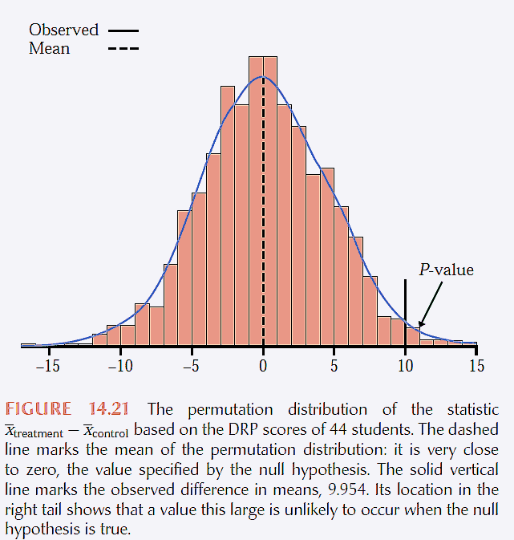

Moore et al., “The practice of business statistics"

Slide 41
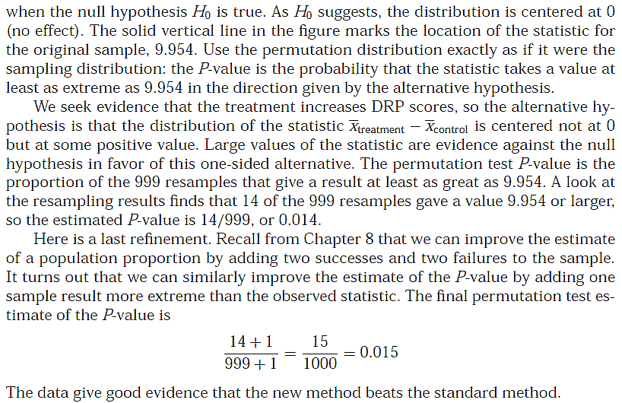
Moore et al., “The practice of business statistics"

