Slide 1
Efficient Similarity Retrieval for Protein Binding Sites Based on Histogram Comparison
Thomas Fober, Marco Mernberger, Gerhard Klebe and Eyke Hüllermeier 2010 German Conference on Bioinformatics (GCB 2010, Sept. 20 - Sept. 22), pp. 51-59, Braunschweig Germany
Presenter: Chun-Chieh Tai
Date: February 21, 2012
Notes:
http://scholar.googleusercontent.com/scholar?q=cache:emwz5ajcx5oJ:scholar.google.com/+Efficient+Similarity+Retrieval+for+Protein+Binding+Sites+based+on+Histogram+Comparison&hl=zh-TW&as_sdt=0,5

Slide 2
Abstract
We propose a method for comparing protein structures or, more specifically, protein binding sites using a histogram-based representation that captures important geometrical and physico-chemical properties. In comparison to hitherto existing approaches in structural bioinformatics, especially methods from graph theory and computational geometry, our approach is computationally much more efficient. Moreover, despite its simplicity, it appears to capture and recover functional similarities surprisingly well.

Slide 3
CavBase is a database for protein binding sites
data base containing protein binding sites
61,516 proteins, from which
248,686 protein binding sites are extracted (March 2010)
current comparison approaches
graph-based: kernel methods, evolutionary optimization, …
geometric: geometric hashing, labeled point cloud superposition, …
→ some with high computational complexity
infeasible for large scale studies
RW Kernel | SP Kernel | Greedy Heuristic | GAVEO | Subgraph Isomorphism
O(n⁶) | O(n⁴) | NP-complete | NP-complete | NP-complete
65.51 s | 9.75 s | 121.74 s | --- | ---
188 d | 28 d | 350 d | --- | ---
→ time-efficient methods are needed for large-scale screening!

Slide 4
Histograms model pseudocenter distribution in 3D space
protein binding sites are represented by a set of histograms
each histogram summarizes the distance distribution for each combination of pseudocenter types:
D_{i,j} distribution of distances between pseudocenters of type i and j
for each D_{i,j} a histogram h is created
set of bins B = {1, …, b_{max}}
h(b) = percentage of distances d 2 [b-1, b[
7 pseudocenter types: H-acceptor, H-donor, mixed donor/acceptor, aromatic, aliphatic, metal, pi
b_{max} = 11 Å

Slide 5
Each histogram represents a combination of pseudocenter types
1
2
3
1
2
3
0.8
1.5
0.9
0.6
1
2
3
1
2
3
1
2
3
1
2
3

Slide 6
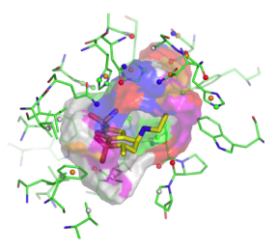



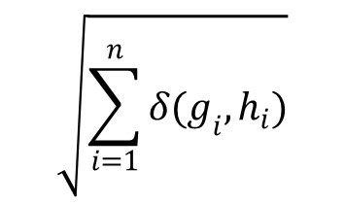
Histogram distances are aggregated into one distance measure
...
$$\sqrt{\sum_{i=1}^{n}{δ(g_{i}, h_{i})}}$$
$$δ(∙,∙)$$
$$δ(∙,∙)$$
...
$$δ(∙,∙)$$
...

Slide 7
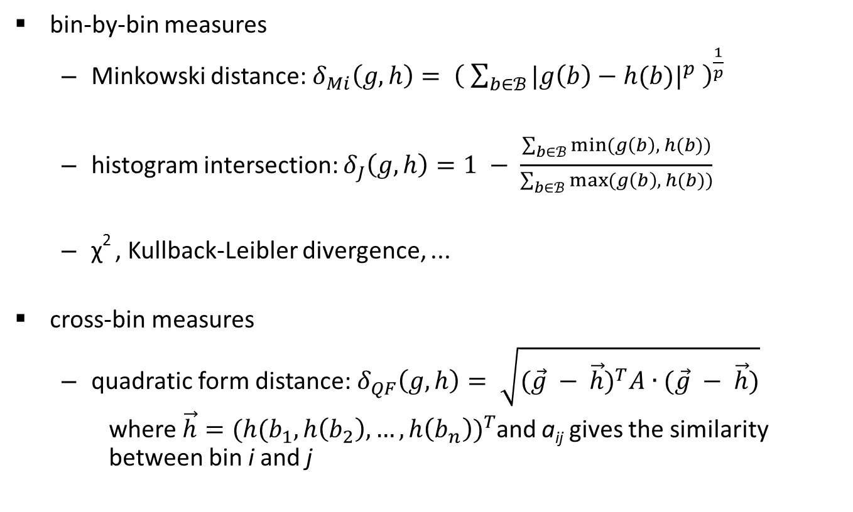
A variety of distance metrics can be used
bin-by-bin measures
Minkowski distance: $δ_{Mi}\left(g,h\right)= {\left( \sum_{b∈ℬ}{{|g\left(b\right)−h(b)|}^{p}} \right)}^{\frac{1}{p}}$
histogram intersection: $δ_{J}\left(g,h\right)=1 − \frac{\sum_{b∈ℬ}{\min_{ }{(g\left(b\right), h(b))}}}{\sum_{b∈ℬ}{\max_{ }{(g\left(b\right), h(b))}}}$
χ² , Kullback-Leibler divergence, ...
cross-bin measures
quadratic form distance: $δ_{QF}\left(g,h\right)= \sqrt{{(\vec{g} − \vec{h})}^{T}A∙(\vec{g} − \vec{h})}$
where$\vec{h}={(h(b_{1}, h\left(b_{2}\right), …, h\left(b_{n}\right))}^{T}$and a_{ij} gives the similarity between bin i and j

Slide 8
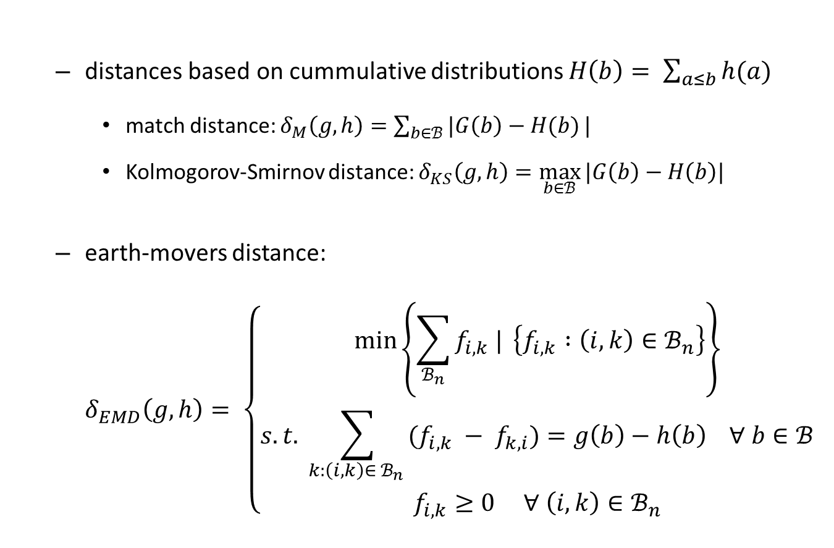
A variety of distance metrics can be used
distances based on cummulative distributions $H\left(b\right)= \sum_{a≤b}{h(a)}$
match distance: $δ_{M}\left(g,h\right)=\sum_{b∈ℬ}{|G\left(b\right)−H(b)}|$
Kolmogorov-Smirnov distance: $δ_{KS}\left(g,h\right)=\max_{b∈ℬ}{|G\left(b\right)−H\left(b\right)|}$
earth-movers distance: $δ_{EMD}\left(g,h\right)= \left\{\begin{aligned}\min_{ }\left\{\sum_{ℬ_{n}}{f_{i,k} | }\left\{f_{i,k} :\left(i,k\right)∈ℬ_{n}\right\}\right\} \\ s.t. \sum_{{k:\left(i,k\right)∈ ℬ_{n}}_{ }}{(f_{i,k} − f_{k,i})}=g\left(b\right)−h\left(b\right) ∀ b∈ℬ \\ f_{i,k}≥0 ∀ \left(i,k\right)∈ℬ_{n}\end{aligned}\right.$

Slide 9
Histogram comparison can discriminate binding sites by ligand
classification of a two-class data set
the higher the classification rates, the better the similarity measure
ATP/NADH data set contains 355 protein binding sites
214 bind NADH substrates
141 bind ATP substrates
binary classification experiment
leave-one-out cross-validation
k-nearest neighbor classifier

Slide 10
Histogram comparison can discriminate binding sites by ligand
bin-by-bin measures:
cross-bin measures:
k | δ_{MF} (p=1) | δ_{MF} (p=2) | δ_{MF} (p = ∞) | δ_{J}
1 | 87.0 | 84.8 | 80.6 | 87.3
3 | 85.4 | 83.4 | 81.7 | 87.0
5 | 79.4 | 81.4 | 79.2 | 84.8
runtime (h) | 0.471 | 0.473 | 0.473 | 0.472
k | δ_{QF} | δ_{M} | δ_{KS} | δ_{EMD}
1 | 86.2 | 86.5 | 85.9 | 77.2
3 | 85.6 | 88.2 | 85.4 | 74.9
5 | 84.5 | 86.5 | 83.7 | 73.2
runtime (h) | 0.785 | 0.470 | 0.472 | 11.53
Best result so far (geometric approach): 93.5 % accuracy, 361.58 h runtime

Slide 11
Histogram comparison can retrieve similar binding sites from database searches
query structure: main pocket of acetylcholinesterase (pdb-code: 2ACK)
distance metric: match distance (δ_{M})
first false positive on rank 98
rank | id | distance | function
1 | '2ACK' | 0 | Acetylcholinesterase (AChE)
2 | '1AX9' | 0,179581271 | Acetylcholinesterase (AChE)
3 | '1GQS' | 0,203090689 | Acetylcholinesterase (AChE)
4 | '2C5F' | 0,212960305 | Acetylcholinesterase (AChE)
5 | '1DX6' | 0,214545705 | Acetylcholinesterase (AChE)
6 | '1H22' | 0,216633938 | Acetylcholinesterase (AChE)
7 | '2vt7' | 0,217438742 | Acetylcholinesterase (AChE)
… | … | … | …
95 | '1QIK' | 0,402146435 | Acetylcholinesterase (AChE)
96 | '2v98' | 0,402262892 | Acetylcholinesterase (AChE)
97 | '1ZGC' | 0,403866967 | Acetylcholinesterase (AChE)
98 | '1G6R' | 0,404798145 | Aspartate aminotransferase (mAspAT)
99 | '2JEZ' | 0,40503194 | Acetylcholinesterase (AChE)
100 | '1SI8' | 0,406246972 | Catalase

Slide 12
Histogram comparison can cluster active sites of enzyme classes
enzyme dataset contains
eight highly populated enzyme classes from the PDB
for each class, binding sites with at least two catalytic residues according to the catalytic site atlas (CSA v.2.2.12)
clustering experiment
hierarchical clustering using repeated bisection (CLUTO)
comparison of clustering to original enzyme class structure via Rand index
multi-classification experiment
leave-one-out cross-validation
k-nearest neighbor classifier

Slide 13
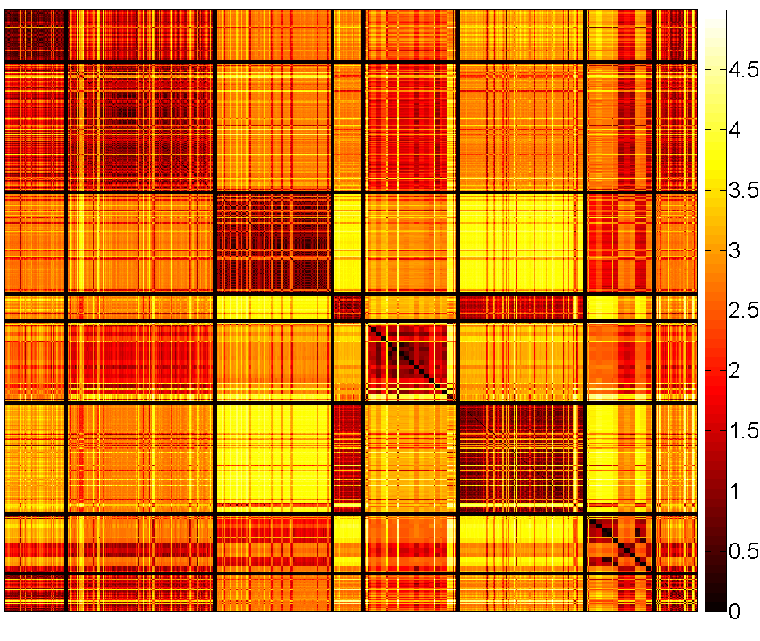
Distance matrix (δ_{M}) reveals functional clusters
EC 2.1.1.45: thymidylate
synthase
EC 3.4.21.4: trypsin
EC 3.4.23.16: HIV-1
retropepsin
EC 3.4.24.27: thermolysin
EC 1.9.3.1: cytochrome c
oxidase
EC 4.2.1.1: hyaluronate
lyase
EC 3.4.25.1: proteasome
endopeptidase
EC 2.6.1.1: aspartate
transaminase

Slide 14
Histogram comparison can cluster and classify enzymes by EC number
comparison of clustering (δ_{M}) to real class structure
Rand index: R = 0.8633
classification experiment: k-nearest neighbor
k | d_{QF} | d_{M} | d_{KS}
1 | 94.1 | 94.4 | 94.5
3 | 92.9 | 91.9 | 92.6
5 | 90.5 | 91.2 | 91.6

Slide 15

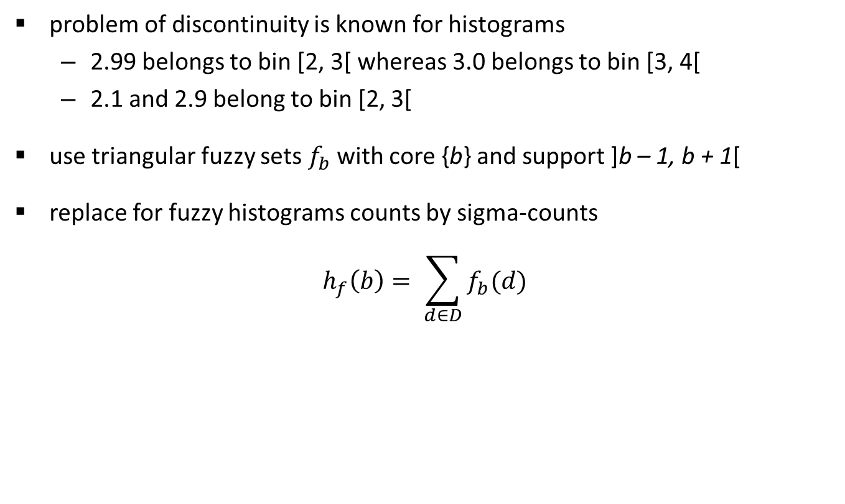



Fuzzification solves the problem of discontinuity
problem of discontinuity is known for histograms
2.99 belongs to bin [2, 3[ whereas 3.0 belongs to bin [3, 4[
2.1 and 2.9 belong to bin [2, 3[
use triangular fuzzy sets $f_{b}$with core {b} and support ]b – 1, b + 1[
replace for fuzzy histograms counts by sigma-counts
$$h_{f}\left(b\right)= \sum_{d∈D}{f_{b}(d)}$$
new distance: 2.9
... 2
3 ...
$$f_{1}$$
$$f_{2}$$
$$f_{3}$$
...
$$f_{7}$$
...
1
1
2
3
4
5
6
7
8
9

Slide 16
Fuzzy histograms increase performance of bin-by-bin measures
bin-by-bin measures:
cross-bin measures:
k | δ_{MF} (p=1) | δ_{MF} (p=2) | δ_{MF} (p = ∞) | δ_{J}
1 | 89.0 | 89.0 | 86.8 | 88.5
3 | 90.1 | 87.6 | 85.1 | 89.0
5 | 87.9 | 87.0 | 81.4 | 86.2
runtime (h) | 2.21 | 2.22 | 2.21 | 2.22
k | δ_{QF} | δ_{M} | δ_{KS} | δ_{EMD}
1 | 85.3 | 86.2 | 85.9 | 83.9
3 | 85.1 | 87.9 | 86.8 | 83.9
5 | 84.8 | 85.6 | 84.8 | 83.4
runtime (h) | 2.52 | 2.21 | 2.22 | 13.15

Slide 17
Conclusions
histograms can be used to represent a protein binding site in a simple way
despite loss of information, histograms still carry enough information to retrieve meaningful similarity values
runtime much smaller in comparison to approaches used so far
cross-bin measures mitigate the discontinuity problem
bin-by-bin measures benefit the most from fuzzyfication
useful extension to more expensive approaches as pre-filtering method

Slide 18
Thanks for your listening.

