Slide 1
Feature Selection and Parameter Optimization of a Fuzzy-based Stock Selection Model Using Genetic Algorithms
International Journal of Fuzzy Systems,
Vol. 14, No. 1, March 2012
Chien-Feng Huang(黃健峯), Bao Rong Chang(張保榮),
Dun-Wei Cheng(???), and Chih-Hsiang Chang(張志向)
Presenter: Cheng-Han Lee
Date: 2012/12/25

Slide 2
Abstract
In the areas of investment research and applications, feasible quantitative models include methodologies stemming from soft computing for prediction of financial time series, multi-objective optimization of investment return and risk reduction, as well as selection of investment instruments for portfolio management, etc. Among all these, stock selection has long been identified as a challenging and important task. This line of research is highly contingent upon reliable stock ranking for successful portfolio construction. Recent advances in machine learning and data mining are leading to significant opportunities to solve these problems more effectively. In this study, we aim at developing a methodology for effective stock selection using fuzzy models as well as genetic algorithms (GA).

Slide 3
We first devise a stock scoring mechanism using fundamental variables and apply fuzzy membership functions to re-scale the scores properly. The scores are then used to obtain the relative rankings of stocks and top-ranked stocks can be selected to form a portfolio. On top of the stock scoring model, we employ GA for optimization of model parameters and feature selection for input variables simultaneously. We will show that the investment returns provided by our proposed methodology significantly outperform the benchmark. Based upon the promising results obtained, we expect that this hybrid fuzzy-GA methodology can advance the research in soft computing for finance and provide an effective solution to stock selection in practice.

Slide 4
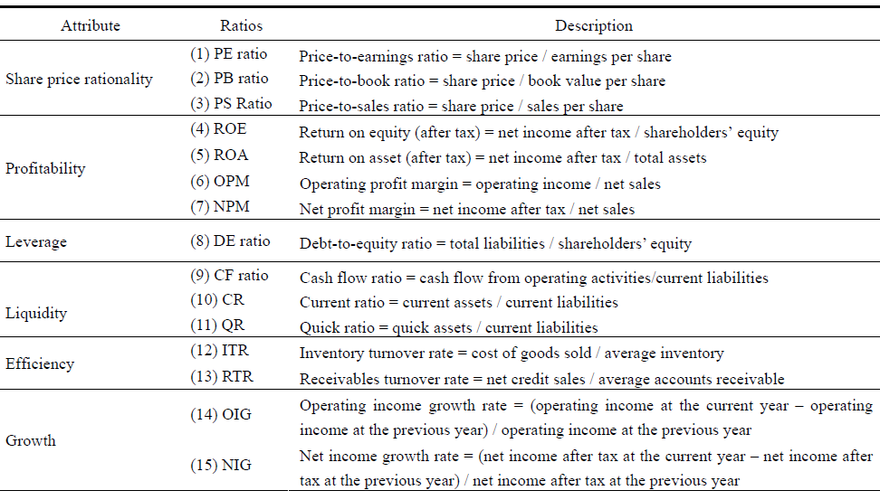
Fundamental variables
Notes:
PE http://zh.wikipedia.org/wiki/%E5%B8%82%E5%87%80%E7%8E%87
PB http://zh.wikipedia.org/wiki/%E5%B8%82%E7%9B%88%E7%8E%87 ROE http://zh.wikipedia.org/wiki/%E8%82%A1%E6%9C%AC%E5%9B%9E%E5%A0%B1%E7%8E%87 ROA http://zh.wikipedia.org/wiki/%E8%B5%84%E4%BA%A7%E6%94%B6%E7%9B%8A%E7%8E%87

Slide 5
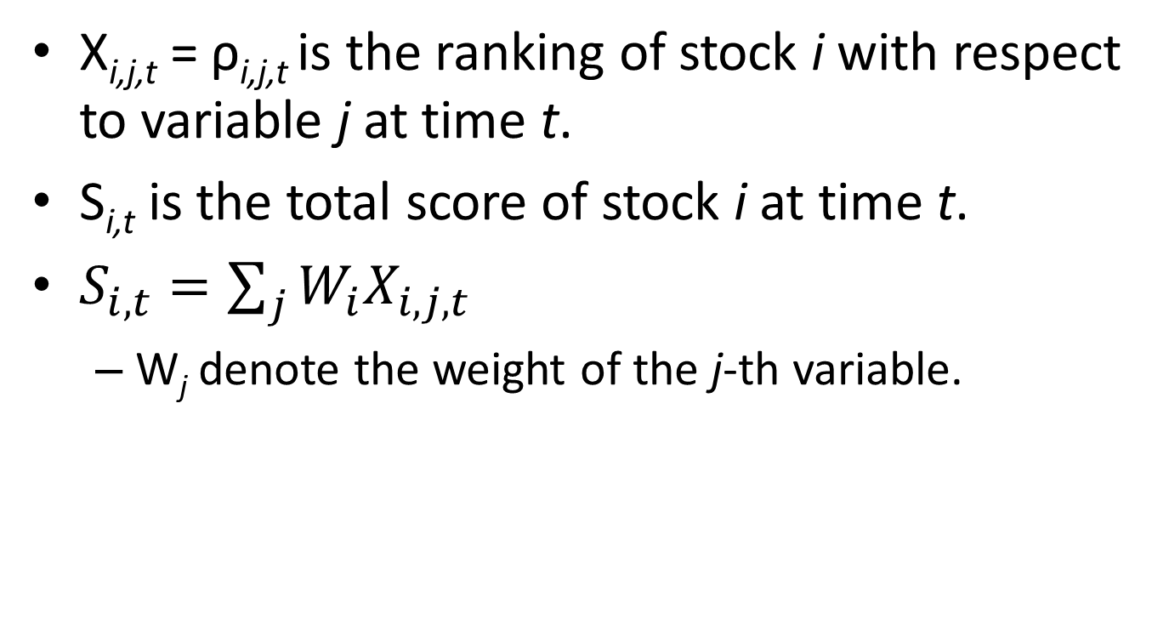
Score (potential)
X_{i,j,t} = ρ_{i,j,t} is the ranking of stock i with respect to variable j at time t.
S_{i,t} is the total score of stock i at time t.
$S_{i,t}=\sum_{j}{W_{i}X_{i,j,t}}$
W_{j} denote the weight of the j-th variable.

Slide 6
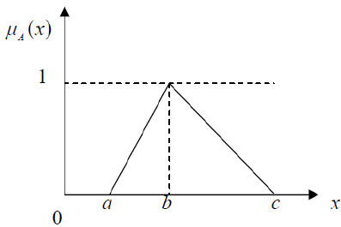

Fuzzy membership function
y_{i,t} = S_{i,t} * μ_{i,t}
${\text{μ}}_{A}\left(x\right)=\left\{\begin{aligned}0,&x≤a \\ \frac{x−a}{b−a}, &a<x≤b \\ \frac{c−x}{c−b}, &b<x≤c \\ 0,& c<x\end{aligned}\right.$

Slide 7
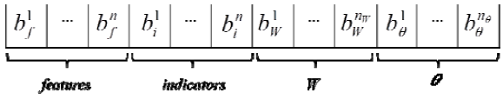
Encoding
F : features
1 = selected
0 = unselected
I : indicators
1 = rank sorted by descending.
0 = rank sorted by ascending.
W: weight , binary encoding, 50 bits
θ : {a,b,c}, parameters of membership function , binary encoding, 50bits

Slide 8
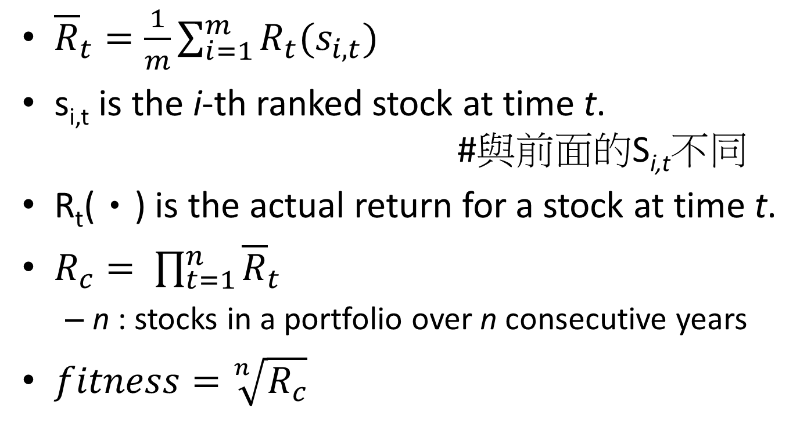
Fitness function
${\overline{R}}_{t}=\frac{1}{m}\sum_{i=1}^{m}{R_{t}(s_{i,t})}$
s_{i,t} is the i-th ranked stock at time t. #與前面的S_{i,t}不同
R_{t}(•) is the actual return for a stock at time t.
$R_{c}= \prod_{t=1}^{n}{{\overline{R}}_{t}}$
n : stocks in a portfolio over n consecutive years
$fitness=\sqrt[n]{R_{c}}$

Slide 9
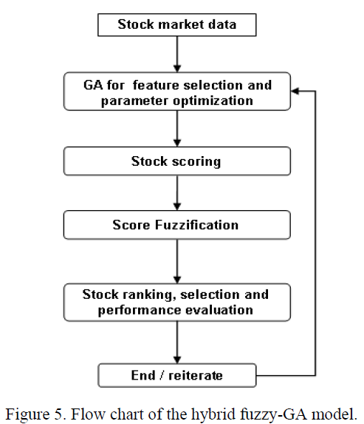
Flow chart

Slide 10
Experimental
Select 200 largest market capitalizations listed in the Taiwan Stock Exchange as the as investment universe.
Database : TEJ, 1995 ~ 2009
Every original attribute is scaled into the range of [−1, 1]

Slide 11
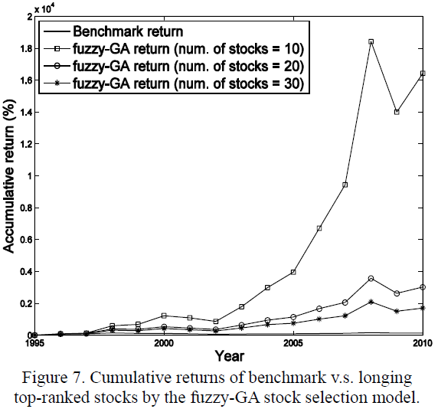

Slide 12
