Slide 1
A.M. Turing Award
-- 'Nobel Prize' of Computing
Date : Feb. 25, 2005
Created by : Hsing-Yen Ann

Slide 2
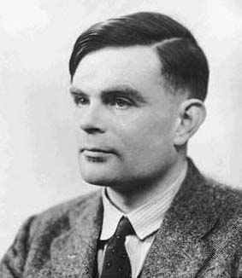
Who was Turing?
Alan Mathison Turing
Founder of computer science
Mathematician
Philosopher
Codebreaker (hacker)
Strange visionary
Marathoner
Gay man

Slide 3
About Turing
1912: Birth, Paddington, London
1936: The Turing machine, computability, universal
machine
1939-40: The Bombe, machine for Enigma decryption
1947: The fifth placed of A.A.A. Marathon
1950: The Turing Test for machine intelligence
1952: Arrested as a homosexual, loss of security clearance
1954: Death (suicide) by cyanide poisoning, Wilmslow,
Cheshire.
1966: The Turing Award was first given.

Slide 4
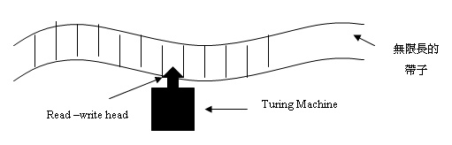
Turing Machine -- 1936
An idealised computing device consisting of a read/write head with a paper tape.
Each square on the tape bearing a single symbol, e.g. '0' or '1'.
This tape is the machine's general purpose storage medium.
  Vehicle for input / output.
  Working memory for storing the computing results.

Slide 5

Enigma Decryption -- 1939
The Bombe was used to break messages enciphered on the simpler Enigma system used by the German Air Force and more secure Enigma system from the U-boat fleet. (e.g. U-571)
Turing was awarded an OBE in 1946.

Slide 6
Turing Test -- 1951
Imitation game:
  A human being and a computer would be interrogated under conditions where the interrogator would not know which was which, the communication being entirely by textual messages.
  If the computer can fool the interrogator, it is deemed intelligent.
Loebner Prize:
  Established by Dr. Hugh Loebner in 1991.
  Award $100,000 to the first computer that could pass the Turing Test. Before that, he would give $2,000 each year to the best entrant in the competition.

Slide 7
Turing Test Example
Q: Please write me a sonnet on the subject of the Forth Bridge.
A: Count me out on this one. I never could write poetry.
Q: Add 34957 to 70764
A: (Pause about 30 seconds and then give as answer) 105621.
Q: Do you play chess ?
A: Yes.
Q: I have K at my K1, and no other pieces. You have only K at
K6 and R at R1. It is your move. What do you play?
A: (After a pause of 15 seconds) R-R8 mate..

Slide 8
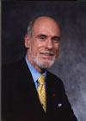
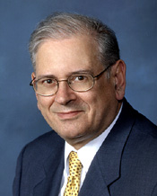
ACM A.M. Turing Award
The most prestigious technical award of ACM.
  ACM: Association for Computing Machinery
  http://www.acm.org/
2004 Winners ^{HOT!}
  Vinton G. Cerf and Robert E. Kahn
  For pioneering work on internetworking,
  including the design and implementation
  of the Internet's basic communications
  protocols, TCP/IP, and for inspired leadership
  in networking.

