Slide 1
Combinatorial Problems Arising in SNP and Haplotype Analysis

Slide 2
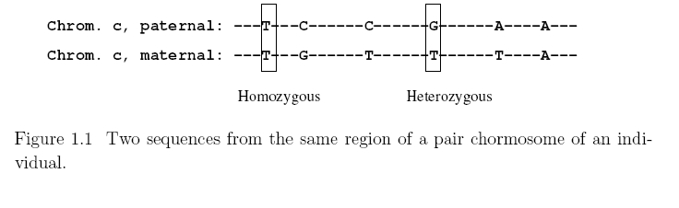
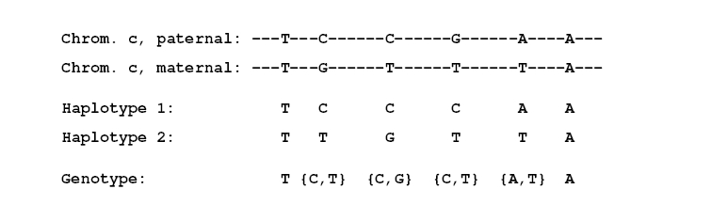
Introduction

Slide 3
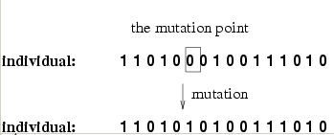
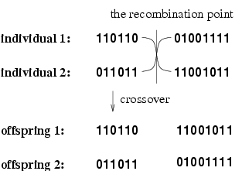

Slide 4
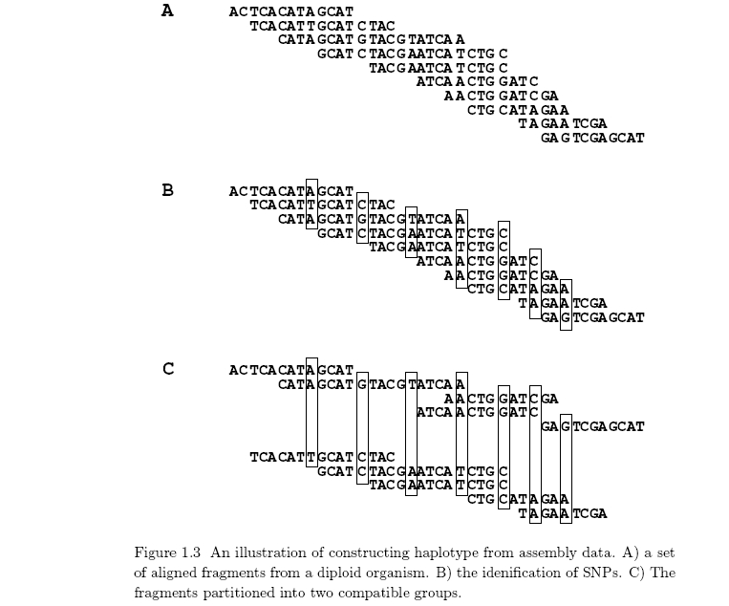

Slide 5

The Haplotype Phasing Problem
Haplotype Phasing (Generic)
Input: A set G of genotypes.
Output: A set H of haplotypes, such that
for each g G there exists h1, h2 H such that the conflation of h1 with h2 is g.

Slide 6
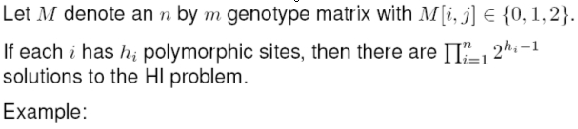
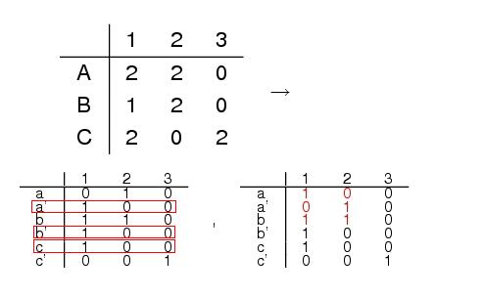
Example

Slide 7
Clark’s Rule
Maximum Likelihood
Parsimony
Perfect Phylogeny

Slide 8
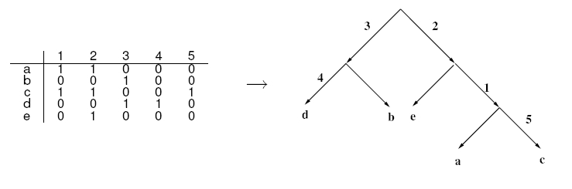
Perfect Phylogeny

Slide 9
Haplotype Assembly
Various approaches to single molecule sequencing have been described recently and some of these may mature to the point that phasing based solely on genotype analysis becomes unnecessary.

Slide 10
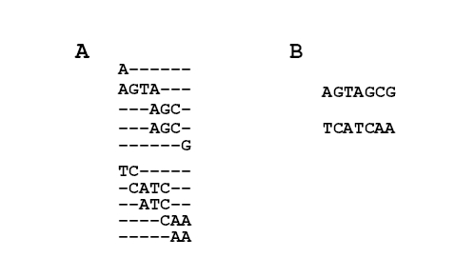
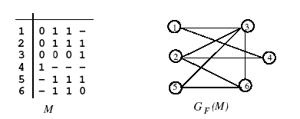
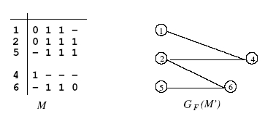
Haplotype Assembly

Slide 11
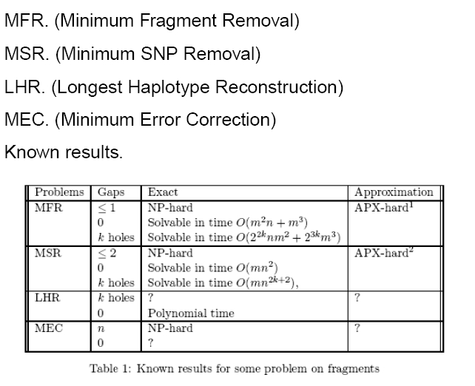
The haplotyping Problems for an individual

Slide 12
Haplotype Block Detection
SNP Selection

