Slide 1
An O(N²) Algorithm for Discovering Optimal Boolean Pattern Pairs
Hideo Bannai, Heikki Hyyro, Ayumi Shinohara, Masayuki Takeda, Kenta Nakai, and Satoru Miyano
IEEE/ACM Trans. on Computational Biology and Bioinformatics, Vol. 1, No. 4, pp. 159-170, 2004
Date : May 10, 2005
Created by : Hsing-Yen Ann

Slide 2
Abstract
We consider the problem of finding the optimal combination of string patterns, which characterizes a given set of strings that have a numeric attribute value assigned to each string. Pattern combinations are scored based on the correlation between their occurrences in the strings and the numeric attribute values. The aim is to find the combination of patterns which is best with respect to an appropriate scoring function. We present an O(N²) time algorithm for finding the optimal pair of substring patterns combined with Boolean functions, where N is the total length of the sequences.

Slide 3

Abstract (cont’d)
The algorithm looks for all possible Boolean combinations of the patterns, e.g., patterns of the form , which indicates that the pattern pair is considered to occur in a given string s,
if p occurs in s, AND q does NOT occur in s. An efficient implementation using suffix arrays is presented, and we further show that the algorithm can be adapted to find the best k-pattern Boolean combination in O(N^{k}) time. The algorithm is applied to mRNA sequence data sets of moderate size combined with their turnover rates for the purpose of finding regulatory elements that cooperate, complement, or compete with each other in enhancing and/or silencing mRNA decay.

Slide 4
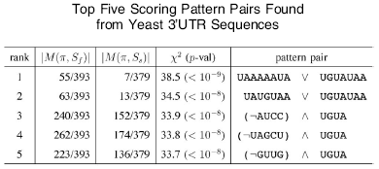
An Example
Input:
  Two sets of predicted 3’UTR Yeast mRNA sequences
  S_{f} : 393 sequences with fast degradation rate
  S_{s} : 379 sequences with slow degradation rate
Output:
  Finding sequence elements which determine mRNA degradation rates

Slide 5
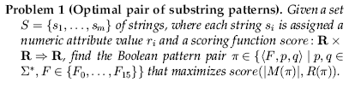
Problem Definition
That is, finding two patterns p and q, and a boolean operation F, such that |M(π)| and R(π) to be the optimal input data for function score.
■ ψ(p, s)= True / False, boolean match function
■ (<F, p, q>, s) = F (ψ(p, s), ψ(q, s), matching function value
■ M(π) : subset of s which match by π
■ R(π) : sum of r_{i} over all elements in M(π)

Slide 6
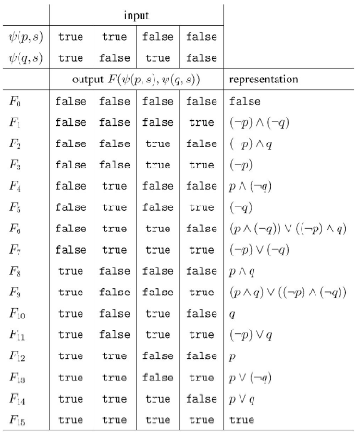
Summary of Candidate Boolean Operations on Pattern Pair <F, p, q>

Slide 7
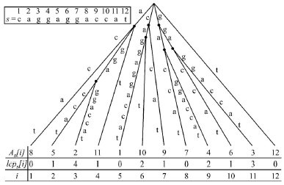
Suffix Trees, Suffix Arrays and LCP Arrays

Slide 8
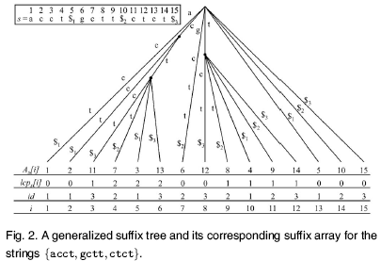
Generalized Suffix Trees

Slide 9
The Algorithm and Its Time Analysis
There are O(N²) possible candidate pattern pairs for calculating the score value.
For each given pattern pair candidate π= <F, l(v₁), l(v₂)>, the values |M(π)| and R(π) can be computed in O(N) time.
Therefore, a naïve algorithm needs O(N³) time and O(N) space.
By cumulating the sums and correction factors during a linear time bottom-up traversal of the GST, the proposed algorithm needs only O(N²) time and O(N) space.

Slide 10
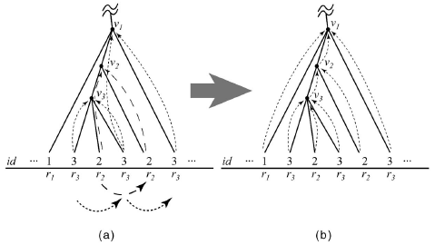
Calculate R(l(v)) and |M(l(v))| with removing the redundancies

Slide 11
Problem Types
Positive/Negative Sequence Set Discrimination
  Scoreing function:
  Entropy information gain,
  Gini index,
  Chi-square statistic
Finding Correlated Patterns
  Scoreing function:
  Wilcoxon rank sum test

Slide 12

Computational Experiments -- Yeast
Input:
  Two sets of predicted 3’UTR Yeast mRNA sequences
  Using chi-squared statistic
Output:
  Finding sequence elements which determine mRNA degradation rates

Slide 13

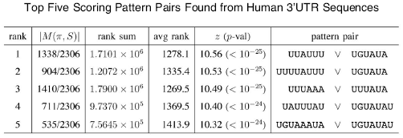
Computational Experiments -- Human
Input:
  2306 sequences
  Using Wilcoxon rank sum test statistic
Output:
  Finding Correlated patterns from human sequences

