Slide 1
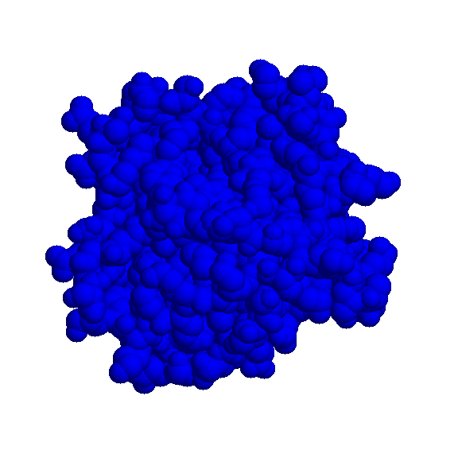
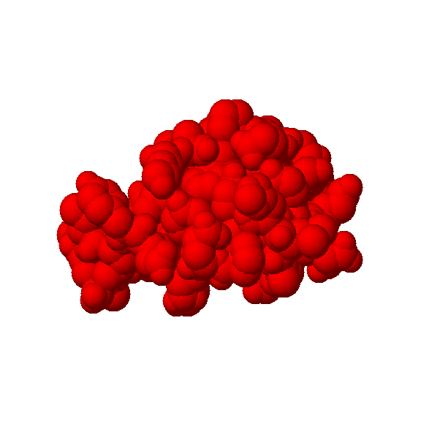
Unbound Docking of Rigid Molecules

Slide 2
Problem Definition
Given two molecules find their correct association:
+
=

Slide 3
Problem Importance
Computer aided drug design – a new drug should fit the active site of a specific receptor.
Understanding of the biochemical pathways - many reactions in the cell occur through interactions between the molecules.
Crystallizing large complexes and finding their structure is difficult.

Slide 4
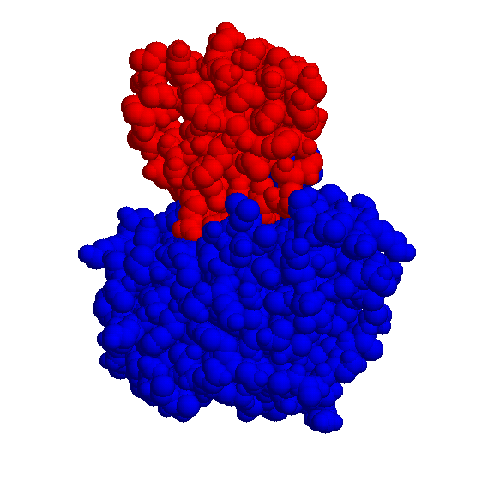
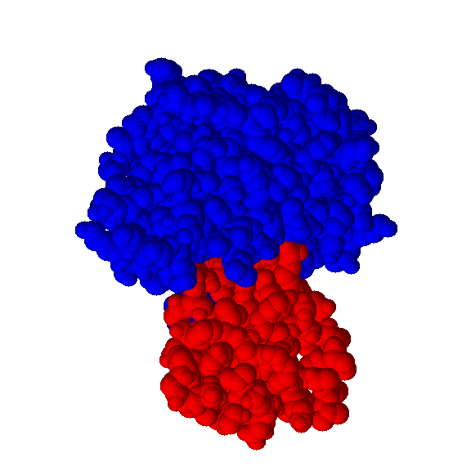
Bound Docking
In the bound docking we are given a complex of 2 molecules.
The goal is to separate and reconstruct them.
No conformational changes are involved.

Slide 5
Unbound Docking
In the unbound docking we are given 2 molecules in their native conformation
The goal is to find the correct association.
Problems: conformational changes (side-chain and backbone movements), experimental errors in the structures.

Slide 6
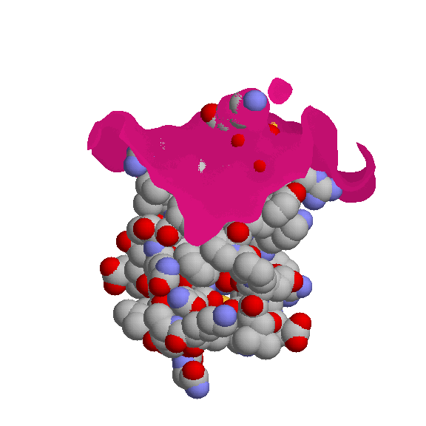
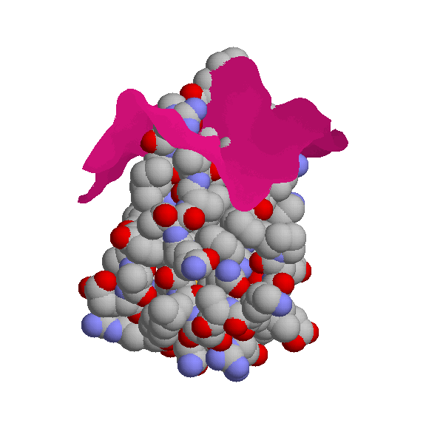
Bound vs. Unbound
Receptor surface
Ligand
Kallikrein A/trypsin inhibitor complex (PDB codes 2KAI,6PTI)
10 penetrating residues

Slide 7
Docking Algorithms
Brute force enumeration of the transformation space:
FFT – Katchalski-Katzir et al. (1992) (Walls & Sternberg, Vakser, Gabb et al., Camacho et al., Chen & Weng)
Soft Docking – Jiang & Kim, Palma et al.,
Genetic algorithms – Jones et al., Gardiner et al.
Local shape feature matching:
Dock - Kuntz (1982)
‘knobs’ and ‘holes’ – Connolly (1986)
Geometric Hashing - Norel et al., Fischer et al.
Flexible docking - Sandak et al.
Hydrogen H-bonding – Rarey et al.

Slide 8
Docking Algorithm (Name???)
We develop local shape feature matching docking algorithm.
We try to focus on local shape patches that are likely to be in the binding site.
The algorithm also improves the geometric scoring.
Although it may be used for any type of molecules (protein-protein, protein-drug), it has features specific to each type.

Slide 9
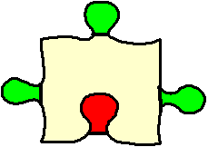
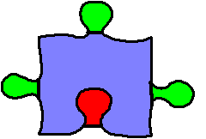
Docking Algorithm Scheme
Molecular shape representation
Matching of critical features
Filtering and scoring of candidate transformations

Slide 10
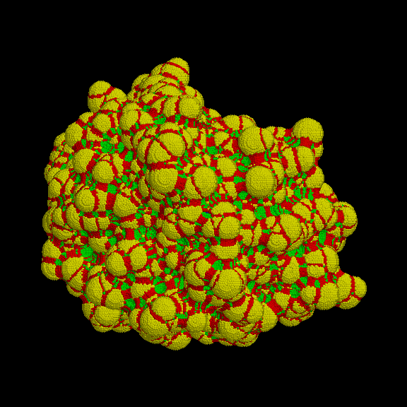
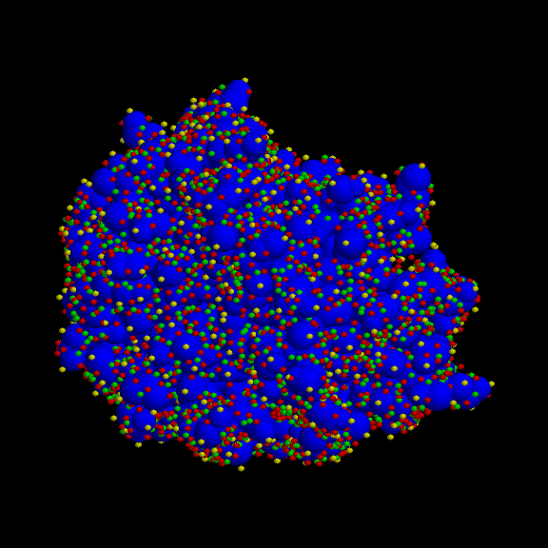
Molecular Surface Representation
Dense MS surface (Connolly)
Sparse surface (Shuo Lin et al.)

Slide 11
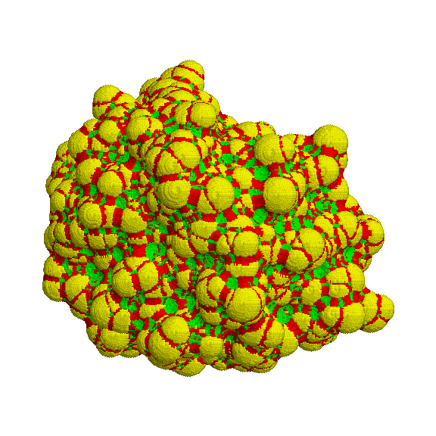
Distance Transform Grid
Dense MS surface (Connolly)
-1
0
+1

Slide 12
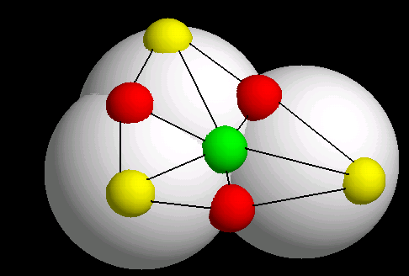
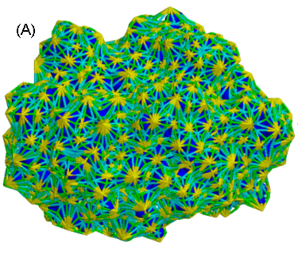
Sparse Surface (Shuo Lin)
Caps, pits, belts:
G_{top} – Surface topology graph:
V=surface points
E={(u,v)| u,v belong to the same atom}

Slide 13
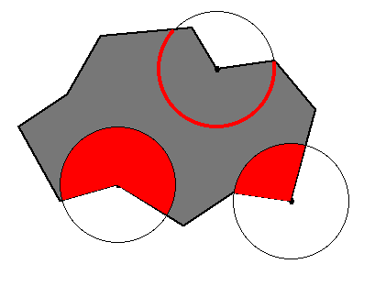
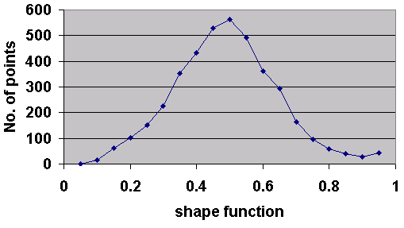
Shape function
Shape function is a measure of local curvature.
‘knobs’ and ‘holes’ are local minima and maxima (<1/3 or >2/3).
Problem: more than 70% of surface points are ignored.
Solution: divide the values of the shape function to 3 equal sized sets: ‘knobs’, ‘flats’ and ‘holes’.

Slide 14
Patch Detection
Goal: divide the surface into connected, non-intersecting, equal sized patches of critical points.
connected – the points of the patch correspond to a connected sub-graph of G_{top}.
equal sized – to assure better matching we want shape features of the same size.

Slide 15
Patch Detection
Construct a graph for each type of points (knobs,holes,flats). For example G_{knob} will include all surface points that are nodes and an edge between two ‘knobs’ if they belong to the same atom.
Compute connected components of every graph.
Output: connected components, but the sizes can vary.
Solution: apply ‘split’ and ‘merge’ routines.

Slide 16
Split and Merge
Geodesic distance between two nodes is a weight of the shortest path between them in surface topology graph. The weight of each edge is equal to the Euclidean distance between the corresponding surface points.
Diameter of the component – is the largest geodesic distance between the nodes of the component. Nodes s and t that give the diameter are called diameter nodes.
s
t

Slide 17
Split and Merge (cont.)
The diameter of every connected component is computed using the APSP (All pairs shortest paths) algorithm.
1. low_patch_thr ≤ diam ≤ high_patch_thr → valid patch
2. diam > high_patch_thr → split
3. diam < low_patch_thr → merge
low_patch_thr = 10Å
high_patch_thr = 20Å

Slide 18
Split and Merge (cont.)
Split routine: compute Voronoi cells of the diameter nodes s,t. Points closer to s belong to new component S, points closer to t belong to new component T. The split is applied until the new component has a valid diameter.
Merge routine: compute the geodesic distance of every component point to all the patches. Merge with the patch with closest distance.
s
t

Slide 19
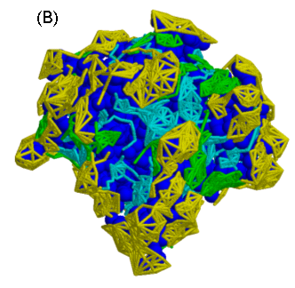
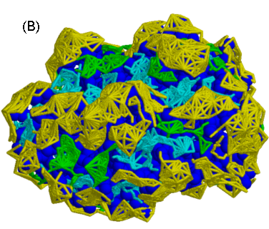
Examples of Patches:
Yellow – knob patches, cyan – hole patches, green – flat patches, the proteins are in blue

Slide 20
Active Site Focusing
There are major differences in the interactions of different types of molecules (protease-inhibitor, antibody-antigen, protein drug). Studies have shown the presence of energetic hot spots in the active sites of the molecules.
Protease/inhibitor – select patches with high enrichment of hot spot residues (Ser,Gly,Asp and His for protease; and Arg,Lys,Leu,Cys and Pro for protease inhibitor).
Antibody/antigen – 1.detect CDRs of the antibody. 2. select hot spot patches (Tyr,Asp,Asn,Glu,Ser and Trp for antibody; and Arg,Lys,Asn and Asp for antigen)
Protein/drug – select largest protein cavity (highest value of average shape function for the patch)

Slide 21
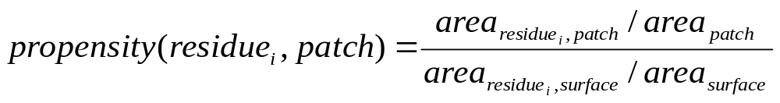
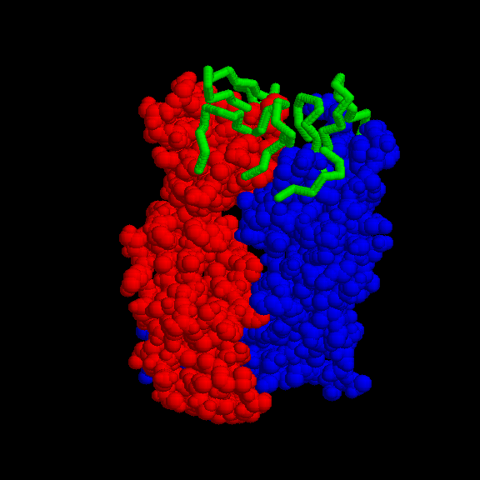
Active Site Focusing
The enrichment of hot spot residue in patch is measured by propensity. Propensity is a ratio of residue frequency in patch and residue frequency in surface.
The CDRs are detected by aligning the sequence of the given antibody to the consensus sequence of the library of the antibodies.

Slide 22
Docking Algorithm Scheme
Molecular shape representation
Matching of critical features
Filtering and scoring of candidate transformations

Slide 23
Matching of patches
The aim is to match knob patches with hole patches, and flat patches with any patch. We use two types of matching:
Single Patch Matching – one patch from the receptor is matched with one patch from the ligand. Used in protein-drug cases.
Patch-Pair Matching – two patches from the receptor are matched with two patches from the ligand. Used in protein-protein cases.

Slide 24
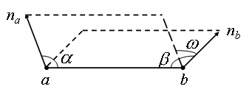
Matching of patches
The transformations are computed by matching 2 points and their normals.
The signature of the base is defined as follows:
Euclidean and geodesic distances between 2 points
The angles α,β between a,b segment and the normals
The torsion angle w between the planes
Two bases are compatible if their signatures match.

Slide 25
Single Patch Matching
Preprocessing: the bases are built for each ligand base and stored in hash table. There are 3 hash tables for each type.
Recognition: for each patch of the receptor build the bases and access the hash-table with base signature. The transformations set is computed for all compatible bases.
At the end of this step each patch has a list of ligand transformations.

Slide 26
Patch-Pair Matching
Two patches are neighbors if there is an edge connecting them in surface topology graph.
Preprocessing: the bases are built for each pair of the ligand patches. We use one point and normal from each patch. The bases are stored in hash table. There are 3² hash tables for each pair of types.
Recognition: for each pair of the receptor patches we build the bases and access the hash-table with the base signature. The transformations set is computed for all compatible bases.

Slide 27
Clustering
Since local features are matched, we may have multiple instances of “almost” the same transformation.
We apply 2 clustering techniques:
1.Clustering transformation parameters – coarse but very fast.
2.RMSD clustering – accurate but slow. (according to FLEXX, Rarey et al., 1996)

Slide 28
Clustering Transformation Parameters
Use 6 transformation parameters: 3 rotational and 3 translational.
The transformations are stored in the hash-table with bucket size 0.1 for rotation and 2.0 for translation.
It is assumed that the correct solution is obtained by matching a large enough number of local features. Thus, we compute a histogram of cluster sizes and traverse only high scoring buckets (10% of the total number of buckets).
The transformation of each cluster is computed by applying the best least-squares fitting method on the points of matched bases.
Note, that it is possible to improve the clustering by using 4 quaternion rotation parameters instead of 3.
Complexity: proportional to the number of transformations

Slide 29
Docking Algorithm Scheme
Molecular shape representation
Matching of critical features
Filtering and scoring of candidate transformations

Slide 30
Filtering and Scoring
Since the transformations were computed by local shape features matching they may include unacceptable steric clashes.
The scoring is necessary to rank the remaining solutions.
Steric clash test:
For each candidate ligand transformation
transform ligand surface points
For each transformed point
access Distance Transform Grid and check distance value
If it is more than max_penetration
Disqualify transformation
Geometric score: the surface of the receptor is divided into five ranges: [-5.0,-3.6), [-3.6,-2.2), [-2.2, -1.0), [-1.0,1.0), [1.0→) and each range is given a weight: -10, -6, -2, 1, 0. The geometric score is a weighted average on a number of points inside every range.

Slide 31
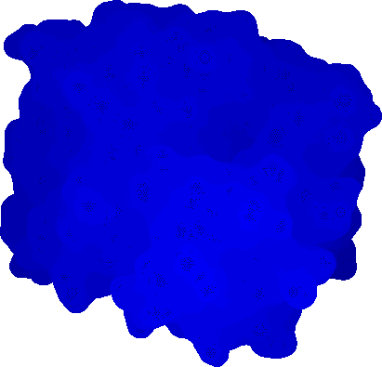
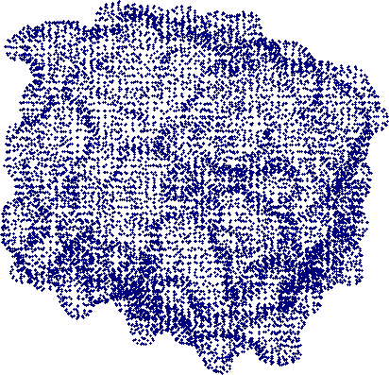
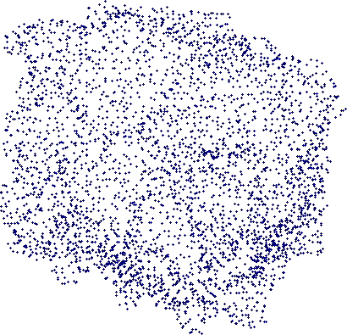
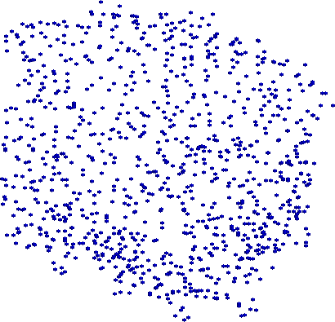
Filtering and Scoring
Performance Problem: the number of surface points for high resolution MS surface may reach 100,000. For each candidate transformation, for each surface point we apply the transformation and access distance transform grid.
We develop multi-resolution surface data structure that supports fast queries for penetrations and geometric score.
119,000 points
16,000 points
4,100 points
1,000 points

Slide 32
Multi-resolution surface
point
radius
number of leaves
low-level pointers
Node:
Level 2:
Level 1:
Level 0: Connolly Surface points

Slide 33
Queries in Multi-resolution surface data structure
The queries are: isPenetrating(trans, threshold), maxPenetration(trans), score(trans), interface(trans).
All the searches are performed by DFS.
We check every node from highest level and go down if it is in interface.
For each node we check distance transform value and radius. If they are within the threshold we don’t check the children.
Worst case complexity of each query: O(interface size + highest level size)

Slide 34
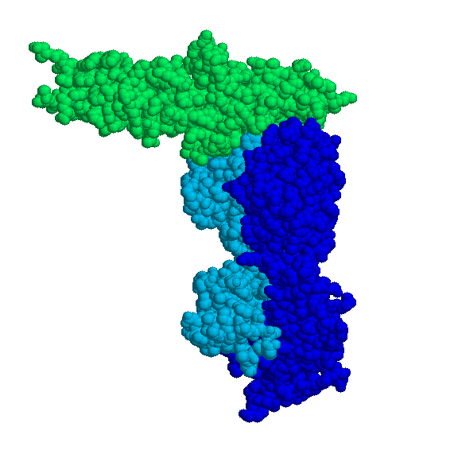
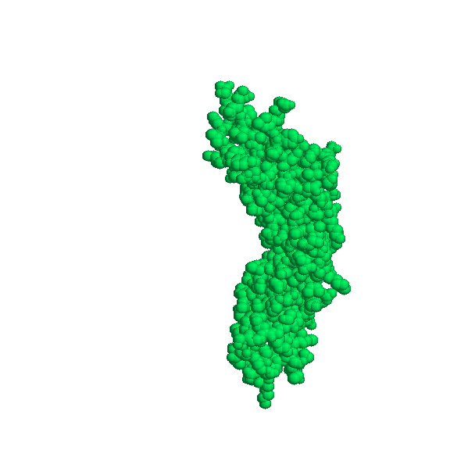
Antibody-Antigen Scoring
Although only the patches including CDRs are used in the matching stage, the results may still include transformations where most of the interface doesn’t belong to CDRs.
In addition to regular score, we compute the percentage of the interface included in the CDRs. All the transformations with less than 70% of CDRs are disqualified.

Slide 35
Results
Datasets:
Protein-Protein docking:
Enzyme-inhibitor – 22 cases
Antibody-antigen – 13 cases
Protein-DNA docking: 2 unbound-bound cases
Protein-drug docking: tens of bound cases (Estrogen receptor, HIV protease, CYP450_{cam}, COX)
Performance:
Several minutes for large protein molecules and seconds for small drug molecules

Slide 36
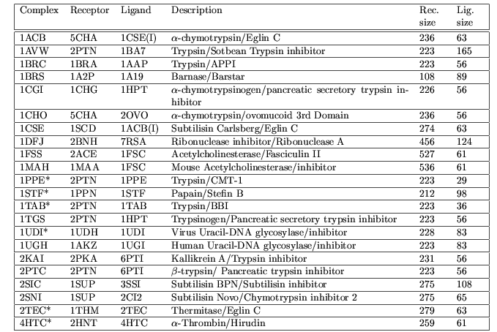
Enzyme-inhibitor cases

Slide 37
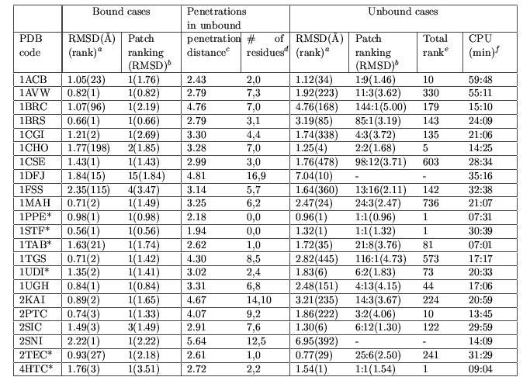
Enzyme-inhibitor results

Slide 38
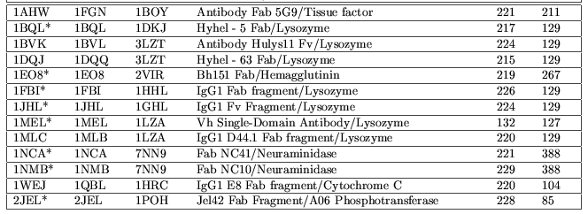
Antibody-antigen cases

Slide 39

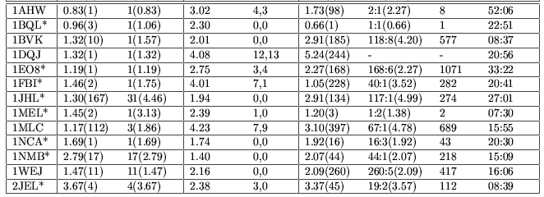
Antibody-antigen results

Slide 40
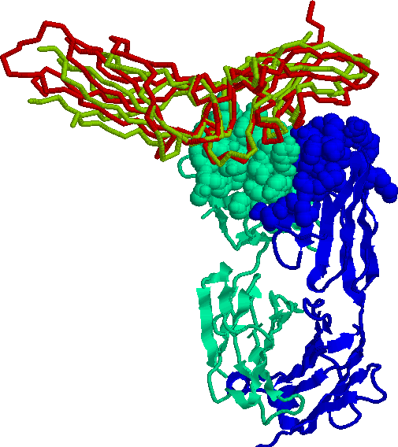
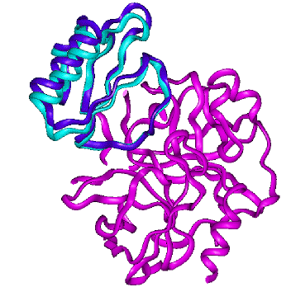
Pictures
Antibody-antigen (unbound)
Enzyme-inhibitor (unbound)
Antibody Fab 5G9 (1FGN) with tissue factor (1BOY). RMSD 2.27Å, rank 8
Α-chymotrypsin (5CHA) with Eglin C (1CSE(I)). RMSD 1.46Å, rank 10

Slide 41
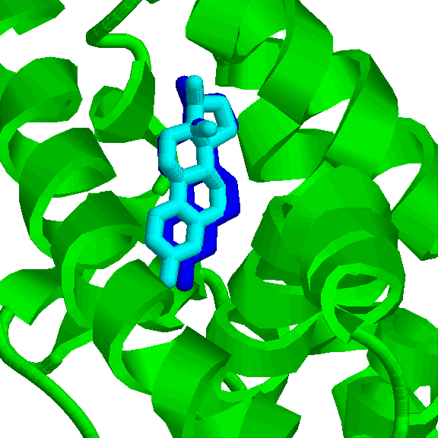
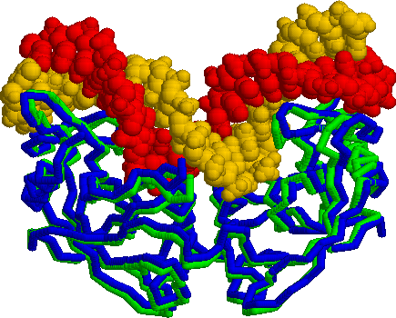
Pictures
Protein-drug (bound)
Protein-DNA (unbound-bound)
Estrogen receptor with estradiol (1A52). RMSD 0.9Å, rank 1
Endonuclease I-PpoI (1EVX) with DNA (1A73). RMSD 0.87Å, rank 2

Slide 42
Factors that influence the rank of the correct solution
Shape complementarity
Interface shape – in the concave/convex interfaces (enzyme-inhibitor, receptor-drug), shape complementarity is easier to detect comparing to flat interfaces (antibody-antigen).
Sizes of molecules – the larger the molecules the higher the number of the results.

Slide 43
Conclusions and Future Work
The division to shape-based patches improves the performance of the unbound cases.
Multi-resolution data structure and distance transform grid improve the efficiency and quality of the geometric score.
Hot-spots allow to focus on relevant surface parts.
Additional biological scores will improve the ranking of the correct association.
Introducing side-chain flexibility into algorithms will improve the results for difficult unbound cases.

Slide 44
“Small” Points
Local curvature computation
Matching of patches by critical points
Transformation clustering – memory allocations
Geometric score by ranges
Weights on ranges

