Slide 1
Sparse LCS Common Substring Alignment
Gad M. Landau, Baruch Schieber, Michal Ziv-Ukelson
Information Processing Letters, Vol. 88, 2003, pp. 259–270
Date : Oct. 20, 2005
Created by : Hsing-Yen Ann

Slide 2
Abstract
The "Common Substring Alignment" problem is defined as follows. The input consists of a set of strings S₁, S₂, ... , S_{c}, with a common substring appearing at least once in each of them, and a target string T. The goal is to compute similarity of all strings S_{i} with T, without computing the part of the common substring over and over again.
In this paper we consider the Common Substring Alignment problem for the LCS (Longest Common Subsequence) similarity metric. Our algorithm gains its efficiency by exploiting the sparsity inherent to the LCS problem.

Slide 3
Abstract (cont’d)
Let Y be the common substring, n be the size of the compared sequences, Ly be the length of the LCS of T and Y, denoted |LCS[T, Y]|, and L be max{|LCS[T, S_{i}]|}. Our algorithm consists of an O(n﹒Ly) time encoding stage that is executed once per common substring, and an O(L) time alignment stage that is executed once for each appearance of the common substring in each source string. The additional running time depends only on the length of the parts of the strings that are not in any common substring.

Slide 4
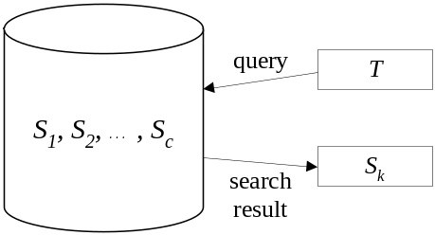
Common Substring Alignment Problem
Input:
a set of strings (database): S₁, S₂, …, S_{c}
a target string (query): T
assume that all S_{i} and T are of size n
Output:
the similarity of all strings S_{i} with T:
sim(S₁, T), sim(S₂, T), …, sim(S_{c}, T)
(then we can find out the most similar one)
Similarity metric: length of LCS
an intuitive algorithm: O(c．n²)

Slide 5
Research Goal
If there exists a common substring Y in all S_{i} (S_{i} = B_{i} Y F_{i}, for each S_{i}), then we only need to compare Y and T once.
A three-stage approach
Preprocessing stage: (off-line)
giving S₁, S₂, …, S_{c}, to find a common substring Y of
all strings S_{i} (not considered in this paper)
Encoding stage: (on-line)
encoding the result of comparing Y and T
Alignment stage: (on-line)
for each S_{i}, compute the similarity to T by using
the encoded result

Slide 6
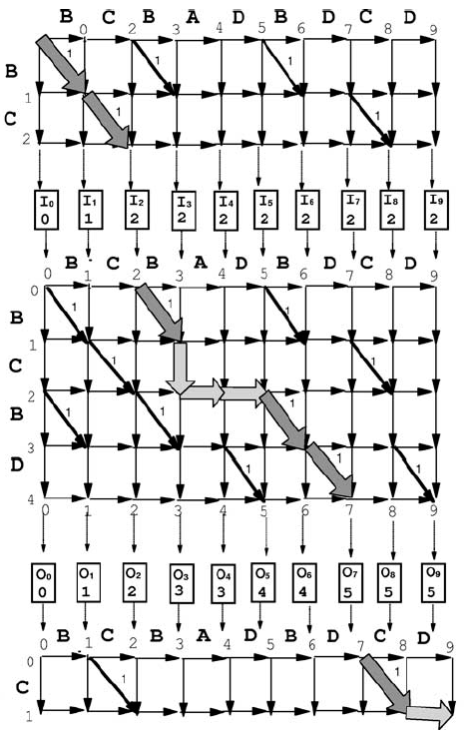
T
Transformed problem:
Input:
string T, Y,
row I (PI)
Output:
row O (PO)
Dominative indexes PI, PO is sufficient for computing
I = {0,1,2,2,2,2,2,2,2,2}
➔ PI = {0,1,2}
O = {0,1,2,3,3,4,4,5,5,5}
➔ PO = {0,1,2,3,5,7}
B_{i}
Y
F_{i}

Slide 7

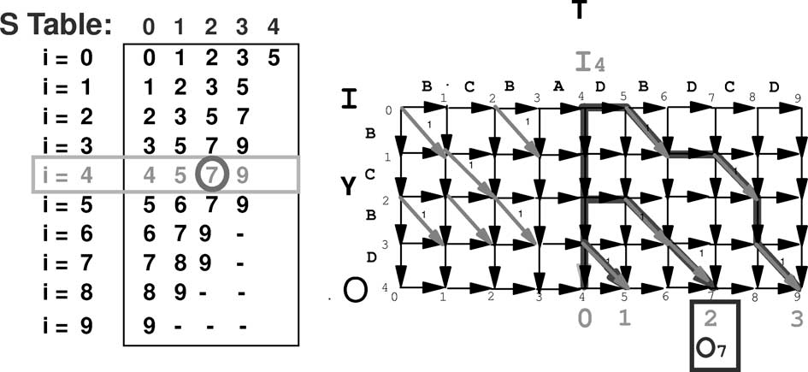
Encoding Stage
Transform the DP table of T and Y to table S.
S can be constructed in O(n．Ly) time and space by Myers' Consecutive Alignments algorithm[27].
S[i, k]: the smallest index that start from (i,0) and |LCS| = k
Notes:
Table S is independent to each S_{i} in database.

Slide 8
Encoding Stage (cont'd)
S can easily answer the two questions:
  What is the smallest index of O, where the LCS start at I_{a} and its length is k.
  What is the LCS length from I_{a} to O_{b}.
Notes:
Table S is independent to each S_{i} in database.

Slide 9
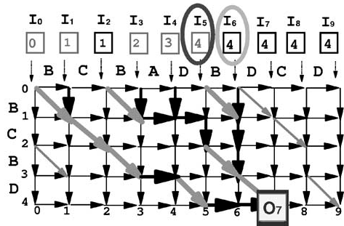
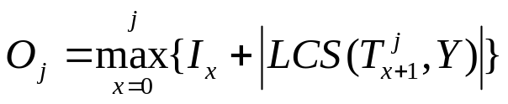
Alignment stage
Given I, how to compute O?
Fix an element in O, then search in I
Only the indexes in PI are useful.
(e. g. I₅ is better than I₆)
Time: O(n．|PI|)

Slide 10
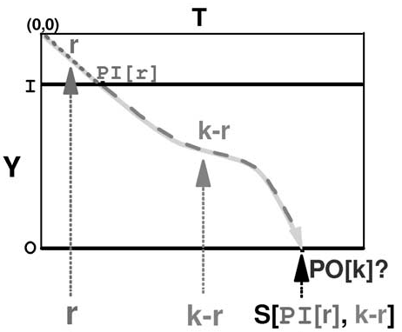
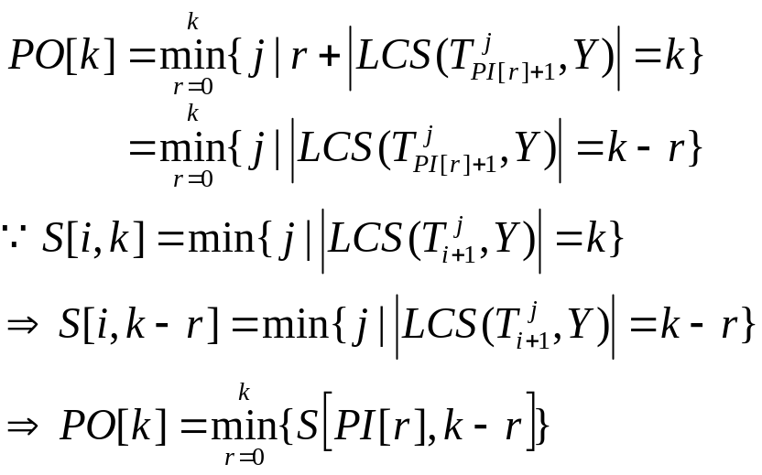
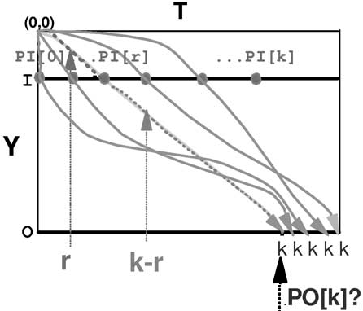
Alignment stage (cont'd)
How about Compute Row PO Directly?
Time: O(|PO|²)

Slide 11

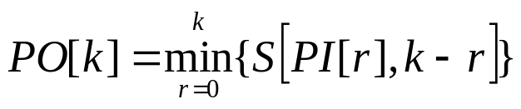
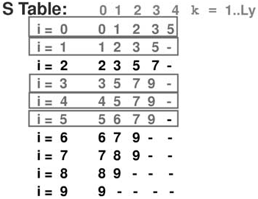
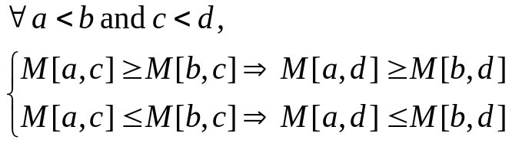
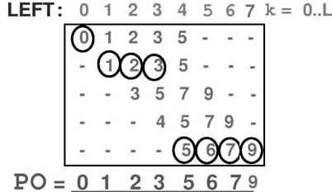
Reducing the Queries on Table S
LEFT: necessary queries on table S
PO: column minima of LEFT
totally monotone:
SMAWK algorithm can find the column minima in a virtual full, rectangular, convex totally monotone matrix LEFT. (Aggarwal et al. [3])
Time: O(|PO|)
r
k-r

Slide 12
Conclusions and Open Questions
Conclusions:
  Encoding stage: O(n．Ly) time and space by Myers' Consecutive Alignments algorithm[27].
  Alignment stage: O(L) time by SMAWK algorithm[3].
Open questions:
  Whether a more efficient algorithm exists when the target string contains encoded repetitions as well as the source strings.
  How to extend the solutions to more general metrics (e. g. Edit Distance).

