Slide 1
Constrained Multiple Structure Feature Alignment (CMSFA)
蘇柏翰,周偉堯,白敦文,張大慈,張顥騰,周維宜
NCS2005

Slide 2
Abstract
With the rapid accumulation of released three-dimensional protein structure database, the importance of structural comparison parallels that of sequence alignment. It has been shown that despite primary sequence diversity, protein structures of related sequences possess a structural core of α- helices and β-sheets and vary in the loop regions.To determine the characteristic properties for each target sequence from a protein family, we have developed a fast algorithm for structure alignment based on the combination of primary sequences and three-dimensional structures. The sequence-based comparison utilizes the labeled consensus motifs to provide combinatorial features for multiple sequence alignment, and the spatial positions of the key amino acids in each of the combinational segments are assigned for the proposed constrained multiple structure feature alignment (CMSFA).

Slide 3
Abstract
The 3D coordinates of aligned amino acids provide data for calculating the root-mean-square deviation (RMSD) values which build the references for the detection of structurally distinct regions. In this study, RNase A P450, and ricin A protein families were employed to demonstrate the outstanding performance of the structure alignment algorithms, and the comparisons between our proposed CMSFA and several existing structural alignment tools are also described in this paper.

Slide 4
Materials and Methods
Problem Definitions
The protein sequences retrieved from the C-alpha atom in the PDB files are represented as strings over the 20 amino acid set.
Each residue is assigned its own three-dimensional rectangular coordinates.
Let W be the set of input protein sequences in this paper.
The ith protein sequence in W will be denoted by Wi (W set is constructed as W={W1,W 2,…,WN-1,WN} ), and the total number will be indicated by N=|W|.

Slide 5
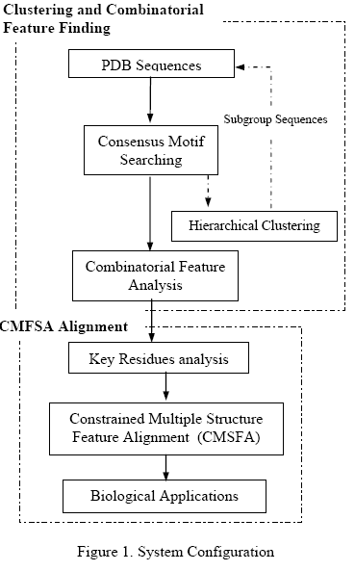
Materials and Methods
The system requires importing protein sequences of a family in PDB format.
The first phase focuses on sequence analysis which provides both clustering and combinatorial feature extraction operations.
The modules in the second phase include key residue analysis, constrained 3D feature alignment, and related biological applications.

Slide 6
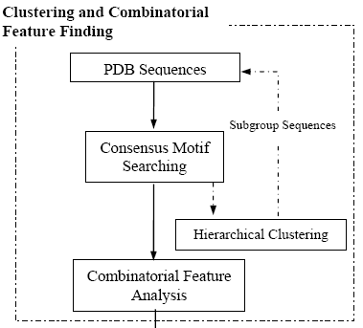
Materials and Methods
The first module searches consensus motifs by Ladderlike Interval Jumping Searching Algorithms (LIJSA)
Users are able to determine whether clustering functions should be performed or not.
If the sequences under analysis comprise the near neighboring proteins in addition to target protein family, the system will suggest to perform clustering operations to divide the near neighboring proteins into several subgroups for better performance in terms of combinatorial feature analysis

Slide 7
Materials and Methods
On the other hand, the performance of extraction of combinatorial features will be obtained with better results if the imported sequences are clustered with higher similarity in each subgroup
The agglomerative clustering algorithms are employed to cluster sequences into several subgroups, and our system takes the simple linkage, a kind of hierarchical measurement to determine which sequences should be grouped together.

Slide 8
Materials and Methods
Once the imported sequences are clustered, the combinatorial features of each subgroup are aligned employing traditional Dynamic Programming techniques.
The fundamental elements in DP algorithms are labeled consensus motifs instead of individual residues.
The output results from this module provide combinatorial features sequentially for each subgroup family

Slide 9
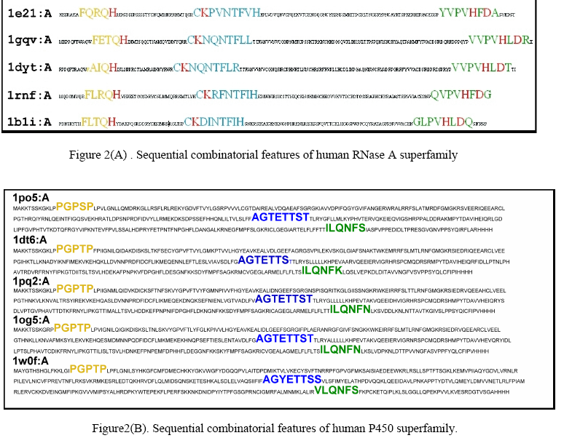

Slide 10
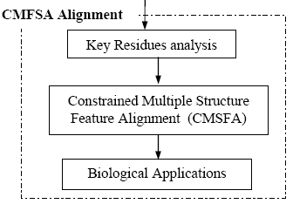
Materials and Methods
W i (j) means the jth residue in W i.
Based on the properties of hydrophobicity, hydrophilicity, and charge.
charge :
CH [AA] = 1 AA ∈{ R , K , H , E , D}; otherwise CH [AA] = 0
AA represents one of the 20 amino acids.
ex : CH [ R ] = 1, CH [G] = 0
Hydrophilic :
HY [AA] = 1 , AA ∈ {T , S, Q, N, Y, C, G, R, K, H, E, D }
ex : HY [ D ] = 1 , HY[ A ] = 0
homology characteristics : the amino acids based on the aligned sequence similarities in W and indicated by HO [⋅ ], i.e. HO [ AA ] = 1 if AA belongs to the homology set.

Slide 11
Materials and Methods
According to the combinatorial features, the module of key residue analysis evaluates priority score, cp ( j ), of each residue for further identification.
The priority score is determined by protein properties including homology (HO [⋅ ]), charge (CH [⋅ ]) and hydrophilicity (HY [⋅ ] ).

Slide 12
Materials and Methods
According to the above formulated properties, the jth residue in W i (l , k) can be assigned with a score Cp ( j ）, that stands for the degree of significance of chemical properties.
For proteins possessing enzyme activities, the system will regard the set of residues, KR {⋅ } possessing the highest scores in each combinatorial feature segment, as the potential key residues for further constrained multiple structure feature alignment.
KR {⋅} = {W (j ) ∈ W i ( l, k), l ≤ j ≤ k } .

Slide 13

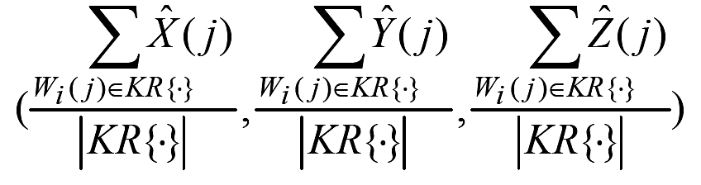
Materials and Methods
X ( j ), Y( j ) , and Z ( j ) stands for the orthogonal coordinates of the jth residue X, Y and Z in the unit of Angstroms.
Afterwards, the geometric centers of the selected key sites in each aligned consensus motif are calculated as
in each subgroup sequence, and these centers are utilized to perform constrained multiple structure feature alignment.
With these centers, the module will randomly choose three candidates for multiple alignments, since three spatial positions can determine a surface plane and then confirm the orientation of each structure.

Slide 14
Materials and Methods
With these centers, the module will randomly choose three candidates for multiple alignments, since three spatial positions can determine a surface plane and then confirm the orientation of each structure.
Based on the structure alignment, all other proteins in each subgroup family will be aligned rapidly with their fixed plane in 3D space constructed from the selected points.

Slide 15
