Slide 1
A Pairwise Alignment Algorithm Which Favors Clusters of Blocks
Elodie Nedelec | Thomas Moncion
Elisabeth Gassiat | Bruno Bossard
Guillemette Duchateau-Nguyen | Alain Denise
Michel Termier
JOURNAL OF COMPUTATIONAL BIOLOGY Volume 12, Number 1, 2005, pp. 33-47
Original： Joel Lipschultz
Modified by： Shiuan-Wen Chen
Date： Dec. 29, 2005

Slide 2
Abstract
Pairwise sequence alignments aim to decide whether two sequences are related or not, and, if so, to exhibit their related domains. Recent works have pointed out that a significant amount of true homologous sequences are missed when using classical comparison algorithms. This is the case when two homologous sequences share several little blocks of homology, too small to lead to a significant score. On the other hand, classical alignment algorithms, when detecting homologies, may fail to recognise all the significant biological signals.

Slide 3
Abstract (cont.)
The aim of the paper is to give a solution to these two problems. We propose a new scoring method which tends to increase the score of an alignment when “blocks” are detected. This so-called “Block-Scoring” algorithm, which makes use of dynamic programming, is worth being used as a complementary tool to classical exact alignments methods. We validate our approach by applying it on a large set of biological data. Finally, we give a limit theorem for the score statistics of the algorithm.

Slide 4
In an ideal world…
Given any two arbitrary biological sequences, we will ALWAYS be able to detect whether they are homologous or not.
Pairwise Alignment

Slide 5
Pairwise Alignment
Concept
  Reconstruct most probable alignment using substitution scores and gap penalties.
  Score the resulting alignment to determine their similarity
Needleman-Wunch
  Global Alignment
Smith Waterman
  Local Alignment

Slide 6
Problems
Twilight Zone
  Substitution score not high or low enough
Possible Reasons
  Ill-chosen gap penalties and substitution matrices
    evolution distance between species
    Highly conserved domains
  Mutations are not identically distributed

Slide 7
Motivation
Some regions are strongly conserved, such as islands of stability
These “BLOCKS” are likely integral to the function of the sequence
Current alignment algorithms assume mutation is constant, and thus do not consider these blocks.

Slide 8
Solution
Block Scoring Algorithm
  Alignment algorithm that enhances conserved blocks
  Corresponding new scoring function weights these blocks
  Dynamic Programming
  Finite state algorithm
    Length of block affects score of block

Slide 9
Outline
Model
Algorithm
Validation
Conclusion

Slide 10

Setup
X => alphabet of sequences
For any pair of letters {a,b} in X :
  => alignment
  s(a,b) => score of this alignment

Slide 11
Block-Thresholds
For any letter a, let T(a) be a real number, denoted the Block-Threshold of a.
For any letters “a” and “b”:
  s(a, b) >= T(a)
    if and only if
  s(a, b) >= T(b)

Slide 12
Block Match/Mismatch
is a ….
  Block-match if s(a, b) >= T(a)
  Block-mismatch is s(a, b) < T(a)
  Gap if a = “-” or b = “-”
Block – an alignment which contains only block-matches

Slide 13
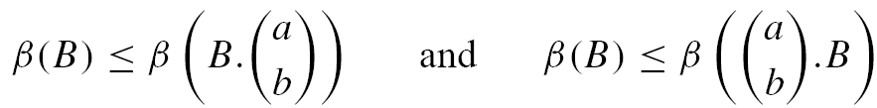
Block Score Function
Function β
associates a positive, real number to any block
increasing in the following sense:
  For any block B, for any block-match

Slide 14
Block-Mismatch Score Func.
Function μ
Associates a real number to each sequence which only contains block-mismatches

Slide 15
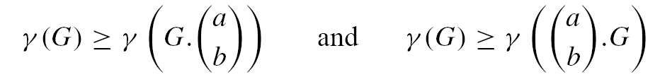
Gap-Score Function
Function γ
Associates a negative real number to each sequence which contains ONLY gaps
Decreasing in the following sense
  For any sequence G which contains only gaps and for any gap

Slide 16
Decomposition
In this manner, any alignment A can be decomposed as follows:
  A = A₀ . A₁ . A₂ . … . A_{q-1} . A_{q}
  Where each of A_{i}’s is either a
  Block
  Sequence of Block Mismatches
  Sequence of Gaps
  And no two consecutive A_{i}’s are identical.
This decomposition is unique

Slide 17
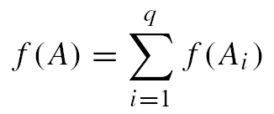
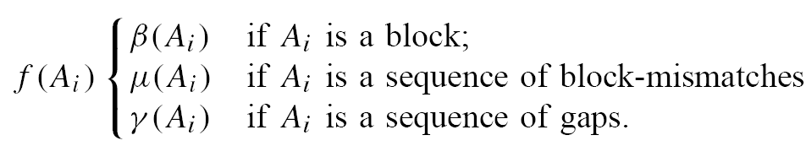
Scoring
For alignment A, the score is
  where

Slide 18
Gap Score
Classical, Affine Gap score:
  where
  |G| is the length of sequence of gaps G
  γ_{o} is the gap-opening penalty
  γ_{e} is the gap-extension penalty

Slide 19

Block Scoring
Where g is a positive real function, i is the length of the block
Idea: give high scores to long blocks
g is strictly increasing on i

Slide 20
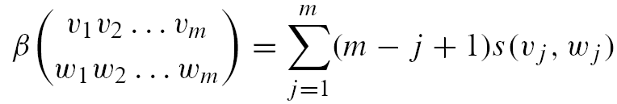
Block Scoring (cont.)
As |Block| increases, score increases
Moreover, the rate of that increase increases
EX: Say s(a, a) = 1
m | β(B)
1 | 1
2 | 3
3 | 6

Slide 21
Outline
Model
Algorithm
Validation
Conclusion

Slide 22

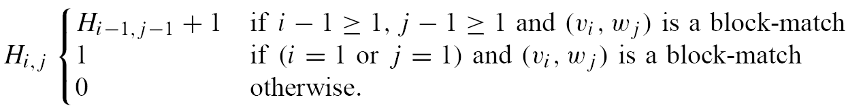
H matrix
The following matrix is the length of the maximal block ending in
Line 1
DT | i
j |  | 5 | 6
 | 2 | 2
 | 3 |  | BM:3

Slide 23
H matrix
The following matrix is the length of the maximal block ending in
Line 2
DT | i
J |  | 1
 | 4 | BM:1

Slide 24
H matrix
The following matrix is the length of the maximal block ending in
Line 3 => not a block match
 | i
j | ~BM:0

Slide 25
But wait – There’s More!
Let b_{i,j} be the current block length
Let S_{i,j} be the local maximum score ending in
Then we get….

Slide 26
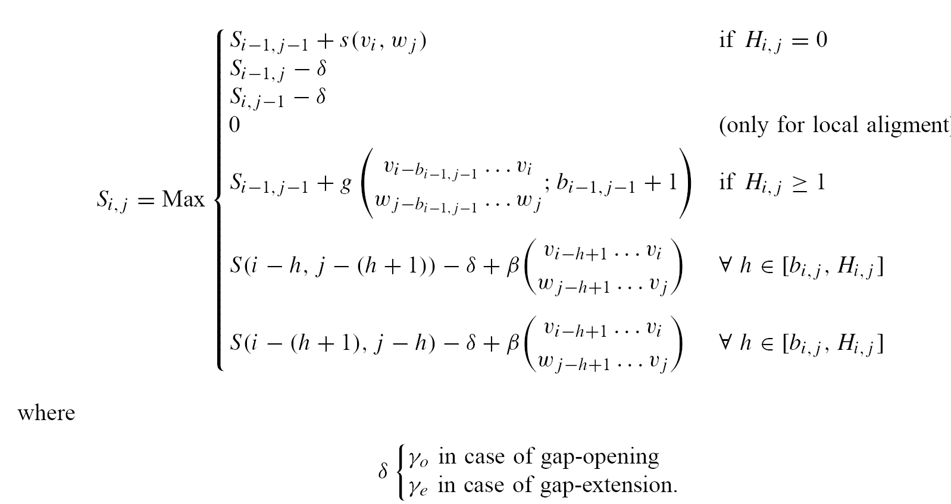
S_{i,j}

Slide 27
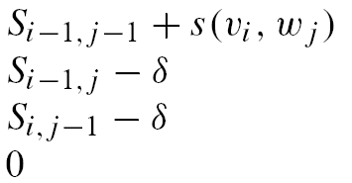

S_{i,j}
First Four Lines: Nothing new
If 0 removed, becomes global alignment

Slide 28
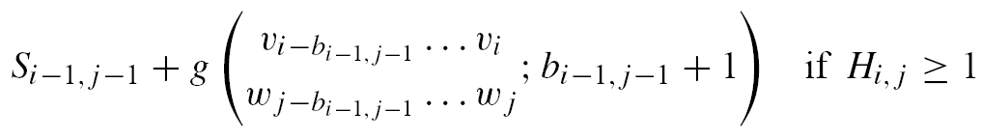

S_{i,j}
Fifth Line => Current position is block match
This is similar to
but with the block weighted

Slide 29
S_{i,j}
6th line => Current Position is block Match
Idea:
Change AC-GT to A-CGT
  ACTGT ACTGT

Slide 30

S_{i,j}
7th line => Current Position is block Match
Idea:
  Change ACTGT to ACTGT
  AC –GT A- CGT

Slide 31
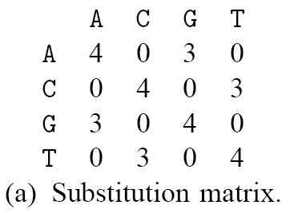
Example
Let v=ACTGT, w=ACGT, δ = -4, T(x)=3

Slide 32
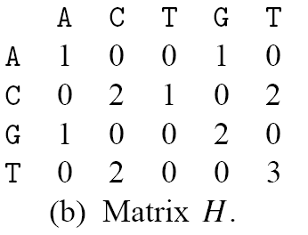
Example
Let v=ACTGT, w=ACGT, δ = -4, T(x)=3
這裡應該是1

Slide 33
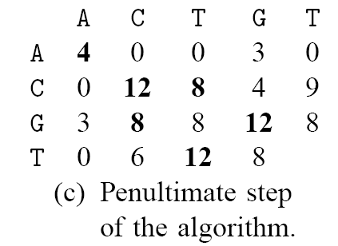

Example
Let v=ACTGT, w=ACGT, δ = -4, T(x)=3
這裡應該是1

Slide 34
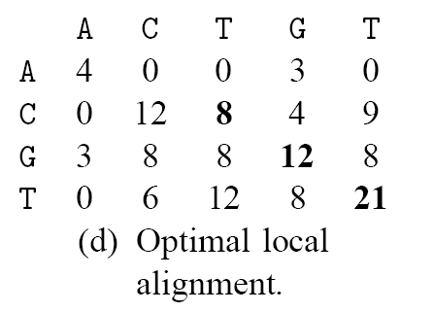

Example
Let v=ACTGT, w=ACGT, δ = -4, T(x)=3
這裡應該是1

Slide 35
Outline
Model
Algorithm
Validation
Conclusion

Slide 36
Validation
Compared Block Scoring with Smith Waterman on homologous but distant sequences
In most cases (about 90% of alignments), the SW alignment is exactly included in the Block Scoring one, but the latter goes further.

Slide 37
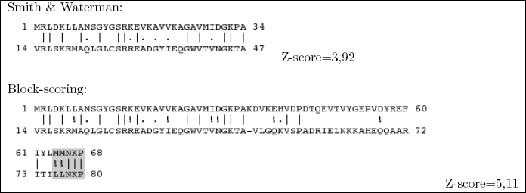
Alignment 1
Block Scoring aligns a five amino acids block further which is the core binding-site of this protein

Slide 38
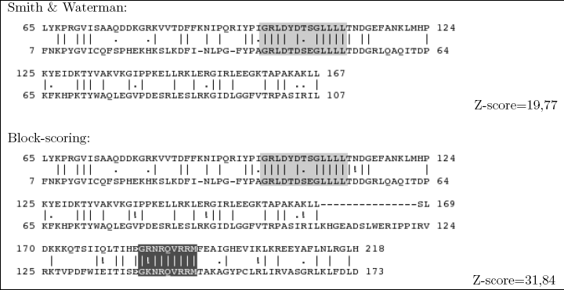
Alignment 2
Only Block Scoring Algorithm aligns the C-terminal motif

Slide 39

資料標準化(Standardization)
標準化值又稱為 z-值(z-score)
  A measure of the distance in standard deviations of a sample from the mean. Calculated as (X - X bar) / sigma

Slide 40
Conclusions
Block scoring effectively detects relevant similar blocks in cases that classical alignment algorithms do not.
When precise block information has to be detected, this algorithm can be used in conjunction with those classical algorithms.

