Slide 1

Thomas Kämpke, Markus Kieninger and Michael Mecklenburg
Bioinformatics vol. 17 no. 3
Pages 214 225
Presenter: Bamfa Ceesay
Date: March 13th 2012

Slide 2

Motivation: Primer design involves various parameters such as string-based alignment scores, melting temperature, primer length and GC content. This entails a design approach from multicriteria decision making. Values of some of the criteria are easy to compute while others require intense calculations.

Slide 3

Results: The reference point method was found to be tractable for trading-off between deviations from ideal values of all the criteria. Some criteria computations are based on dynamic programs with value iteration whose run time can be bounded by a low degree polynomial. For designing standard PCR primers, the scheme offers in a relative gain in computation speed of up to 50: 1 over ad-hoc computational methods. Single PCR primer pairs have been used as model systems in order to simplify the quantization of the computational acceleration factors.

Slide 4

The development of polymerase chain reaction (PCR) has revolutionized genetic analysis and engineering science.
The objective of PCR is to amplify a specific DNA fragment, the target sequence. Primers function in pairs, the forward primer and the reverse primer with this distinction being arbitrary from the computational viewpoint.
The primer pair are chosen such that they will be extended towards each other to cover the given target region.

Slide 5

During PCR (polymerase chain reaction), DNA polymerase is only able to add nucleotides to the 3’end of a growing chain of DNA.
However DNA polymerase can’t just start building strand for a single stranded DNA
An enzyme call primase produce a short string of nucleotides that are complementary to the first part of the segment of DNA that being copied.
This string of nucleotides, call primer, attaches to the beginning of the template by base pairing.
DNA polymerase then carried out the extension of the replica from the 3’ends

Slide 6

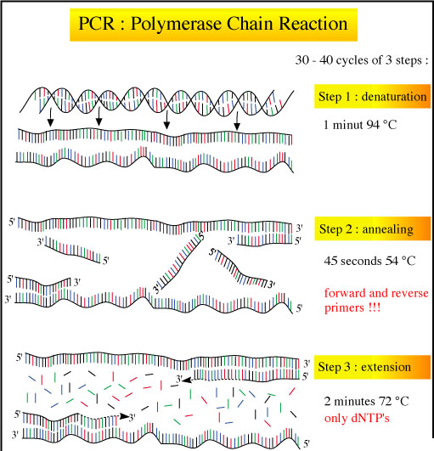

Slide 7
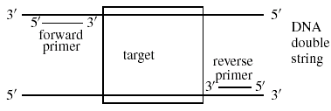
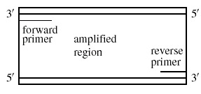

Slide 8

Melting temperature
Primer length
GC content
String-base alignment scores
  self annealing and self end annealing
  pair annealing and pair end annealing

Slide 9
GC: GC content
Tm: Melting temperature
sa: Self annealing
sea: self-end annealing
pa: pair annealing
pea: pair-end annealing

Slide 10

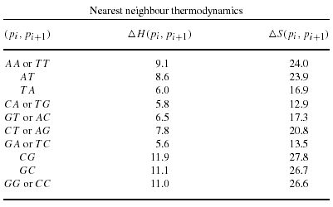
Melting temperature are specified by nearest neighbor thermodynamic
ex:p=GGAT with
△(GGAT)=
△H(GG)+△H(GA)+△H(AT)
= 11.0 + 5.6 + 8.6
= 25.2(kcal/mol)

Slide 11
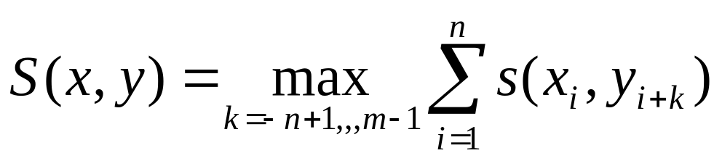
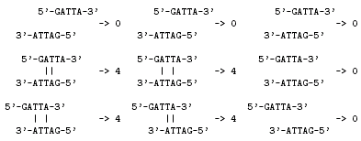
2, if { x_{i} , y_{j} } = { A , T }
4, if { x_{i} , y_{j} } = { C , G }
0, else
s(x_{i},y_{i})=
Score for a pair
of characters
Alignment Score for
primers
sa(p) =S(~p,p) sea(p)=S’’(~p,p)
~p= reverse primer
p= forward primer
K=-4
K=-3
K=-2
K=-1
K=0
K=1
K=2
K=3
K=4

Slide 12

Y = A T T A G X=GATT
G
A
  T
T
K=3 S=0
G
A
  T
T
K=2 S=0
G
A
T
T
K=1 S=0
G
A
T
T
K=0 S=4
G
A
T
T
K=-1 S=4
G
A
T
T
K=-2 S=0
G
A
T
T
K=-3 S=2
G
A
T
T
K=-4 S=2

Slide 13


pa(p,q) =S(~p,q) pea(p,q)=S”(~p,q)
p = GGATTGATAATGTAATAGG |p|=19
q = CATTATGGGTGGTATGTTGG |q|=20
sa(p)=12
sea(p)=0
5- G G A T T G A T A A T G T A A T A G G -3
3- G G T T G T A T G G T G G G T A T T A C-5
pa(p,q)=16
->16
pea(p,q)=4

Slide 14
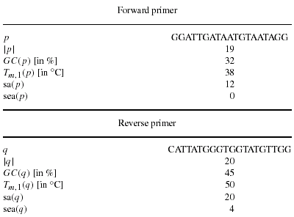

Slide 15
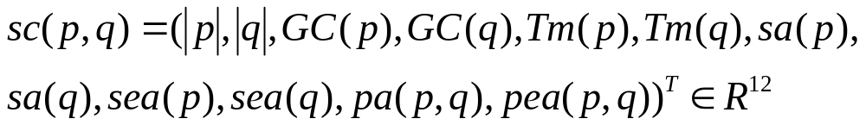
Aggregation of assessments for ordinary PCR
scideal =(length _{f} ,length _{r} ,GC_{f} ,GC_{r},T _{mf} , T_{mr} ,0, 0 ,0 ,0 ,0 ,0) ^{T}
All ideal annealing T _{mf} = T_{mr} , as well as GC_{f} =,GC_{r} set to zero
l₁-Distance:
|| sc(p,q) – (sc_{ideal})||= Σ¹²_{i=1} | sc(p,q)_{i} – (sc _{ideal}) _{i}|
Weight distance:
|| sc(p,q) – (sc_{ideal})||_{k} =Σ¹²_{i=1} k_{i} | sc(p,q)_{i} – (sc _{ideal})_{i}|

Slide 16
Ordinary PCR Assessment:
Deviation from ideal length, length_{f} =length_{r} κ₁=κ₂=0.5
Deviation from ideal GC content,GC _{f} =GC_{r} κ₃=κ₄=1
Deviation from ideal temperature, T_{mf} =T_{mr} κ₅=κ₆=1
Deviation from ideal self annealing value 0 κ₇=κ₈=0 1
Deviation from ideal self-end annealing value 0 κ₉=κ₁₀=0 2
Deviation from ideal pair annealing value 0 κ₁₁=0 1
Deviation from ideal pair-end annealing value 0 κ₁₂=0 2
sa(p)=O(n²)= sea(p)
sa(q)=O(m²)= sea(q)
pa(p,q)=O(nm)= pea(p,q)
l₁-Distance or Weight distance:O(n²+m²+nm)=O((n+m)²)

Slide 17

Given two windows w=(w₁,….,w_{N}) and v = (v₁,….,v_{M})
p=(p₁,….,p_{n}) = (w_{i},….,w_{i+n-1}) and
q= (q₁,….,q_{m}) = (v_{j},….,v_{j+m-1})
5’
w₁
w_{N}
3‘
p₁
p_{n}
p₁
p_{n}
3’
v_{M}
v₁
5’
q_{m}
q₁
q₁
q_{m}

Slide 18



Slide 19

5’
w₁
w_{N}
3‘
p₁
p_{n}
3‘
v_{M}
v₁
5’
q_{m}
q₁
|Sub(w)|=N(N-1)/2 ; Sub(V)|=M(M-1)/2
Complexity for candidate pairs O(N²M²)
Each of the candidate require O((N+M)²) effort to count sa ,sea, pa, pea.
Results in O((N²M+M²N)²) overall computation

Slide 20
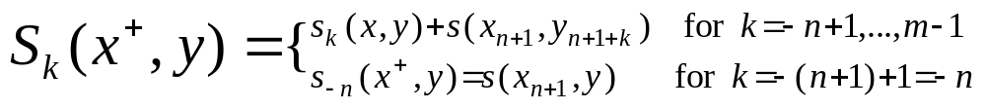

Define: //S(x,y) →S(x⁺,y)
S(x⁺,y) for x⁺ =(x₁,…,x_{n+1})
S_{k}(x , y)=Σ^{n}_{i=1} s(x_{i} , y_{i+k}) for
k=-n+1,…,m-1 then
|x|=n |y|=m
s(A,T)=2 s(C,G)=4

Slide 21
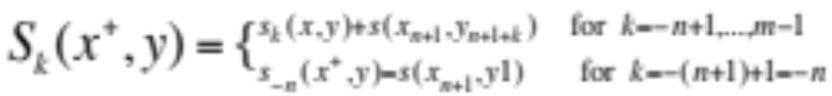
y=“GAT” =(y₁,y₂,…y_{m}) ;
x=“CC”=(x₁,x₂,…x_{n}) x⁺=“CCG”=(x₁,x₂,…x_{n+1})
GAT K
CCG 2= m-1
CCG 1
CCG 0
CCG -1 = -(n-1)
CCG -2 = -n
Thus, O(n+m) instead of O(nm)

Slide 22

w₂ w₁
w₁ w₂
w₁ w₂
w₁ w₂
1.(Initialization)Computation of sa(w₁,w₂)
sa(w₁,w₂) = S((w₂,w₁),(w₁,w₂))
= max{ s(w₁,w₁) , s(w₁,w₂) + s(w₂,w₁) , s(w₂,w₂) }
2.(Iteration) For n = 2 to N-1 do
(a) Computation of sa(w_{n},w_{n+1}) as the initialization.
(b) For i = 1 to n-1 do
Computation of sa(w_{n-i},…,w_{n+1}) =
S( (w_{n-1},…,w_{n-i}) , (w_{n-i},…,w_{n+1}) ) from values of
S_{k} and update of these values as in Section
Dynamic programming requisites.

Slide 23

w₁w₂
1.Initial sa(w₁,w₂)
2.n=2 (a) sa(w₁,w₂)
(b) i=1 sa(w₁,w₂,w₃)
3.n=3 (a) sa(w₃,w₄)
(b) i=1 sa(w₂,w₄)
i=2 sa(w₁,w₂,w₃,w₄)
w₁w₂
w₂w₃
w₁w₂
w₂w₃
w₁w₂
w₂w₃
w₃w₄
w₁w₂
w₂w₃
w₃w₄
w₁w₂
w₂w₃
w₃w₄

Slide 24
4.n=4 (a) sa(w₄,w₅)
(b) i=1 sa(w₃,w₄,w₅)
i=2 sa(w₂,w₃,w₄,w₅)
i=3 sa(w₁,w₂,w₃,w₄,w₅)
w₁w₂
w₂w₃
w₃w₄
w₄w₅
w₃w₄w₅
w₁w₂
w₂w₃
w₃w₄
w₄w₅
w₂w₃w₄w₅
w₁w₂
w₃w₄
w₄w₅
w₂w₃
w₁w₂w₃w₄w₅
w₁w₂
w₂w₃
w₃w₄
w₄w₅

Slide 25
DYNSA
O(2²)+O(3²)+…+O(N²)=O(N³)
w₁w₂w₃...w_{n+1}
O(n²)
w₂w₃…w_{n+1}
w₂w₃…w_{n}
w_{n-2}w_{n-1}w_{n}w_{n+1}
w₁w₂w₃w₄
O(3²)
w_{n-1}w_{n}w_{n+1}
O(2²)
w₁w₂w₃
w₂w₃w₄
w_{n-2}w_{n-1}w_{n}
w_{n}w_{n+1}
w₁w₂
w₂w₃
w₃w₄
w_{n-1}w_{n}

Slide 26

1.(Initialization) Computation of pa((w₁,w₂), (v₁,v₂))
pa((w₁,w₂), (v₁,v₂)) = S((w₂,w₁),(v₁,v₂))
= max{ s(w₁, v₁) , s(w₁, v₂)+s(w₂, v) , s(w₂, v₂) }
2.(Iteration) For k = 2 to max{ N , M } -1 do
(a) If k ≤ N-1 then for i = 0 to k-1 do
Computation of pa( (w_{k-i},…,w_{k+1}) , q )
∀q ∈ Sub(v₁,…,v_{min{k,M}})
(b) If k ≤ M-1 then for i = 0 to k-1 do
Computation of pa( p , (v_{k-i},…,v_{k+1}) )
∀p∈ Sub(w₁,…,w_{min{k+1,N}})

Slide 27
pa(p,q) for (p,q)∈ Sub(w) x Sub(v)
Update computation for the transition from p to p⁺
n (m-1) m/2 O(N+M)
v_{1….}v_{m}
W₁w₂w₃…w_{n+1}
v _{m-1}v_{m}
v₁v₂
v_{1….}v_{m}
v _{m-1}v_{m}
v₁v₂
v_{1….}v_{m}
w_{n-1}w_{n}w_{n+1}
v _{m-1}v_{m}
W_{n}w_{n+1}
v₁v₂

Slide 28
p→ p⁺ n (m-1) m/2 O(N+M)
All updates for subsequences of w:
N
= Σ_{n=2} n(m-1)m/2 O(N+M)
N
≤ (M-1)M/2 O(N+M) Σ_{n=2}n
= O ((N+M)N²M²)
Overall: O ((N+M)N²M²)
Appears to be optimal since sub(w) × sub(v)
has cardinality θ(N²M²)

Slide 29
Enumeration for restricted primer lengths w and v bounded by N ≥ λ_{w} and M ≥ λ_{v} ,forward and
reverse primers meet the condition λ_{w} ≥ λ_{f} , λ_{v} ≥ λ_{r} aim at:
  To reduce the computation effort
  Increase the fidelity of the PCR reaction
  Lower synthesis costs
The primer candidate sets :
  sub(w,λ_{w}) = { p | p∈Sub(w), |p|≤ λ_{w} } has cardinalities ½(2N- λ_{w})(λ_{w}-1) = θ ((N- λ_{w}) λ_{w})
  sub(v, λ_{v}) = { q | q∈Sub(v), |q|≤ λ_{v} } has cardinalities ½(2M- λ_{v})(λ_{v}-1) = θ ((M- λ_{v}) λ_{v})

Slide 30

1.(Initialization) Computation of sa(w₁,w₂)
= S((w₂,w₁),(w₁,w₂))
= max{ s(w₁,w₁) , s(w₁,w₂)+s(w₂,w₁) , s(w₂,w₂) }
2.(Iteration) For n = 2 to N-1 do
(a) Computation of sa(w_{n},w_{n+1})
(b) For i = 1 to min{ n-1 , λ_{w}-2 } do
Computation of sa(w_{n-i},…,w_{n+1}) =
S( (w_{n-1},…,w_{n-i}) , (w_{n-i},…,w_{n+1}) ) from values of
S_{k} and update of these values as in Section
Dynamic programming requisites.
O(Nλ_{w}²)
O(λ_{w}²)

Slide 31
Enumeration for restricted primer lengths
w and v bounded by N ≥ λ_{w} and M ≥ λ_{v} ,forward and
reverse primers meet the condition λ_{w} ≥ λ_{f} , λ_{v} ≥ λ_{r}
  To reduce the computation effort
  Increase the fidelity of the PCR reaction
  Lower synthesis costs
The primer candidate sets :
  sub(w,λ_{w}) = { p | p∈Sub(w), |p|≤ λ_{w} } has cardinalities ½(2N- λ_{w})(λ_{w}-1) = θ ((N- λ_{w}) λ_{w})
  sub(v, λ_{v}) = { q | q∈Sub(v), |q|≤ λ_{v} } has cardinalities ½(2M- λ_{v})(λ_{v}-1) = θ ((M- λ_{v}) λ_{v})

Slide 32
Dynamic programming for approximation
W₁…..W_{λw}
N- λ_{w} +1
W_{N- λw+1}…..W_{N}
λ_{w}-1
N-1
W_{N-1}W_{N}
w₁w₂
Trapezoidal Hasse diagram of sub(w,λ_{w})

Slide 33
DYNSA-APP
O(λ_{w}²) + O(λ_{w}²) +…+ O(λ_{w}²) =O(N λ_{w}²)
O(λ_{w}²)
W₁…..W_{λw}
W_{N- λw+1}…..W_{N}
O(λ_{w}²)
O(λ_{w}²)
w₁w₂
W_{N-1}W_{N}

Slide 34

1.(Initialization) Computation of
pa ((w₁,w₂),(v₁,v₂))
= max{ s(w₁, v₁) , s(w₁, v₂)+s(w₂, v₁) , s(w₂, v₂) }
2.(Iteration) For k = 2 to max{ N , M } -1 do
(a) If k ≤ N-1 then for i = 0 to min{ k-1 , λ_{w}-2 } do
Computation of pa( (w_{k-i},…,w_{k+1}) , q )
∀q ∈ Sub(v₁,…,v_{min{k,M}} , λ_{v})
(b) If k ≤ M-1 then for i = 0 to min{ k-1, λ_{v}-2 } do
Computation of pa( p , (v_{k-i},…,v_{k+1}) )
∀p ∈ Sub(w₁,…,w_{min{k+1,N}} , λ_{w})

Slide 35

The complexity for update
min{k,λ_{w}}(λ_{v} -1) λ_{v} / 2 O(λ_{w}+ λ_{v})
All updates for subsequences of w:
N
= Σ_{k=2} min{k,λ_{w}}(λ_{v} -1) λ_{v} / 2 O(λ_{w}+ λ_{v}) (loop)
N
= O((λ_{v} + λ_{w}) λ_{v}²N λ_{w})
Overall: O((λ_{w}+ λ_{v}) (λ_{v}²Nλ_{w}+λ_{w}²Mλ_{v}))
= O((λ_{w}+ λ_{v}) λ_{w}λ_{v} (λ_{v}N+λ_{w}M))
= O((max{λ_{w}, λ_{v} })⁴(N+M))
DYNPA : each pair →n (m-1) m/2 O(N+M)
overall →O(N²M²(N+M))

Slide 36
Primer candidate are restricted to lie in sets
Sub(w,λ_{l,1}, λ_{u,1}) = { p | p∈Sub(w), λ_{l,1} ≤ |p|≤ λ_{u,1}}
The size of such a set is θ ((λ_{u,1} - λ_{l,1}) N)
Simplicity all bounds
λ_{l} ≤ |p|,|q| ≤ λ_{u}
GC _{l} ≤ GC(p), GC(q) ≤ GC_{u}
T_{m,l} ≤ T_{m} (p), T_{m} (q) ≤ T_{m,u}
0 ≤ sa(p),sa(q) ≤ sa_{u}
0 ≤ sea(p),sea(q) ≤ sea _{u}
0 ≤ pa(p,q) ≤ pa_{u}
0 ≤ pea(p,q) ≤ pea_{u}

Slide 37
BOUND
1.Computation of the inividual feasibility sets
γ(w)= { p | p∈Sub(w)|λ_{l} ≤ |p|≤ λ_{u,}
,GC _{l} ≤ GC(p) ≤ GC_{u},T_{m,l}≤T_{m} (p), ≤ T_{m,u}
,0≤sa(p)≤ sa_{u} ,0≤sea(p)≤ sea _{u} } and
δ(v)= { q | q∈Sub(v)|λ_{l} ≤ |q|≤ λ_{u,}
,GC _{l} ≤ GC(q) ≤ GC_{u},T_{m,l}≤T_{m} (q), ≤ T_{m,u}
,0≤sa(q)≤ sa_{u} ,0≤sea(q)≤ sea _{u} }
2. Computation of the conjoint feasibility set
ε(w,v) ={ (p,q) ∈ γ(w)X δ(v) | 0 ≤pa(p,q)≤ pa_{u},
0≤pea(p,q)≤ pea_{u} }
3. Computation of best primer pair
(p¹,q¹)=argmin _{(p,q) ∈ε(w,v)} || sc(p,q) – sc_{ideal}||_{k}

Slide 38
BOUND
1.Step 1 DYNSA-APP AND DYNSEA-APP
in O((N λ_{u}² +Mλ_{u}²) = O((N+M) λ_{u}²)
2. Step 2
(a) if ad-hoc applied take effort O(|γ(w)||δ(v)|λ_{u}²)
(b)bound from step 1 reduce the product set
γ(w)X δ(v) to the conjoint set from step 2
(c) reducing the product set γ(w)X δ(v) to the
conjoint set ε(w,v)
3. Step 3 Obviously O(|ε(w,v)| )

