Slide 1
A hybrid procedure for stock price prediction by integrating self-organizing map and genetic programming
Chih-Ming Hsu
Expert Systems with Applications 38 (2011) 14026–14036
Presenter : Chang-Hao Huang
Date : Mar. 5, 2012

Slide 2
Abstract(1/2)
Stock price prediction is a very important financial topic, and is considered a challenging task and worthy of the considerable attention received from both researchers and practitioners. Stock price series have properties of high volatility, complexity, dynamics and turbulence, thus the implicit relationship between the stock price and predictors is quite dynamic. Hence, it is difficult to tackle the stock price prediction problems effectively by using only single soft computing technique. This study hybridizes a self-organizing map (SOM) neural network and genetic programming (GP) to develop an integrated procedure, namely, the SOM-GP procedure, in order to resolve problems inherent in stock price predictions. The SOM neural network is utilized to divide the sample data into several clusters, in such a manner that the objects within each cluster possess similar properties to each other, but differ from the objects in other clusters.

Slide 3
Abstract(2/2)
The GP technique is applied to construct a mathematical prediction model that describes the functional relationship between technical indicators and the closing price of each cluster formed in the SOM neural network. The feasibility and effectiveness of the proposed hybrid SOM-GP prediction procedure are demonstrated through experiments aimed at predicting the finance and insurance sub-index of TAIEX (Taiwan stock exchange capitalization weighted stock index). Experimental results show that the proposed SOM-GP prediction procedure can be considered a feasible and effective tool for stock price predictions, as based on the overall prediction performance indices. Furthermore, it is found that the frequent and alternating rise and fall, as well as the range of daily closing prices during the period, significantly increase the difficulties of predicting.

Slide 4
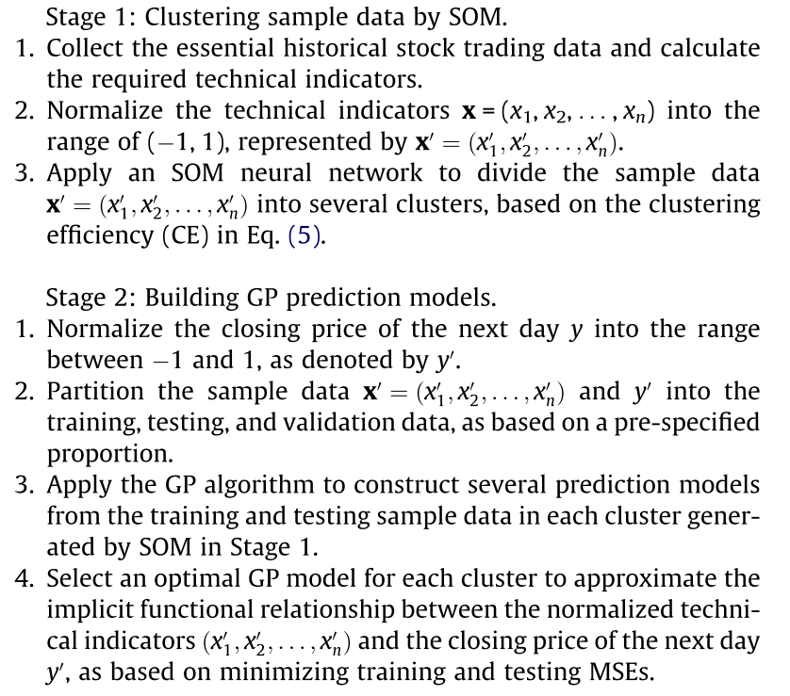
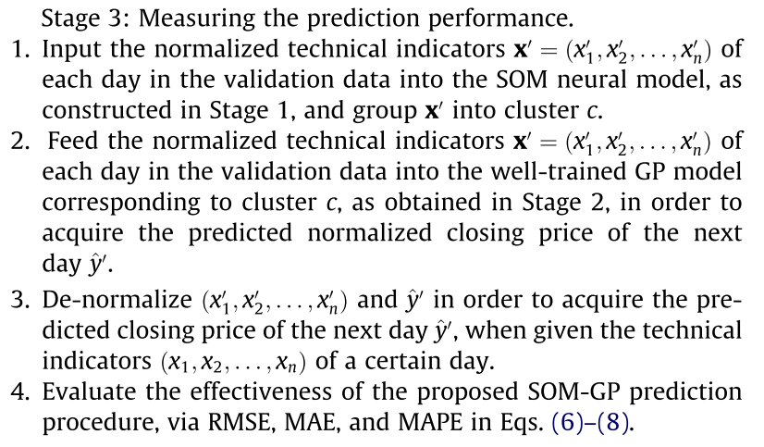
SOM-GP procedure

Slide 5
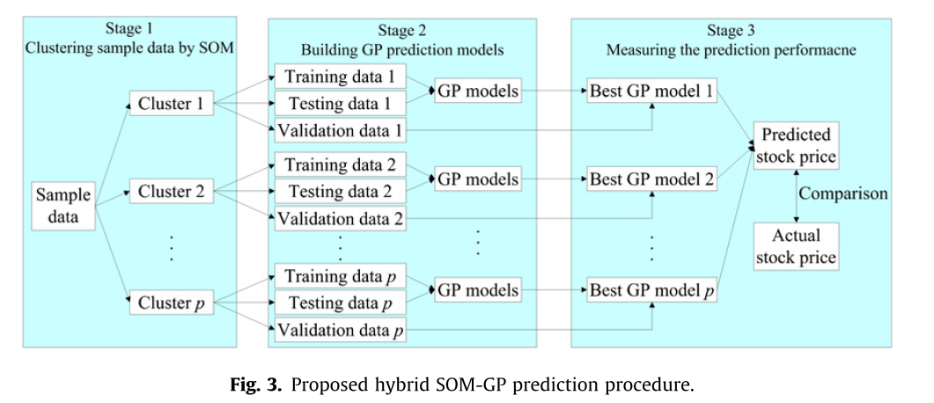

Slide 6
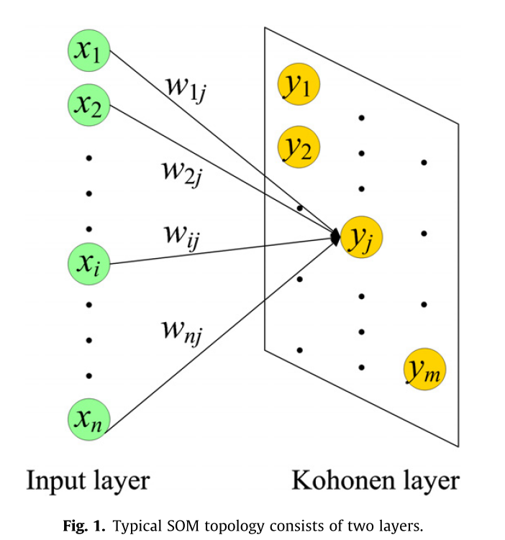
self-organizing map (SOM)

Slide 7
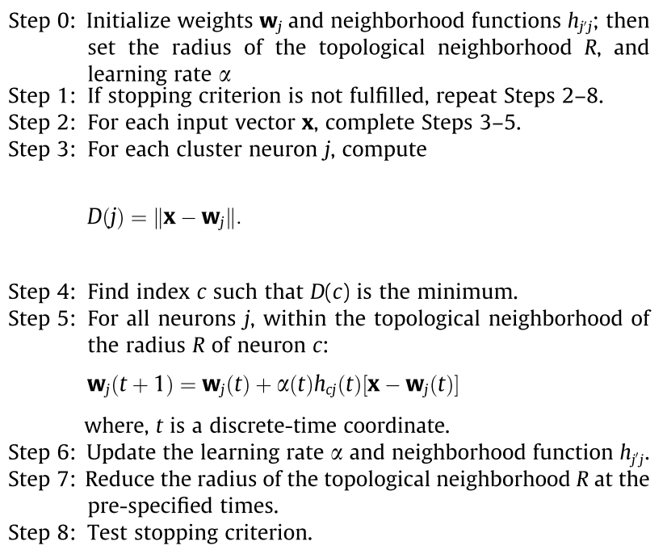
algorithm

Slide 8



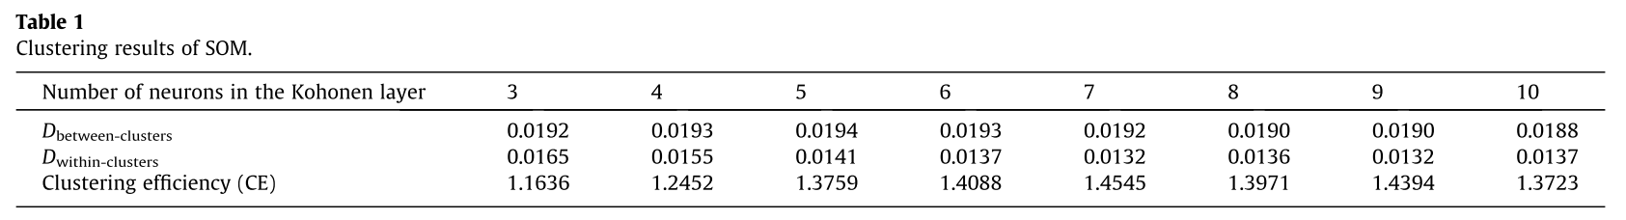
Index to measure the performance of clustering

Slide 9
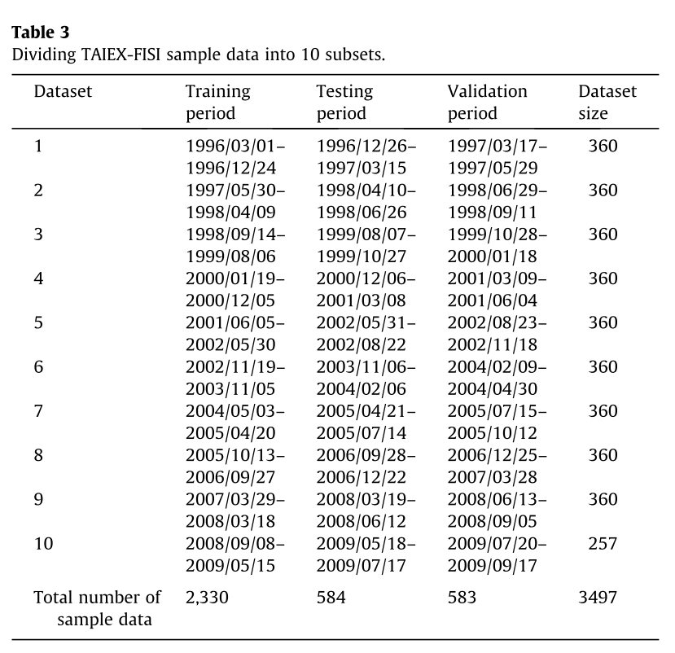
TAIEX-FISI(1996/3/1 to 2009/9/17)

Slide 10
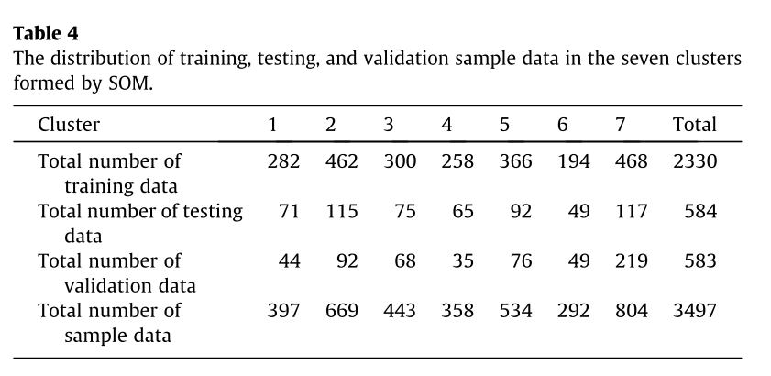

Slide 11
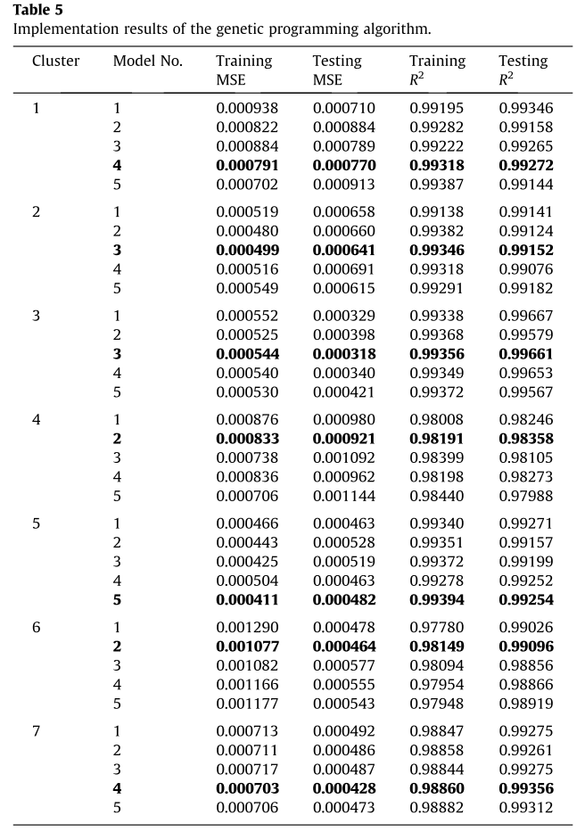

Slide 12
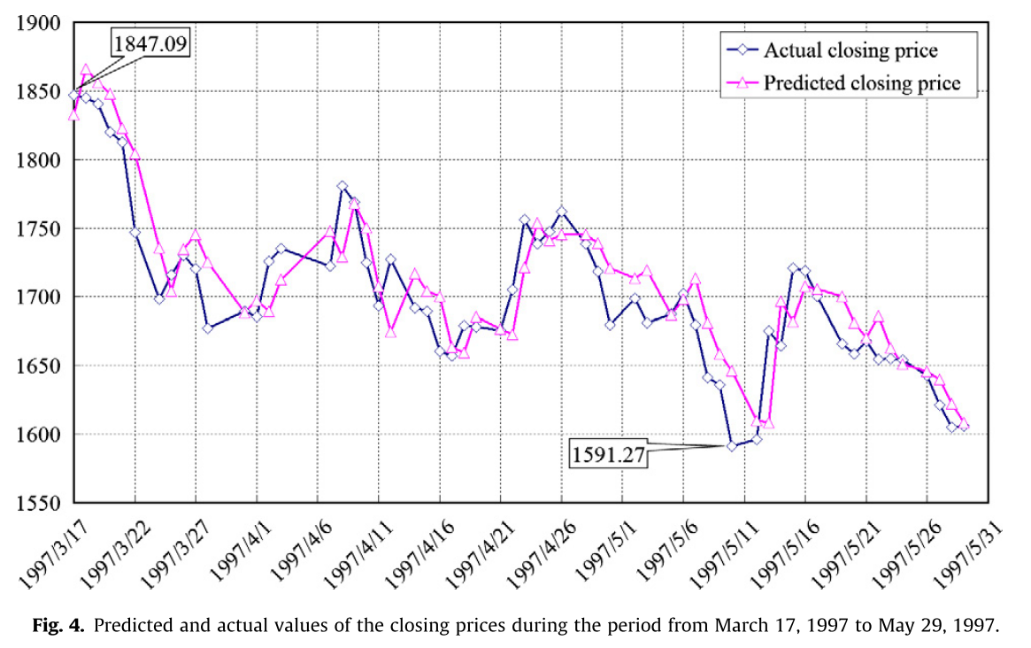

Slide 13
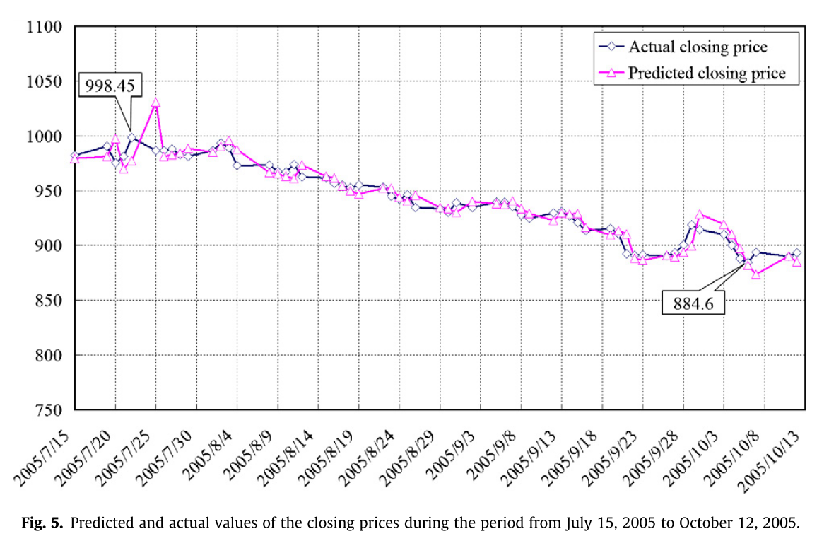

Slide 14
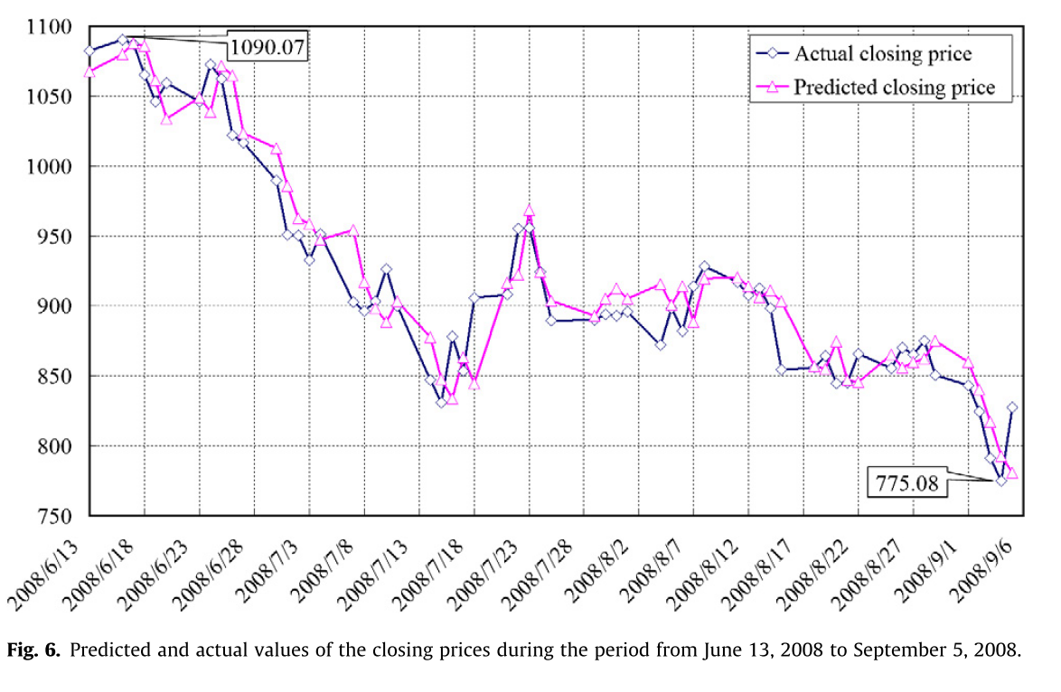

Slide 15
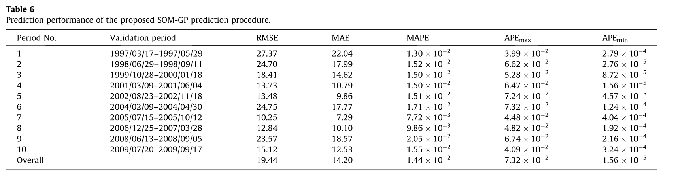
Result

Slide 16
Technical indicators
MA_10 (10-day moving average)
BIAS_20 (20-day bias )
MACD (moving average convergence divergence )
K_9 (9-day stochastic indicator K )
D_9 (9-day stochastic indicator D)
WMS%R_9 (9-day Williams overbought oversold index )
+DI_14 (14-day plus directional indicator)
-DI_14 (14-day minus directional indicator )
MTM_10 (10-day momentum )
ROC_10 (10-day rate of change )
RSI_5 (5-day relative strength index )
CCI_24 (24-day commodity channel index )
AR_26 (26-day buying/selling momentum indicator )
BR_26 (26-day buying/selling willingness indicator)
26-day volume ratio (VR_26)
PSY_13 (13-day psychological line )

