Slide 1
Cysteine separations profiles on protein secondary structure infer disulfide connectivity Guantao Chen, Hai Deng , Yufeng Gui, Yi Pan and Xue Wang IEEE International Conference on Granular Computing, pp. 663-665, 2006
Presenter: Hong-Yu Chen
Date: March 28, 2012

Slide 2
Abstract (1/2)
Disulfide connectivity prediction from one chain of protein helps determine protein tertiary structure. The more accuracy of prediction it reaches the more precise three dimensional structures we can obtain through computational methods. Previous methods only use local sequence or secondary structure information or global sequence information or combination of the above descriptors to predict the disulfide bond pattern. Instead of using those descriptors, we take an alternative descriptor of global secondary structure to make prediction, and the highest performance among all pattern-wise methods is obtained.

Slide 3
Abstract (2/2)
Cysteine separation profiles on protein secondary structure have been used to predict the disulfide connectivity of proteins. The cysteine separation profiles on secondary structure(CSPSS) represent a vector encoded from the sepeartions between any two consecutive cysteine-corresponding positions in a predicted protein secondary structure sequence. Through comparisons of their CSPSS, the disulfide connectivity of a test protein is inferred from a template set. In 4-fold of SP39, any two proteins from different groups share less than 30% sequence identity. The result shows a prediction accuracy (54%), which proves again a disulfide bond pattern is highly related to protein secondary structure.

Slide 4


CSPSS
Cysteine separation profile of secondary structure
Basic assumption
Similar protein secondary structure patterns possibly imply similar protein tertiary structure patterns and lead to similar disulfide connectivity pattern because a disulfide bonding pattern is one aspect of protein tertiary structure.
where li is the length of the vector, Ci is the number of C, Hi is the number of H and Ei is the number of E.

Slide 5
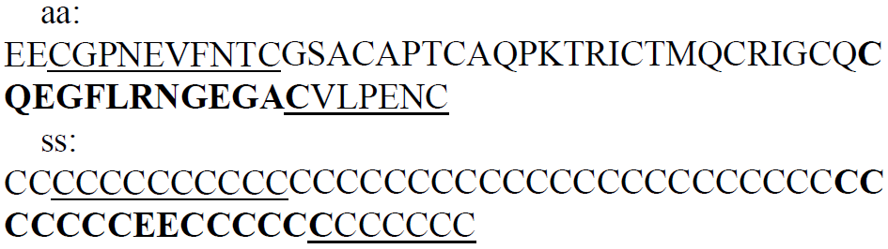

CSPSS
A protein chain(AMCI_APIME) with 56 amino acids (aa) and 10 cysteines with the pattern (1-7, 2-5, 3-6, 4-10, 8-9),
$S_{1}:\left[CCCCCCCCCC\right] →\left[10, 10, 0, 0\right]$
$S_{1}:\left[CCCCCCEECCCCC\right] →\left[13, 11, 2, 0\right]$
$S_{1}:\left[CCCCCCC\right] →\left[7, 7, 0, 0\right]$

Slide 6
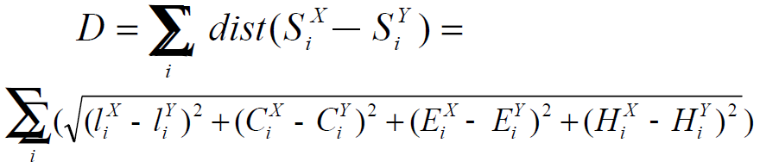
Divergence

Slide 7
Dataset
SP39
The dataset was divided into four groups to guarantee that each two proteins from different groups have a sequence identity less than 30%.
Dataset | B = 2 | B = 3 | B = 4 | B = 5 | B = 2…5
SP39 | 156 | 146 | 99 | 45 | 446

Slide 8
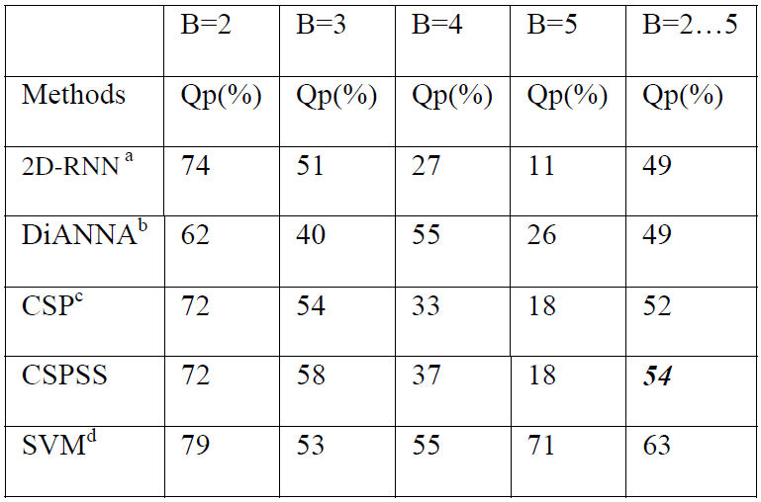
Result

Slide 9
Conclusion
Our results for correct predictions contain ones from the CSP method, which validated that our descriptor includes the information of the CSP descriptor.

