Slide 1
Computational Design of the Sequence and Structure of a Protein-Binding Peptide
Deanne W. Sammond,†,§,^ Dustin E. Bosch,‡,^ Glenn L. Butterfoss,†,|| Carrie Purbeck,† Mischa Machius,‡ David P. Siderovski,‡ and Brian Kuhlman †,*
†Department of Biochemistry and Biophysics, University of North Carolina, Chapel Hill, North Carolina 27599-7260, United States ‡Department of Pharmacology, University of North Carolina, Chapel Hill, North Carolina 27599-7365, United States
Journal of The American Chemical Society 2011, 133, 4190-4192
Presenter: Yi-Pu Guo
2012-03-28

Slide 2
Abstract
The de novo design of protein-binding peptides is challenging because it requires the identification of both a sequence and a backbone conformation favorable for binding. We used a computational strategy that iterates between structure and sequence optimization to redesign the C-terminal portion of the RGS14 GoLoco motif peptide so that it adopts a new conformation when bound to Gα_{i1}. An X-ray crystal structure of the redesigned complex closely matches the computational model, with a backbone rootmean-square deviation of 1.1 Å.

Slide 3
pdb: 2OM2
(a) Crystal structure of the wild-type RGS14 GoLoco motif peptide bound to Gα_{i1}.
(b) Model of the redesigned GoLoco motif, GL_{helix}-4, bound to Gα_{i1}.

Slide 4
Method
The backbone conformation of the GoLoco motif C-terminus was rebuilt using a fragment assembly protocol with helical fragments from the Protein Data Bank.
A low-resolution score function was used to prevent steric立體 overlap with Gα_{i1} and favor the burial of hydrophobic疏水 residues.

Slide 5
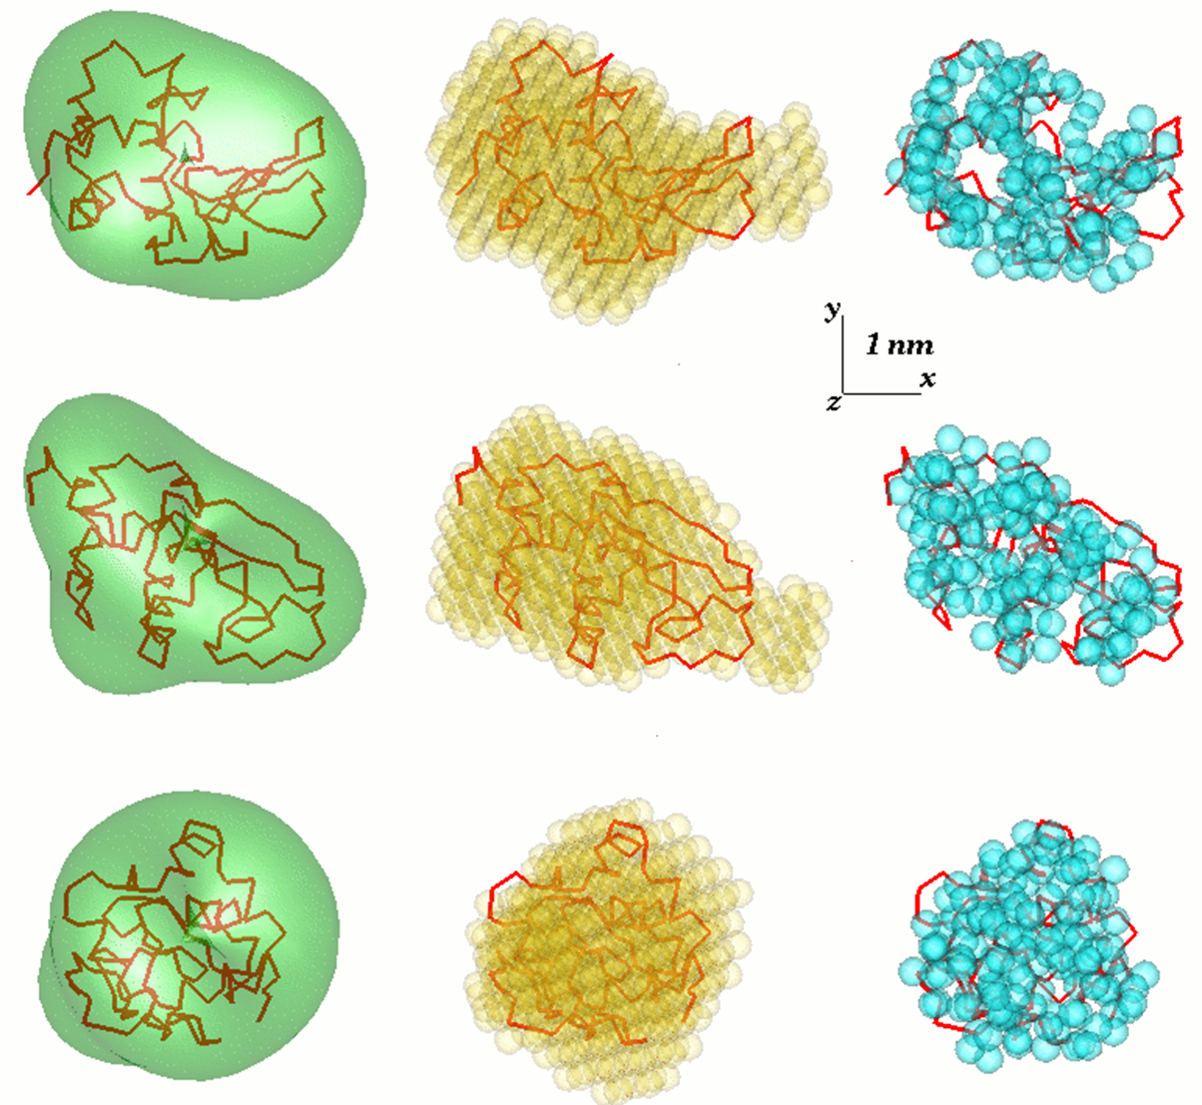
Low-resolution models
To get a three-dimensional structure from an one-dimensional scattering pattern.

Slide 6
Method
Each of the starting structures was optimized with four rounds of sequence design followed by backbone and side-chain minimization with a high-resolution score function.
Evaluated: van der Waals contacts, hydrogen bonding, desolvation energies, backbone and side-chain torsion potentials, and residue-typebased reference energies.

Slide 7
Method
Sequence optimization was performed using a simulated annealing退火 protocol.
Backbone and side-chain torsion angle minimization used a gradient-based quasi-Newtonian method.

Slide 8
Method
After four rounds of sequence design followed by backbone refinement, the energies of the models stopped decreasing, suggesting that most of the sequence/structure combinations were trapped in local minima on the energy landscape.

Slide 9
Conclusion
Such capabilities represent important steps toward the full de novo design of peptide-protein interactions.
In this study, we designed an α-helical peptide to bind to a hydrophobic groove and therefore did not need to consider hydrogen bonds across the interface.

