Slide 1
Improving the prediction of disulfide bonds in Eukaryotes with machine learning methods and protein subcellular localization
Castrense Savojardo^{1,2}, Piero Fariselli^{1,2,*}, Monther Alhamdoosh¹, Pier Luigi Martelli¹,
Andrea Pierleoni³ and Rita Casadio¹
¹Biocomputing Group, University of Bologna, CIRI-Life Science and Health Technologies and Department of Biology, Via San Giacomo 9/2, Bologna, ²Department of Computer Science, Via Mura Anteo Zamboni 7, 40127 Bologna and ³Externautics s.p.a., Department of Bioinformatics, Via Fiorentina 1, 53100 Siena, Italy
Bioinformatics Vol. 27 no. 16 2011, pages 2224-2230
2012-04-17
Presentor: Yi-Pu Guo

Slide 2
Abstract (1/3)
Motivation: Disulfide bonds stabilize protein structures and play relevant roles in their functions. Their formation requires an oxidizing environment and their stability is consequently depending on the redox ambient potential, which may differ according to the subcellular compartment. Several methods are available to predict cysteine-bonding state and connectivity patterns. However, none of them takes into consideration the relevance of protein subcellular localization.

Slide 3
Abstract (2/3)
Results: Here we develop DISLOCATE, a two-step method based on machine learning models for predicting both the bonding state and the connectivity patterns of cysteine residues in a protein chain. We find that the inclusion of protein subcellular localization improves the performance of these predictive steps by 3 and 2 percentage points, respectively. When compared with previously developed methods for predicting disulfide bonds from sequence, DISLOCATE improves the overall performance by more than 10 percentage points.

Slide 4
Abstract (3/3)
Availability: The method and the dataset are available at the Web page http://www.biocomp.unibo.it/savojard/Dislocate.html. GRHCRF code is available at http://www.biocomp.unibo.it/savojard/biocrf.html.

Slide 5
Database: PDBCYS
from PDB (release May 2010)
extracted 1797 eukaryotic(真核生物) protein structures
with resolution <2.5Å
with at least two cysteine residues
global pairwise sequence similarity <25%

Slide 6
PDBCYS subcellular localization
For each protein in PDBCYS, we extracted from the corresponding UniProt file the annotated subcellular localization.
Localization | Bonded Cysteines (%) | Free Cysteines (%) | # of proteins
Chloroplast (葉綠體) | 11 | 89 | 28
Cytoplasm (細胞質) | 9 | 91 | 472
Mitochondrion (線粒體) | 2 | 98 | 62
Nucleus (細胞核) | 5 | 95 | 322
Secreted (分泌) | 79 | 21 | 227

Slide 7
Predicting disulfide bonding state
From HMMs to CRFs
From CRFs to GRHCRFs
Bonding state prediction with GRHCRFs
Details on the employment of BaCelLo

Slide 8
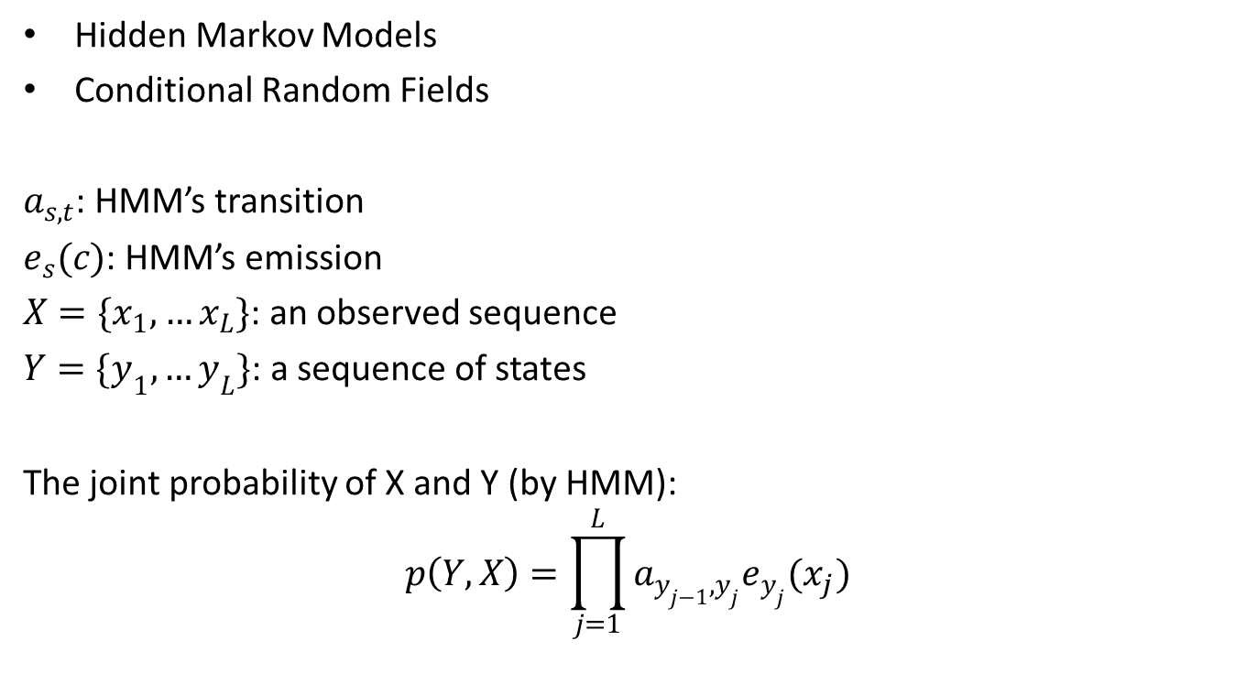
From HMMs to CRFs
Hidden Markov Models
Conditional Random Fields
$a_{s,t}$: HMM’s transition
$e_{s}(c)$: HMM’s emission
$X=\{x_{1},…x_{L}\}$: an observed sequence
$Y=\{y_{1},…y_{L}\}$: a sequence of states
The joint probability of X and Y (by HMM):
$$p\left(Y,X\right)=\prod_{j=1}^{L}{a_{y_{j−1},y_{j}}e_{y_{j}}(x_{j})}$$

Slide 9
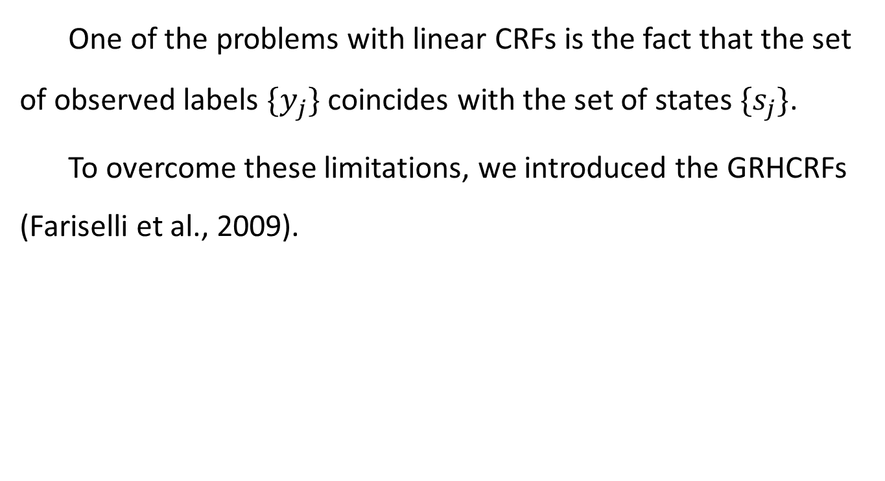
From CRFs to GRHCRFs
One of the problems with linear CRFs is the fact that the set of observed labels $\{y_{j}\}$ coincides with the set of states $\{s_{j}\}$.
To overcome these limitations, we introduced the GRHCRFs (Fariselli et al., 2009).

Slide 10
Bonding state prediction with GRHCRFs
encode each cysteine with a “local vector” representing the sequence nearest neighborhood.
The vector is computed starting from the PSSM as internally computed by PSI-BLAST using BLOSUM62.
Supplemented the local encoding (PSSM) with the piece of information provided by the subcellular localization (PSSM + SL) as obtained by the BaCelLo predictor.

Slide 11
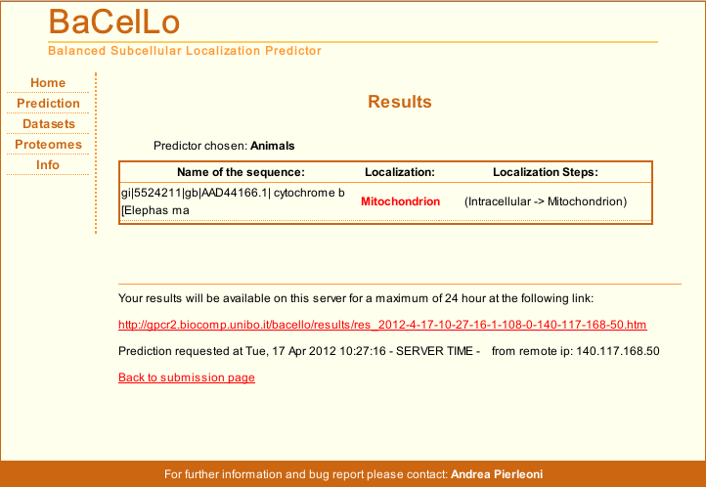
Details on the employment of BaCelLo

Slide 12
Predicting connectivity patterns
SVR
20-fold cross validation procedure
window size: 13

Slide 13

Measuring scoring efficiency
$Q_{2}=\frac{T_{p}+T_{n}}{T_{p}+T_{n}+F_{p}+F_{n}}$
$P_{r}=\frac{T_{p}}{T_{p}+F_{p}},R_{c}=\frac{T_{p}}{T_{p}+F_{n}}$
$F1=\frac{2×P_{r}×R_{c}}{P_{r}+R_{c}}$
$CC=\frac{T_{p}×T_{n}−F_{p}×F_{n}}{\sqrt{\left(T_{p}+F_{p}\right)×\left(T_{p}+F_{n}\right)×\left(T_{n}+F_{p}\right)×\left(T_{n}+F_{n}\right)}}$
$Q_{prot}=\frac{N_{cp}}{N_{p}}$
$P_{b}=,\frac{N_{c}}{N_{p}} R_{b}=\frac{N_{c}}{N_{b}},Q_{p}=\frac{N_{pat}}{N_{p}}$

Slide 14
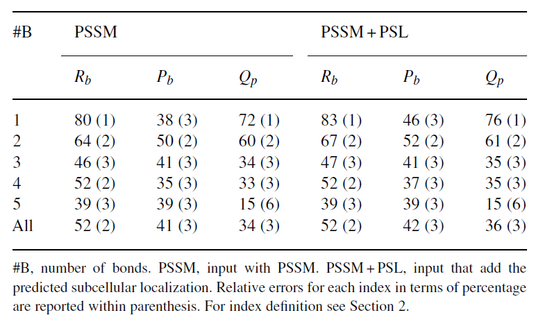
Result

