Slide 1
A Polyhedral Investigation of the LCS Problem and a Repetition-Free Variant
Cristina G. Fernandes, Carlos E. Ferreira,
Christian Tjandraatmadja and Yoshiko Wakabayashi
Proceedings of the 8th Latin American conference on Theoretical informatics, pp. 329-338, 2008
Presenter: Chiou-Ting Tseng
Date: May 1, 2012

Slide 2
Abstract (1/2)
We consider the longest common subsequence problem (LCS) and a variant of it where each symbol may occur at most once in the common subsequence. The LCS is a well-known problem that can be solved in polynomial time by a dynamic programming algorithm. We provide a complete description of a polytope we associate with the LCS. The integrality of this polytope can be derived by showing that it is in fact the clique polytope of a perfect graph.

Slide 3
Abstract (2/2)
The repetition-free version of the problem is known to be difficult. We also associate a polytope with this version and investigate its facial structure. We present some valid and facet-defining inequalities for this polytope and discuss separation procedures. Finally, we present some computational results of a branch and cut algorithm we have implemented for this problem.

Slide 4
數學家與熱氣球
一切數學家有興趣的東西都是沒用的
一切沒用的東西都是數學家有興趣的
本篇目的：把LCS轉成n維空間的convex hull問題

Slide 5
Polytope
n維多面體
In elementary geometry, a polytope is a geometric object with flat sides, which exists in any general number of dimensions.
A polygon is a polytope in two dimensions, a polyhedron in three dimensions, a polychoron in four dimensions.

Slide 6
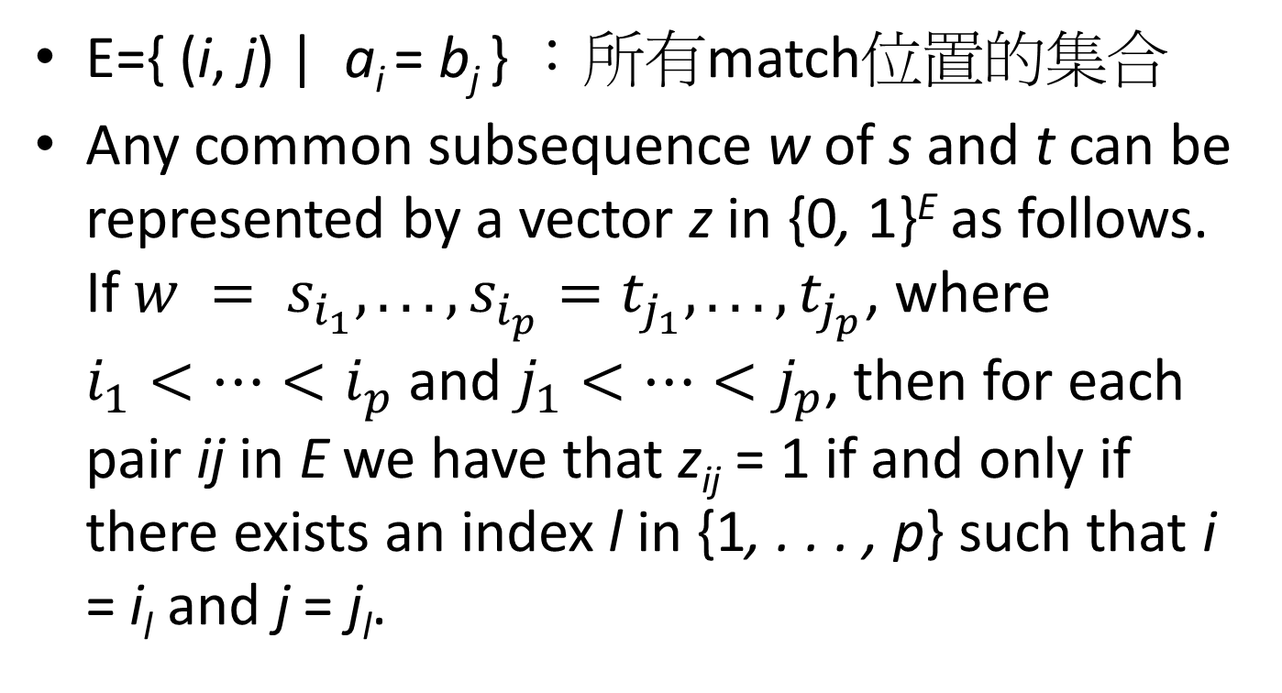
Transformation
E={ (i, j) | a_{i} = b_{j} } ：所有match位置的集合
Any common subsequence w of s and t can be represented by a vector z in {0, 1}^{E} as follows. If $w = s_{i_{1}}, . . . ,s_{i_{p}}=t_{j_{1}}, . . . ,t_{j_{p}}$, where $i_{1}<⋯<i_{p}$ and $j_{1}<⋯<j_{p}$, then for each pair ij in E we have that z_{ij} = 1 if and only if there exists an index l in {1, . . . , p} such that i = i_{l} and j = j_{l}.

Slide 7
Example
A = atatc, B = attcac
E = {(1,1), (1,5), (3, 1), (3, 5), (2, 2), (2, 3), (4, 2), (4, 3), (5, 4), (5, 6)}
LCS₁ = atac = {(1, 1), (2, 3), (3, 5), (5, 6)}
z₁ = 1001010001
LCS₂ = attc = {(1, 1), (2, 2), (4, 3), (5, 4)}
z₂ = 1000100110
CS₃ = ttc = {(2, 2), (4, 3), (5, 4)}
z₃ = 0000100110

Slide 8
表示法
A = atatc, B = attcac
E = {(1,1), (1,5), (3, 1), (3, 5), (2, 2), (2, 3), (4, 2), (4, 3), (5, 4), (5, 6)}
LCS₁ = atac = {(1, 1), (2, 3), (3, 5), (5, 6)}
z₁ = 1001010001
paper中的表示法是z₁₁=1, z₁₅=0, z₃₁=0, z₃₅=1,
z₂₂=0, z₂₃=1, z₄₂=0, z₄₃=0, z₅₄=0, z₅₆=1

Slide 9
LCS
The feasible solutions of this instance of the LCS are the vertices of the following polytope (defined as the convex hull of these solutions).
P_{lcs} := conv{z ∈ {0, 1}^{E} | z represents a common subsequence of s and t}.
Obviously, finding a vector z∗ in P_{LCS} with maximum number of nonzero components is equivalent to finding a longest common subsequence of s and t.

Slide 10
Proposition 1
The polytope P_{LCS} is full-dimensional.
A polytope is called full-dimensional, if it is an n-dimensional object in R^{n}.
取每個維度對應的match都是CS的一個feasible solution

Slide 11
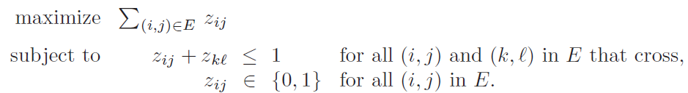
Integer Programming
We say that two distinct pairs (i, j) and (k, l) in E cross if (i ≤ k and j ≥ l) or (k ≤ i and l ≥ j).

Slide 12
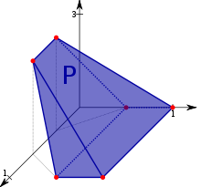
Facet
A face of a convex polytope is any intersection of the polytope with a halfspace such that none of the interior points of the polytope lie on the boundary of the halfspace.
If a polytope is d-dimensional, its facets are its (d − 1)-dimensional faces, its vertices are its 0-dimensional faces, its edges are its 1-dimensional faces, and its ridges are its (d − 2)-dimensional faces.

Slide 13
Proposition 2
For every (i, j) in E, the inequality z_{ij} ≥ 0 defines a facet of P_{LCS}.
Proof. Fix an (i, j) in E. It is easy to see that the zero vector and the unit vectors e^{kl} for all (k, l) = (i, j) are vertices of P_{LCS} that satisfy z_{ij} = 0 and they are affinely independent.

Slide 14
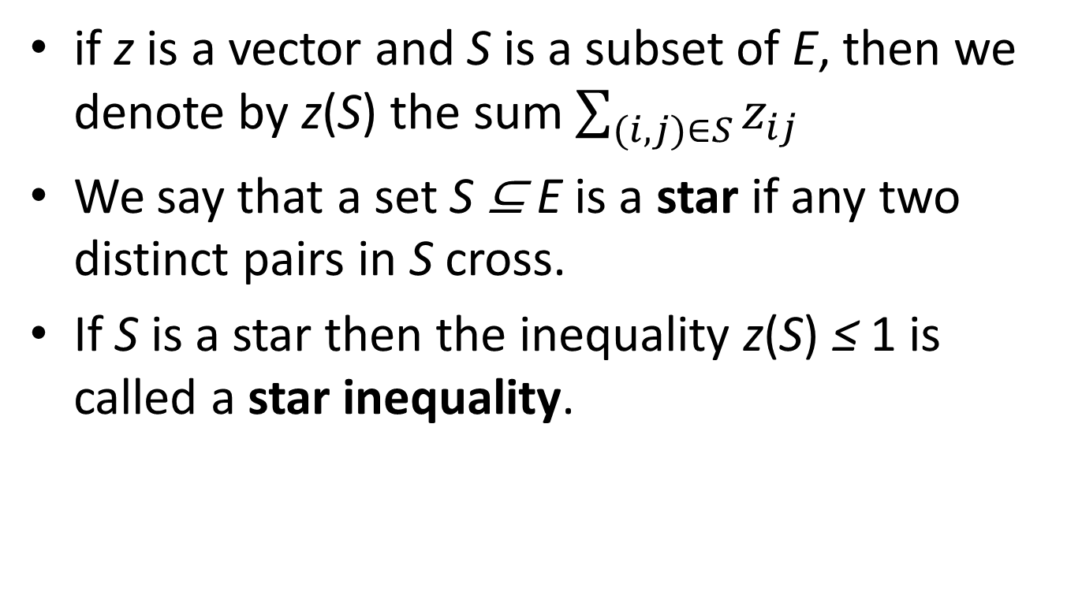
Star
if z is a vector and S is a subset of E, then we denote by z(S) the sum $\sum_{(i,j)∈S}{z_{ij}}$
We say that a set S ⊆ E is a star if any two distinct pairs in S cross.
If S is a star then the inequality z(S) ≤ 1 is called a star inequality.

Slide 15
Lemma 1
Consider a star S ⊆ E. Then the star inequality z(S) ≤ 1 is valid for P_{LCS}, and it defines a facet if and only if S is maximal.

Slide 16
Theorem 1
Any facet-defining inequality of P_{LCS} is either a nonnegativity inequality or a maximal star inequality
P_{lcs} = {z ∈ R^{E} | z_{ij} ≥ 0 for all (i, j) ∈ E and z(S) ≤ 1 for all maximal star S ⊆ E}.

Slide 17
Finding the Maximal Stars
Consider the problem of finding a maximum weight common subsequence of the reversal of s and the sequence t, where the weight of aligning s_{i} with t_{j} is z_{ij}.
If such a maximum weight star, say S, has value greater than 1, the corresponding star inequality z(S) ≤ 1 is violated by z. Conversely, if this value is less than or equal to 1, no star inequality is violated by the current solution z.

Slide 18
The Integrality of the LCS Polytope
A polyhedron P is said to be integral if all its vertices or extreme points are integral (belong to Z^{n}).
略

Slide 19
Repetition-Free LCS
在LCS中同樣的字母不能出現兩次
It has been proved that this problem is NP-hard.
Indeed, Adi et al. proved that it is APX-hard even if each symbol appears at most twice in each of the given sequences.

Slide 20
APX (approximable)
The set of NP optimization problems that allow polynomial-time approximation algorithms with approximation ratio bounded by a constant.

Slide 21
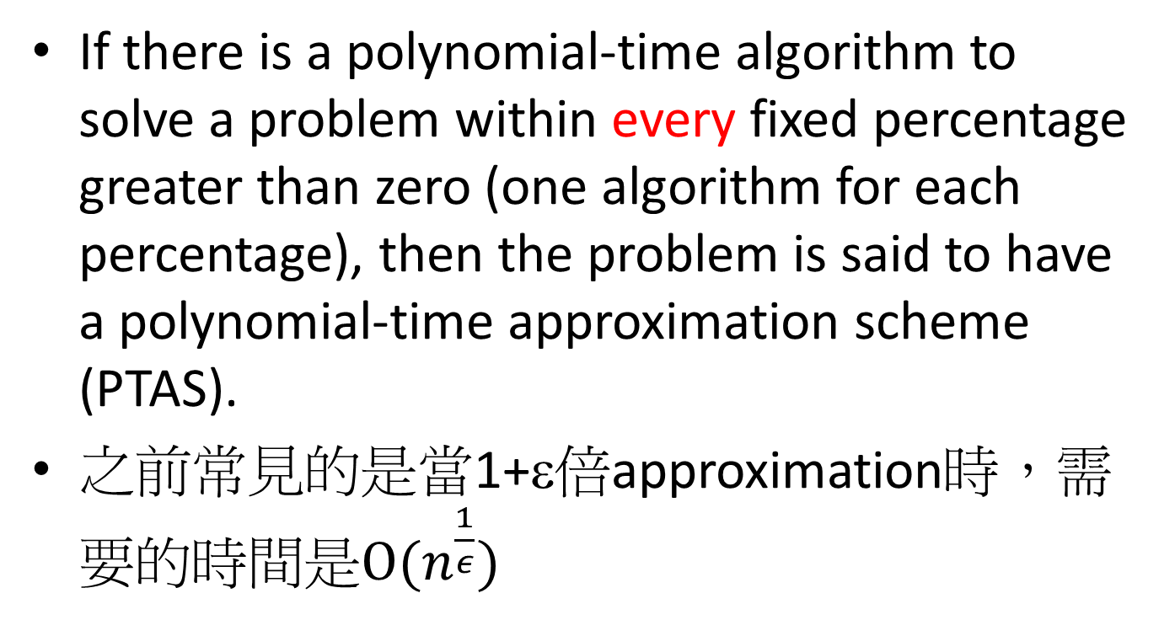
Polynomial-Time Approximation Scheme (PTAS).
If there is a polynomial-time algorithm to solve a problem within every fixed percentage greater than zero (one algorithm for each percentage), then the problem is said to have a polynomial-time approximation scheme (PTAS).
之前常見的是當1+ε倍approximation時，需要的時間是$O(n^{\frac{1}{ε}})$

Slide 22
APX-hard
A problem is said to be APX-hard if there is a PTAS reduction from every problem in APX to that problem.
Unless P=NP, it can be shown that there are problems that are in APX but not in PTAS; that is, problems that can be approximated within some constant factor, but not every constant factor

Slide 23
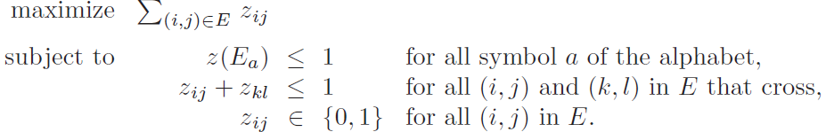
Formulation for the RFLCS

Slide 24
Extended Star
For a set S ⊆ E, let Sa = S∩(s(a)×t(a)), where a is a symbol of the alphabet.
We say that a set S ⊆ E is an extended star if, for every two distinct symbols a and b, each pair in S_{a} crosses all pairs in S_{b}.

Slide 25
Example
s =xxxxfxxxxexxxd₂xd₁xcb₃xb₂xxb₁xa₃xxa₂xxa₁
t =ayayayybybyyybyyycdyyyyydyeyyfyy
s^{r}=a₁xxa₂xxa₃xb₁xxb₂xb₃cxd₁xd₂xxxexxxxfxxxx

Slide 26
Theorem 2
Let S be a maximal extended star. The inequality z(S) ≤ 1 defines a facet of P_{RFLCS}.

Slide 27
Finding the Violating Extended Stars
It looks for a maximum weight alignment between s^{r} and t.
The weights for the alignments are given by z.
Such an alignment allows crossings only among pairs corresponding to a common symbol.
One can find such an alignment by a dynamic programming algorithm.

Slide 28
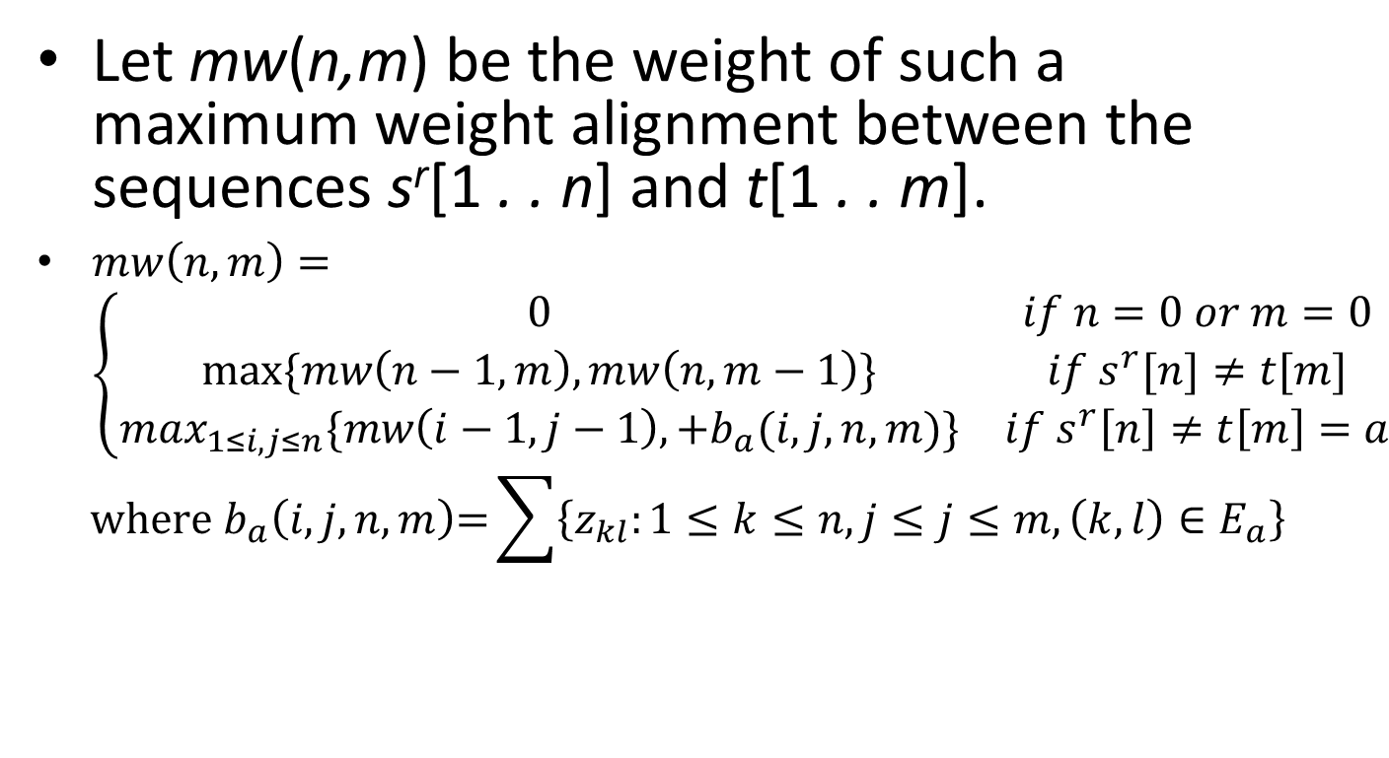
Finding the Violating Extended Stars
Let mw(n,m) be the weight of such a maximum weight alignment between the sequences s^{r}[1 . . n] and t[1 . . m].
$mw\left(n,m\right)=\left\{\begin{matrix}0 & if n=0 or m=0 \\ max⁡\{mw\left(n−1,m\right),mw\left(n,m−1\right)\} & if s^{r}[n]≠t[m] \\ \max_{1≤i,j≤n}\{mw\left(i−1,j−1\right),+b_{a}(i, j,n, m)\} & if s^{r}\left[n\right]≠t\left[m\right]=a\end{matrix}\right.$
$$\text{where} b_{a}\left(i, j, n, m\right)\text{=}\sum{\left\{z_{kl}:1≤k≤n, j≤j≤m, \left(k,l\right)∈E_{a}\right\}}$$

Slide 29
Finding the Violating Extended Stars
If mw(n,m) < 1, then such an alignment corresponds to an extended star that is violated.
If mw(n,m) ≥ 1, then no extended star is violated.
It is not hard to see that mw(n,m) can be computed by an O(n²m²) algorithm.

Slide 30
Results
We implemented a branch and cut algorithm for the RFLCS using the exact separation procedure for the extended star inequalities.
We considered instances consisting of two sequences of equal length n = 512, and with alphabet sizes 1/8n, 2/8n, . . . , 7/8n.
The instances are generated randomly with uniform probability.
To solve the linear programming relaxation we use the GLPK (Gnu Linear Programming Kit).

Slide 31
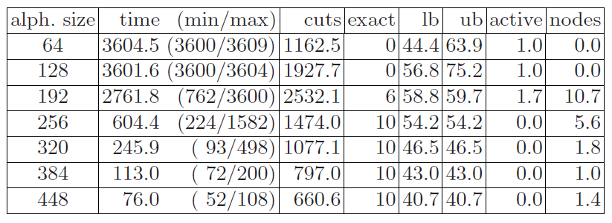
Result 1

Slide 32
Result 1
It becomes more difficult to solve instances in which the alphabet size is small compared to the length of the sequences (up to 3/8n).
It is interesting to note that we could solve all instances to optimality when the size of the alphabet is at least 1/2n.

Slide 33
Result 2
In order to investigate the strength of the extended star inequalities we ran GLPK with the integer programming formulation.
We set the parameters of the solver to use clique and Gomory cuts.

Slide 34
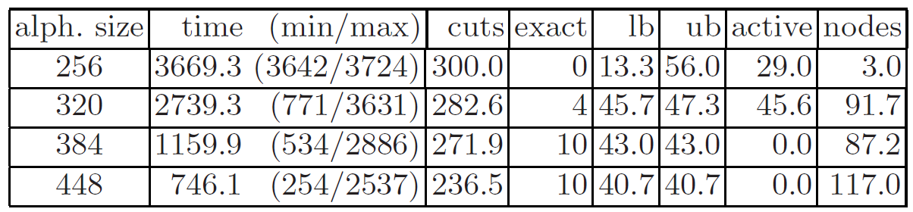
Result 2

Slide 35
End

