Slide 1
Efficient String Matching in The Presence of Errors
Landau, G.M., Vishkin, U.
Foundations of Computer Science, 26th Annual Symposium on
1985, Pages 126-136
Presenter: Huang-Ting Chan
Date:2015/6/16

Slide 2
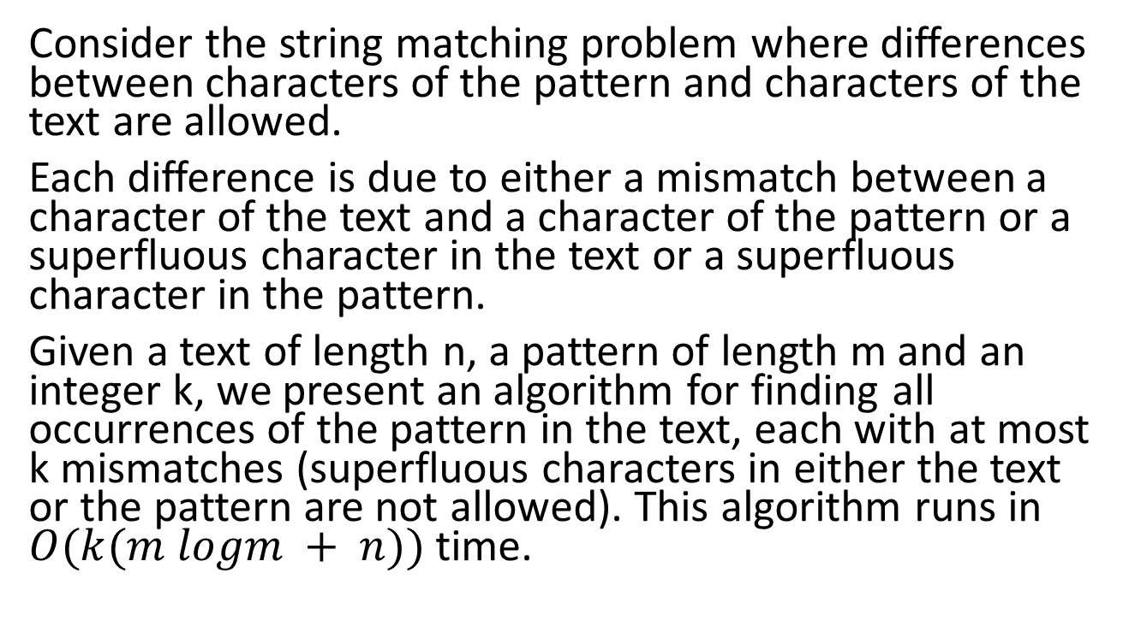
Abstract
Consider the string matching problem where differences between characters of the pattern and characters of the text are allowed.
Each difference is due to either a mismatch between a character of the text and a character of the pattern or a superfluous character in the text or a superfluous character in the pattern.
Given a text of length n, a pattern of length m and an integer k, we present an algorithm for finding all occurrences of the pattern in the text, each with at most k mismatches (superfluous characters in either the text or the pattern are not allowed). This algorithm runs in $O(k(m logm + n))$time.

Slide 3
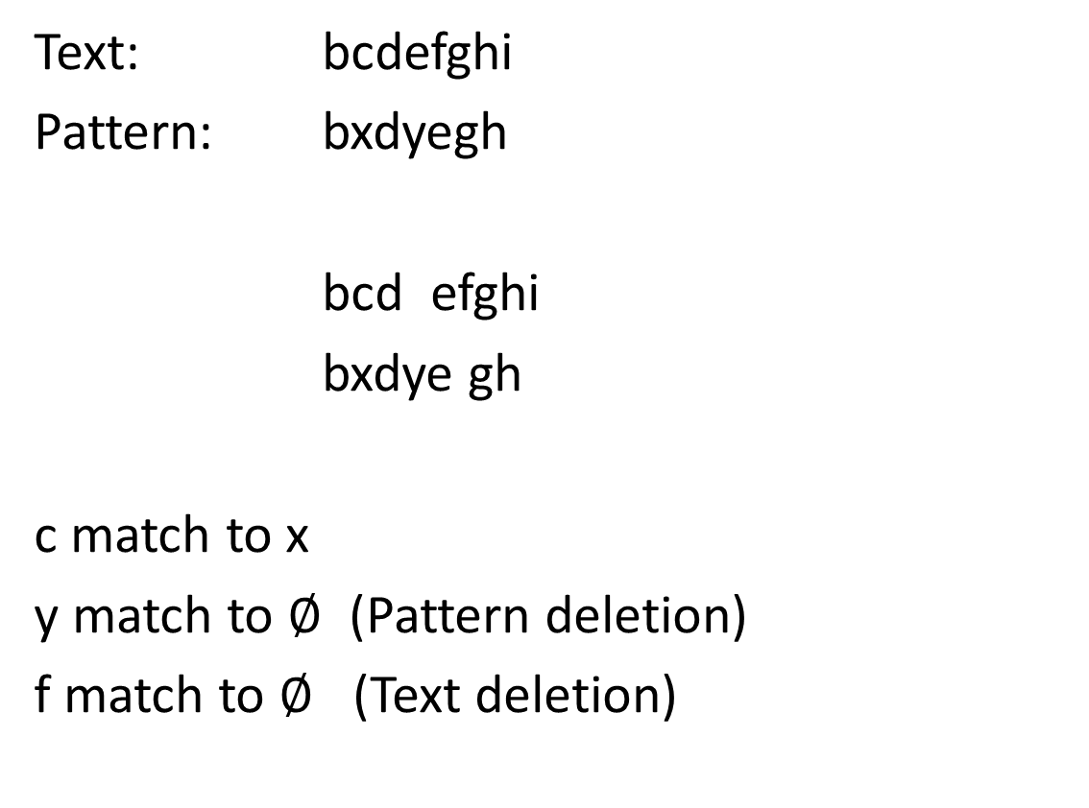
The problem
Text: bcdefghi
Pattern: bxdyegh
bcd efghi
bxdye gh
c match to x
y match to $∅$ (Pattern deletion)
f match to $∅$ (Text deletion)

Slide 4
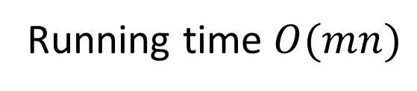
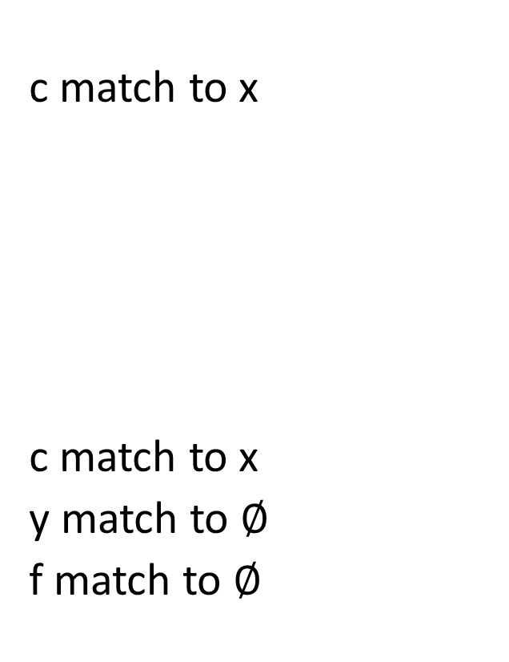
The problem
c match to x
c match to x
y match to $∅$
f match to $∅$
String matching with k mismatch
Find all occurrences of the
pattern in the text with at most
k mismatch
String matching with k differences
Find all occurrences of the
pattern in the text with at most
k differences
Running time $O(mn)$

Slide 5
Algorithm
Two parts
Pattern analysis:
Build a table which is based on analysis of the pattern.
Text analysis:
Show how to find efficiently all the occurrences of the pattern in the text with at most k mismatches.

Slide 6
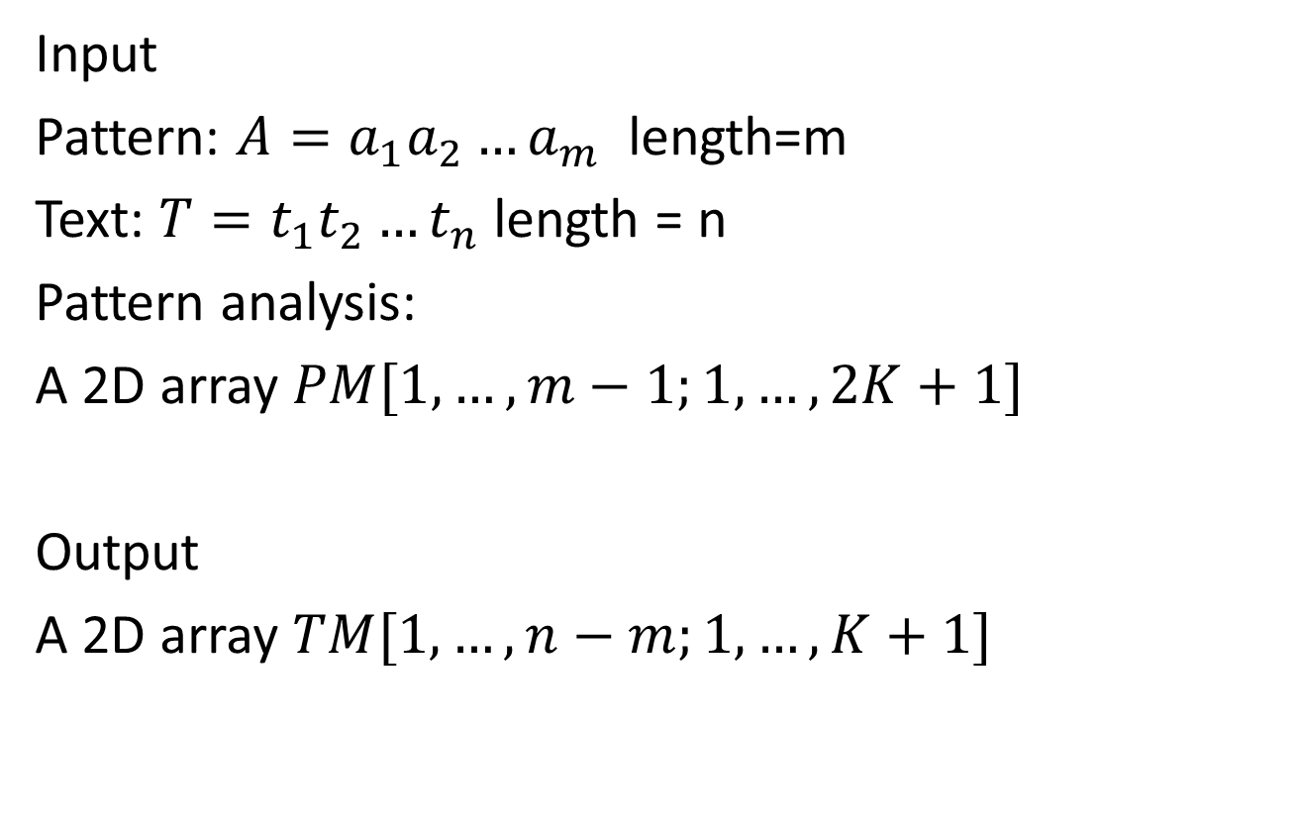
Text Analysis
Input
Pattern: $A=a_{1}a_{2}…a_{m}$ length=m
Text: $T=t_{1}t_{2}…t_{n}$ length = n
Pattern analysis:
A 2D array $PM[1,…,m−1;1,…,2K+1]$
Output
A 2D array $TM[1,…,n−m;1,…,K+1]$

Slide 7
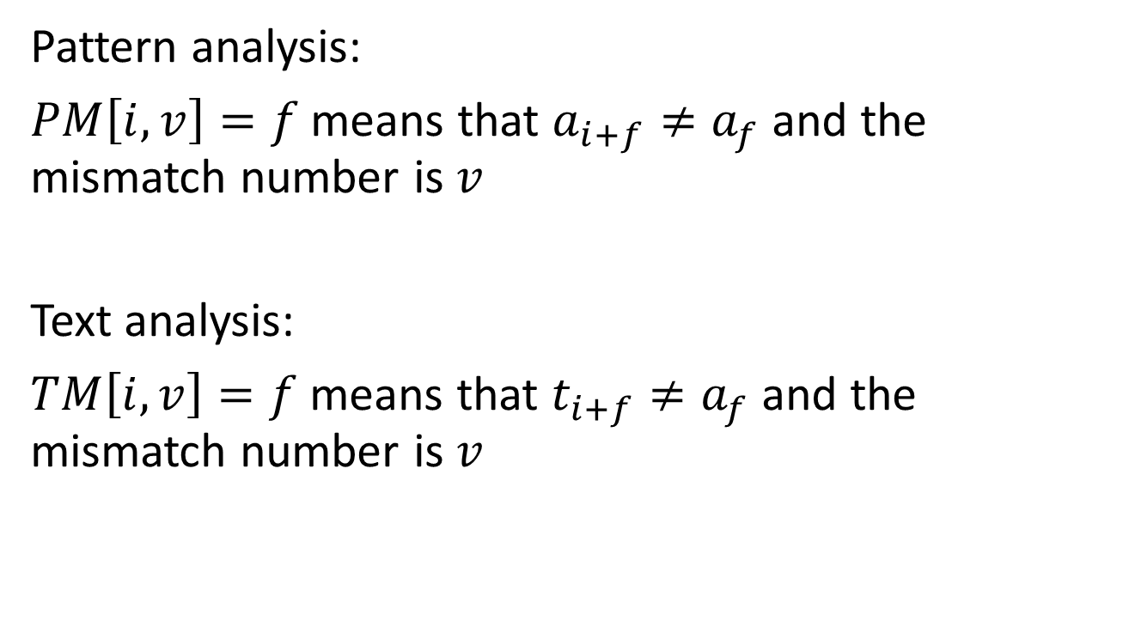
Pattern analysis:
$PM\left[i,v\right]=f$ means that $a_{i+f}≠a_{f}$ and the mismatch number is $v$
Text analysis:
$TM\left[i,v\right]=f$ means that $t_{i+f}≠a_{f}$ and the mismatch number is $v$

Slide 8

Example
Pattern = abaacaa
$$PM\left[2,1\right]=2$$
$$PM\left[2,2\right]=3$$
$$PM\left[2,3\right]=5$$
abaacaa
| | | | |
abaacaa

Slide 9
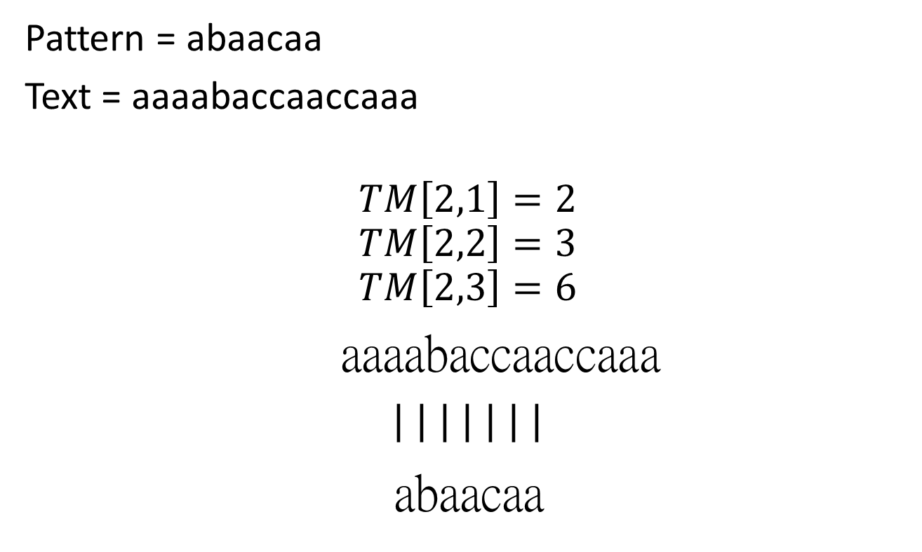
Example
Pattern = abaacaa
Text = aaaabaccaaccaaa
$$TM\left[2,1\right]=2$$
$$TM\left[2,2\right]=3$$
$$TM\left[2,3\right]=6$$
aaaabaccaaccaaa
| | | | | | |
abaacaa

Slide 10
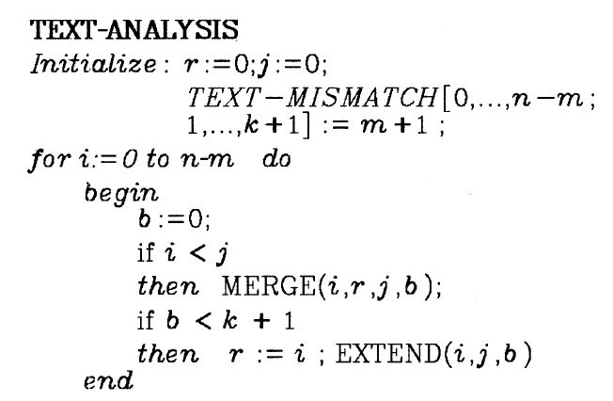
Text analysis

Slide 11
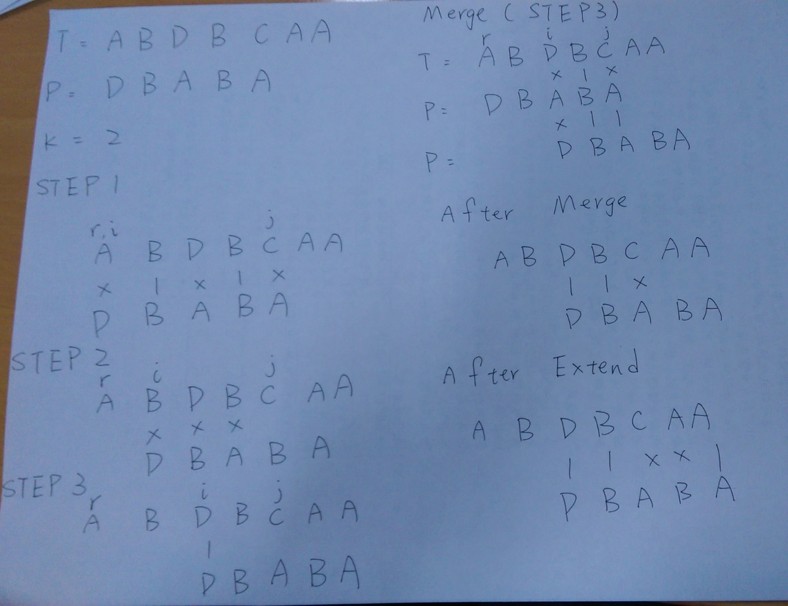
Example

Slide 12
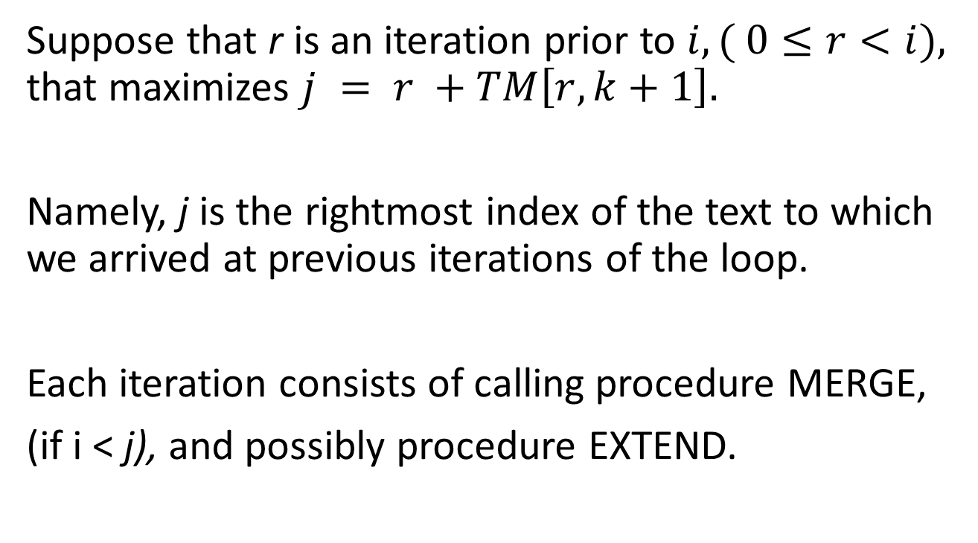
Suppose that r is an iteration prior to $i, ( 0≤r<i),$ that maximizes $j = r +TM\left[r,k+1\right].$
Namely, j is the rightmost index of the text to which we arrived at previous iterations of the loop.
Each iteration consists of calling procedure MERGE,
(if i < j), and possibly procedure EXTEND.

Slide 13
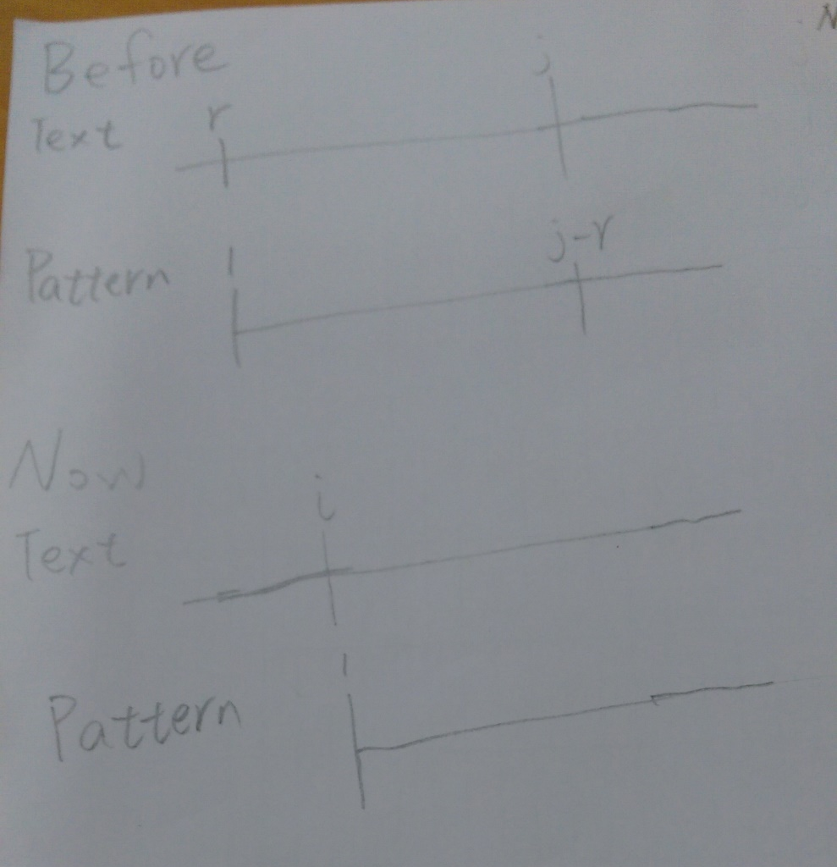
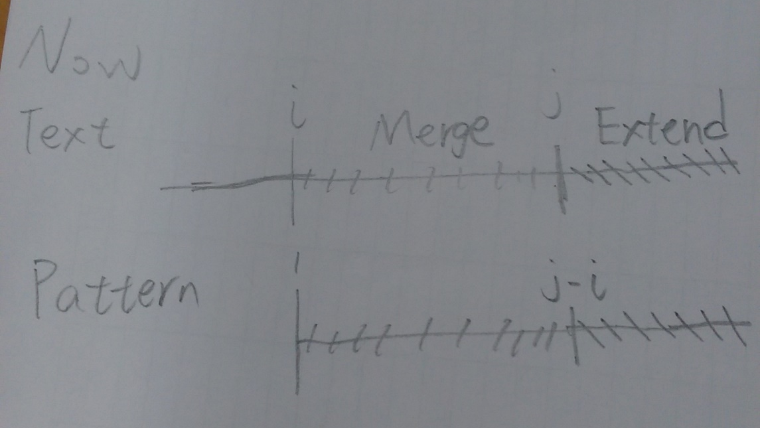

Slide 14

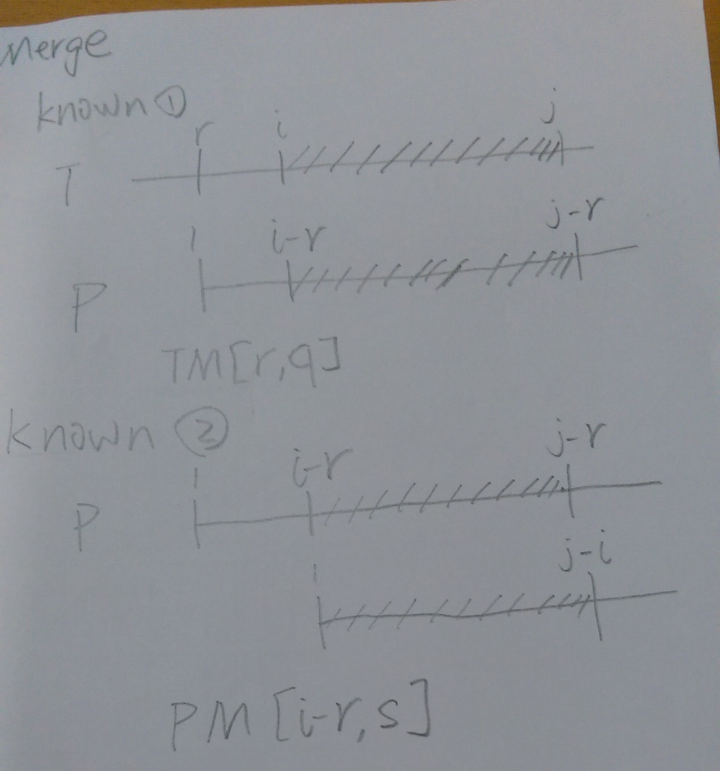

Slide 15
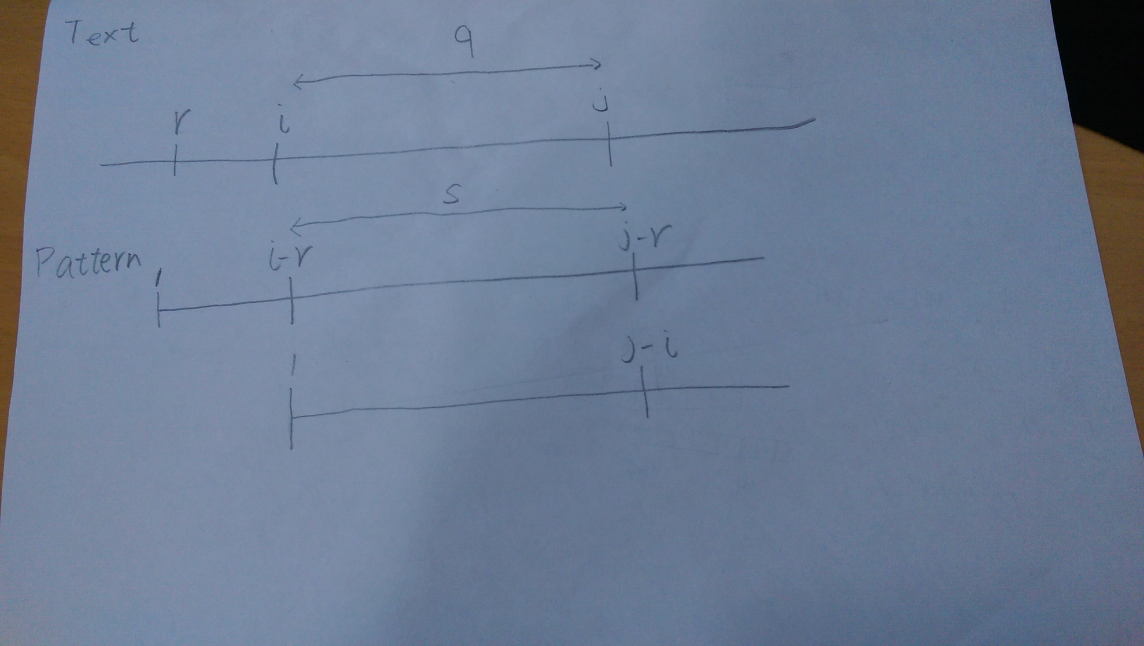
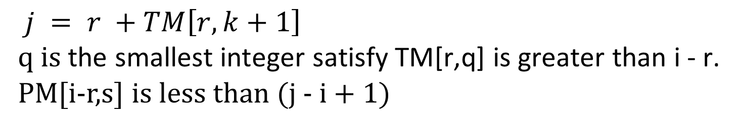
$j = r +TM\left[r,k+1\right]$
$$\text{q} \text{is} \text{the} \text{smallest} \text{integer} \text{satisfy} \text{TM}\text{[}\text{r}\text{,}\text{q}\text{] }\text{is} \text{greater} \text{than} \text{i}\text{ - }\text{r}\text{.}$$
PM[i-r,s] is less than (j - i + 1)

Slide 16
Pattern Analysis
Partiton the set into logm sets as follows:
[1],[2,3],[4,5,6,7],…[m/2,…,m-1].
And then use Merge and Extend to compute.

Slide 17
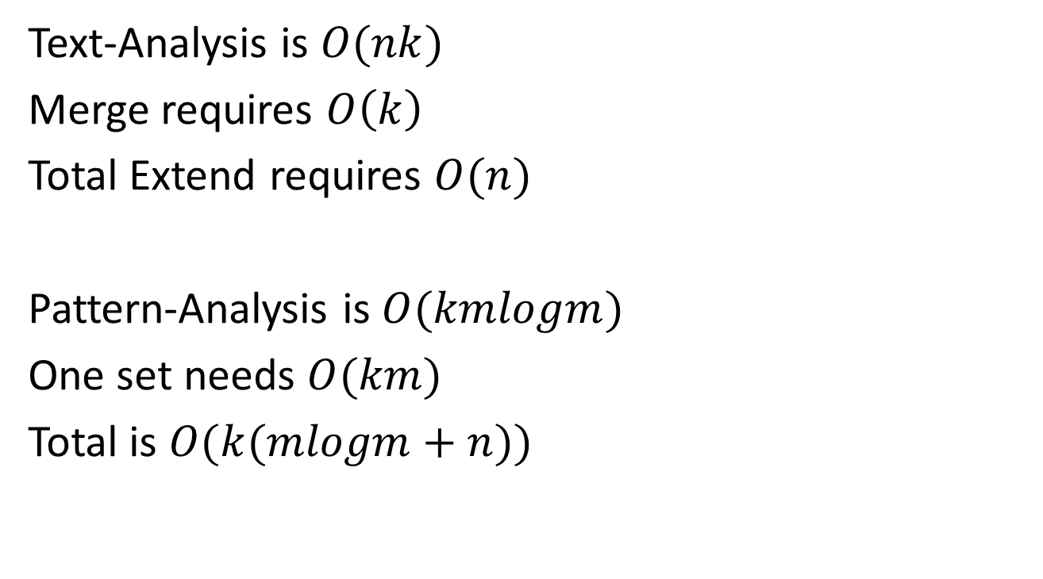
Time Complexity
Text-Analysis is $O(nk)$
Merge requires $O\left(k\right)$
Total Extend requires $O(n)$
Pattern-Analysis is $O(kmlogm)$
One set needs $O(km)$
Total is $O(k(mlogm+n))$

