Slide 1
An Efficient Algorithm for Computing Non-overlapping Inversion and Transposition Distance
Toan Thang Ta, Cheng-Yao Lin and Chin Lung Lu
The 32nd Workshop on Combinatorial Mathematics and Computation Theory, Taichung, Taiwan, May 1-2,
pp. 55-61 (2015)
Presenter: Tzu-Chiang Hsu (徐子強)
2015/06/16

Slide 2
Abstract (1/2)
Given two strings of the same length n, the non-overlapping inversion and transposition distance (also called mutation distance) between them is defined as the minimum number of non-overlapping inversion and transposition operations used to transform one string into the other.

Slide 3
Abstract (2/2)
In this study, we present an O(n³) time and O(n²) space algorithm to compute the mutation distance of two input strings.

Slide 4
Inversion
A T C G
C G A T

Slide 5
Transposition
3 4 5 6 1 2
1 2 3 4 5 6

Slide 6
Non-overlapping
A C G T A T C G A
T T A C G C G T A

Slide 7
A T C G T A
T T A C G A

Slide 8
A T C G T A
T T A C G A

Slide 9
①
A T C G T A
T T A C G A

Slide 10
②
A T C G T A
T T A C G A

Slide 11
②
A T C G T A
T T A C G A

Slide 12
②
A T C G T A
T T A C G A

Slide 13
③
A T C G T A
T T A C G A

Slide 14
③
A T C G T A
T T A C G A

Slide 15
④
A T C G T A
T T A C G A

Slide 16
①
A T C G T A
T T A C G A

Slide 17
⑴
A T C G T A
T T A C G A

Slide 18
⑵
A T C G T A
T T A C G A

Slide 19
⑵
A T C G T A
T T A C G A

Slide 20
⑵
A T C G T A
T T A C G A

Slide 21
⑶
A T C G T A
T T A C G A

Slide 22
⑶
A T C G T A
T T A C G A

Slide 23
⑶
A T C G T A
T T A C G A

Slide 24
⑶
A T C G T A
T T A C G A

Slide 25
⑴
A T C G T A
T T A C G A

Slide 26
{1}
A T C G T A
T T A C G A

Slide 27
{1}
A T C G T A
T T A C G A

Slide 28
{2}
A T C G T A
T T A C G A

Slide 29
{2}
A T C G T A
T T A C G A

Slide 30
A T C G T A
T T A C G A

Slide 31
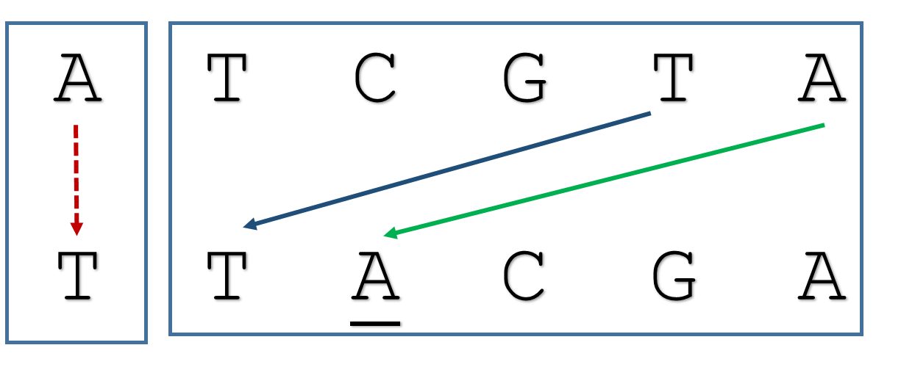
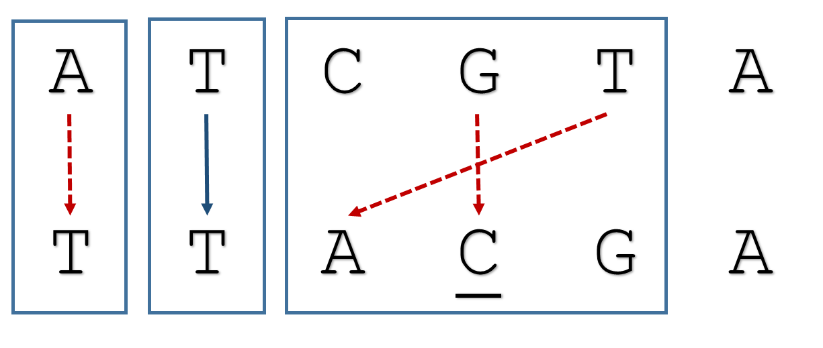
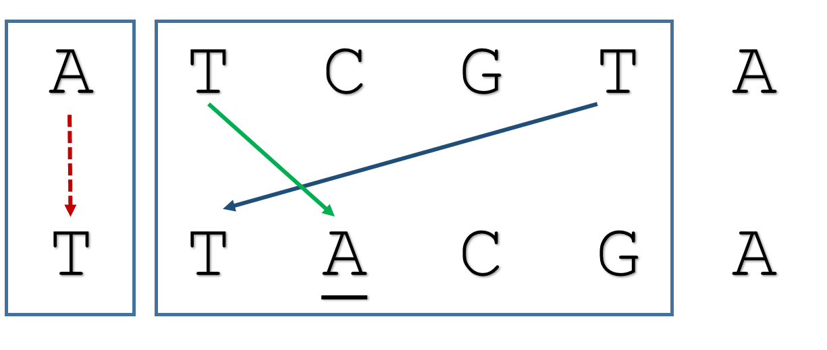
[2, 1, 1, (3, 6, A)] type F
[0, 0, (1, 1, θ(A))] type V
[0, 1, (2, 2, T)] type V
[1, 1, (4, 4, θ(G))] type I
T
[2, 1, 2, (2, 3, T)] type S

Slide 32
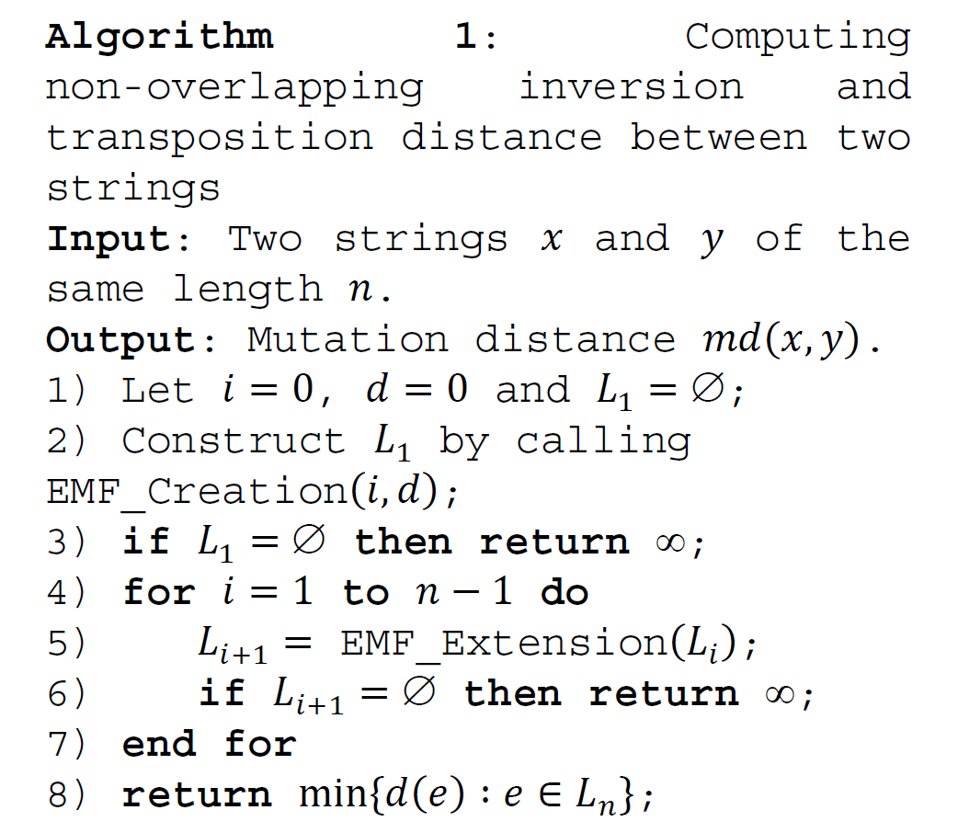

Slide 33
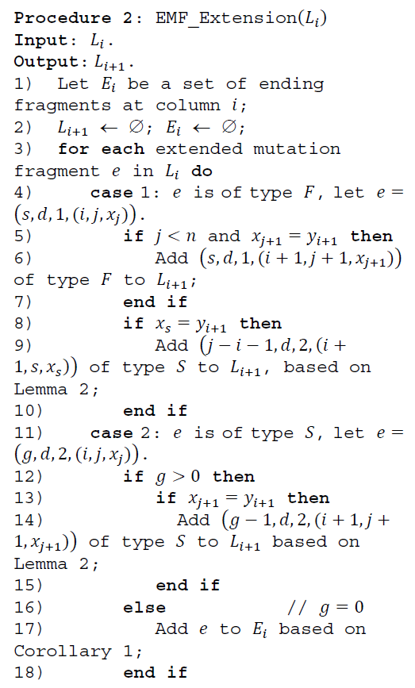
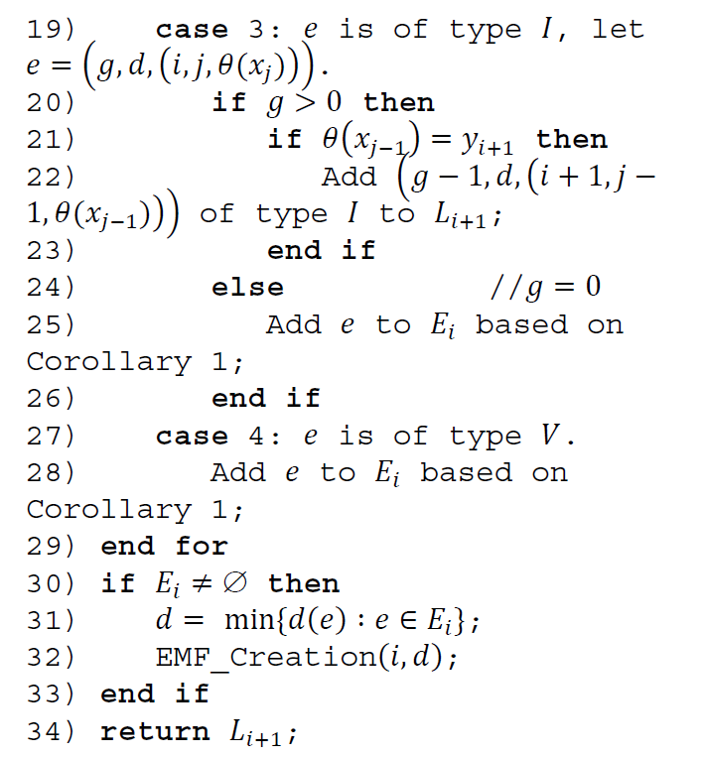

Slide 34

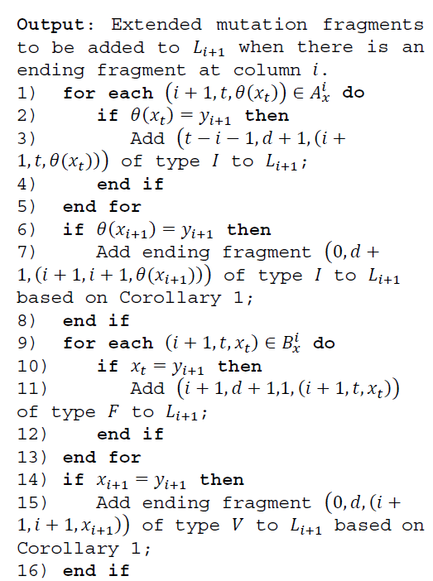

Slide 35
O(n³) time O(n²) space

