Slide 1
Repetition-free longest common subsequence
Said S. Adi, Marília D.V. Braga, Cristina G. Fernandes,
Carlos E. Ferreira, Fábio Viduani Martinez,
Marie-France Sagot, Marco A. Stefanes,
Christian Tjandraatmadja, Yoshiko Wakabayashi
Discrete Applied Mathematics, volume 158, pp.1315~1324(2010)
Presenter: Shian-Liang Lin

Slide 2
Abstract
We study the following problem. Given two sequences x and y over a finite alphabet, find
a repetition-free longest common subsequence of x and y.
We show several algorithmic results, a computational complexity result, and we describe a preliminary experimental study based on the proposed algorithms. We also show that this problem is APX-hard.

Slide 3
Definition
Input: two strings s₁ and s₂.
Output: a longest common subsequence s of s₁ and s₂, so that s contains at most one occurrence of each symbol σ ∈ Σ.
Example:
S₁ : a c b a
S₂ : a b c b a
RF-LCS: a c b a(4) => a c b, a c a, c b a(3)

Slide 4
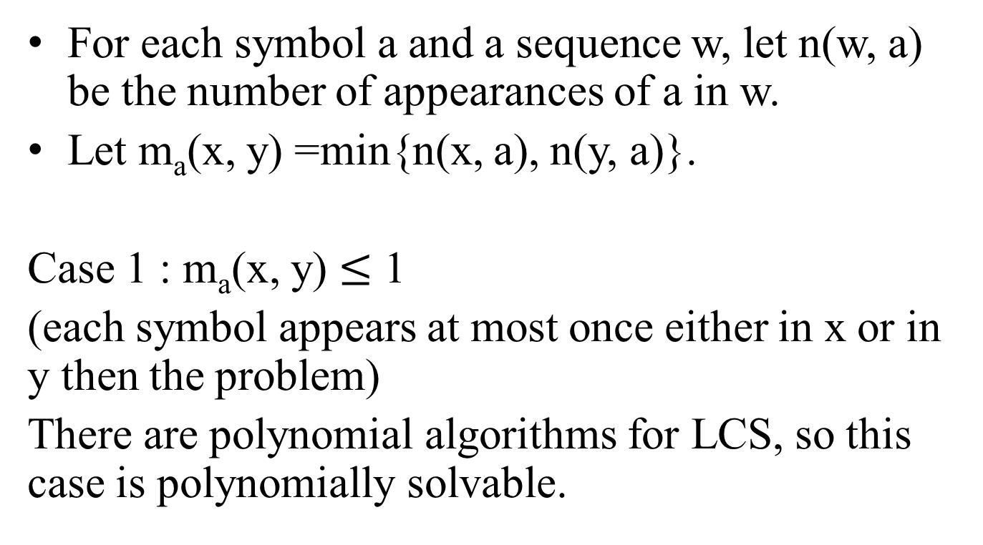
Polynomially solvable cases of RFLCS(x ,y)(1/2)
For each symbol a and a sequence w, let n(w, a) be the number of appearances of a in w.
Let m_{a}(x, y) =min{n(x, a), n(y, a)}.
Case 1 : m_{a}(x, y) $≤$ 1
(each symbol appears at most once either in x or in y then the problem)
There are polynomial algorithms for LCS, so this case is polynomially solvable.

Slide 5
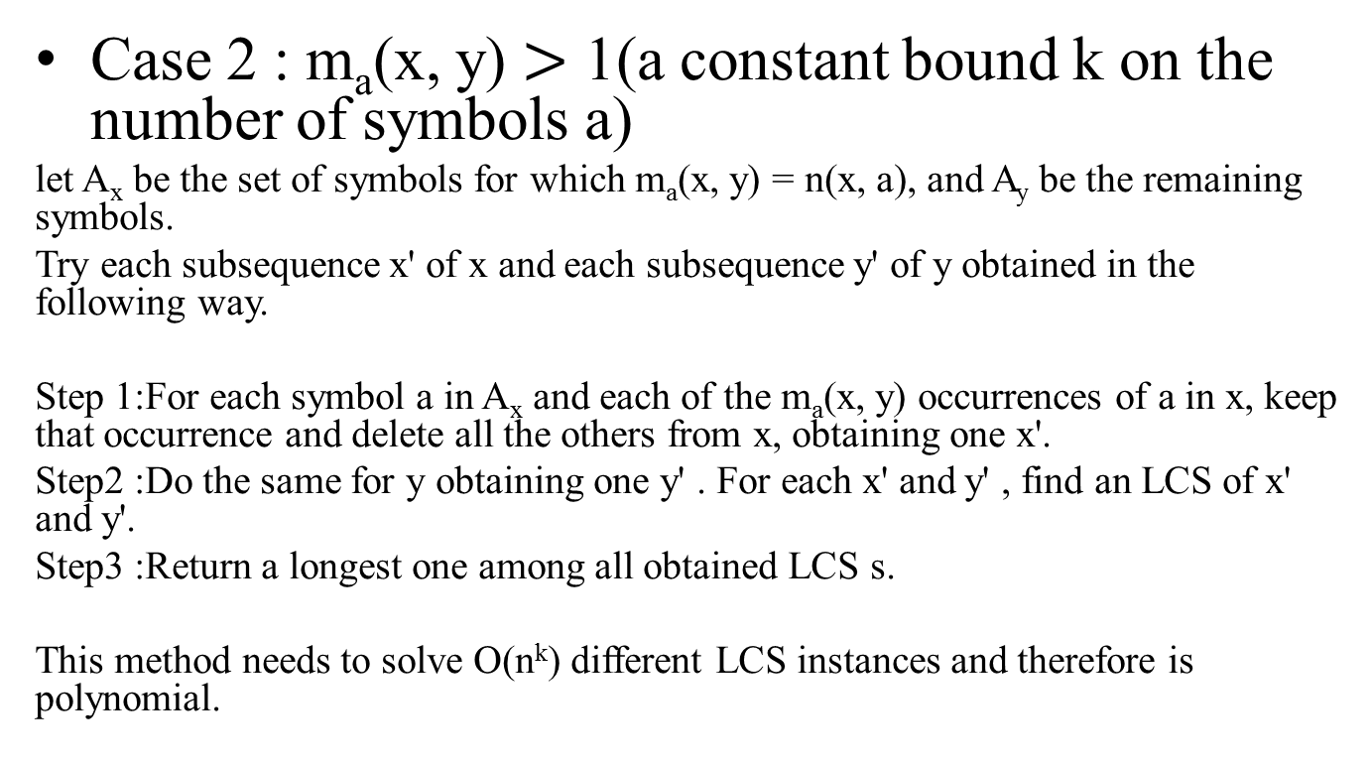
Polynomially solvable cases of RFLCS(x ,y)(1/2)
Case 2 : m_{a}(x, y) $>$ 1(a constant bound k on the number of symbols a)
let A_{x} be the set of symbols for which m_{a}(x, y) = n(x, a), and A_{y} be the remaining symbols.
Try each subsequence x' of x and each subsequence y' of y obtained in the following way.
Step 1:For each symbol a in A_{x} and each of the m_{a}(x, y) occurrences of a in x, keep that occurrence and delete all the others from x, obtaining one x'.
Step2 :Do the same for y obtaining one y' . For each x' and y' , find an LCS of x' and y'.
Step3 :Return a longest one among all obtained LCS s.
This method needs to solve O(n^{k}) different LCS instances and therefore is polynomial.

Slide 6
Polynomially solvable cases of RFLCS(x ,y)(1/2)
Example
x:a b c b a b y:c b c a b
m_{a}(x, y)= m_{c}(x, y)=1 m_{b}(x, y)= 2 (constant bound K=2)
Step 1: A_{x} ={c}
x' = a b c b a b
Step 2:A_{y} ={a, b}
y' = c b c a b, c b c a , c c a b
Step 3: LCS(x', y') =>bcab, cba, cab
max of LCS(x', y') = bcab
different LCS instances = 3 < |Σ|² < n^{k} =6²

Slide 7
Simple approximation algorithms(1/5)
Algorithm A1 :
given x and y, compute an LCS of x and y and remove all repeated symbols but one, in the obtained LCS. Return the resulting sequence.
Algorithm A1 is an m-approximation for RFLCS(x, y).
(m is the maximum value of m_{a}(x ,y) )
Example
x:a b c b a b y:c b c a b
LCS(x , y)=c b a b
remove repeated symbols => c b a

Slide 8
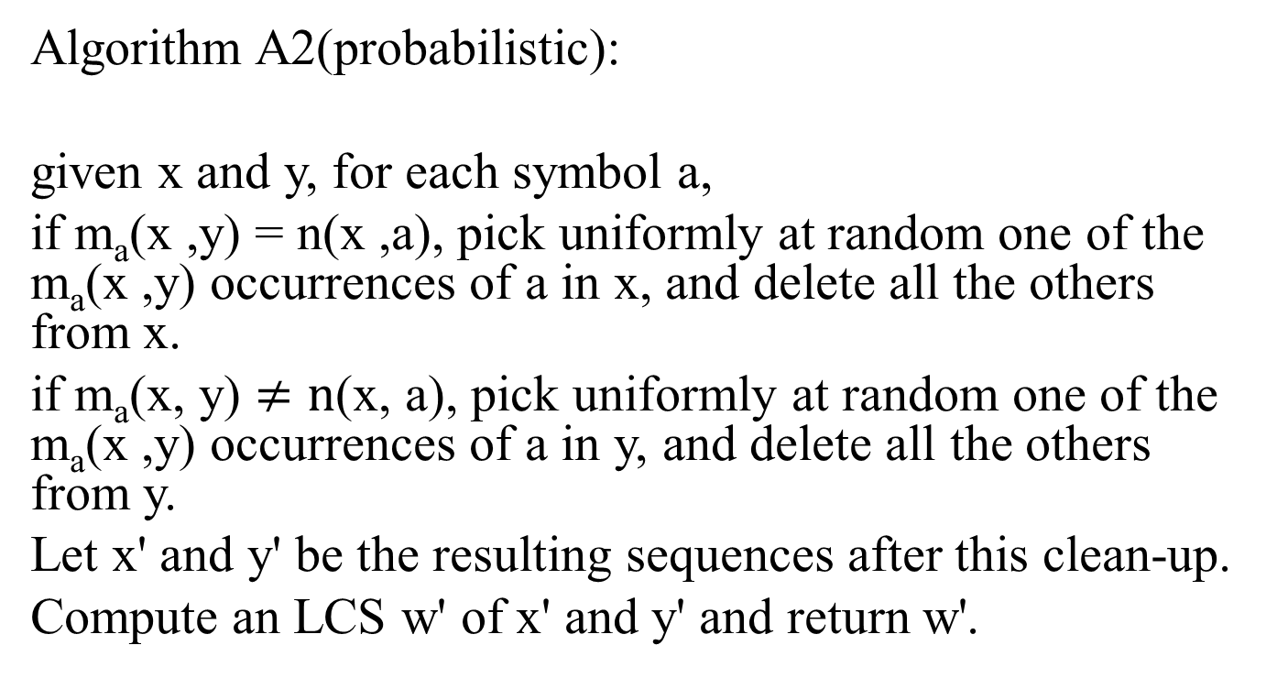
Simple approximation algorithms(2/5)
Algorithm A2(probabilistic):
given x and y, for each symbol a,
if m_{a}(x ,y) = n(x ,a), pick uniformly at random one of the m_{a}(x ,y) occurrences of a in x, and delete all the others from x.
if m_{a}(x, y) $≠\text{n}\text{(}\text{x}\text{,} \text{a}\text{)}$, pick uniformly at random one of the m_{a}(x ,y) occurrences of a in y, and delete all the others from y.
Let x' and y' be the resulting sequences after this clean-up.
Compute an LCS w' of x' and y' and return w'.

Slide 9
Simple approximation algorithms(3/5)
Example
x:a b c b a b y:c b c a b
m_{a}(x, y)= m_{c}(x, y)=1 m_{b}(x, y)= 2 (constant bound K=2)
Step 1: m_{c}(x ,y) = n(x ,c)=1
random pick one of ' c ' in y and delete all the others
x' = a b c b a b
Step 2 : m_{a}(x ,y) = n(y ,a)= 1 , m_{b}(x ,y) = n(y ,b)= 2
random pick one of 'a' or 'b' in y and delete all the others of the picked one.
y' = c b c a b (pick 'a' )
Step 3: LCS(x', y') = w' = bcab

Slide 10
Simple approximation algorithms(4/5)
Algorithm A3 : a variant of Algorithm A2 that uses less random bits.
The difference now is that A3 picks uniformly at random only one number, say r, in the interval [0, 1] and uses r to select which occurrence of each symbol will remain.
For each repeated symbol, the selection is done using the same number r.

Slide 11
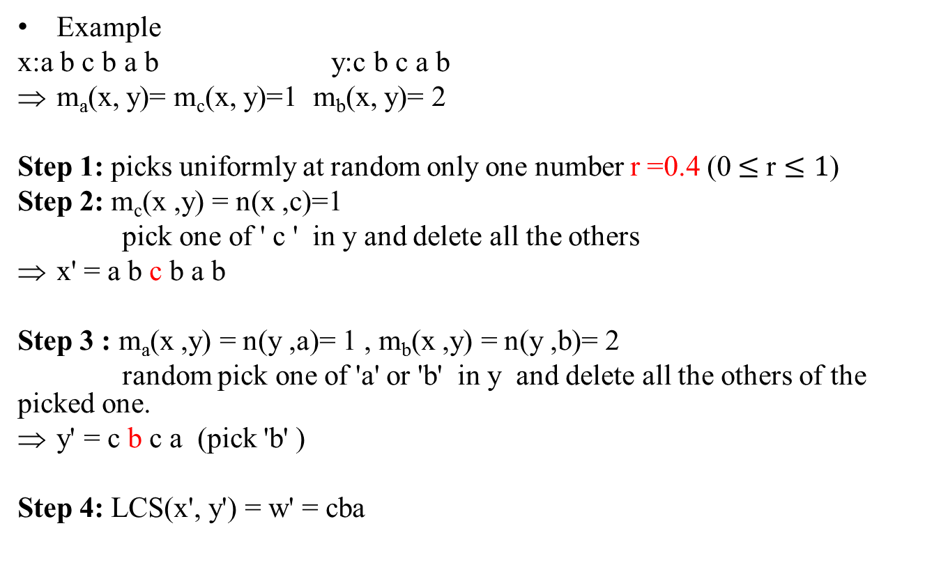
Simple approximation algorithms(5/5)
Example
x:a b c b a b y:c b c a b
m_{a}(x, y)= m_{c}(x, y)=1 m_{b}(x, y)= 2
Step 1: picks uniformly at random only one number r =0.4 (0$≤$ r $≤1$)
Step 2: m_{c}(x ,y) = n(x ,c)=1
pick one of ' c ' in y and delete all the others
x' = a b c b a b
Step 3 : m_{a}(x ,y) = n(y ,a)= 1 , m_{b}(x ,y) = n(y ,b)= 2
random pick one of 'a' or 'b' in y and delete all the others of the picked one.
y' = c b c a (pick 'b' )
Step 4: LCS(x', y') = w' = cba
1
0.4
c
0
1
b₂
0.4
b
b₁
0

Slide 12

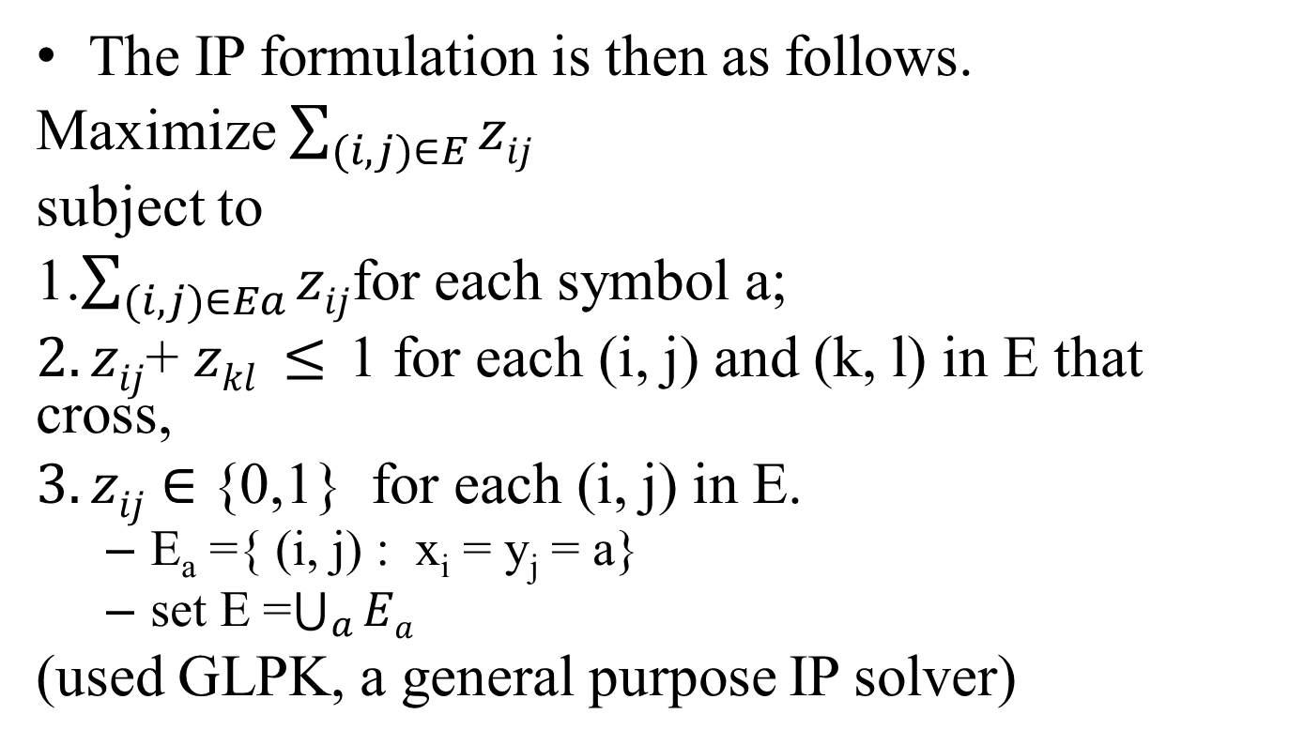
An IP(Integer programing) based exact algorithm
The IP formulation is then as follows.
Maximize $\sum_{(i,j)∈E}{zij}$
subject to
1.$\sum_{(i,j)∈Ea}{zij}$for each symbol a;
$2.zij$+ $zkl ≤$1 for each (i, j) and (k, l) in E that cross,
$3.zij$ $∈$ {0,1} for each (i, j) in E.
E_{a} ={ (i, j) : x_{i} = y_{j} = a}
set E =$\bigcup_{a}{Ea}$
(used GLPK, a general purpose IP solver)
Example:
x:a b c b a b
y:c b c a b
$z25$+ $z33 ≤$1
b c

Slide 13
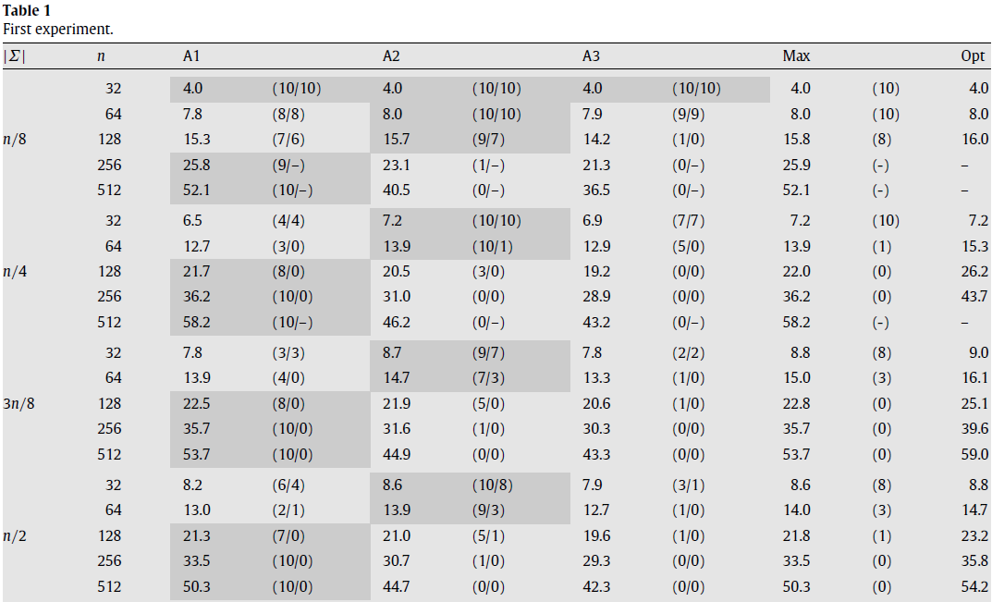
Computational experiments (Type 1:the length and the alphabet size, 10 instances)
obtained by our branch-and-cut code
More than two hours
(x,y) x : the number of times (out of 10) that the corresponding algorithm is the best of the three.
y : the number of times it found an optimal solution.
Max: the average solution length for the algorithm that runs A1, A2, and A3 and outputs the best solution found.

Slide 14
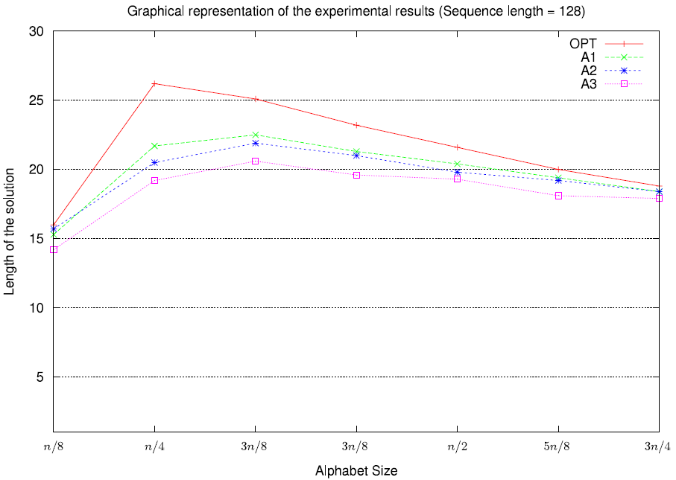
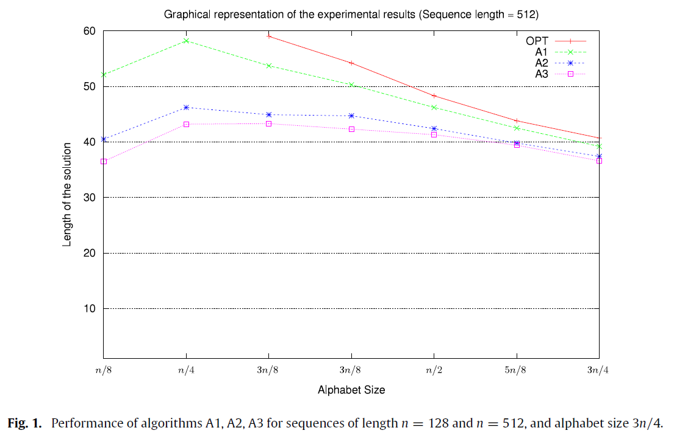
Observation 1:
that the performance of the approximation algorithms improves when the number of repetitions decreases

Slide 15
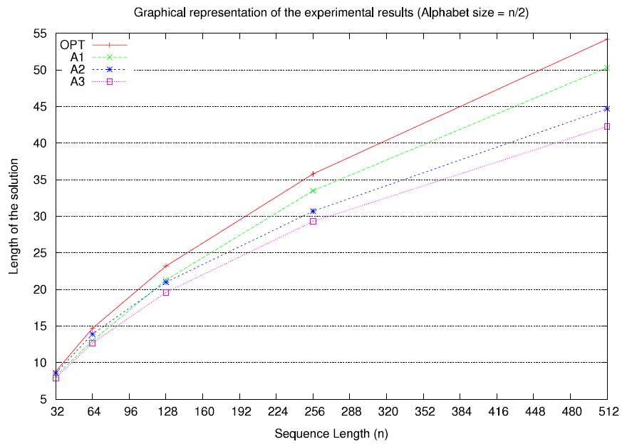
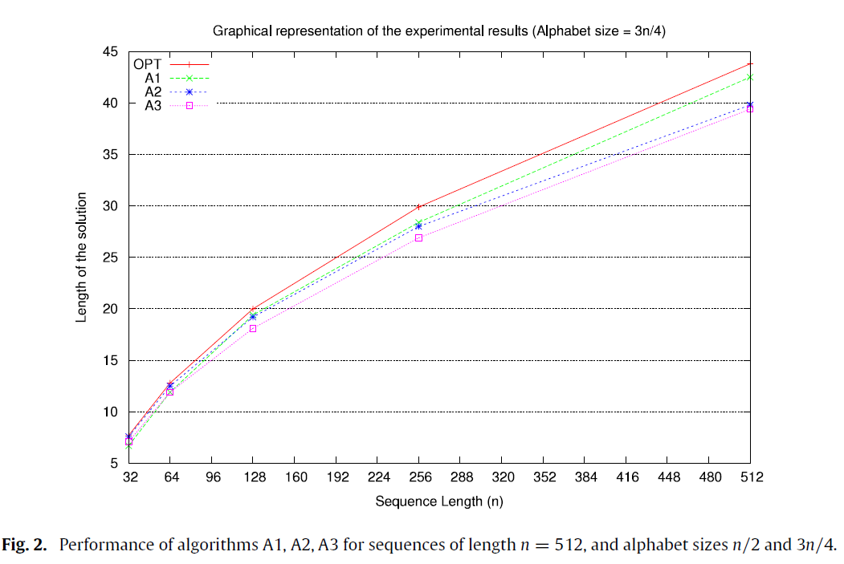
Observation 2:
for a fixed (expected) number of repetitions of each symbol, the perfor-mance of the algor-ithms decays when the length of the sequences increases.

Slide 16
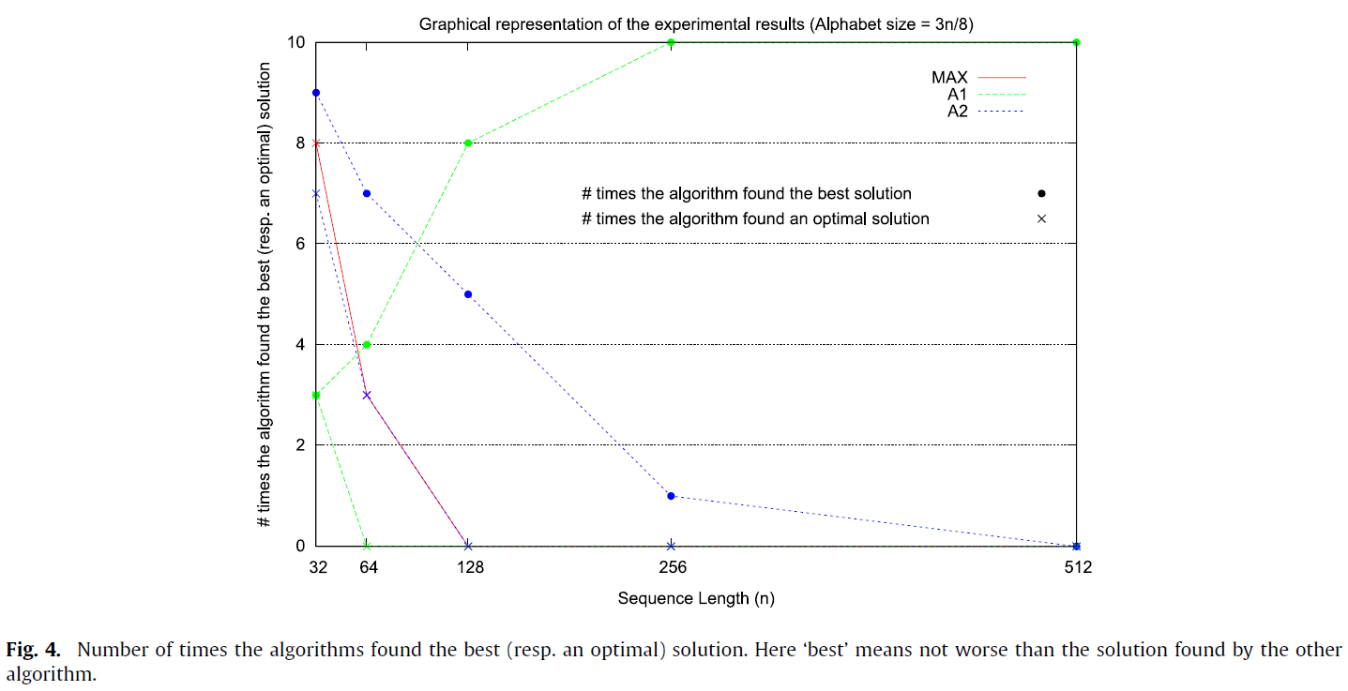
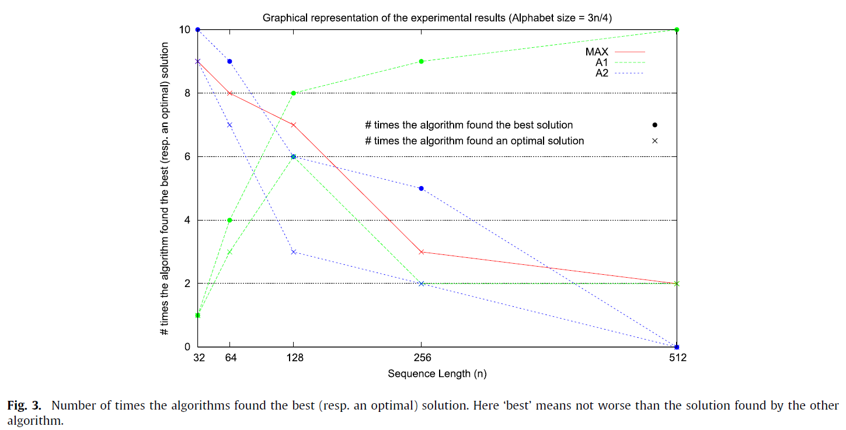

For
sequences of length n < 128, Algorithm A2 finds better solutions than Algorithm A1.
But for n $≥$128, Algorithm A1
outperforms Algorithm A2. In these figures, we also note that as n gets larger, Max finds fewer optimal solutions.

Slide 17
Thanks for listening.

Slide 18
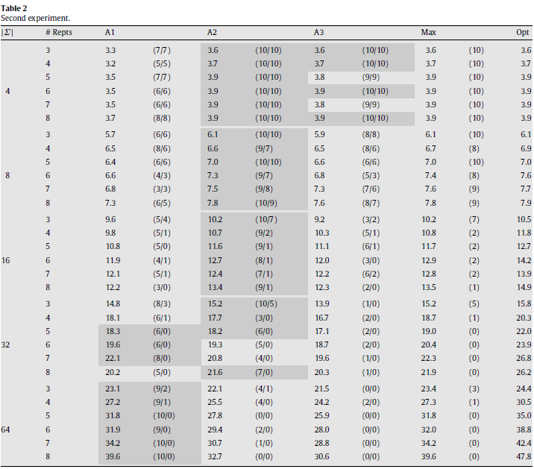
Computational experiments (Type 1:alphabet size and the maximum number of repetitions)

Slide 19

Analysis of the probabilistic algorithms
we say A is an α -approximation for RFLCS(x, y) if E[A(x, y)] $≥$ opt(RFLCS(x, y))/α, for all x and y. The number may depend on x and y.

