Slide 1
Efficient String Matching in The Presence of Errors
Landau, G.M., Vishkin, U.
Foundations of Computer Science, 26th Annual Symposium on
1985, Pages 126-136
Presenter: Huang-Ting Chan
Date:2015/6/23

Slide 2
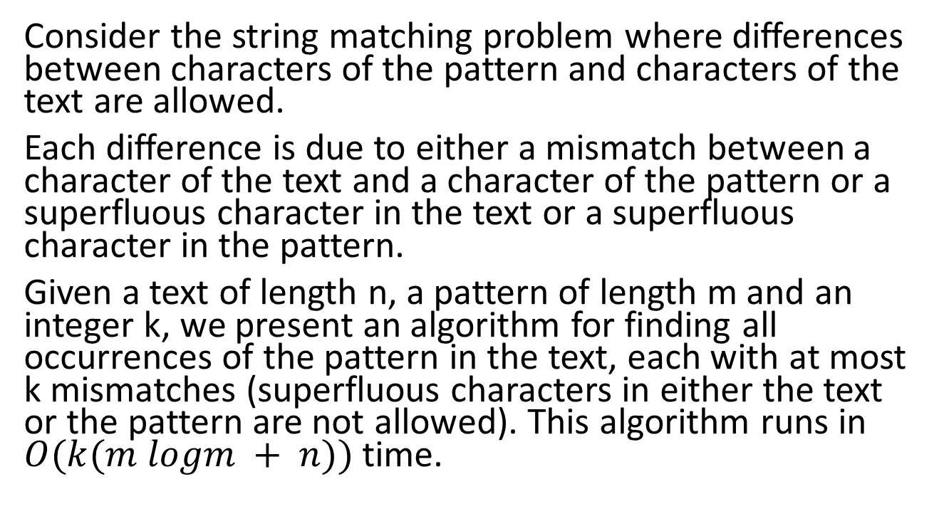
Abstract
Consider the string matching problem where differences between characters of the pattern and characters of the text are allowed.
Each difference is due to either a mismatch between a character of the text and a character of the pattern or a superfluous character in the text or a superfluous character in the pattern.
Given a text of length n, a pattern of length m and an integer k, we present an algorithm for finding all occurrences of the pattern in the text, each with at most k mismatches (superfluous characters in either the text or the pattern are not allowed). This algorithm runs in $O(k(m logm + n))$time.

Slide 3
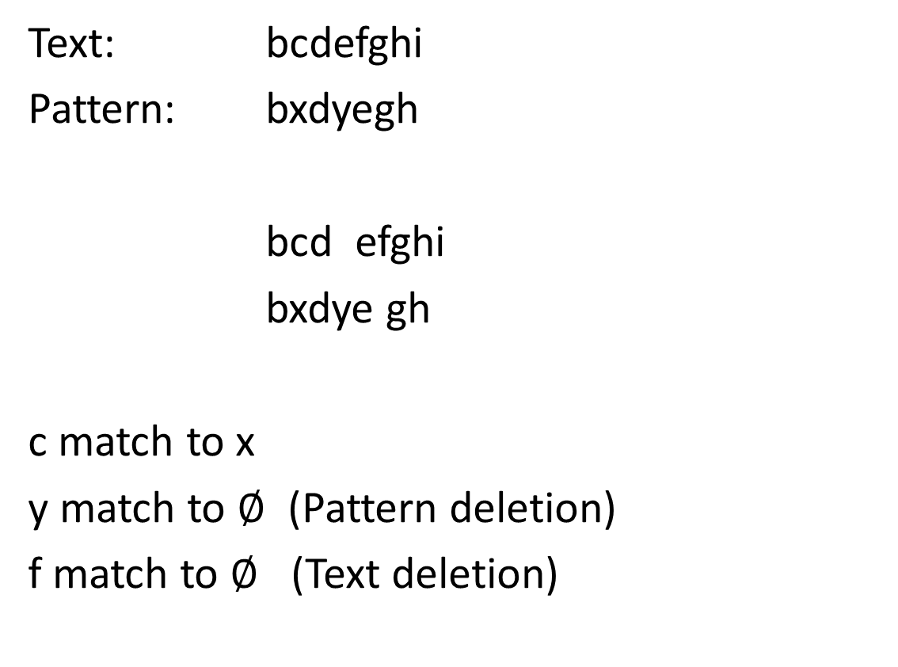
The problem
Text: bcdefghi
Pattern: bxdyegh
bcd efghi
bxdye gh
c match to x
y match to $∅$ (Pattern deletion)
f match to $∅$ (Text deletion)

Slide 4
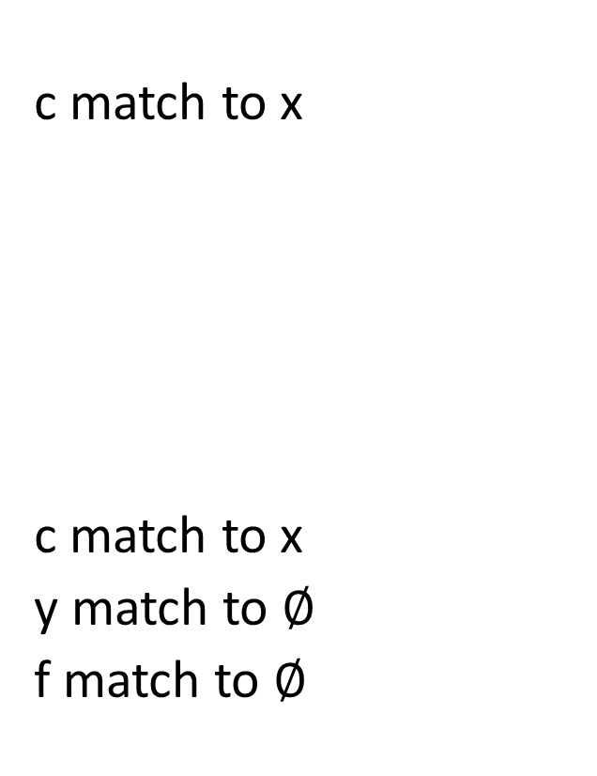
The problem
c match to x
c match to x
y match to $∅$
f match to $∅$
String matching with k mismatch
Find all occurrences of the
pattern in the text with at most
k mismatch
String matching with k differences
Find all occurrences of the
pattern in the text with at most
k differences

Slide 5
Algorithm
Two parts
Pattern analysis:
Build a table which is based on analysis of the pattern.
Text analysis:
Show how to find efficiently all the occurrences of the pattern in the text with at most k mismatches.

Slide 6
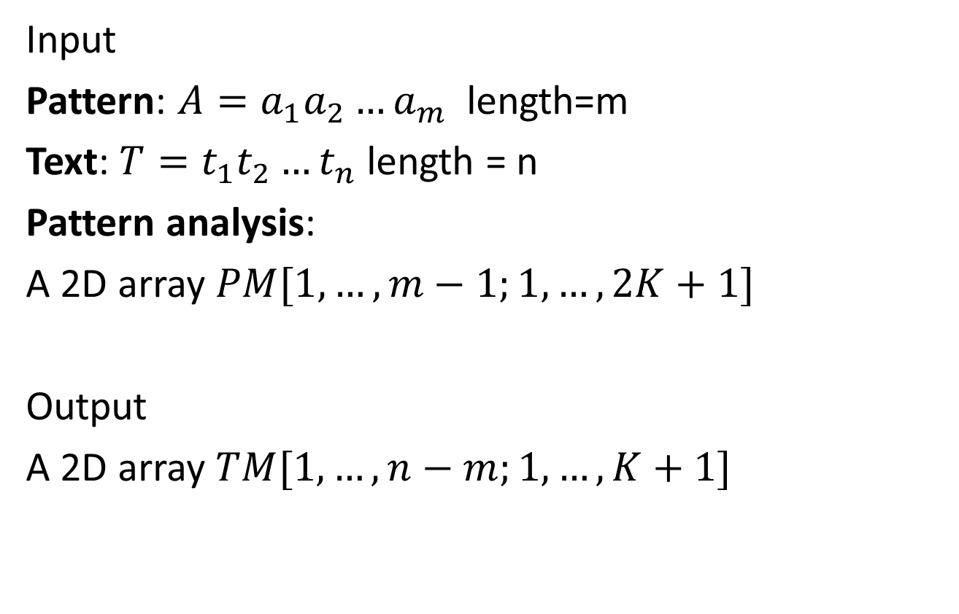
Text Analysis
Input
Pattern: $A=a_{1}a_{2}…a_{m}$ length=m
Text: $T=t_{1}t_{2}…t_{n}$ length = n
Pattern analysis:
A 2D array $PM[1,…,m−1;1,…,2K+1]$
Output
A 2D array $TM[1,…,n−m;1,…,K+1]$

Slide 7
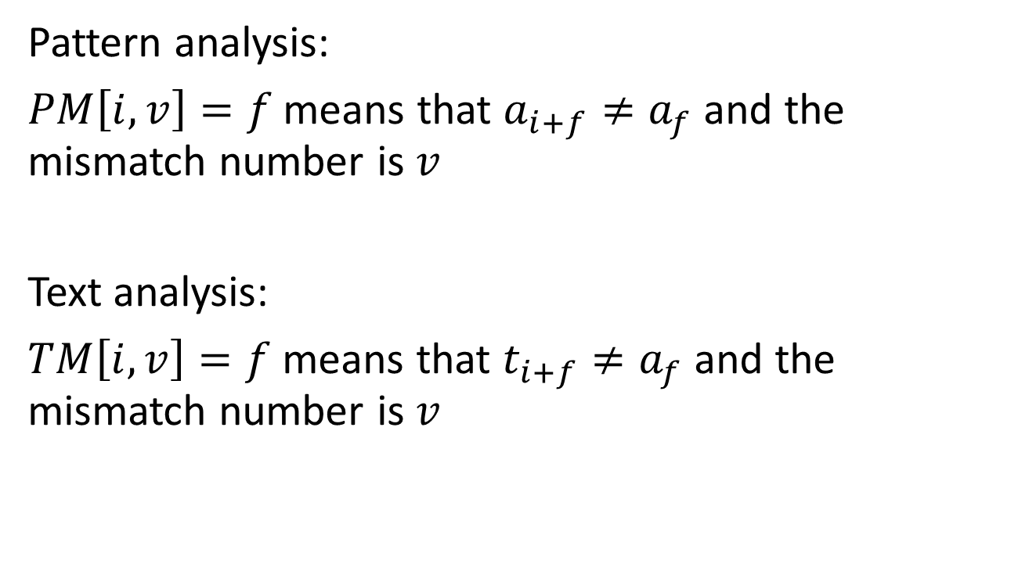
Pattern analysis:
$PM\left[i,v\right]=f$ means that $a_{i+f}≠a_{f}$ and the mismatch number is $v$
Text analysis:
$TM\left[i,v\right]=f$ means that $t_{i+f}≠a_{f}$ and the mismatch number is $v$

Slide 8

Example
Pattern = abaacaa
$$PM\left[2,1\right]=2$$
$$PM\left[2,2\right]=3$$
$$PM\left[2,3\right]=5$$
abaacaa
| | | | |
abaacaa

Slide 9
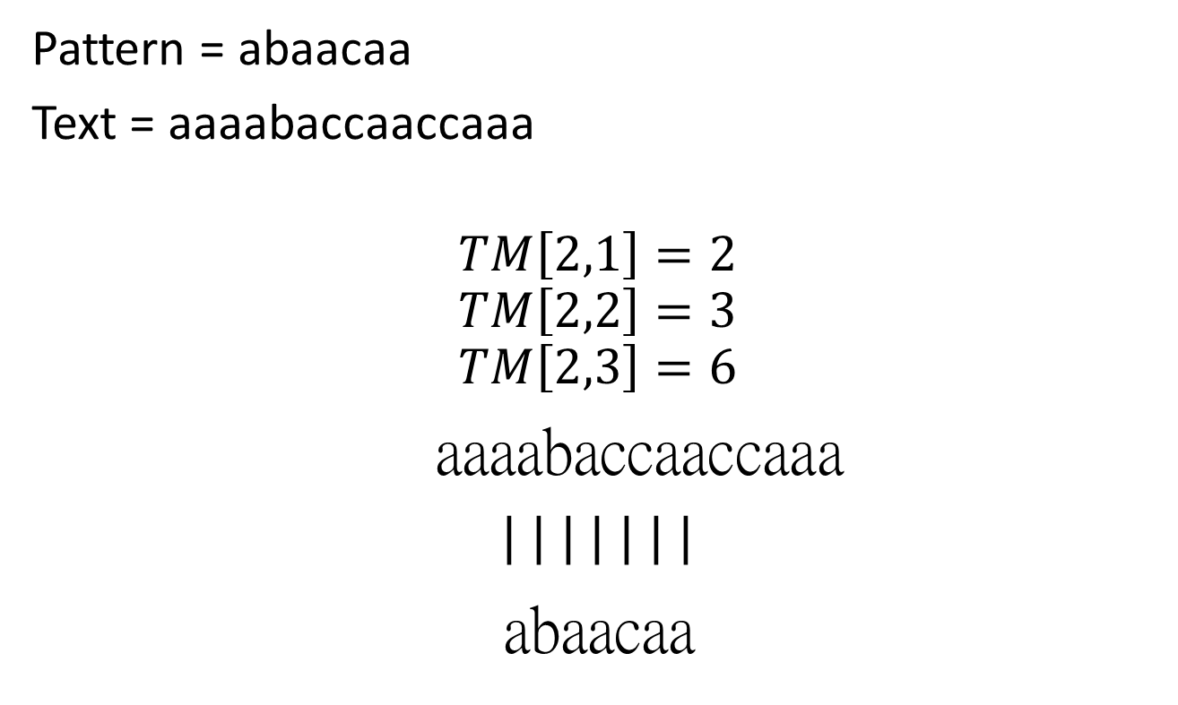
Example
Pattern = abaacaa
Text = aaaabaccaaccaaa
$$TM\left[2,1\right]=2$$
$$TM\left[2,2\right]=3$$
$$TM\left[2,3\right]=6$$
aaaabaccaaccaaa
| | | | | | |
abaacaa

Slide 10
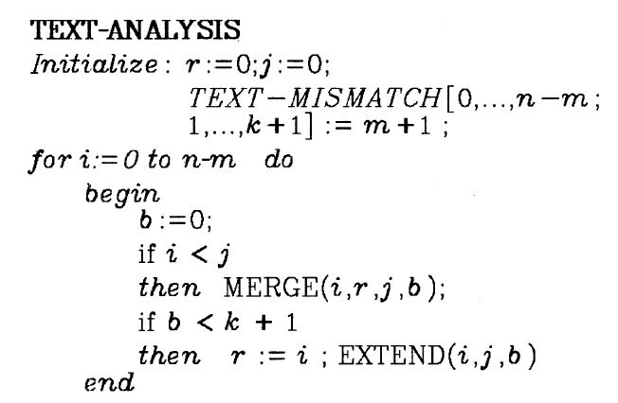
Text analysis

Slide 11
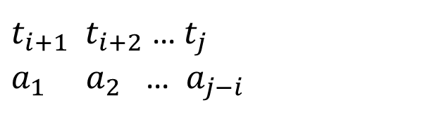
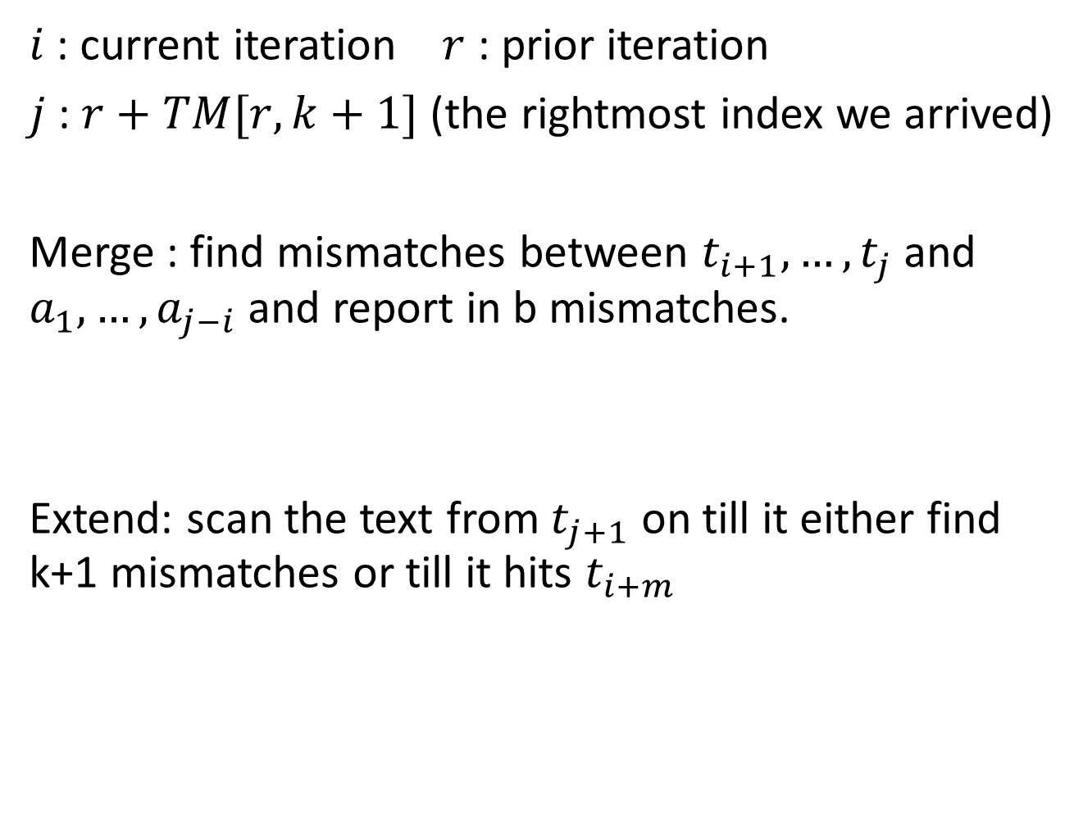
$i$ : current iteration $r$ : prior iteration
$j$ : $r+TM[r,k+1]$ (the rightmost index we arrived)
Merge : find mismatches between $t_{i+1},…,t_{j}$ and $a_{1},…,a_{j−i}$ and report in b mismatches.
Extend: scan the text from $t_{j+1}$ on till it either find k+1 mismatches or till it hits $t_{i+m}$
$t_{i+1}$ $t_{i+2}$ … $t_{j}$
$a_{1}$ $a_{2}$ … $a_{j−i}$

Slide 12
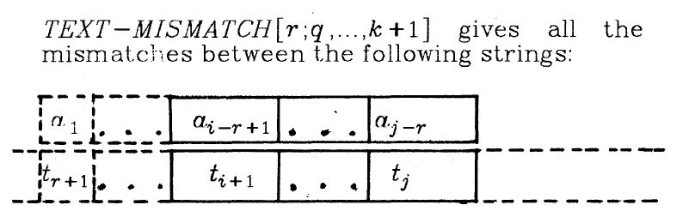
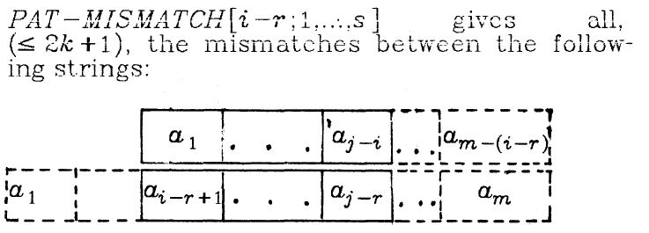

Merge
Input $TM[r,q…k+1]$
$PM[i−r,1…s]$
Ouput $TM[i,1…b]$

Slide 13
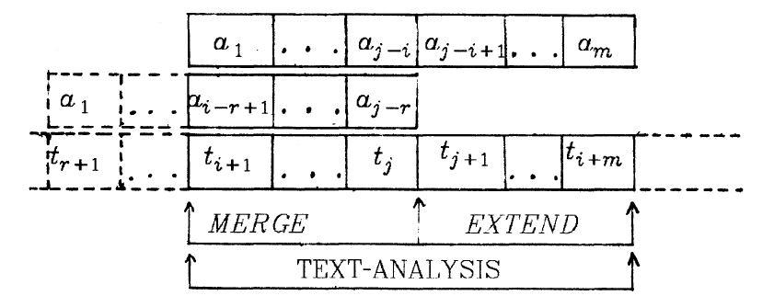

Slide 14
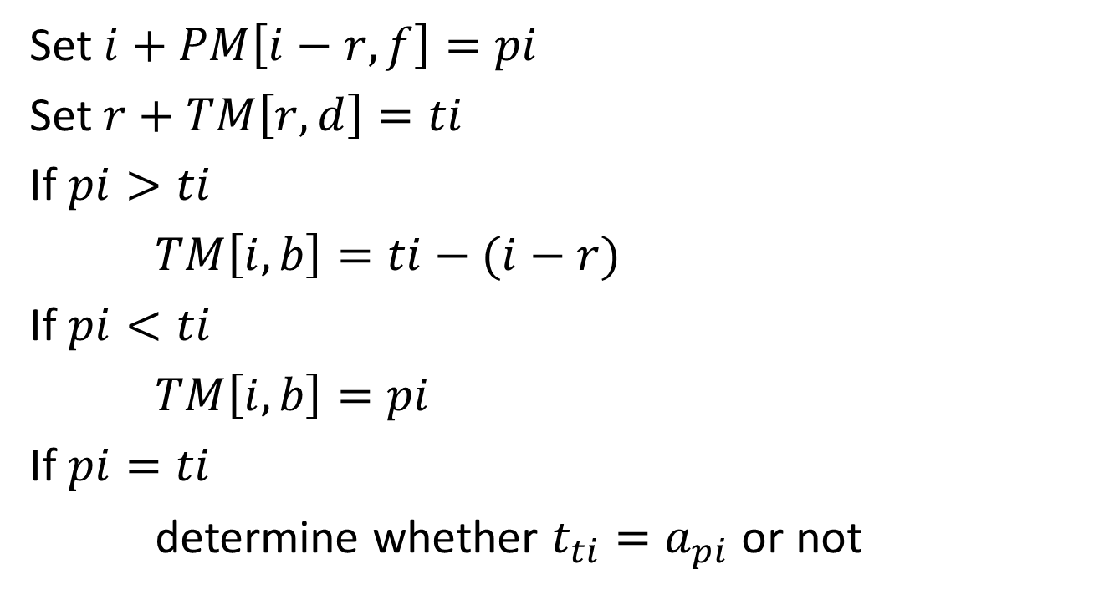
Procedure of Merge
Set $i+PM\left[i−r,f\right]=pi$
Set $r+TM\left[r,d\right]=ti$
If $pi>ti$
$TM\left[i,b\right]=ti−(i−r)$
If $pi<ti$
$TM\left[i,b\right]=pi$
If $pi=ti$
determine whether $t_{ti}=a_{pi}$ or not

Slide 15
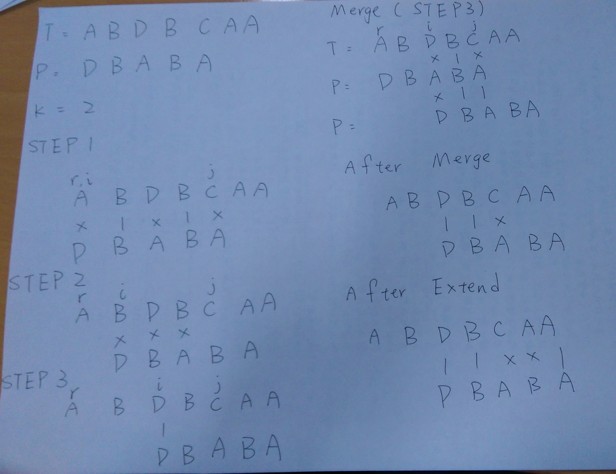
Example

Slide 16

Example
$r+TM[0,2]=3 r+TM[0,3]=5$
$i+PM[2,1]=3$

Slide 17
PM[1…m-1,1…2K+1] why 2K+1?

Slide 18
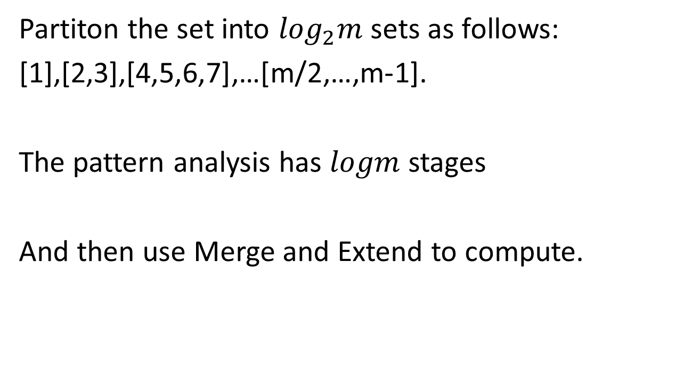
Pattern Analysis
Partiton the set into $\log_{2}m$ sets as follows:
[1],[2,3],[4,5,6,7],…[m/2,…,m-1].
The pattern analysis has $logm$ stages
And then use Merge and Extend to compute.

Slide 19

At the last stage
Input
Pattern : $a_{1}…a_{\frac{m}{2}}$
Text : $a_{\frac{m}{2}+1}…a_{m}$
2D array $PM[1…m/2−1,1…4K+1]$
Output
2D array $PM[1…m,1…2K+1]$

Slide 20
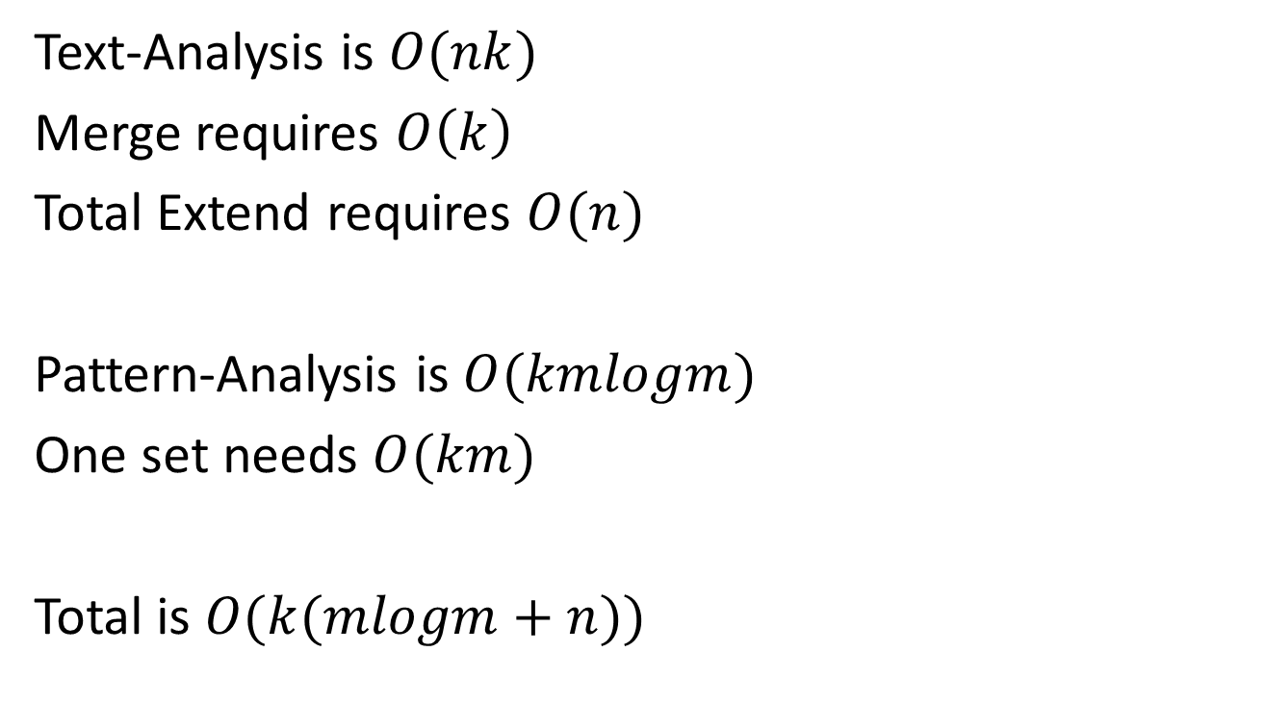
Time Complexity
Text-Analysis is $O(nk)$
Merge requires $O\left(k\right)$
Total Extend requires $O(n)$
Pattern-Analysis is $O(kmlogm)$
One set needs $O(km)$
Total is $O(k(mlogm+n))$

