Slide 1
An Efficient Parallel Algorithm for Longest Common Subsequence Problem on GPUs
Jiaoyun Yang, Yun Xu, Yi Shang
Proceedings of The World Congress on Engineering
pp. 499-504 (2010)
Presenter: Bi-Shiang Lin
Date:2015/8/11

Slide 2
Abstract(1/4)
Sequence alignment is an important problem in computational biology and finding the longest common subsequence (LCS) of multiple biological sequences is an essential and effective technique in sequence alignment. A major computational approach for solving the LCS problem is dynamic programming. Several dynamic programming methods have been proposed to have reduced time and space complexity.

Slide 3
Abstract(2/4)
As databases of biological sequences become larger, parallel algorithms become increasingly important to tackle large size problems. In the meantime, general-purpose computing on graphics processing units (GPGPU) has emerged as a promising technology for cost-effective high performance computing.

Slide 4
Abstract(3/4)
In this paper, we develop an efficient parallel algorithm on GPUs for the LCS problem. We propose a new technique that changes the data dependency in the score table used by dynamic programming algorithms to enable higher degrees of parallelism. The algorithm takes advantage of the large number of processing units and the unique memory-accessing properties of GPUs to achieve high performance.

Slide 5
Abstract(4/4)
The algorithm was implemented on Nvidia 9800GT GPUs and tested on randomly generated sequences of different lengths. The experiment results show that the new algorithm is about 6 times faster on GPUs than on typical CPUs and is 3 times faster than an existing efficient parallel algorithm, the diagonal parallel algorithm.

Slide 6

The LCS Problem
Sequence $X$: ATTGCCA
Sequence $Y$: TAGAC
Common Subsequence : TA、TGC、AC …
Longest Common Subsequence : AGC、TGA …

Slide 7

Method : Dynamic Programming
Sequence $X$: ATTGCCA
Sequence $Y$: TAGAC
 |  | A | T | T | G | C | C | A
 | 0 | 0 | 0 | 0 | 0 | 0 | 0 | 0
T | 0 | 0 | 1 | 1 | 1 | 1 | 1 | 1
A | 0 | 1 | 1 | 1 | 1 | 1 | 1 | 2
G | 0 | 1 | 1 | 1 | 2 | 2 | 2 | 2
A | 0 | 1 | 1 | 1 | 2 | 2 | 2 | 3
C | 0 | 1 | 1 | 1 | 2 | 3 | 3 | 3

Slide 8
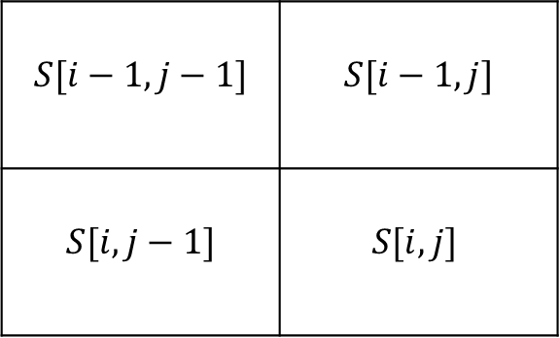

The Formula and Data Dependency
$$S\left[i,j\right]= \left\{\begin{aligned} 0 i or j is 0 \\ S\left[i−1,j−1\right]+1 a_{i}=b_{j} \\ max\left(S\left[i−1,j\right],S\left[i,j−1\right]\right) o.w.\end{aligned}\right.$$
$$S[i−1,j−1]$$ | $$S[i−1,j]$$
$$S[i,j−1]$$ | $$S[i,j]$$

Slide 9

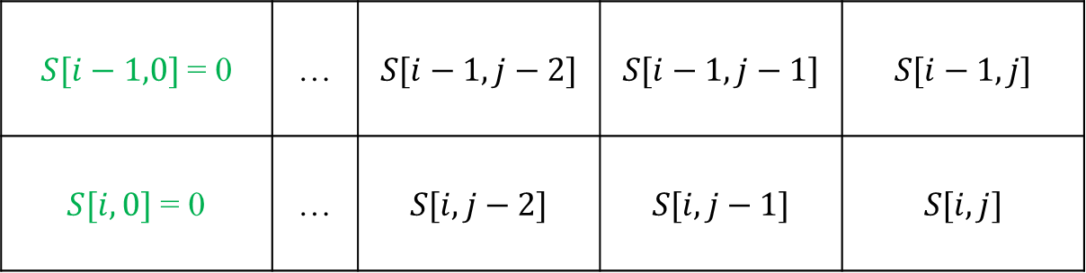
Re-formulate The Equation(1/3)
$$S\left[i,j\right]= \left\{\begin{aligned} 0 i or j is 0 \\ S\left[i−1,j−1\right]+1 a_{i}=b_{j} \\ max\left(S\left[i−1,j\right],S\left[i,j−1\right]\right) o.w.\end{aligned}\right.$$
$S[i−1,0]$ = 0 | … | $$S[i−1,j−2]$$ | $$S[i−1,j−1]$$ | $$S[i−1,j]$$
$S[i,0]$ = 0 | … | $$S[i,j−2]$$ | $$S[i,j−1]$$ | $$S[i,j]$$
Step 2
Step 1

Slide 10
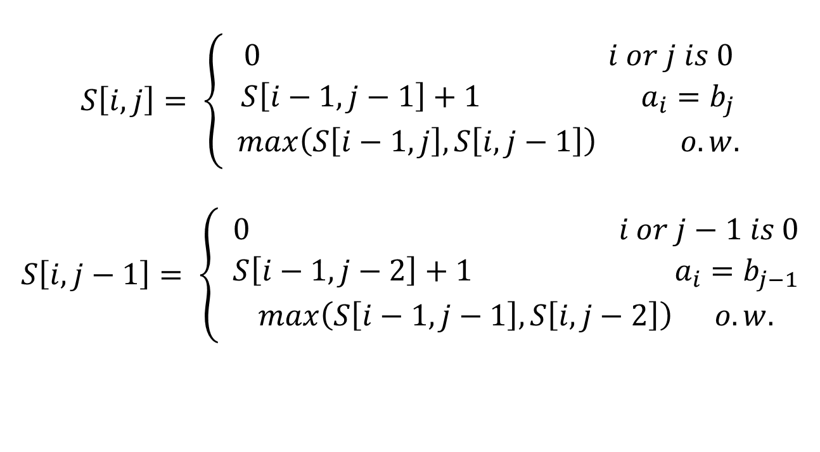
Re-formulate The Equation(2/3)
$$S\left[i,j\right]= \left\{\begin{aligned} 0 i or j is 0 \\ S\left[i−1,j−1\right]+1 a_{i}=b_{j} \\ max\left(S\left[i−1,j\right],S\left[i,j−1\right]\right) o.w.\end{aligned}\right.$$
$$S\left[i,j−1\right]= \left\{\begin{aligned} 0 i or j−1 is 0 \\ S\left[i−1,j−2\right]+1 a_{i}=b_{j−1} \\ max\left(S\left[i−1,j−1\right],S\left[i,j−2\right]\right) o.w.\end{aligned}\right.$$

Slide 11
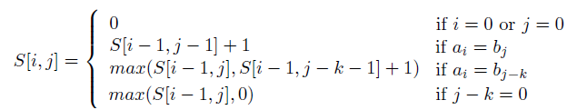
Re-formulate The Equation(3/3)
 |  | A | T | G | A
 | 0 | 0 | 0 | 0 | 0
T | 0 | 0 | 1 | 1 | 1

Slide 12

Preprocessing
 |  | A | T | T | G | C | C | A
 | 0 | 1 | 2 | 3 | 4 | 5 | 6 | 7
A | 0 | 0 | 1 | 1 | 1 | 1 | 1 | 1
T | 0 | 0 | 0 | 2 | 3 | 3 | 3 | 3
C | 0 | 0 | 0 | 0 | 0 | 0 | 5 | 6
G | 0 | 0 | 0 | 0 | 0 | 4 | 4 | 4

Slide 13
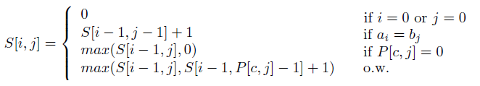
Re-formulate The Equation

Slide 14
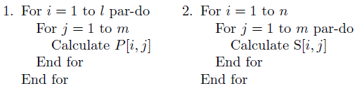
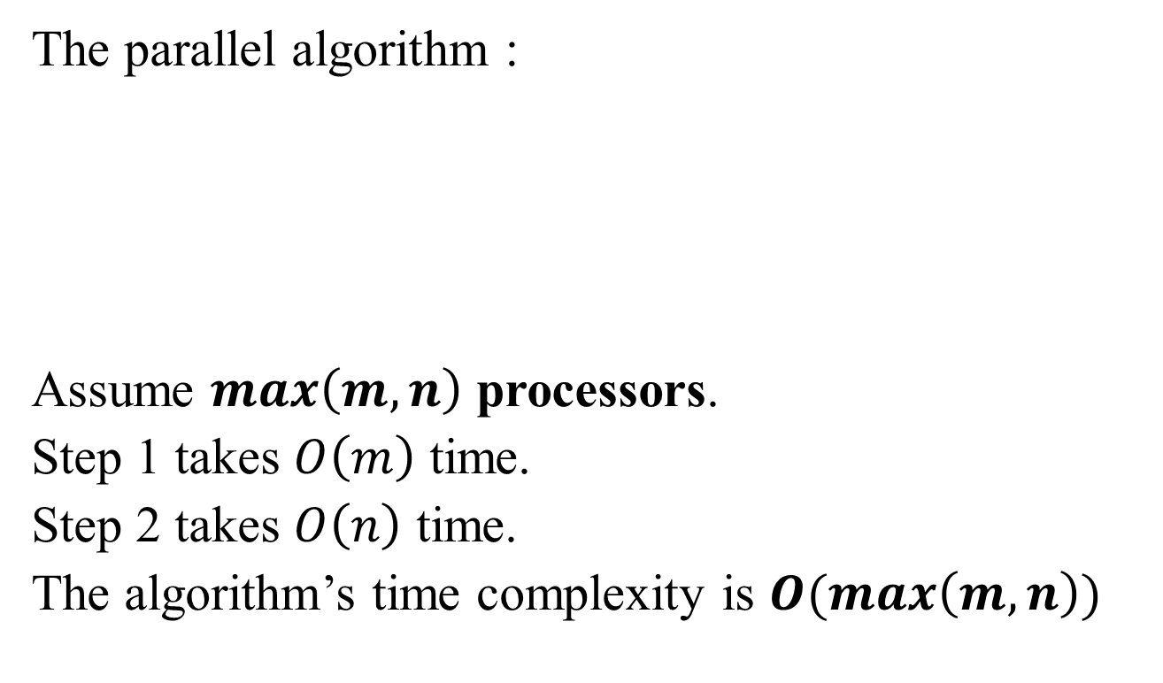
Time Complexity Analysis
The parallel algorithm :
Assume $max\left(m,n\right)$ processors.
Step 1 takes $O\left(m\right)$ time.
Step 2 takes $O\left(n\right)$ time.
The algorithm’s time complexity is $O(max\left(m,n\right))$

Slide 15

Optimize(1/3)

Slide 16

Optimize(2/3)

Slide 17
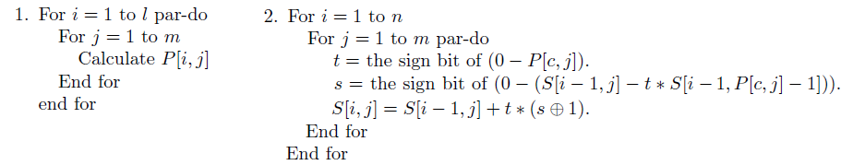
Optimize(3/3)

Slide 18
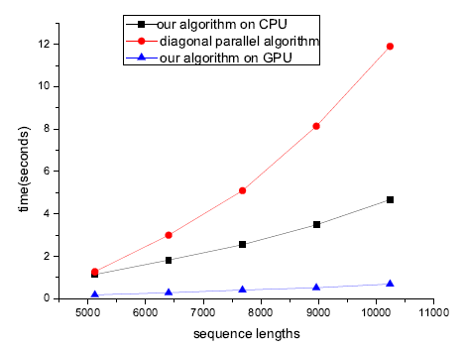
Experiment Result

