Slide 1
Algorithms for Two Versions of LCS Problem for Indeterminate Strings
Costas S. Iliopoulos, M. Sohel Rahman, and Wojciech Rytter
Journal of Combinatorial Mathematics and Combinatorial Computing, Volume 71, pp. 155-172(2009)
Presenter: Shian-Liang Lin
Notes:
http://www.combinatorialmath.ca/jcmcc/jcmcc71.html

Slide 2
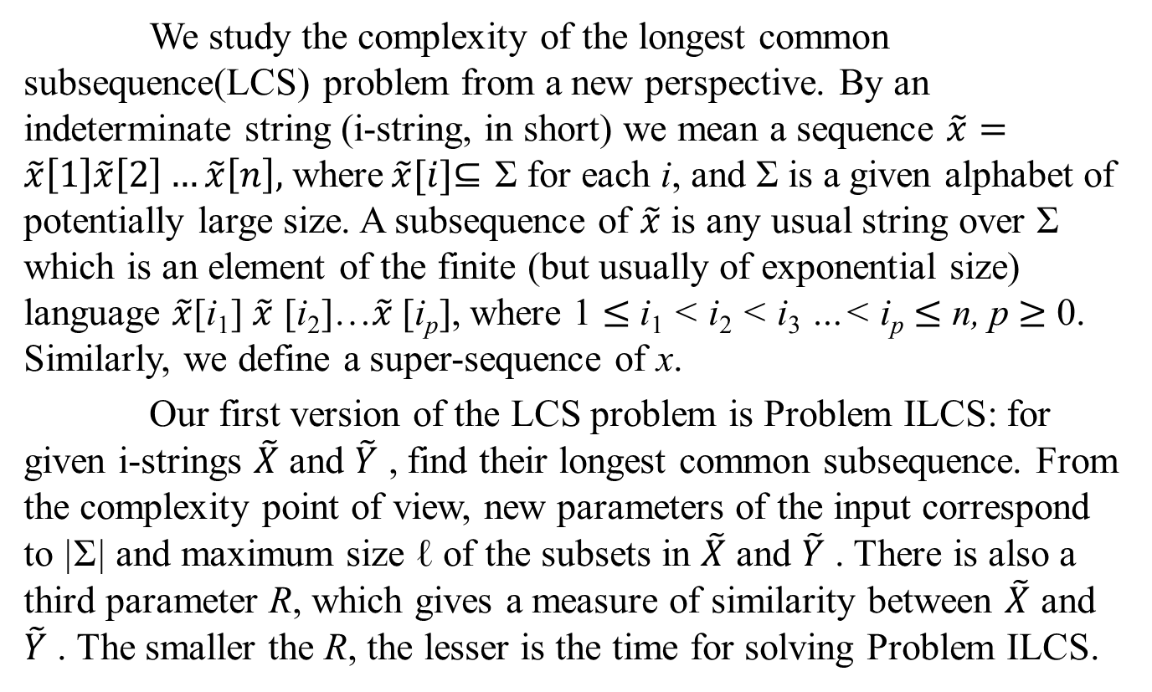
Abstract
We study the complexity of the longest common subsequence(LCS) problem from a new perspective. By an indeterminate string (i-string, in short) we mean a sequence $\tilde{x}=\tilde{x}\left[1\right]\tilde{x}\left[2\right]…\tilde{x}\left[n\right],$ where$\tilde{x}[i]$⊆ Σ for each i, and Σ is a given alphabet of potentially large size. A subsequence of $\tilde{x}$ is any usual string over Σ which is an element of the finite (but usually of exponential size) language $\tilde{x}$[i₁] $\tilde{x}$ [i₂]…$\tilde{x}$[i_{p}], where 1 $≤$ i₁ < i₂ < i₃ …< i_{p} $≤$ n, p $≥$ 0. Similarly, we define a super-sequence of x.
Our first version of the LCS problem is Problem ILCS: for given i-strings $\tilde{X}$ and $\tilde{Y}$ , find their longest common subsequence. From the complexity point of view, new parameters of the input correspond to |Σ| and maximum size ℓ of the subsets in $\tilde{X}$ and $\tilde{Y}$ . There is also a third parameter R, which gives a measure of similarity between $\tilde{X}$ and $\tilde{Y}$ . The smaller the R, the lesser is the time for solving Problem ILCS.

Slide 3
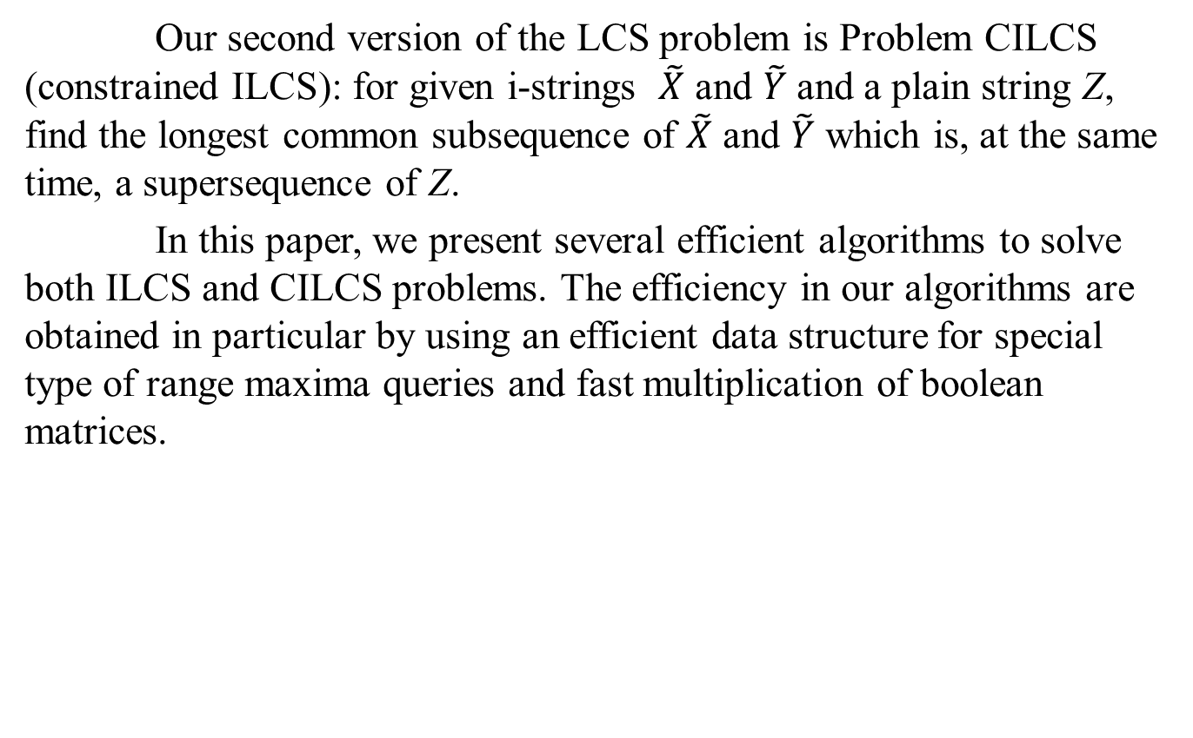
Abstract
Our second version of the LCS problem is Problem CILCS (constrained ILCS): for given i-strings $\tilde{X}$ and $\tilde{Y}$and a plain string Z, find the longest common subsequence of $\tilde{X}$ and $\tilde{Y}$ which is, at the same time, a supersequence of Z.
In this paper, we present several efficient algorithms to solve both ILCS and CILCS problems. The efficiency in our algorithms are obtained in particular by using an efficient data structure for special type of range maxima queries and fast multiplication of boolean matrices.

Slide 4
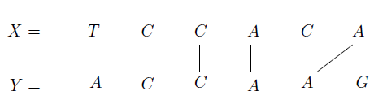
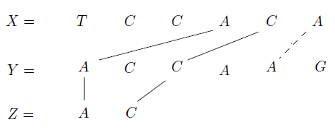
LCS & CLCS
Example of LCS:
Example of CLCS:

Slide 5
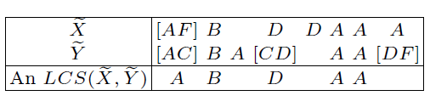
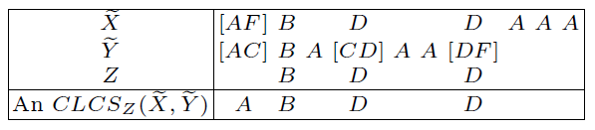
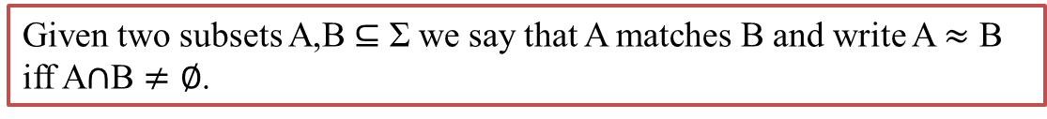
ILCS & CILCS
Example of ILCS:
Given two subsets A,B ⊆ Σ we say that A matches B and write A $≈$ B iff A$∩$B $≠∅$.
Example of ICLCS:

Slide 6
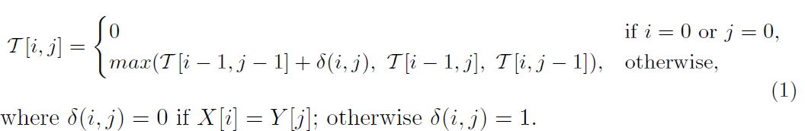

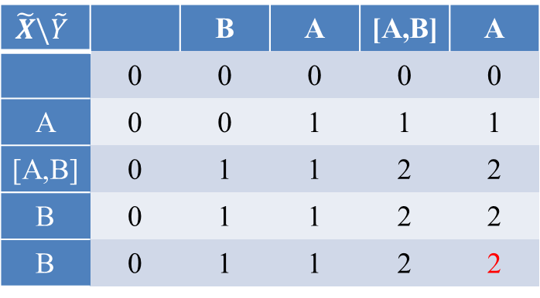
Algorithm for ILCS
$$≈$$
Example of ILCS:
$$\tilde{X}=A\left[A,B\right]BB$$
$$\tilde{Y}=BA\left[A,B\right]A$$
$$\tilde{X}\backslash \tilde{Y}$$ |  | B | A | [A,B] | A
 | 0 | 0 | 0 | 0 | 0
A | 0 | 0 | 1 | 1 | 1
[A,B] | 0 | 1 | 1 | 2 | 2
B | 0 | 1 | 1 | 2 | 2
B | 0 | 1 | 1 | 2 | 2
Problem ILCS can be solved in O(|Σ|n²) time by DP

Slide 7
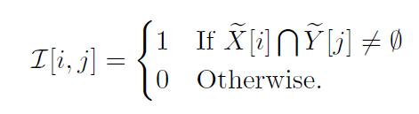
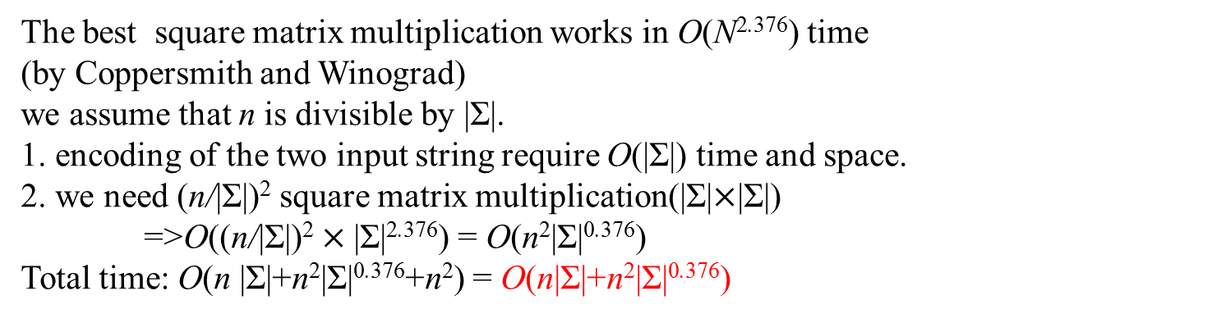
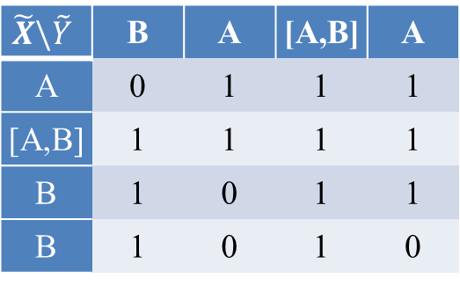
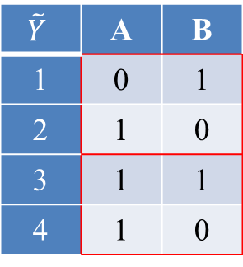
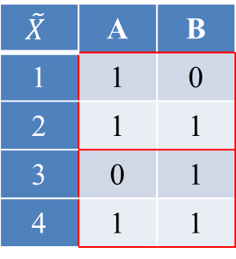
Preprocessing 1 for ILCS (square matrix multiplication)
$$\tilde{X}=A\left[A,B\right]BB \tilde{Y}=BA\left[A,B\right]A$$
$$\tilde{X}$$ | A | B
1 | 1 | 0
2 | 1 | 1
3 | 0 | 1
4 | 1 | 1
$$\tilde{Y}$$ | A | B
1 | 0 | 1
2 | 1 | 0
3 | 1 | 1
4 | 1 | 0
$$\tilde{X}\backslash \tilde{Y}$$ | B | A | [A,B] | A
A | 0 | 1 | 1 | 1
[A,B] | 1 | 1 | 1 | 1
B | 1 | 0 | 1 | 1
B | 1 | 0 | 1 | 0
The best square matrix multiplication works in O(N^{2.376}) time
(by Coppersmith and Winograd)
we assume that n is divisible by |Σ|.
1. encoding of the two input string require O(|Σ|) time and space.
2. we need (n/|Σ|)² square matrix multiplication(|Σ|$×$|Σ|)
=>O((n/|Σ|)² $×\text{|}\text{Σ}\text{|}\text{2}\text{.}\text{376}$) = O(n²|Σ|^{0.376})
Total time: O(n |Σ|+n²|Σ|^{0.376}+n²) = O(n|Σ|+n²|Σ|^{0.376})

Slide 8
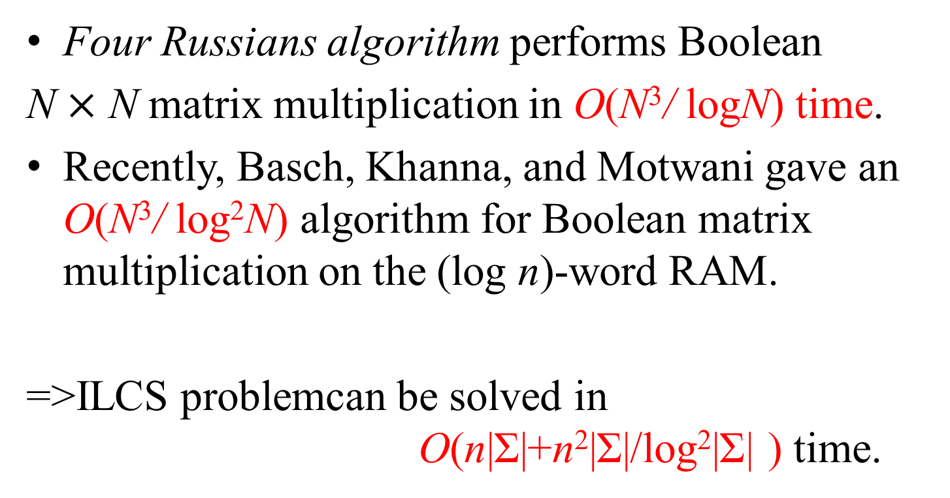
Preprocessing 1 for ILCS (boolean matrix multiplication)
Four Russians algorithm performs Boolean
N $×$ N matrix multiplication in O(N³/ logN) time.
Recently, Basch, Khanna, and Motwani gave an O(N³/ log²N) algorithm for Boolean matrix multiplication on the (log n)-word RAM.
=>ILCS problemcan be solved in O(n|Σ|+n²|Σ|/log²|Σ| ) time.

Slide 9
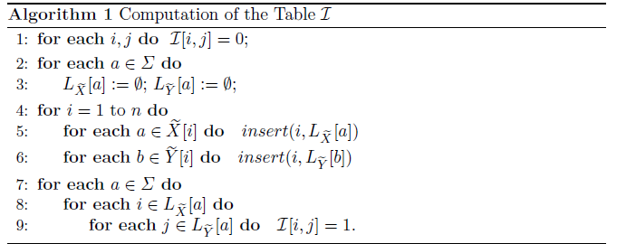


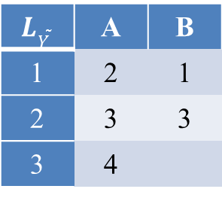
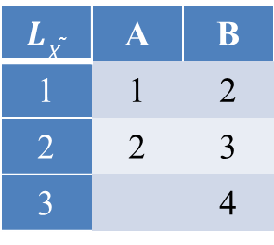

Preprocessing 3 for ILCS
$$\tilde{X}=A\left[A,B\right]BB \tilde{Y}=BA\left[A,B\right]A$$
$$L\tilde{X}$$ | A | B
1 | 1 | 2
2 | 2 | 3
3 |  | 4
$$L\tilde{Y}$$ | A | B
1 | 2 | 1
2 | 3 | 3
3 | 4
$≤$|Σ|
=O(n²)
$$\tilde{X}\backslash \tilde{Y}$$ | B | A | [A,B] | A
A | 0 | 1 | 1 | 1
[A,B] | 1 | 1 | 1 | 1
B | 1 | 0 | 1 | 1
B | 1 | 0 | 1 | 0

Slide 10

Preprocessing 3 for ILCS
O(nℓ)
$≤$|Σ|
O(Rℓ)
=O(n²)
Problem ILCS can be solved in O(nℓ + n² + Rℓ) time.
Using van Emde Boas data structure
=>Problem ILCS can be solved in O(Rℓ + Rloglogn + n) time.

Slide 11
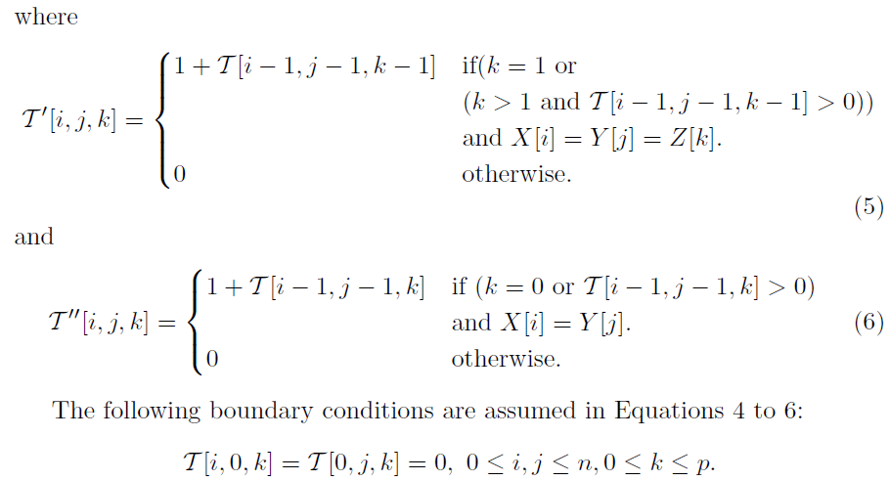
Algorithm for CILCS

Slide 12


Time complexity
method | ILCS | CILCS
DP | O(|Σ|n²) | O(|Σ|n²p)
Preprocessing1 (square matrix multiplication) | 1.O(n|Σ|+n²|Σ|^{0.376}) 2. O(n|Σ|+n²|Σ|/log²|Σ|) | 1.O(n|Σ|+n²|Σ^{|0.376}+n²p) 2. O(n|Σ|+n²|Σ|/log²|Σ|+n²p)
Preprocessing3 (square matrix multiplication) | O(nℓ + n² + Rℓ) | O(nℓ + n² + ℓ(R+R₃))
=O(n²p)
=O(n²)
$≤$|Σ|

Slide 13
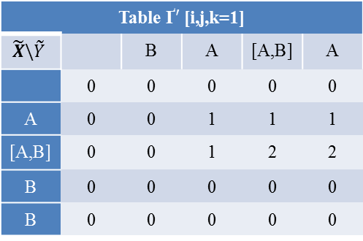
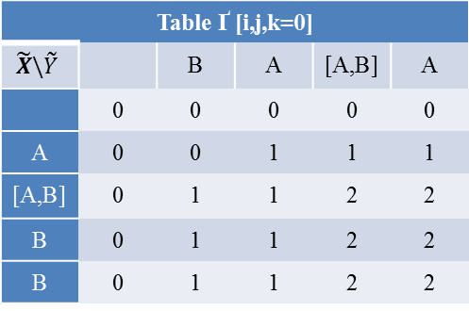
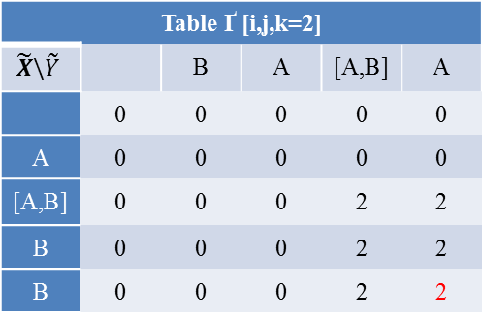
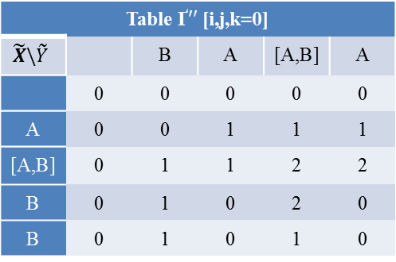





Algorithm for CILCS
$\tilde{X}=A\left[A,B\right]BB , \tilde{Y}=BA\left[A,B\right]A$ , Z=AB
Table Ґ [i,j,k=0]
$$\tilde{X}\backslash \tilde{Y}$$ |  | B | A | [A,B] | A
 | 0 | 0 | 0 | 0 | 0
A | 0 | 0 | 1 | 1 | 1
[A,B] | 0 | 1 | 1 | 2 | 2
B | 0 | 1 | 1 | 2 | 2
B | 0 | 1 | 1 | 2 | 2
Table Ґ [i,j,k=1]
$$\tilde{X}\backslash \tilde{Y}$$ |  | B | A | [A,B] | A
 | 0 | 0 | 0 | 0 | 0
A | 0 | 0 | 1 | 1 | 1
[A,B] | 0 | 0 | 1 | 2 | 2
B | 0 | 0 | 1 | 2 | 2
B | 0 | 0 | 1 | 2 | 2
Table Ґ [i,j,k=2]
$$\tilde{X}\backslash \tilde{Y}$$ |  | B | A | [A,B] | A
 | 0 | 0 | 0 | 0 | 0
A | 0 | 0 | 0 | 0 | 0
[A,B] | 0 | 0 | 0 | 2 | 2
B | 0 | 0 | 0 | 2 | 2
B | 0 | 0 | 0 | 2 | 2
Table Ґ$′$[i,j,k=0]
$$\tilde{X}\backslash \tilde{Y}$$ |  | B | A | [A,B] | A
 | 0 | 0 | 0 | 0 | 0
A | 0 | 0 | 0 | 0 | 0
[A,B] | 0 | 0 | 0 | 0 | 0
B | 0 | 0 | 0 | 0 | 0
B | 0 | 0 | 0 | 0 | 0
Table Ґ$′$[i,j,k=1]
$$\tilde{X}\backslash \tilde{Y}$$ |  | B | A | [A,B] | A
 | 0 | 0 | 0 | 0 | 0
A | 0 | 0 | 1 | 1 | 1
[A,B] | 0 | 0 | 1 | 2 | 2
B | 0 | 0 | 0 | 0 | 0
B | 0 | 0 | 0 | 0 | 0
Table Ґ$′′$[i,j,k=2]
$$\tilde{X}\backslash \tilde{Y}$$ |  | B | A | [A,B] | A
 | 0 | 0 | 0 | 0 | 0
A | 0 | 0 | 0 | 0 | 0
[A,B] | 0 | 0 | 0 | 2 | 0
B | 0 | 0 | 0 | 2 | 0
B | 0 | 0 | 0 | 2 | 0
Table Ґ$′′$[i,j,k=0]
$$\tilde{X}\backslash \tilde{Y}$$ |  | B | A | [A,B] | A
 | 0 | 0 | 0 | 0 | 0
A | 0 | 0 | 1 | 1 | 1
[A,B] | 0 | 1 | 1 | 2 | 2
B | 0 | 1 | 0 | 2 | 0
B | 0 | 1 | 0 | 1 | 0
Table Ґ$′′$[i,j,k=1]
$$\tilde{X}\backslash \tilde{Y}$$ |  | B | A | [A,B] | A
 | 0 | 0 | 0 | 0 | 0
A | 0 | 0 | 0 | 0 | 0
[A,B] | 0 | 0 | 0 | 2 | 2
B | 0 | 0 | 0 | 2 | 0
B | 0 | 0 | 0 | 2 | 0
Table Ґ$′′$[i,j,k=2]
$$\tilde{X}\backslash \tilde{Y}$$ |  | B | A | [A,B] | A
 | 0 | 0 | 0 | 0 | 0
A | 0 | 0 | 0 | 0 | 0
[A,B] | 0 | 0 | 0 | 0 | 0
B | 0 | 0 | 0 | 0 | 0
B | 0 | 0 | 0 | 0 | 0

