Slide 1
A Faster Algorithm Computing String Edit Distances
WILLIAM J. MASEK, MICHAEL S. PATESON, Journal of Computer and System Sciences Volume 20, Issue 1, February 1980, Pages 18–31
Presenter: Wen-Chuan Ho
Date: 2015/08/25

Slide 2
Abstract(1/2)
The edit distance between two character strings can be defined as the minimum cost of a sequence of editing operations which transforms one string into the other. The operations we admit are deleting, inserting and replacing one symbol at a time, with possibly different costs for each of these operations. The problem of finding the longest common subsequence of two strings is a special case of the problem of computing edit distances.

Slide 3
Abstract(2/2)
We describe an algorithm for computing the edit distance between two strings of length n and m, n > m, which requires O(n * max( 1, m/log n)) steps whenever the costs of edit operations are integral multiples of a single positive real number and the alphabet for the string is finite. These conditions are necessary for the algorithm to achieve the time bound.

Slide 4
Edit Distances
 |  | b | a | b | a | a | a
 | 0 | 1 | 2 | 3 | 4 | 5 | 6
a | 1 | 2 | 1 | 2 | 3 | 4 | 5
b | 2 | 1 | 2 | 1 | 2 | 3 | 4
a | 3 | 2 | 1 | 2 | 1 | 2 | 3
b | 4 | 3 | 2 | 1 | 2 | 3 | 4
b | 5 | 4 | 3 | 2 | 3 | 4 | 5
b | 6 | 5 | 4 | 3 | 4 | 5 | 6
A = ababbb |A|=6
B = babaaa |B|=6
Delete = 1
Insert = 1
Replace = 2

Slide 5
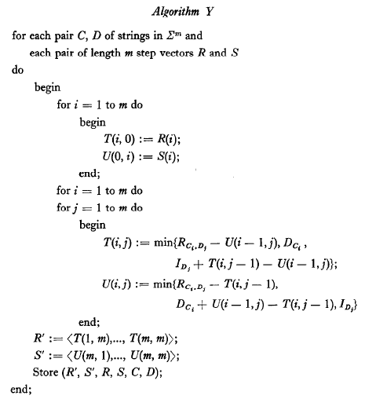
Algorithm Y(1/6)

Slide 6
Algorithm Y(2/6)
 |  | b | a | b | a | a | a
 | 0 | 1 | 2 | 3 | 4 | 5 | 6
a | 1 | 2 | 1 | 2 | 3 | 4 | 5
b | 2 | 1 | 2 | 1 | 2 | 3 | 4
a | 3 | 2 | 1 | 2 | 1 | 2 | 3
b | 4 | 3 | 2 | 1 | 2 | 3 | 4
b | 5 | 4 | 3 | 2 | 3 | 4 | 5
b | 6 | 5 | 4 | 3 | 4 | 5 | 6
 |  | b | a | b | a | a | a
 | 0 | 1 | 2 | 3 | 4 | 5 | 6
a | 1 |  |  | 2 |  |  | 5
b | 2 |  |  | 1 |  |  | 4
a | 3 | 2 | 1 | 2 | 1 | 2 | 3
b | 4 |  |  | 1 |  |  | 4
b | 5 |  |  | 2 |  |  | 5
b | 6 | 5 | 4 | 3 | 4 | 5 | 6

Slide 7
Algorithm Y(3/6)
Compute the value for all possible submatrices.
 |  | b | a | b
 | 0 | 1 | 2 | 3
a | 1 | 2 | 1 | 2
b | 2 | 1 | 2 | 1
a | 3 | 2 | 1 | 2
 |  | a | a | a
 | 3 | 4 | 5 | 6
a | 2 | 3 | 4 | 5
b | 1 | 2 | 3 | 4
a | 2 | 1 | 2 | 3
Store((2,1,2),(2,1,2),(0,1,2,3),(0,1,2,3),aba,bab)
Store((5,4,3),(1,2,3),(3,2,1,2),(3,4,5,6),aba,aaa)

Slide 8
Algorithm Y(4/6)
 |  | b | a | b
 | 3 | 2 | 1 | 2
b | 4 | 3 | 2 | 1
b | 5 | 4 | 3 | 2
b | 6 | 5 | 4 | 3
 |  | b | a | b
 | 3 | 2 | 1 | 2
b | 4 | 3 | 2 | 1
b | 5 | 4 | 3 | 2
b | 6 | 5 | 4 | 3
Store((1,2,3),(5,4,3),(3,4,5,6),(3,2,1,2),bbb,bab)
Store((4,5,6),(4,5,6),(2,1,2,3),(2,1,2,3),bbb,aaa)

Slide 9
Algorithm Y(5/6)
 |  | b | a | b
 | 0 | 1 | 2 | 3
a | 1 | 2 | 1 | 2
b | 2 | 1 | 2 | 1
a | 3 | 2 | 1 | 2
 |  | b | a | b
a | 1 | 1 | -1 | -1
b | 1 | -1 | 1 | -1
a | 1 | 1 | -1 | 1
 |  | b | a | b
 |  | 1 | 1 | 1
a |  | 1 | -1 | 1
b |  | -1 | 1 | -1
a |  | -1 | -1 | 1
Store((-1,-1,1),(-1,-1,1),(1,1,1),(1,1,1),aba,bab)
Store((-1,-1,-1),(-1,1,1),(-1,-1,1),(1,1,1),aba,aaa)
Store((-1,1,1),(-1,-1,-1),(1,1,1),(-1,-1,1),bbb,bab)
Store((1,1,1),(1,1,1),(-1,1,1),(-1,1,1),bbb,aaa)

Slide 10
Algorithm Y(6/6)
1
1
1
 |  | b | a | b
 | 0 | 1 | 2 | 3
a | 1 |  |  | 2
b | 2 |  |  | 1
a | 3 | 2 | 1 | 2
1
-1
1
-1
1
1
-1
-1
1

Slide 11
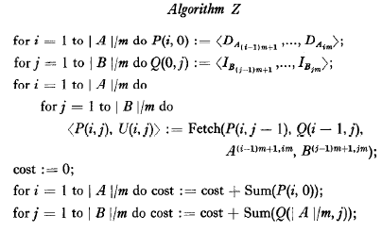
Algorithm Z(1/6)

Slide 12
Algorithm Z(2/6)
 |  | b | a | b | a | a | a
 | 0 | 1 | 2 | 3 | 4 | 5 | 6
a | 1
b | 2
a | 3
b | 4
b | 5
b | 6
 | 0 | 1 | 2
0
1 | <1,1,1> | <-1,-1,1>
2 | <1,1,1>
P
 | 0 | 1 | 2
0 |  | <-1,-1,-1> | <1,1,1>
1
2
Q

Slide 13
Algorithm Z(3/6)
 |  | b | a | b | a | a | a
 | 0 | 1 | 2 | 3 | 4 | 5 | 6
a | 1 |  |  | 2
b | 2 |  |  | 1
a | 3 | 2 | 1 | 2
b | 4
b | 5
b | 6
 | 0 | 1 | 2
0
1 | <1,1,1> | <-1,-1,1>
2 | <1,1,1>
P
 | 0 | 1 | 2
0 |  | <-1,-1,-1> | <1,1,1>
1 |  | <-1,-1,1>
2
Fetch((1,1,1),(1,1,1),aba,bab)
Q

Slide 14
Algorithm Z(4/6)
 |  | b | a | b | a | a | a
 | 0 | 1 | 2 | 3 | 4 | 5 | 6
a | 1 |  |  | 2 |  |  | 5
b | 2 |  |  | 1 |  |  | 4
a | 3 | 2 | 1 | 2 | 1 | 2 | 3
b | 4
b | 5
b | 6
 | 0 | 1 | 2
0
1 | <1,1,1> | <-1,-1,1> | <-1,-1,-1>
2 | <1,1,1>
P
 | 0 | 1 | 2
0 |  | <-1,-1,-1> | <1,1,1>
1 |  | <-1,-1,1> | <-1,1,1>
2
Fetch((-1,-1,1),(1,1,1),aba,aaa)
Q

Slide 15
Algorithm Z(5/6)
 |  | b | a | b | a | a | a
 | 0 | 1 | 2 | 3 | 4 | 5 | 6
a | 1 |  |  | 2 |  |  | 5
b | 2 |  |  | 1 |  |  | 4
a | 3 | 2 | 1 | 2 | 1 | 2 | 3
b | 4 |  |  | 1
b | 5 |  |  | 2
b | 6 | 5 | 4 | 3
 | 0 | 1 | 2
0
1 | <1,1,1> | <-1,-1,1> | <-1,-1,-1>
2 | <1,1,1> | <-1,1,1>
P
 | 0 | 1 | 2
0 |  | <-1,-1,-1> | <1,1,1>
1 |  | <-1,-1,1> | <-1,1,1>
2 |  | <-1,-1,-1>
Fetch((1,1,1),(-1,-1,-1),bbb,bab)
Q

Slide 16
Algorithm Z(6/6)
 |  | b | a | b | a | a | a
 | 0 | 1 | 2 | 3 | 4 | 5 | 6
a | 1 |  |  | 2 |  |  | 5
b | 2 |  |  | 1 |  |  | 4
a | 3 | 2 | 1 | 2 | 1 | 2 | 3
b | 4 |  |  | 1 |  |  | 4
b | 5 |  |  | 2 |  |  | 5
b | 6 | 5 | 4 | 3 | 4 | 5 | 6
 | 0 | 1 | 2
0
1 | <1,1,1> | <-1,-1,1> | <-1,-1,-1>
2 | <1,1,1> | <-1,1,1> | <1,1,1>
P
 | 0 | 1 | 2
0 |  | <-1,-1,-1> | <1,1,1>
1 |  | <-1,-1,1> | <-1,1,1>
2 |  | <-1,-1,-1> | <1,1,1>
Fetch((-1,1,1),(-1,1,1),bbb,aaa)
Q

Slide 17
Time complexity(1/2)
Algorithm Y
Take O(m²log m) to calculate and store each submatrix.
Take O(c^{m}m²logm) = O(k^{m}) to calculate all of the final step vector for some k depending on the number of steps and ∑.
Take Fetch in time O(m+log|A|)

Slide 18
Time complexity(2/2)
Entire algorithm runs in time O(|A||B|/m)
In Algorithm Z, it requires O(|A||B|/m²) fetchs and assignments of length m vectors.
In Algorithm Y, it implements Fetch in time O(m+log|A|) if we choose m = logk|A|. If m > |B|,the algorithm runs in time O(|A|).

