Slide 1
Alignment with Non-overlapping Inversions in O(n³)-Time
Augusto F. Vellozo, Carlos E.R. Alves, and Alair Pereira do Lago
Algorithms in Bioinformatics: 6th International Workshop, WABI 2006, Zurich, Switzerland, September 11-13, 2006. Proceedings (pp.186-196)
Presenter：Tzu-Chiang Hsu(徐子強)
Date：2015/08/25
修復者_{註1} : Yu-Cheng Chang(張育誠)
Notes:
註1 : 由於原始ppt當年學長貌似上船錯誤，導致原始檔案遺失，故我透過影片將其修復(重作) 2020/8/20

Slide 2
Abstract (1/2)
Alignments of sequences are widely used for biological sequence comparisons. Only biological events like mutations, insertions and deletions are usually modeled and other biological events like inversions are not automatically detected by the usual alignment algorithms. Alignment with inversions does not have a known polynomial algorithm and a simplification to the problem that considers only non-overlapping inversions were proposed by Schöniger and Waterman [20] in 1992 as well as a corresponding O(n⁶) solution. An improvement to an algorithm with O(n³logn)-time complexity was announced in an extended abstract [1] and, in this present paper, we give an algorithm that solves this simplified problem in O(n³)-time and O(n²)-space in the more general framework of an edit graph.
Notes:
Schöniger(shu ni ga) 德文

Slide 3
Abstract (2/2)
Inversions have recently [4,7,13,17] been discovered to be very important in Comparative Genomics and Scherer et al. in 2005 [11] experimentally verified inversions that were found to be polymorphic in the human genome. Moreover, 10% of the 1,576 putative inversions reported overlap RefSeq genes in the human genome. We believe our new algorithms may open the possibility to more detailed studies of inversions on DNA sequences using exact optimization algorithms and we hope this may be particularly interesting if applied to regions around known rearrangements boundaries. Scherer report 29 such cases and prioritize them as candidates for biological and evolutionary studies.
Notes:
Scherer ( like share )

Slide 4
insertion / deletion : -1
substitution : -1
match : 1
non-overlapping inversion : c
aatg → ttcatgacg

Slide 5
non-overlapping inversion:
ttcatgacg
ttagtaccg
tttcatgcg

Slide 6
 |  | t | t | c | a | t | g | a | c | g
a | -1 | -1 | -2 | -3 | -2 | -3 | -4 | -5 | -6 | -7
a
t
g
 | input row
 | output row
 | getMaxOut
a t
 | 0 | 1 | 2 | 3 | 4 | 5 | 6 | 7 | 8 | 9
0 | 0 | -1 | -2 | -3 | -4 | -5 | -6 | -7 | -8 | -9
1 | -1 | 1 | 0 | -1 | -2 | -3 | -4 | -5 | -6 | -7
2
3
4
 |  | t | t | c | a | t | g | a | c | g
c
a
t
t | -1 | 1 | 0 | -1 | -2 | -3 | -4 | -5 | -6 | -7

Slide 7
 |  | t | t | c | a | t | g | a | c | g
a
a | -2 | 0 | 0 | -1 | 0 | -1 | -2 | -3 | -4 | -5
t
g
 | input row
 | output row
 | getMaxOut
X X
a t
 | 0 | 1 | 2 | 3 | 4 | 5 | 6 | 7 | 8 | 9
0 | 0 | -1 | -2 | -3 | -4 | -5 | -6 | -7 | -8 | -9
1 | -1 | 1 | 0 | -1 | -2 | -3 | -4 | -5 | -6 | -7
2
3
4
 |  | t | t | c | a | t | g | a | c | g
c
a
t | -2 | 0 | 2 | 1 | 0 | -1 | -2 | -3 | -4 | -5
t

Slide 8
 |  | t | t | c | a | t | g | a | c | g
a
a
t
g
 | input row
 | output row
 | getMaxOut
X X t
a t t
 | 0 | 1 | 2 | 3 | 4 | 5 | 6 | 7 | 8 | 9
0 | 0 | -1 | -2 | -3 | -4 | -5 | -6 | -7 | -8 | -9
1 | -1 | 1 | 0 | -1 | -2 | -3 | -4 | -5 | -6 | -7
2 | -2 | 0 | 2 | 1 | 0 | -1 | -2 | -3 | -4 | -5
3
4
 |  | t | t | c | a | t | g | a | c | g
c
a
t
t | -2 | 0 | 2 | 1 | 0 | -1 | -2 | -3 | -4 | -5

Slide 9
 |  | t | t | c | a | t | g | a | c | g
a
a
t | -3 | -1 | 1 | 1 | 0 | 1 | 0 | -1 | -2 | -3
g
 | input row
 | output row
 | getMaxOut
X X
X X
t a
 | 0 | 1 | 2 | 3 | 4 | 5 | 6 | 7 | 8 | 9
0 | 0 | -1 | -2 | -3 | -4 | -5 | -6 | -7 | -8 | -9
1 | -1 | 1 | 0 | -1 | -2 | -3 | -4 | -5 | -6 | -7
2 | -2 | 0 | 2 | 1 | 0 | -1 | -2 | -3 | -4 | -5
3
4
 |  | t | t | c | a | t | g | a | c | g
c
a | -3 | -1 | 1 | 1 | 2 | 1 | 0 | -1 | -2 | -3
t
t

Slide 10
 |  | t | t | c | a | t | g | a | c | g
a
a
t
g
 | input row
 | output row
 | getMaxOut
X X X
X X a
t a t
不用算，只是特別算出來看而已，
用 getMaxOut 那個演算法可以直接取得最下面的結果
 | 0 | 1 | 2 | 3 | 4 | 5 | 6 | 7 | 8 | 9
0 | 0 | -1 | -2 | -3 | -4 | -5 | -6 | -7 | -8 | -9
1 | -1 | 1 | 0 | -1 | -2 | -3 | -4 | -5 | -6 | -7
2 | -2 | 0 | 2 | 1 | 0 | -1 | -2 | -3 | -4 | -5
3
4
 |  | t | t | c | a | t | g | a | c | g
c
a | -2 | 0 | -1 | -1 | 0 | -1 | -2 | -3 | -4 | -5
t | -3 | -1 | 1 | 0 | -1 | 1 | 0 | -1 | -2 | -3
t

Slide 11
 |  | t | t | c | a | t | g | a | c | g
a
a
t
g
 | input row
 | output row
 | getMaxOut
X X X a
X X a t
t a t t
 | 0 | 1 | 2 | 3 | 4 | 5 | 6 | 7 | 8 | 9
0 | 0 | -1 | -2 | -3 | -4 | -5 | -6 | -7 | -8 | -9
1 | -1 | 1 | 0 | -1 | -2 | -3 | -4 | -5 | -6 | -7
2 | -2 | 0 | 2 | 1 | 0 | -1 | -2 | -3 | -4 | -5
3 | -3 | -1 | 1 | 1 | 2 | 1 | 0 | -1 | -2 | -3
4
 |  | t | t | c | a | t | g | a | c | g
c
a
t
t | -3 | -1 | 1 | 0 | -1 | -1 | -2 | -3 | -4 | -5

Slide 12
 |  | t | t | c | a | t | g | a | c | g
a
a
t
g
 | input row
 | output row
 | getMaxOut
X X X X c
X X X c a
X X c a t
g c a t t
 | 0 | 1 | 2 | 3 | 4 | 5 | 6 | 7 | 8 | 9
0 | 0 | -1 | -2 | -3 | -4 | -5 | -6 | -7 | -8 | -9
1 | -1 | 1 | 0 | -1 | -2 | -3 | -4 | -5 | -6 | -7
2 | -2 | 0 | 2 | 1 | 0 | -1 | -2 | -3 | -4 | -5
3 | -3 | -1 | 1 | 1 | 2 | 1 | 0 | -1 | -2 | -3
4 | -4 | -2 | -2 | -2 | -2 | 0 | 2 | 1 | 0 | 0
 |  | t | t | c | a | t | g | a | c | g
c
a
t
t

Slide 13
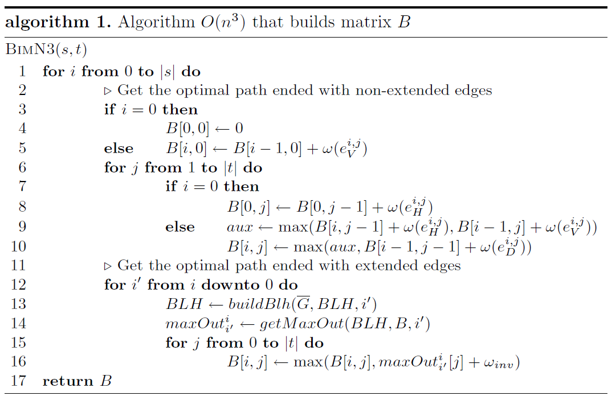
O(#column)

Slide 14
JEANETTE P. SCHMIDT － All Highest Scoring Paths in Weighted Grid Graphs and Their Application to Finding All Approximate Repeats in Strings － SIAM Journal on Computing Vol. 27, No. 4, pp. 972-992, August 1998
Gad M. Landau and Michal Ziv-Ukelson － On the Common Substring Alignment Problem － Journal of Algorithms 41, 338–359 (2001)
[1]
[2]
this(2006)

Slide 15
 | o0 | o1 | o2 | o3 | o4 | o5 | o6 | o7 | o8 | o9
i0 | -4 | -2 | -2 | -2 | -3 | -2 | 0 | -1 | -2 | -3
i1 |  | -4 | -2 | -2 | -3 | -1 | 1 | 0 | -1 | -2
i2 |  |  | -4 | -4 | -2 | 0 | 2 | 1 | 0 | -1
i3 |  |  |  | -4 | -2 | 0 | -1 | -2 | -1 | 0
i4 |  |  |  |  | -4 | -2 | 0 | -1 | -2 | -1
i5 |  |  |  |  |  | -4 | -2 | -2 | -2 | 0
i6 |  |  |  |  |  |  | -4 | -2 | -2 | 0
i7 |  |  |  |  |  |  |  | -4 | -4 | -2
i8 |  |  |  |  |  |  |  |  | -4 | -2
i9 |  |  |  |  |  |  |  |  |  | -4
 |  | 2 | 0 | 0 | -1 | 1 | 2 | -1 | -1 | -1
 |  |  | 2 | 0 | -1 | 2 | 2 | -1 | -1 | -1
 |  |  |  | 0 | 2 | 2 | 2 | -1 | -1 | -1
 |  |  |  |  | 2 | 2 | 2 | -1 | -1 | 0
 |  |  |  |  |  | 2 | 2 | -1 | -1 | 1
 |  |  |  |  |  |  | 2 | 0 | 0 | 2
 |  |  |  |  |  |  |  | 2 | 0 | 2
 |  |  |  |  |  |  |  |  | 0 | 2
 |  |  |  |  |  |  |  |  |  | 2
aatg
ttcatgacg
 | 0 | 1 | 2 | 3 | 4 | 5 | 6 | 7 | 8 | 9
1 |  |  | 1 |  | 2 | 1 |  | 5 | 5 | 3
2 |  |  | 1 |  | 2 |  |  | 6 |  | 4
3 |  |  |  |  | 2 |  |  | 6 |  | 5

