Slide 1
Solving Cyclic Longest Common Subsequence in Quadratic Time
Andy Nguyen
Department of Computer Science, Stanford University
August 17, 2012
Presenter: Siang-Huai Hung
Date:2015/9/23

Slide 2
Abstract
We present a practical algorithm for the cyclic longest common subsequence (CLCS) problem that runs in O(mn) time, where m and n are the lengths of the two input strings. While this is not necessarily an asymptotic improvement over the existing record, it is far simpler to understand and to implement.

Slide 3
CLCS
Given a string A of length n and an integer k, 0 ≤ k < n,
we can define cut(A,k) = substring(A,k,n)+substring(A,0,k).
Example:
cut(“abcd”,2) = “cd”+“ab” = “cdab”
cut(“abcd”,0) = “abcd”+“” = “abcd”
We can extend this definition to any integer k by defining cut(A, k) = cut(A, k mod n) when k < 0 or k ≥ n.

Slide 4
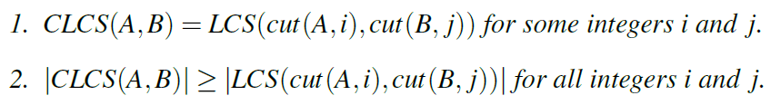
Definition 1
Let A and B be strings of length m and n respectively, where m ≤ n. A cyclic longest common subsequence of A and B CLCS(A, B) is a string that satisfies the following properties:
This implies that we have a solution to CLCS that runs in O(m²n²) time.

Slide 5
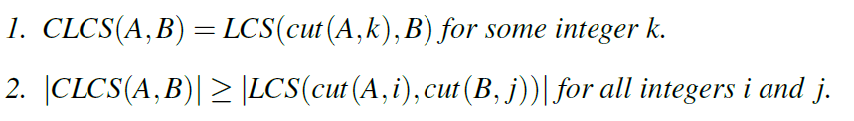
There is some cyclic longest common subsequence of A and B CLCS(A,B) that satisfies the following properties:
runtime of O(m²n)

Slide 6
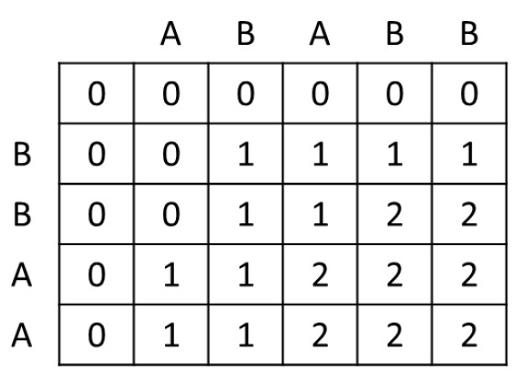
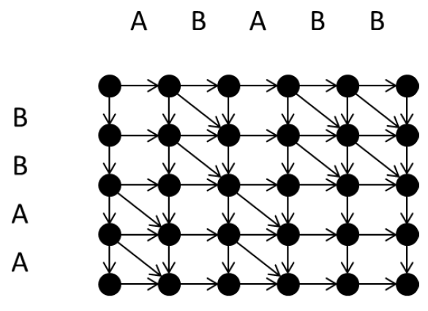
Finding an LCS(A,B) is equivalent to finding a shortest path from (0,0) to (m,n) in GA,B.
The set of parent pointers computed by any DP solution to LCS(A,B) (when treated as undirected edges)
forms a shortest path tree of GA,B rooted at (0,0).

Slide 7
Algorithm
We can solve CLCS by solving m shortest-path problems, one for each cut of A. These shortest-path problems are closely related, as we see when we construct the graph GAA,B (Figure 2). Then the shortest paths we want to find are the ones from (0,0) to (m,n), from (1,0) to (m+1,n), …, and from (m-1,0) to (2m-1,n).

Slide 8
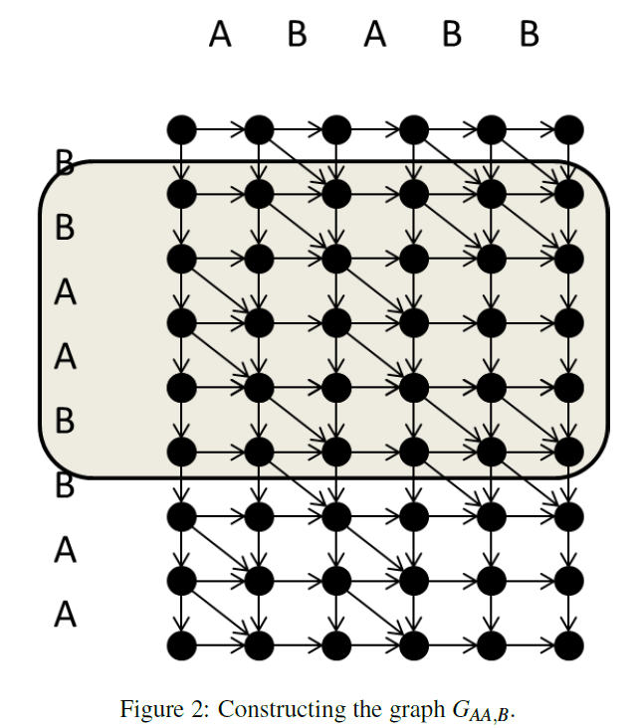

Slide 9
Definition 2
A lowest shortest path tree of GA,B is a shortest path tree where for every node v, the path from the root to v contained in the shortest path tree is lower than any other shortest path from the root to the node.
• The set of parent pointers computed by the DP solution that favors ← first, then ↖ , and finally ↑ in case of ties forms a lowest shortest path tree of GA,B rooted at (0,0).
If we remove the top row of nodes from the lowest shortest path tree rooted at (0,0), we are left with at most two subtrees L and (possibly) R.
For any entry (i, j) in the table, 0 ≤ len(i, j) - len(i, j - 1) ≤ 1.

Slide 10
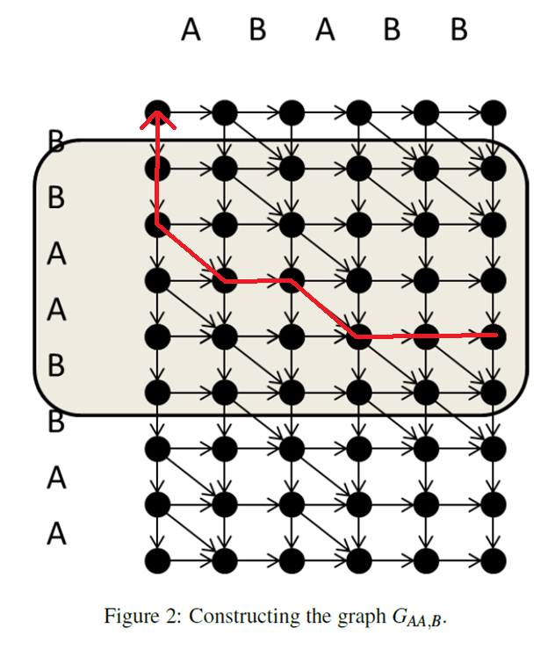

Slide 11
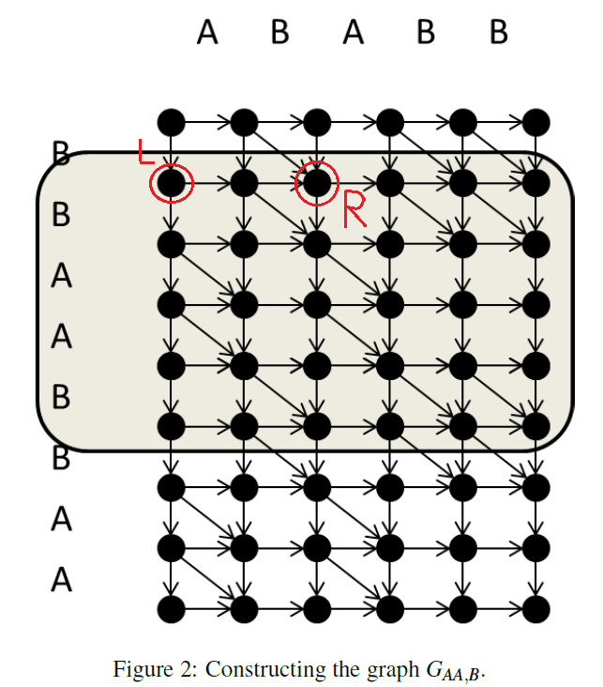

Slide 12

Corollary
Let (i, j) be such that (i, j) $∈$ R but (i, j - 1) $∈$ L. Then len(i, j) = len(i, j - 1)+1.

Slide 13
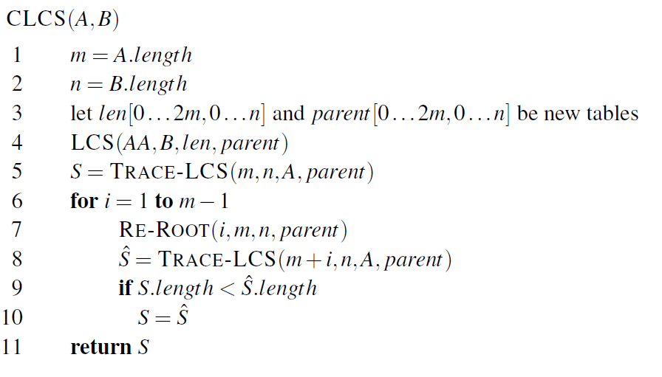

Slide 14
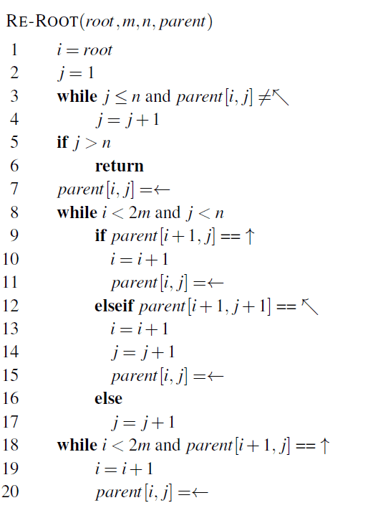
assume that the input tree is rooted at (root – 1,0)

Slide 16
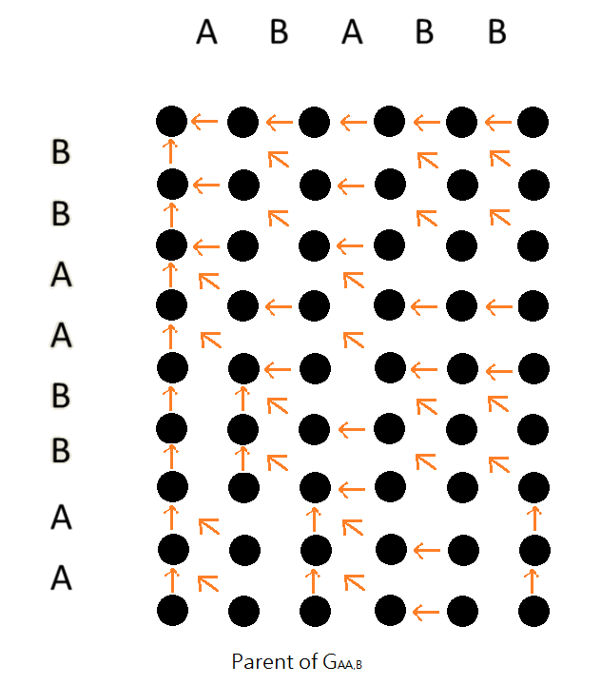

Slide 17
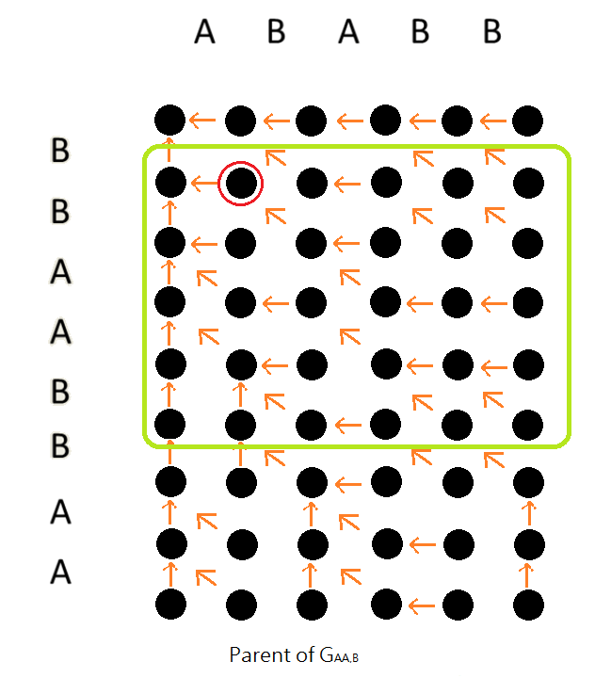

Slide 18
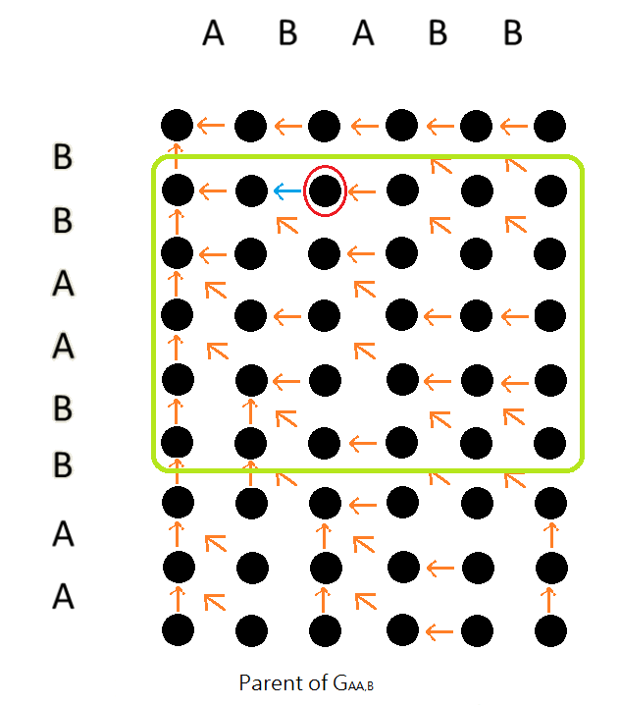

Slide 19
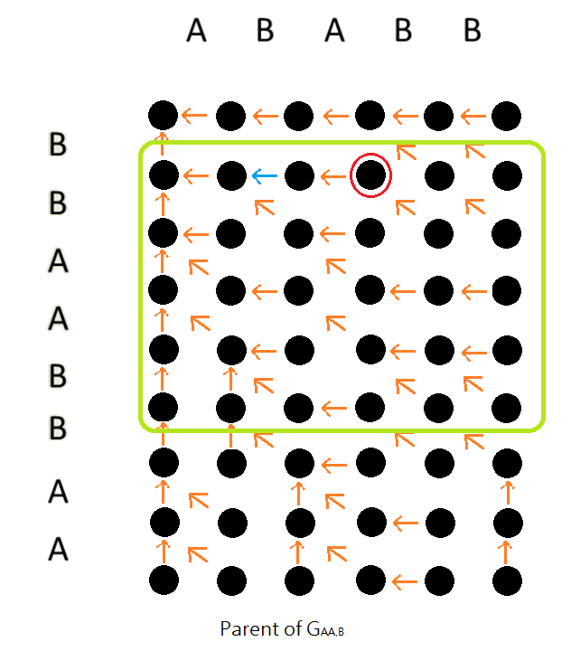

Slide 20
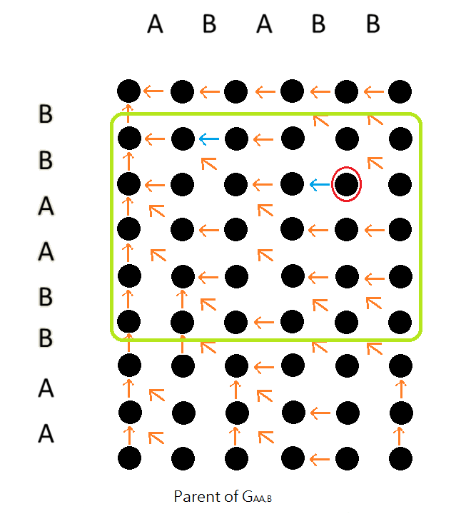

Slide 21
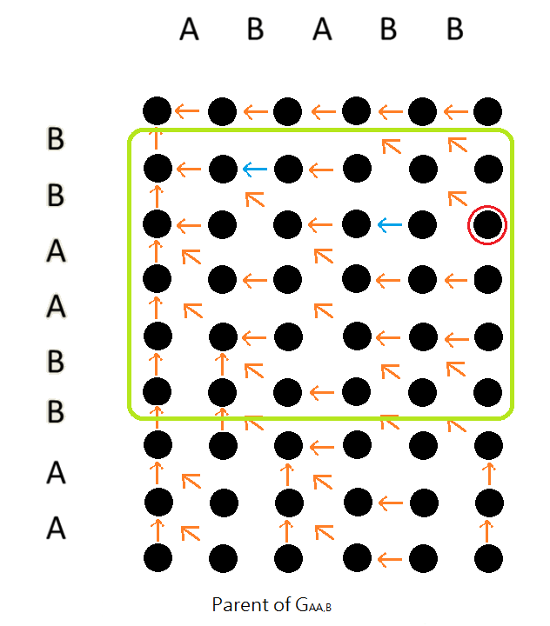

Slide 22
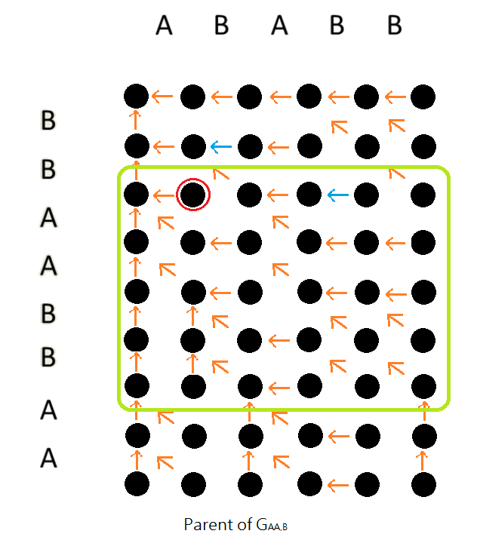

Slide 23
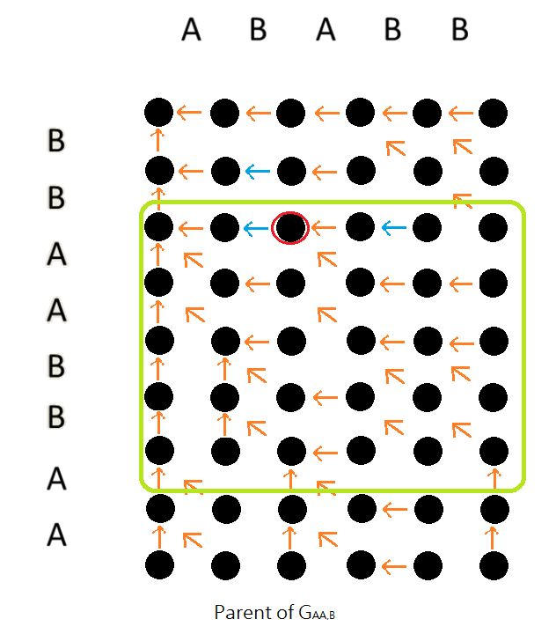

Slide 24
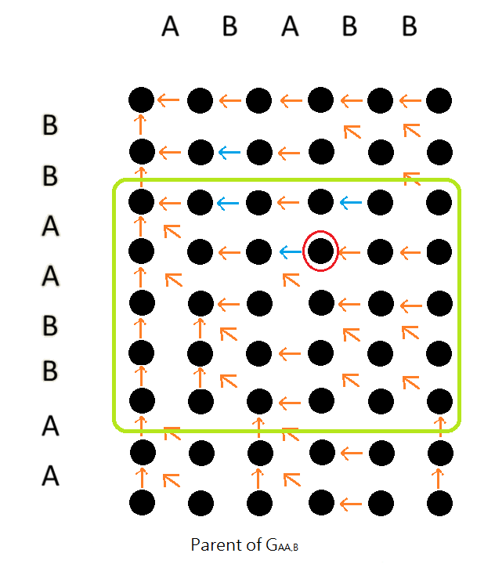

Slide 25
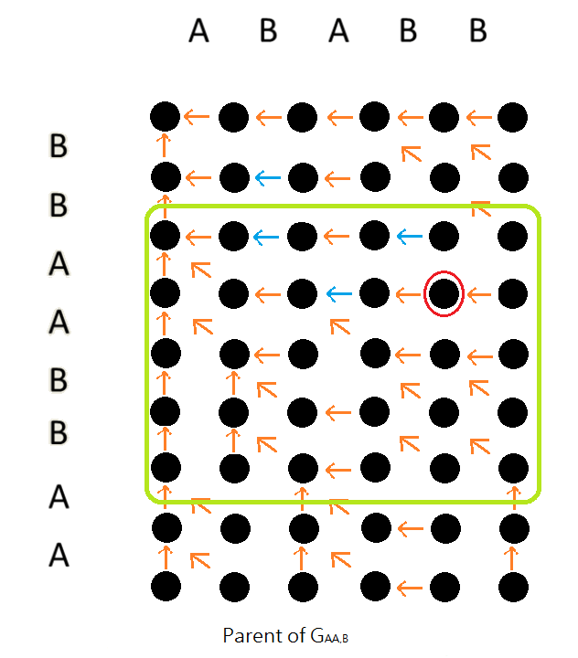

Slide 26
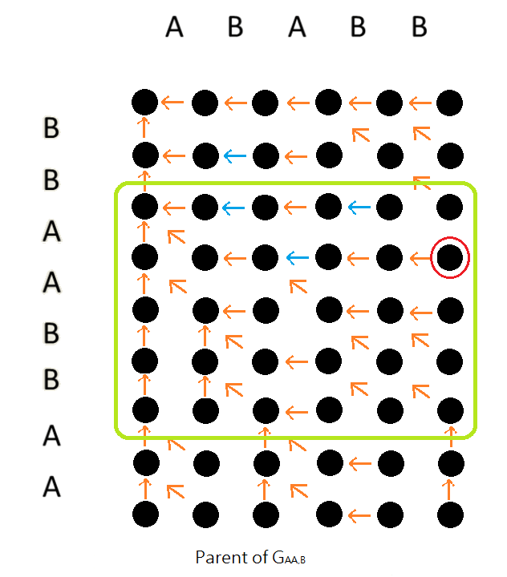

Slide 27
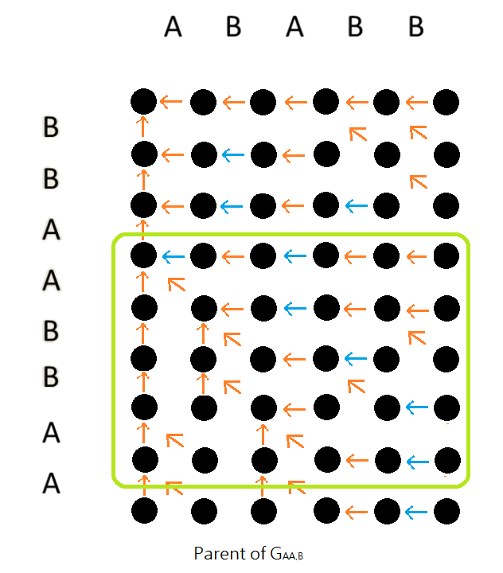

Slide 28
Conclusions
We have presented a practical algorithm that solves CLCS in O(mn) time. Note that the proof of correctness relies heavily on the fact that all edges in the graph have weight 1. This means that this algorithm does not naturally apply to the usual extensions of the problem, such as edit distance and dynamic time warping. It may be worth investigating whether the algorithm can be adapted to certain classes of edge weights.

