Slide 1
Image Texture Recognition Based on Median Filtering and Hough Transform
Luoyan HU, Kejing LI
2009 International Conference on Industrial and Information Systems, pp. 267-270, 2009.
Presenter: Tsai-Ming Sun
Date:2015/9/23

Slide 2
abstract
This paper introduces a new computer recognition algorithm for image texture recognition. Using this algorithm, the texture characteristic of image is extracted exactly for analysis. 2-d bidirectional median filtering is proposed to make image de-noising an ideal state. An image correction algorithm with Hough transfer on local computation is presented to obtain an image with better position state. An approach based on local extreme value is proposed to search for feature points of image texture to further recognize each parameter of image texture. At last, this paper takes example for fabric density recognition, and gives the result and discusses detail process. The result shows that this approach is correct and efficient, and has extensive application.

Slide 3
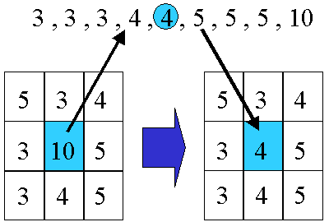
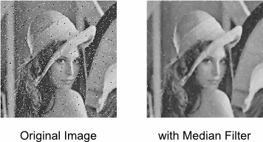
Median filter

Slide 4
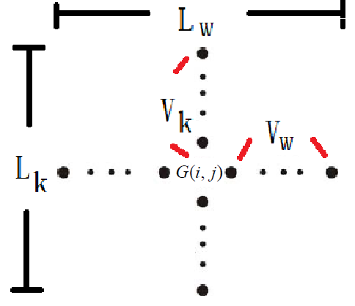


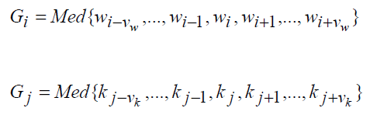

2-D Bidirectional Median Filtering

Slide 5
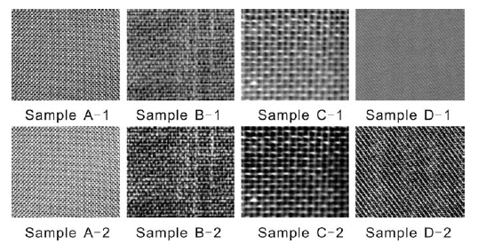
2-D Bidirectional Median Filtering

Slide 6

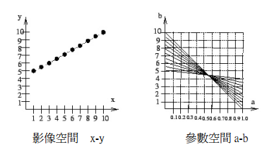
HOUGH TRANSFORM

Slide 7
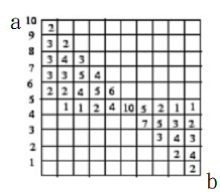
Accumulator
Hough transform演算法：
在影像空間上決定所有可能的特徵點，通常是邊緣點或骨架點。.
2. 尋找影像空間的一個特徵點(x,y)，計算
2.1 對於中每一個a，計算通過(x,y)的所有直線的(a’,b’)
2.2 在accumulator的(a’,b’)位置上累加一次 尋找下一個特 徵點，重複步驟2.1和2.2，直到所有特徵點都通過計算。
3. 找到accumulator的所有區域最大值(maxima) 。
4. 將每一個maxima映射回影像空間的每一條代表直線。
當影像空間上的直線是一 垂直線時，則斜率 a=∞，而無法納入有限的 accumulator。

Slide 8

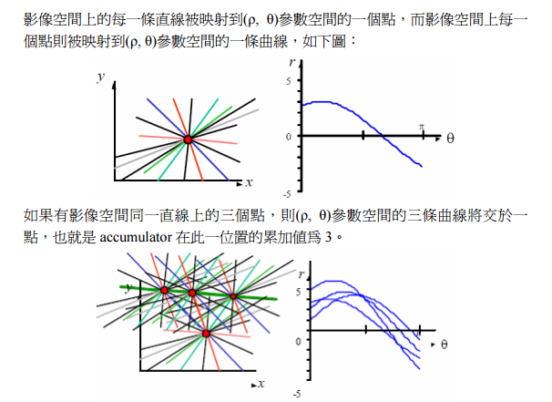
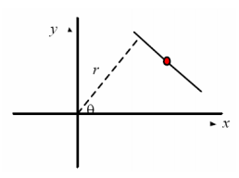
Polar system

Slide 9
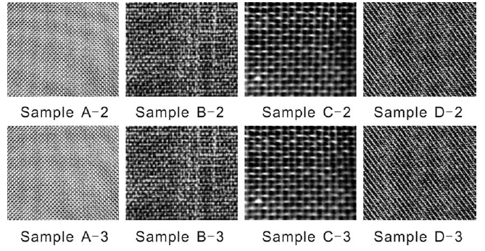
HOUGH TRANSFORM

Slide 10
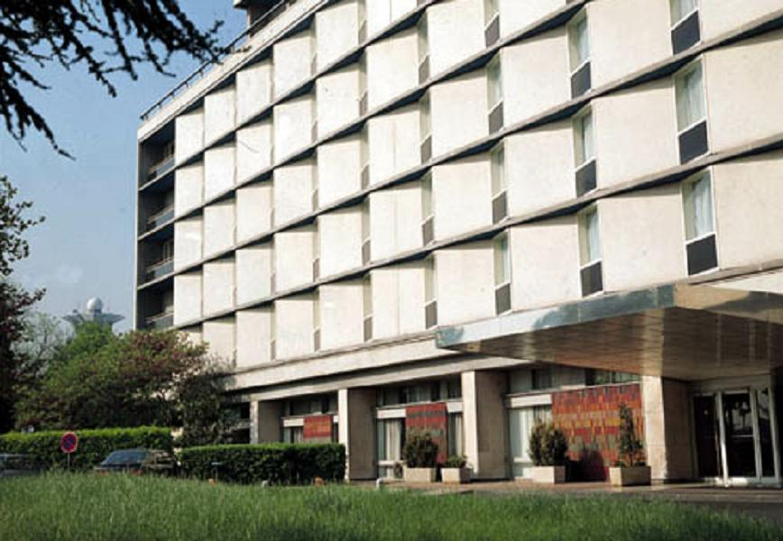
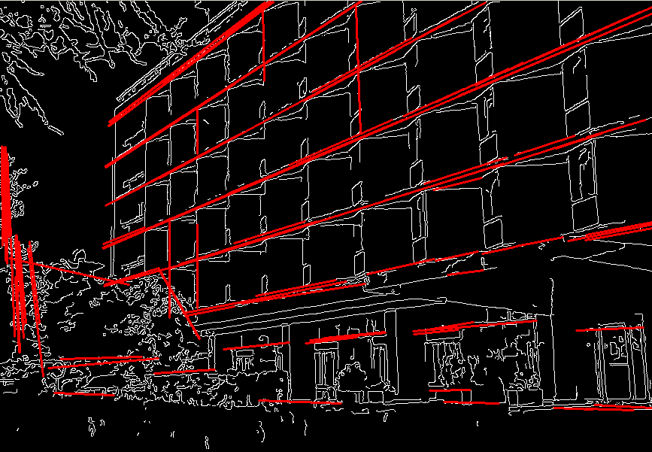
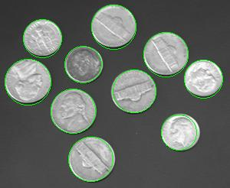
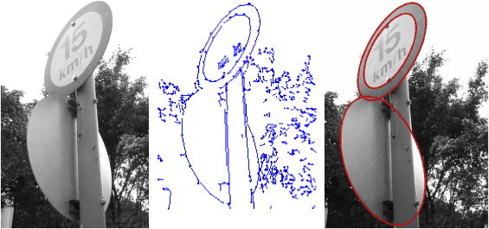

Slide 11

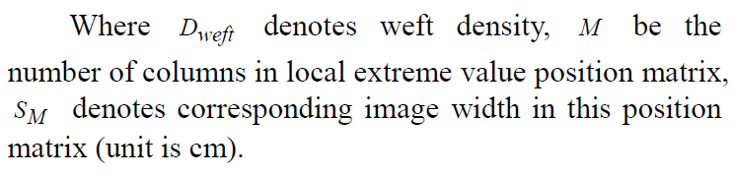



Matrix Construction on Local Extreme Value and Recognition Result

Slide 12
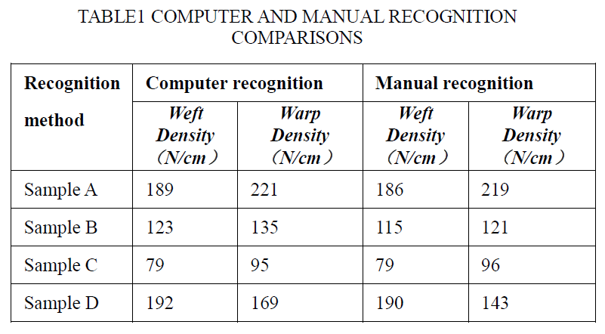
Result

