Slide 1
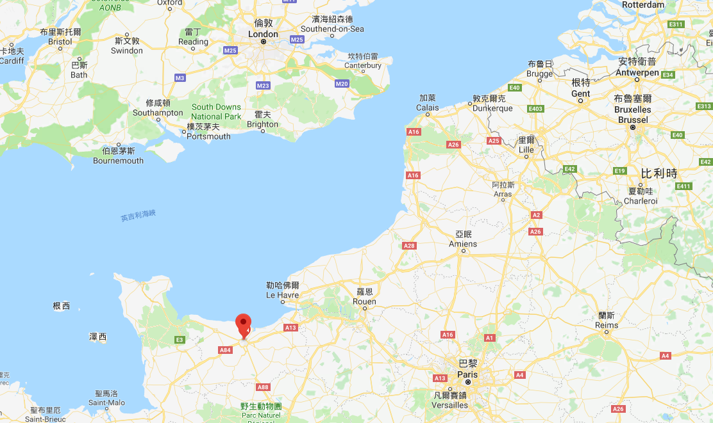
Space-Efficient Algorithms for Longest Increasing Subsequence
Masashi Kiyomi, Hirotaka Ono, Yota Otachi,
Pascal Schweitzer, and Jun Tarui
arXiv:1712.09230v1, 2017 /
STACS 2018, February –March, 2018, Caen, France
(Symposium on Theoretical Aspects of Computer Science)
Speaker: Kuan-Chih Chen
Date: 2018.04.17
Notes:
Masashi Kiyomi
Hirotaka Ono
Yota Otachi
Pascal Schweitzer
Jun Tarui
arxiv by Paul Henry Ginsparg(美國物理學家), 收集物理學、數學、計算機科學與生物學的論文預印本的網站，始於1991年8月14日
現今的一些數學家及科學家習慣先將其論文上傳至arXiv.org，再提交予專業的學術期刊

Slide 2
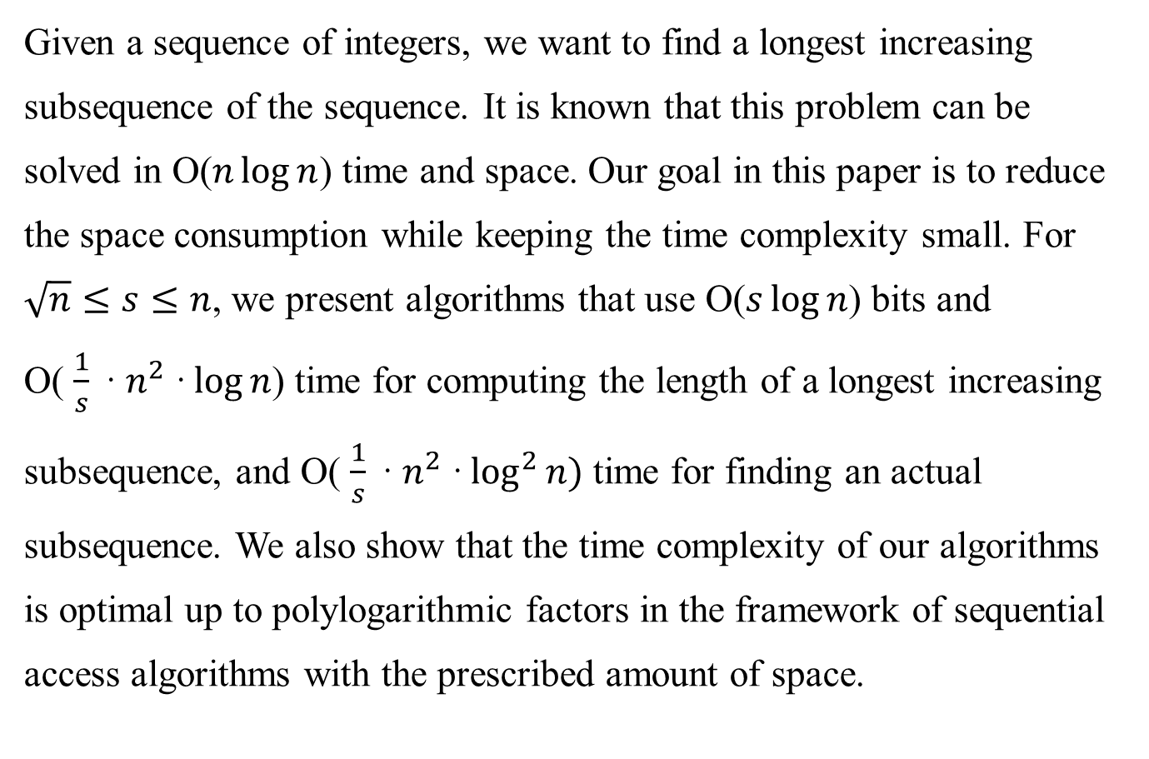
Abstract
Given a sequence of integers, we want to find a longest increasing subsequence of the sequence. It is known that this problem can be solved in O($n\log{n}$) time and space. Our goal in this paper is to reduce the space consumption while keeping the time complexity small. For $\sqrt{n}≤s≤n$, we present algorithms that use O($s\log{n}$) bits and O( $\frac{1}{s} \text{·}{ n}^{2} \text{·}\log{n}$) time for computing the length of a longest increasing subsequence, and O( $\frac{1}{s} \text{·}{ n}^{2} \text{·}\log^{2}{n})$ time for finding an actual subsequence. We also show that the time complexity of our algorithms is optimal up to polylogarithmic factors in the framework of sequential access algorithms with the prescribed amount of space.

Slide 3






































Patience Sorting
input: $τ= <2, 8, 4, 9, 5, 1, 7, 6, 3>$
$$4$$
$$4$$
$$4$$
$$5$$
$$2$$
$2$ 8
$$2$$
8
$$2$$
8
9
$$2$$
8 9
$$P_{1}$$
$P_{1}$ $P_{2}$
$P_{1}$ $P_{2}$
$P_{1}$ $P_{2}{ P}_{3}$
$P_{1}$ $P_{2}{ P}_{3}$
$$3$$
$$1$$
$$4$$
$$5$$
$$1$$
$$4$$
$$5$$
$$1$$
$$4$$
$$5$$
$$6$$
$$1$$
$$4$$
$$5$$
$$6$$
$2$ 8 9
$2$ 8 9 7
$2$ 8 9 7
$2$ 8 9 7
$P_{1}$ $P_{2}{ P}_{3}$
$P_{1}$ $P_{2}{ P}_{3}{ P}_{4}$
$P_{1}$ $P_{2}{ P}_{3}{ P}_{4}$
$P_{1}$ $P_{2}{ P}_{3}{ P}_{4}$
$$lis\left(τ\right)=4$$
$$\text{O}\text{(}n\log{n}\text{) }\text{time} \text{and} \text{space}$$

Slide 4
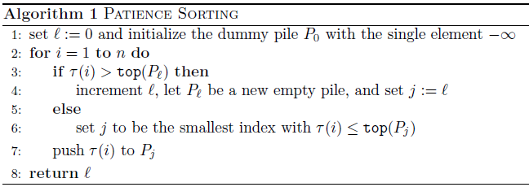


Patience Sorting - Time and Space Complexity
Time: $\text{O}\text{(}\text{n} \text{log} n\text{) }$
$\text{n}$ elements from $τ_{1}$to $τ_{n}$ +
$\text{O}\text{(}\text{log} \text{n}\text{)}$ by using binary search
Space:$\text{O}\text{(}\text{n} \text{log} n\text{)}$
total number of elements in the piles is $\text{O}\text{(}\text{n}\text{)}$ +
a Boolean table of length $\text{n}$

Slide 5



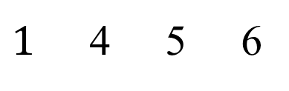

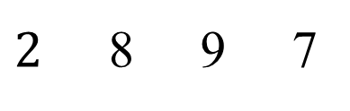

Patience Sorting
input: $τ= <2, 8, 4, 9, 5, 1, 7, 6, 3>$
3
$1$ 4 5 6
$2$ 8 9 7
$P_{1}$ $P_{2}{ P}_{3}{ P}_{4}$
$decreasing subsequence$:
$$2, 1$$
$$8, 4, 3$$
$$9, 5$$
$$7, 6$$

Slide 6




















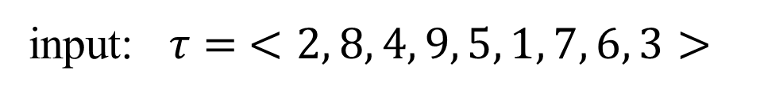















Another way (for permutation input)
$$V$$
$$V$$
$$V$$
$$V$$
$$V$$
$$V$$
$$V$$
$$V$$
$$V$$
$$Used$$
input: $τ= <2, 8, 4, 9, 5, 1, 7, 6, 3>$
$$3$$
$$1$$
$$1$$
$$1$$
$$4$$
$$2$$
$$2$$
$$2$$
8
$$2$$
8
$$P_{1}$$
$$P_{1}$$
$P_{1}$ $P_{2}$
$P_{1}$ $P_{2}$
$$3$$
$$3$$
$$3$$
$$3$$
$$1$$
$$4$$
$$1$$
$$4$$
$$5$$
$$1$$
$$4$$
$$5$$
$$1$$
$$4$$
$$5$$
$$6$$
$2$ 8 9
$2$ 8 9
$2$ 8 9 7
$2$ 8 9 7
$P_{1}$ $P_{2}{ P}_{3}$
$P_{1}$ $P_{2}{ P}_{3}$
$P_{1}$ $P_{2}{ P}_{3}{ P}_{4}$
$P_{1}$ $P_{2}{ P}_{3}{ P}_{4}$
$$\text{O}\text{(}n^{2}\text{) }\text{time} \text{and} \text{O}\text{(}\text{n}\text{) }\text{space}$$

Slide 7


Another way - Time and Space Complexity
Time: $\text{O}\text{(}n^{2}\text{) }$
each for-loop takes $\text{O}\text{(}\text{n}\text{)}$ time, loop is repeated at most $\text{n}$ times
Space: $\text{O}\text{(}n\text{)}\text{ + }\text{O}\text{(}log n\text{)}\text{ = }\text{O}\text{(}\text{n}\text{)}$
a constant number of pointers of $\text{O}\text{(}\text{log} \text{n}\text{)}$ +
a Boolean table of length $\text{n}$ (used, unused)

Slide 8






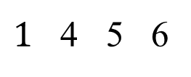
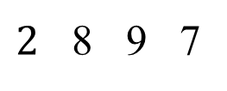

Another way
$$3$$
$1$ 4 5 6
$$τ_{1}= <2, 8, 4, 9, 5, 1, 7, 6, 3>$$
$2$ 8 9 7
$P_{1} :2, 1$ (left-to-right minima subsequence of $τ_{1}$)
$P_{1}$ $P_{2}{ P}_{3}{ P}_{4}$
$$τ_{2}= <8, 4, 9, 5, 7, 6, 3>$$
$P_{2} :8, 4, 3$(left-to-right minima subsequence of $τ_{2}$)
$$τ_{3}= <9, 5, 7, 6>$$
$P_{3} :9, 5$(left-to-right minima subsequence of $τ_{3}$)
$$τ_{4}= <7, 6>$$
$P_{4} :7, 6$(left-to-right minima subsequence of $τ_{4}$)

Slide 9
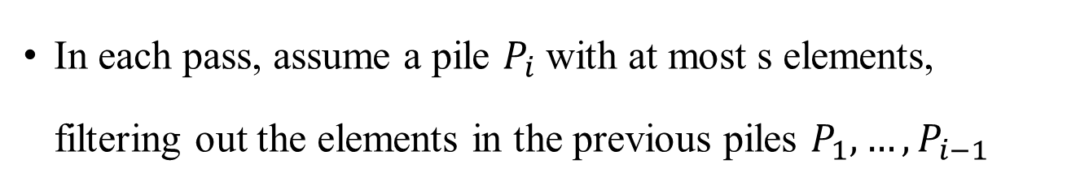

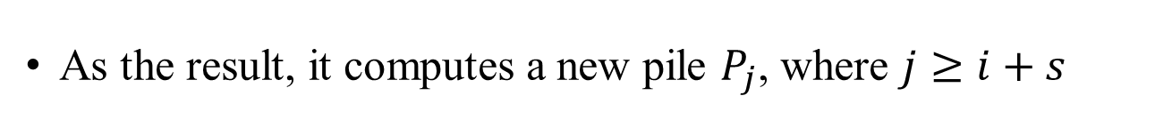
Their Algorithm
Given an integer $s$satisfying$\sqrt{n}≤s≤n$
$s$: memory bound
Scan input (n/s) times
In each pass, assume a pile $P_{i}$with at most s elements, filtering out the elements in the previous piles $P_{1}, …, P_{i−1}$
As the result, it computes a new pile $P_{j}$, where $j≥i+s$

Slide 10
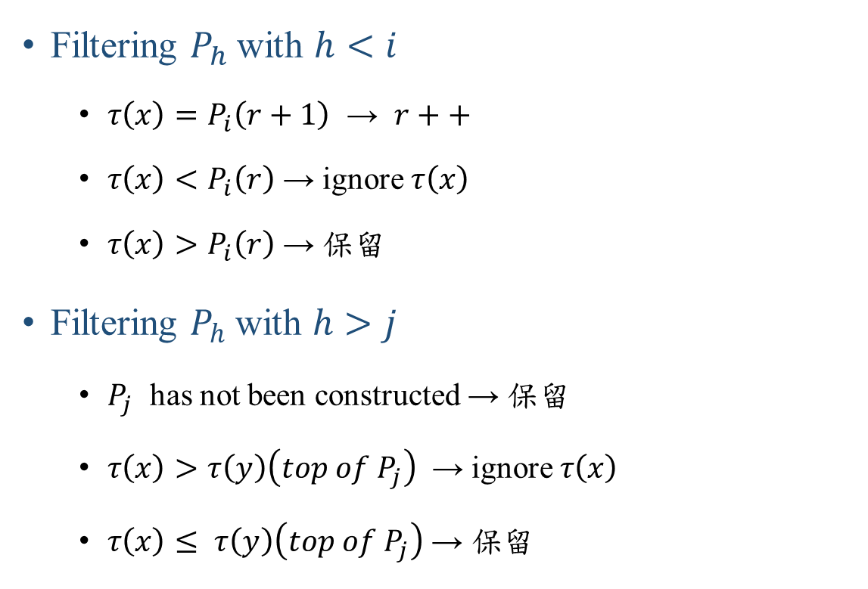



$$P_{i}$$
$$P_{j}$$
Filter
$$…$$
Filtering $P_{h}$with $h<i$
$τ\left(x\right)=P_{i}\left(r+1\right)$ → $r++$
$τ\left(x\right)<P_{i}\left(r\right)$ → ignore $τ\left(x\right)$
$τ\left(x\right)>P_{i}\left(r\right)$ → 保留
Filtering $P_{h}$with $h>j$
$P_{j}$ has not been constructed → 保留
$τ\left(x\right)>τ\left(y\right)\left(top of P_{j}\right)$ → ignore $τ\left(x\right)$
$τ\left(x\right)≤ τ\left(y\right)\left(top of P_{j}\right) \text{→ }\text{保留}$
Notes:
為什麼r+1跟s沒關係

Slide 11
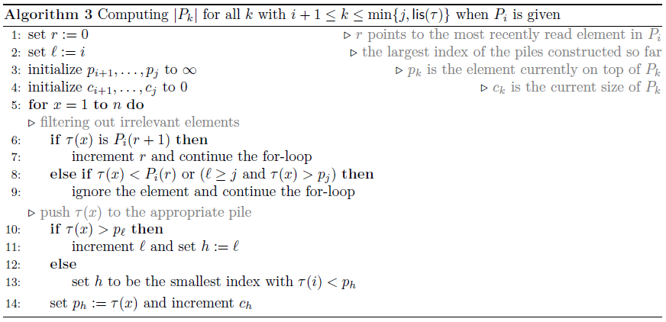
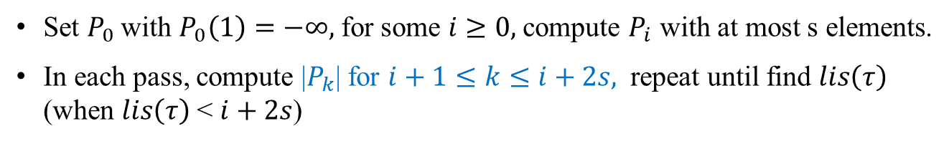
Implementation
Set $P_{0}$with $P_{0}\left(1\right)=−∞,$for some$i≥0,$compute $P_{i}$ with at most s elements.
In each pass, compute |$P_{k}$| for $i+1≤k≤i+2s,$ repeat until find $lis\left(τ\right)$ (when $lis\left(τ\right)$< $i+2s$)

Slide 12
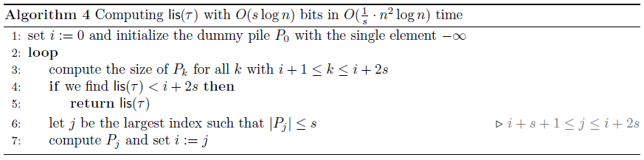
Overview
step 1.
step 2.
step 3.

Slide 13
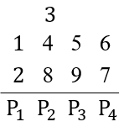





Example 1
$$r$$
$$τ= <2, 8, 4, 9, 5, 1, 7, 6, 3>$$
$$LIS= <2, 4, 5, 6>$$
$$lis\left(τ\right)=4$$
Let n = 9, i = 1, s = 2
$$P_{i}=P_{1}=(2, 1)$$

Slide 14































n = 9, i = 1, s = 2
Step by step (Iteration 1)
i + 2s = 5
$lis(τ)$ = 4
$$τ_{1}= <2, 8, 4, 9, 5, 1, 7, 6, 3>$$
$$r$$
$$τ_{2}= < >$$
$$8$$
$$4$$
$$9$$
$$5$$
$$7$$
$$6$$
$$3$$
$$c$$
$$1$$
$$1$$
$$1$$
$$2$$
$$3$$
$$2$$
$$2$$
$$p$$
$$8$$
$$9$$
$$6$$
$$4$$
$$7$$
$$3$$
$$5$$
$$P_{2}$$
$$P_{3}$$
$$P_{4}$$
$$P_{i+1} \sim P_{i+2s}$$

Slide 15


Example 2
$$r$$
$$τ= <2, 6, 4, 3, 7, 5, 1, 8, 9, 12, 11, 10>$$
$$LIS= <2, 4, 5, 8, 9, 10>$$
$$lis\left(τ\right)=6$$
Let n = 12, i = 1, s = 2
$$P_{i}=P_{1}=(2, 1)$$

Slide 16



































n = 12, i = 1, s = 2
Step by step (Iteration 1)
i + 2s = 5
$$3$$
$$10$$
$lis(τ)$ = 5
$$4$$
5
$$11$$
$$τ_{1}= <2, 6, 4, 3, 7, 5, 1, 8, 9, 12, 11, 10>$$
$$r$$
$$6$$
7
$$8$$
$$9$$
$$12$$
$$P_{2}{ P}_{3}{ P}_{4}$$
$$P_{5}$$
$$P_{6}$$
$$τ_{2}= < >$$
$$6$$
$$4$$
$$3$$
$$7$$
$$5$$
$$8$$
$$9$$
$$12$$
$$11$$
$$10$$
$$next i=5$$
$$c$$
$$3$$
$$2$$
$$1$$
$$1$$
$$p$$
$$3$$
5
$$8$$
$$9$$
$$P_{2}{ P}_{3}{ P}_{4}$$
$$P_{5}$$
$$P_{i+1} \sim P_{i+2s}$$

Slide 17














n = 12, i = 5, s = 2
Step by step (Iteration 2)
i + 2s = 9
$$10$$
$lis(τ)$ = 6
$$11$$
$$τ_{2}= <6, 4, 3, 7, 5, 8, 9, 12, 11, 10>$$
$$r$$
9
$$12$$
$$P_{5}$$
$$P_{6}$$
$$τ_{3}= < >$$
$$12$$
$$11$$
$$10$$
$$c$$
$$3$$
$$2$$
$$1$$
$$1$$
$$3$$
$$p$$
$$3$$
5
$$8$$
$$9$$
$$10$$
$$P_{2}{ P}_{3}{ P}_{4}$$
$$P_{5}$$
$$P_{6}$$
$$P_{i+1} \sim P_{i+2s}$$

Slide 18

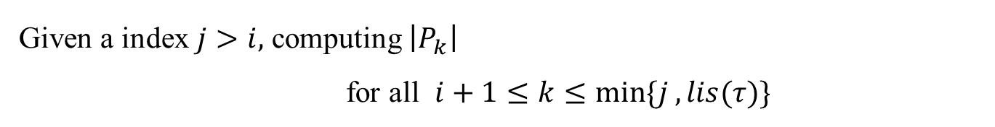
Space Complexity
Given a index $j>i,$ computing $\left|P_{k}\right|$
for all $i+1≤k≤min⁡\{j , lis(τ)\}$
Space: $O(\left(j−i\right)log n)$

Slide 19

Space Complexity
Given s satisfying$\sqrt{n}≤s≤n,$ and a sequence $τ$ of length $n$, computing $lis(τ)$
Space: $O(s log n)$

Slide 20



O($s\log{n}$) space and O( $\frac{1}{s} \text{·}{ n}^{2} \text{·}\log{n}$) time
$(s≥\sqrt{n}$)
O($\sqrt{n}\log{n}$) space and O($n^{1.5} \text{·}\log{n}$) time

Slide 21
Reference
http://shmilyaw-hotmail-com.iteye.com/blog/1721524
Young tableaus(杨氏矩阵)的分析

Slide 22






Step by step (Iteration 2)
$$r$$
$$τ_{2}= <8, 4, 9, 5, 7, 6, 3>$$
$$τ_{2}= < >$$
$$9$$
$$5$$
$$7$$
$$6$$

Slide 23





















set n = 12, s = 4
$$8$$
Step by step (Iteration 1)
$$9$$
$$3$$
$$10$$
$$τ_{1}= <2, 6, 4, 3, 7, 5, 1, 12, 11, 10, 9, 8>$$
$$4$$
5
$$11$$
$$r$$
$$6$$
7
$$12$$
$$τ_{2}= < >$$
$$6$$
$$4$$
$$3$$
$$7$$
$$5$$
$$12$$
$$11$$
$$10$$
$$9$$
$$8$$
$$P_{2}{ P}_{3}{ P}_{4}$$
$$c$$
$$3$$
$$2$$
$$5$$
$$p$$
$$3$$
5
$$8$$
$$P_{2}{ P}_{3}{ P}_{4}$$

Slide 24















set n = 12, s = 4
$$8$$
Step by step (Iteration 2)
$$9$$
$$10$$
$$τ_{2}= <6, 4, 3, 7, 5, 12, 11, 10, 9, 8>$$
5
$$11$$
$$r$$
7
$$12$$
$$τ_{3}= < >$$
$$12$$
$$11$$
$$10$$
$$9$$
$$8$$
$$P_{3}$$
$$P_{4}$$
$$c$$
$$5$$
$$p$$
$$8$$
$$P_{4}$$

