Slide 1
A Linear Time Algorithm for Consecutive Permutation Pattern Matching
M. Kubica, T. Kulczyński, J. Radoszewski,
W. Rytter, and T. Waleń,
Information Processing Letters, Vol. 113,
No. 12, pp. 430-433, June 2013.
Presenter : Shie-Yan Lee
2018/4/17

Slide 2
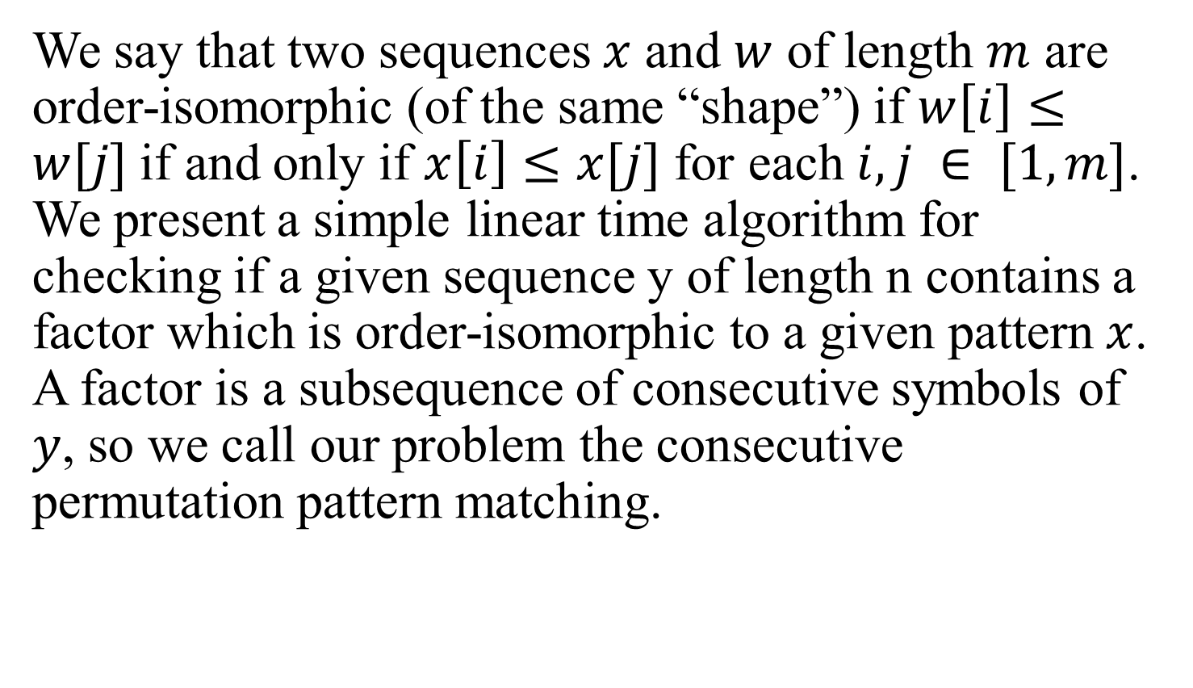
Abstract (1/2)
We say that two sequences $x$ and $w$ of length $m$ are order-isomorphic (of the same “shape”) if $w\left[i\right]≤w[j]$if and only if $x\left[i\right]≤x[j]$ for each $i, j ∈ [1,m]$. We present a simple linear time algorithm for checking if a given sequence y of length n contains a factor which is order-isomorphic to a given pattern $x$. A factor is a subsequence of consecutive symbols of $y$, so we call our problem the consecutive permutation pattern matching.

Slide 3
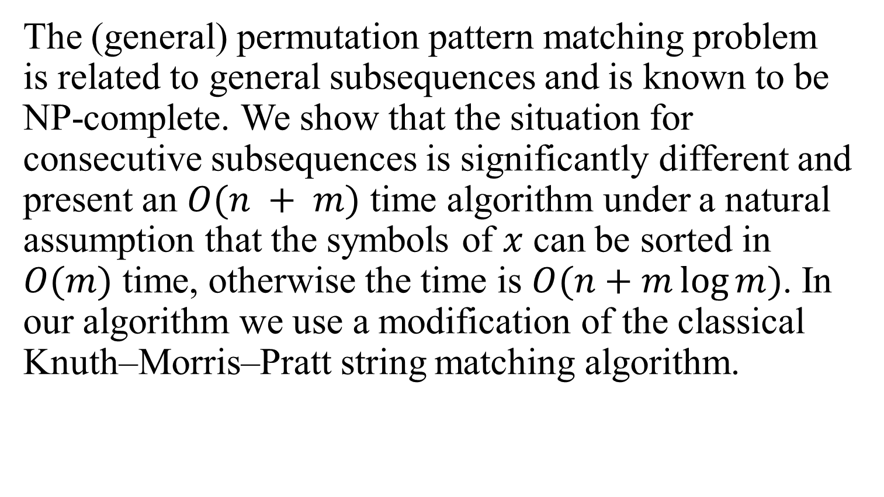
Abstract (2/2)
The (general) permutation pattern matching problem is related to general subsequences and is known to be NP-complete. We show that the situation for consecutive subsequences is significantly different and present an $O(n + m)$ time algorithm under a natural assumption that the symbols of $x$ can be sorted in $O(m)$ time, otherwise the time is $O(n+m\log{m})$. In our algorithm we use a modification of the classical Knuth–Morris–Pratt string matching algorithm.

Slide 4
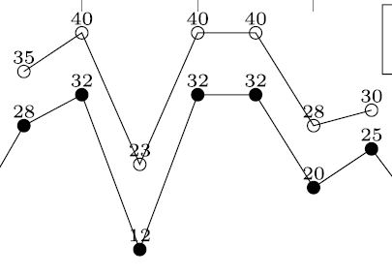
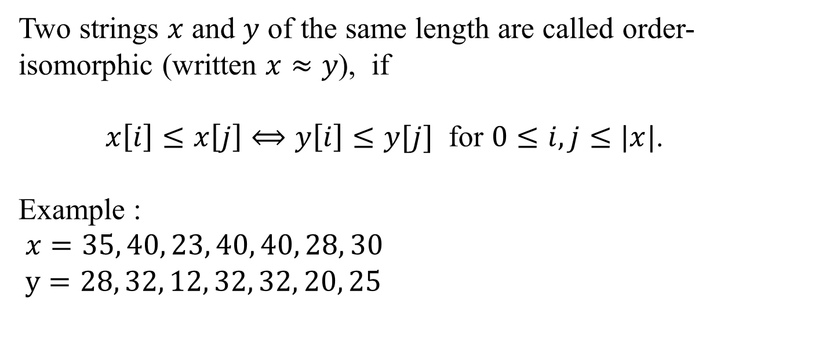
Order-isomorphism
Two strings $x$ and $y$ of the same length are called order-isomorphic (written $x≈y$), if
$x\left[i\right]≤x\left[j\right]⟺y\left[i\right]≤y[j]$ for $0≤i,j≤|x|$.
Example :
$x=35, 40, 23, 40, 40, 28, 30$
$y=28, 32, 12, 32, 32, 20, 25$

Slide 5
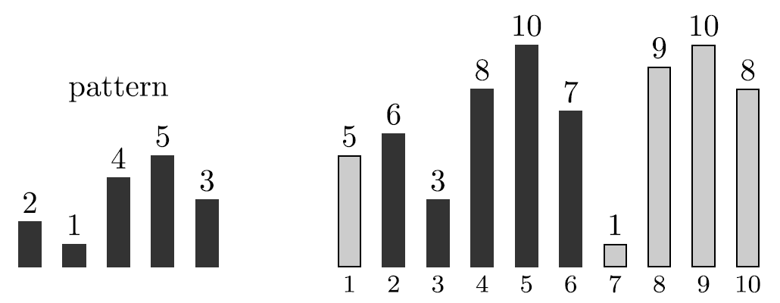
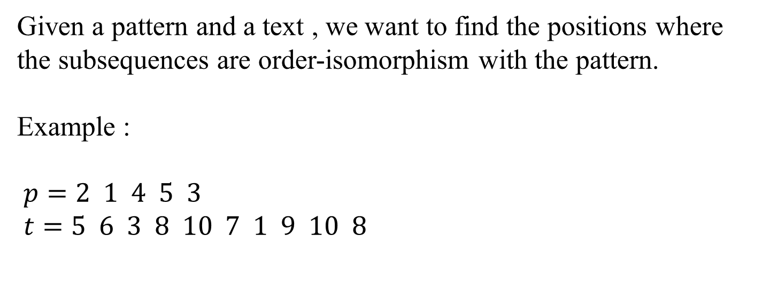
Problem definition
Given a pattern and a text , we want to find the positions where the subsequences are order-isomorphism with the pattern.
Example :
$p=2 1 4 5 3$
$t=5 6 3 8 10 7 1 9 10 8$

Slide 6

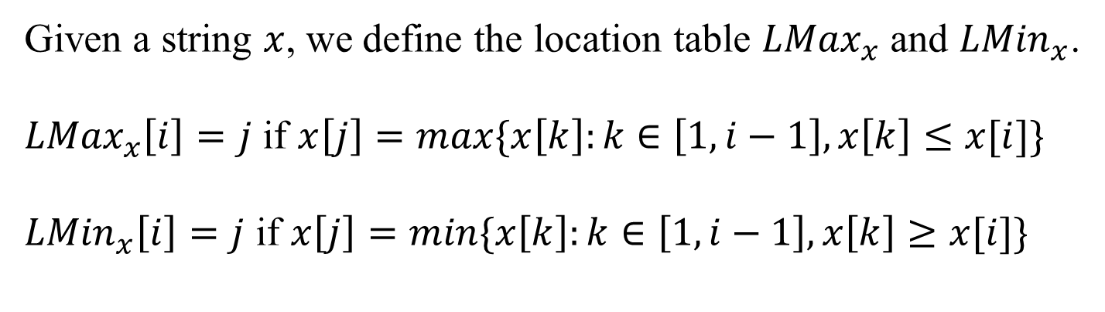



Location tables
Given a string $x$, we define the location table ${LMax}_{x}$ and ${LMin}_{x}$.
${LMax}_{x}\left[i\right]=j$ if $x\left[j\right]=max⁡\{x\left[k\right]:k∈\left[1,i−1\right],x\left[k\right]≤x[i]\}$
${LMin}_{x}\left[i\right]=j$ if $x\left[j\right]=min⁡\{x\left[k\right]:k∈\left[1,i−1\right],x\left[k\right]≥x[i]\}$
$${LMin}_{x}[i]$$
$$LMax_{x}[i]$$
$$i$$
$$x$$
$${LMax}_{x}[i]≤x[i]{≤LMin}_{x}[i]$$

Slide 7
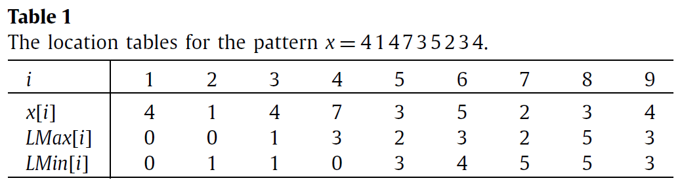
Location Tables
$${LMax}_{x}[i]≤x[i]{≤LMin}_{x}[i]$$

Slide 8
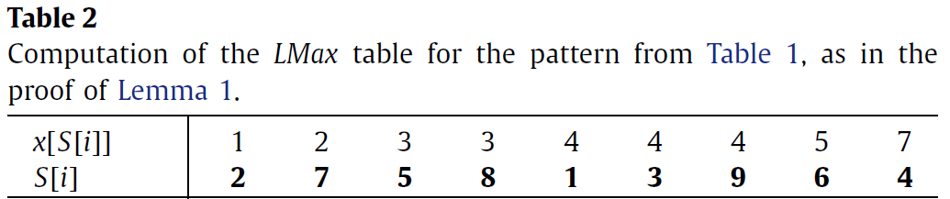
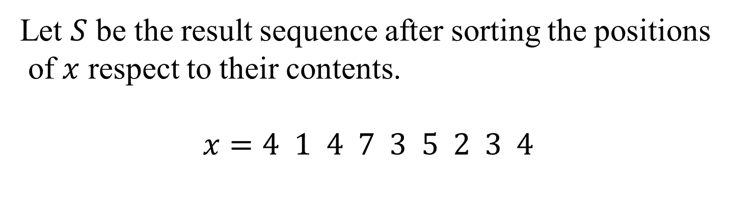
Computation of the location tables
Let $S$ be the result sequence after sorting the positions
of $x$ respect to their contents.
$$x=4 1 4 7 3 5 2 3 4$$

Slide 9
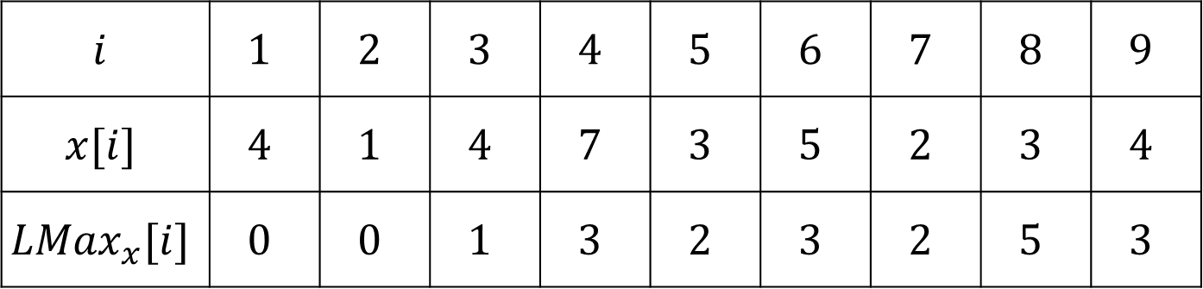
Computation of the location tables
${LMax}_{x}[i]$ is the nearest smaller value to the left of $i$.
$$i$$ | $$1$$ | $$2$$ | $$3$$ | $$4$$ | $$5$$ | $$6$$ | $$7$$ | $$8$$ | $$9$$
$$x[i]$$ | $$4$$ | $$1$$ | $$4$$ | $$7$$ | $$3$$ | $$5$$ | $$2$$ | $$3$$ | $$4$$
$${LMax}_{x}[i]$$ | $$0$$ | $$0$$ | $$1$$ | $$3$$ | $$2$$ | $$3$$ | $$2$$ | $$5$$ | $$3$$

Slide 10
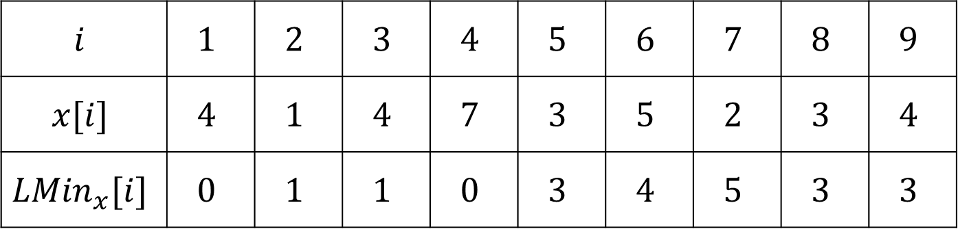
Computation of the location tables
${LMin}_{x}[i]$ is the nearest smaller value to the right of $i$.
9 3 1
$$i$$ | $$1$$ | $$2$$ | $$3$$ | $$4$$ | $$5$$ | $$6$$ | $$7$$ | $$8$$ | $$9$$
$$x[i]$$ | $$4$$ | $$1$$ | $$4$$ | $$7$$ | $$3$$ | $$5$$ | $$2$$ | $$3$$ | $$4$$
$${LMin}_{x}[i]$$ | $$0$$ | $$1$$ | $$1$$ | $$0$$ | $$3$$ | $$4$$ | $$5$$ | $$3$$ | $$3$$

Slide 11
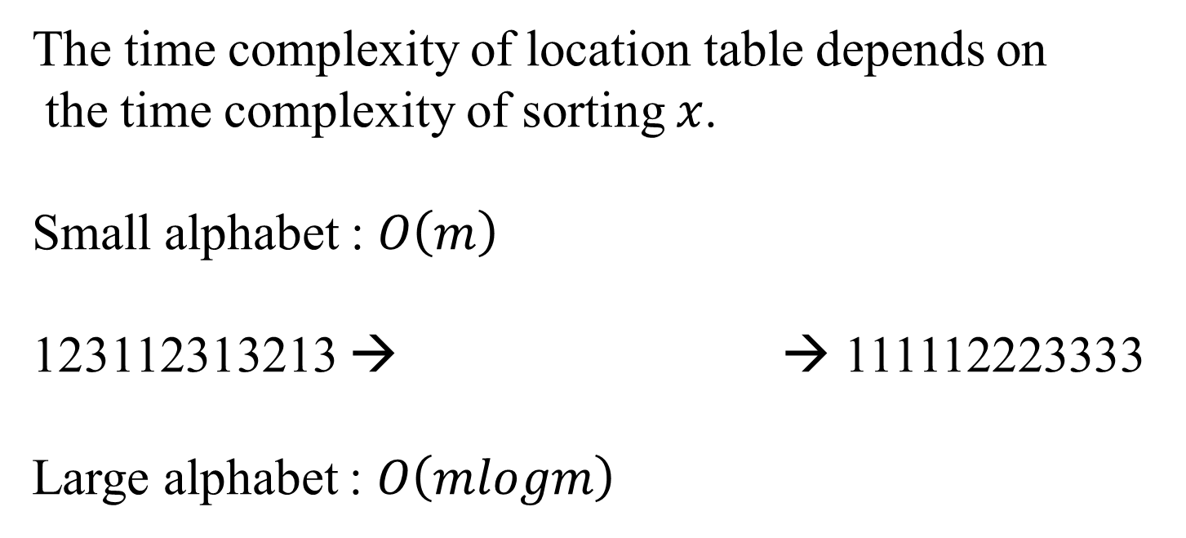
Time complexity of the location tables
The time complexity of location table depends on
the time complexity of sorting $x$.
Small alphabet : $O\left(m\right)$
123112313213 → → 111112223333
Large alphabet : $O\left(mlogm\right)$
value | 1 | 2 | 3
time | 5 | 3 | 4

Slide 12



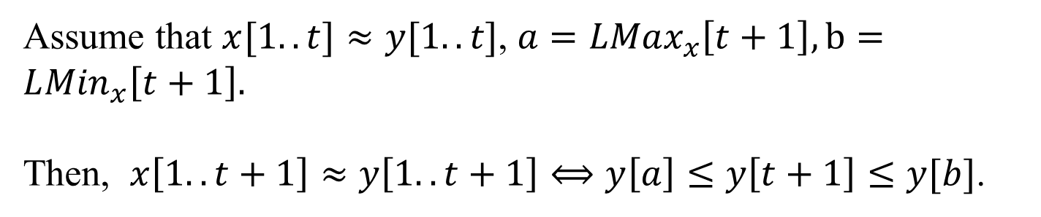





Lemma
Assume that $x[1..t]≈y[1..t]$, $a=LMax_{x}\left[t+1\right],b=L{Min}_{x}\left[t+1\right].$
Then, $x\left[1..t+1\right]≈y\left[1..t+1\right]⟺y\left[a\right]≤y\left[t+1\right]≤y[b]$.
$$a$$
$$b$$
$$t$$
$$x$$
$$a$$
$$b$$
$$t$$
$$y$$

Slide 13
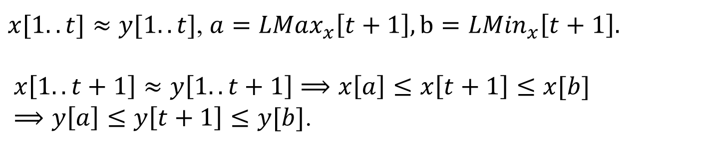

Proof ($⟹$)
$x[1..t]≈y[1..t]$, $a=LMax_{x}\left[t+1\right],b=L{Min}_{x}\left[t+1\right].$
$x\left[1..t+1\right]≈y\left[1..t+1\right]⟹x\left[a\right]≤x\left[t+1\right]≤x[b]$
$⟹y\left[a\right]≤y\left[t+1\right]≤y[b]$.
$$a$$
$$b$$
$$t$$
$$x$$
$$a$$
$$b$$
$$t$$
$$y$$

Slide 14
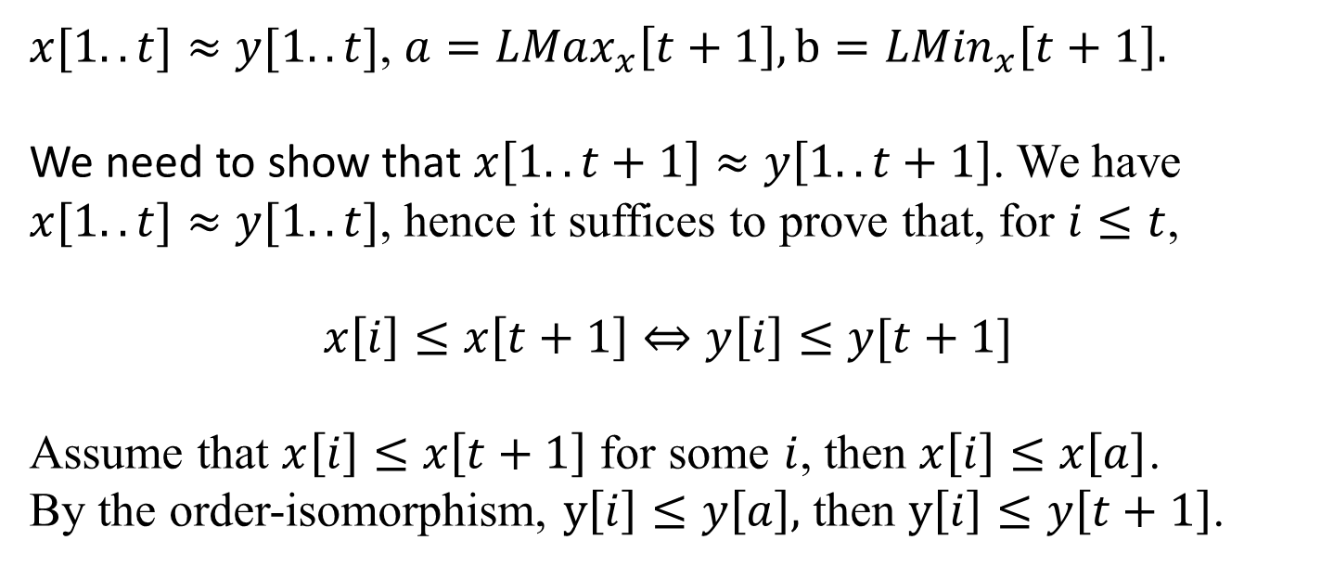

Proof ($⟸$)
$x[1..t]≈y[1..t]$, $a=LMax_{x}\left[t+1\right],b=L{Min}_{x}\left[t+1\right].$
We need to show that $x\left[1..t+1\right]≈y\left[1..t+1\right]$. We have $x[1..t]≈y[1..t]$, hence it suffices to prove that, for $i≤t$,
$$x\left[i\right]≤x\left[t+1\right]⇔y\left[i\right]≤y[t+1]$$
Assume that $x\left[i\right]≤x\left[t+1\right]$ for some $i$, then $x\left[i\right]≤x\left[a\right]$.
By the order-isomorphism, $y\left[i\right]≤y\left[a\right],$ then $y\left[i\right]≤y\left[t+1\right]$.

Slide 15
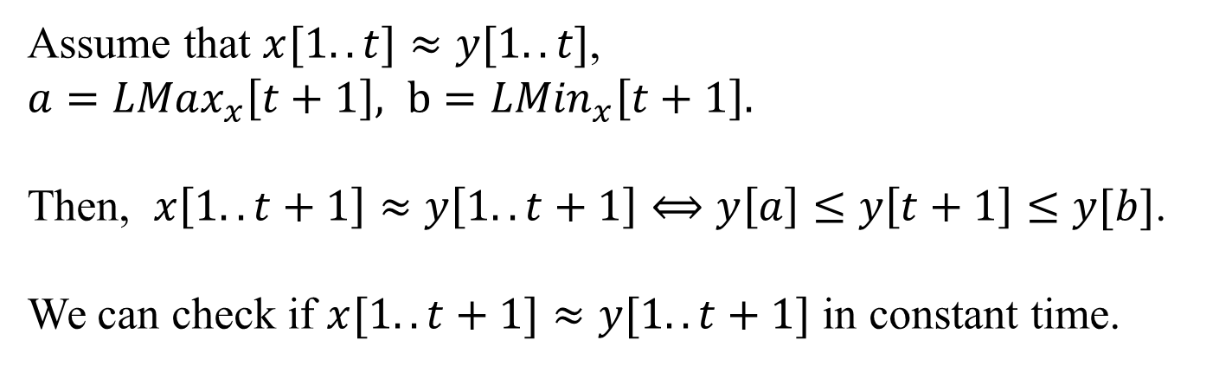
Lemma
Assume that $x[1..t]≈y[1..t]$,
$a=LMax_{x}\left[t+1\right], b=L{Min}_{x}\left[t+1\right].$
Then, $x\left[1..t+1\right]≈y\left[1..t+1\right]⟺y\left[a\right]≤y\left[t+1\right]≤y[b]$.
We can check if $x[1..t+1]≈y[1..t+1]$ in constant time.

Slide 16
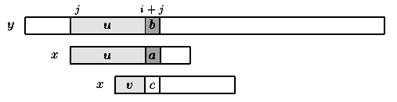
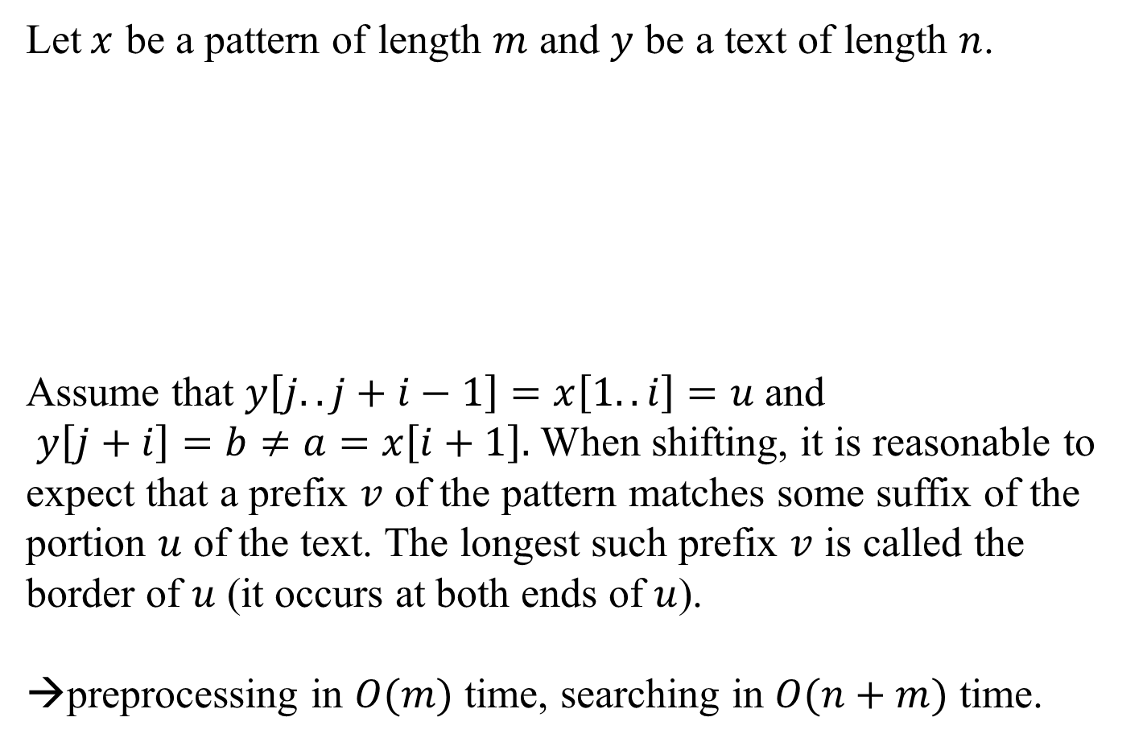
Morris-Pratt algorithm
Let$x$ be a pattern of length $m$ and $y$ be a text of length $n$.
Assume that $y\left[j..j+i−1\right]=x\left[1..i\right]=u$ and
$y\left[j+i\right]=b≠a=x\left[i+1\right].$ When shifting, it is reasonable to expect that a prefix $v$ of the pattern matches some suffix of the portion $u$ of the text. The longest such prefix $v$ is called the border of $u$ (it occurs at both ends of $u$).
→preprocessing in $O(m)$ time, searching in $O(n+m)$ time.

Slide 17

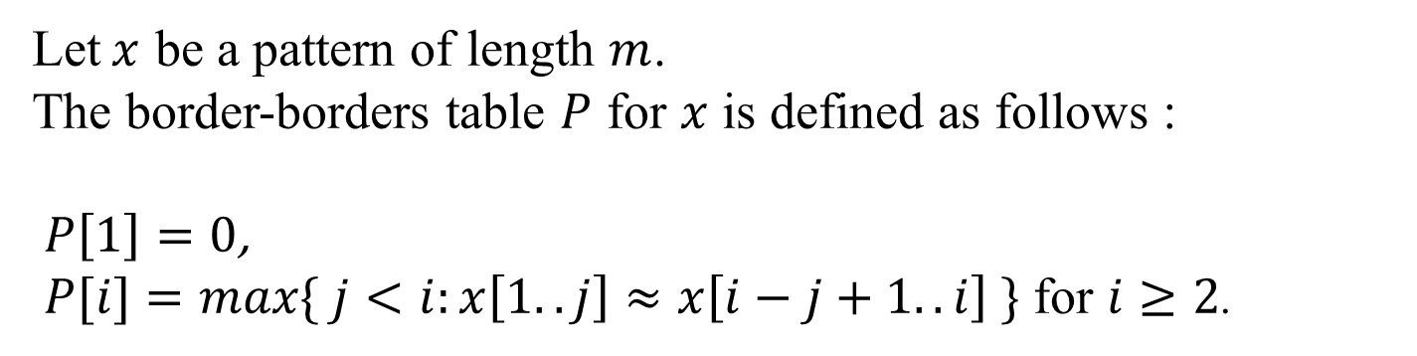



Order-borders table
Let$x$ be a pattern of length $m$.
The border-borders table $P$ for $x$ is defined as follows :
$P\left[1\right]=0$,
$P[i]=max\{ j<i:x\left[1..j\right]≈x\left[i−j+1..i\right] \}$ for $i≥2$.
$$P[i]$$
$$P[i]$$
$$i$$
$$x$$

Slide 18
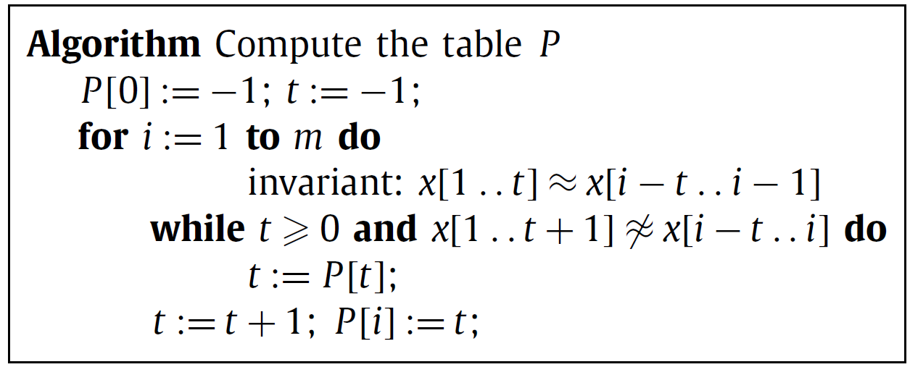

Order-borders table
Let$x$ be a pattern of length $m$.
When considering $P[i]$, $P\left[i−1\right]=t$ is calculated. So we can surely know that $x\left[1..t\right]≈x\left[i−t..i−1\right]$ .
Time complexity : $O(m)$

Slide 19
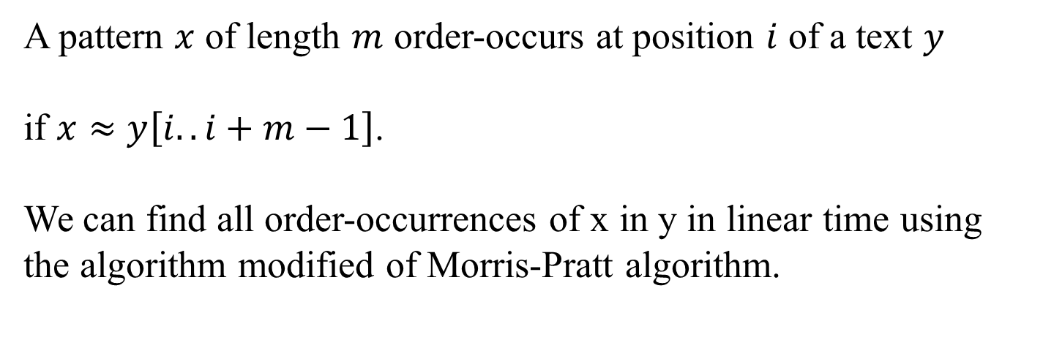
Consecutive permutation pattern matching
A pattern $x$ of length $m$ order-occurs at position $i$ of a text $y$
if $x≈y\left[i..i+m−1\right]$.
We can find all order-occurrences of x in y in linear time using the algorithm modified of Morris-Pratt algorithm.

Slide 20
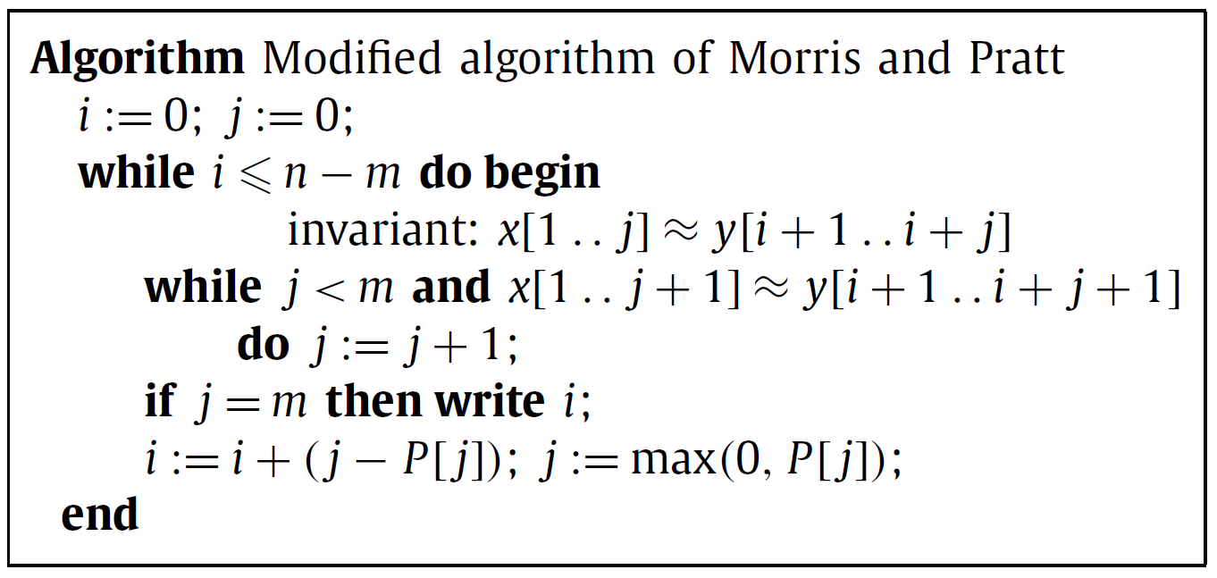
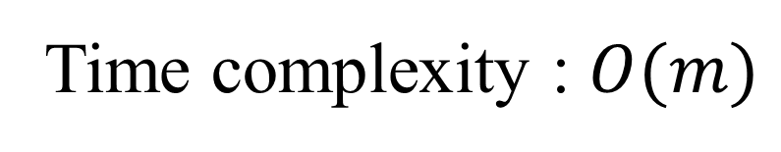
Time complexity : $O(m)$

Slide 21
A Fast Algorithm for Order-preserving Pattern Matching
Sukhyeun Cho, Joong Chae Na, Kunsoo Park,
and Jeong Seop Sim,
Information Processing Letters, Vol. 115,
No. 2, pp. 397-402, February 2015.
Presenter : Shie-Yan Lee
2018/4/17

Slide 22
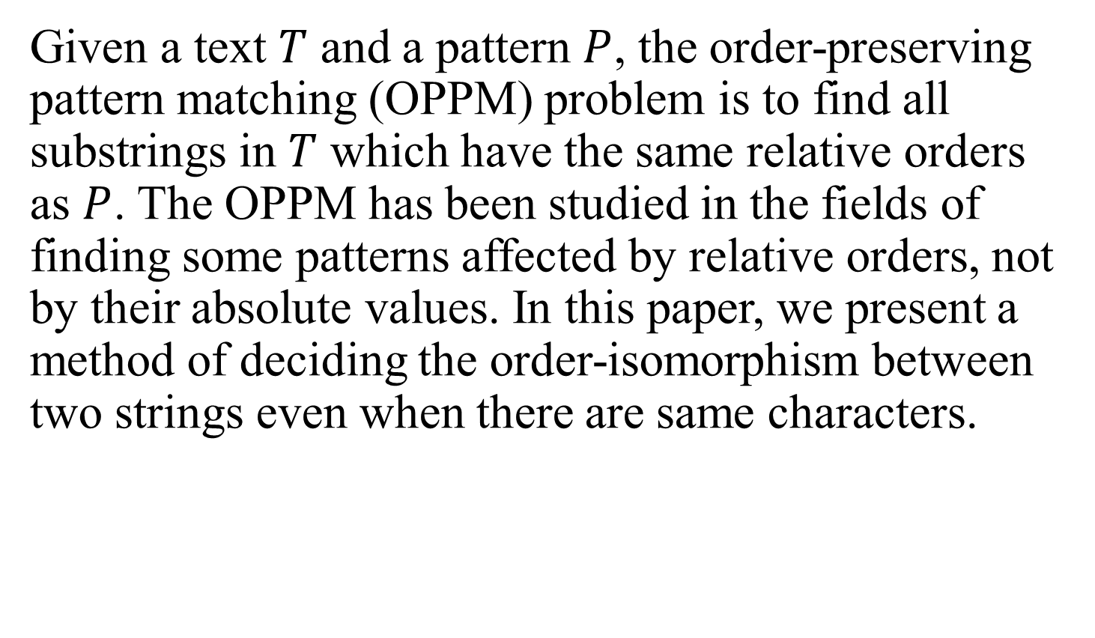
Abstract (1/2)
Given a text $T$ and a pattern $P$, the order-preserving pattern matching (OPPM) problem is to find all substrings in $T$ which have the same relative orders as $P$. The OPPM has been studied in the fields of finding some patterns affected by relative orders, not by their absolute values. In this paper, we present a method of deciding the order-isomorphism between two strings even when there are same characters.

Slide 23
Abstract (2/2)
Then, we show that the bad character rule of the Horspool algorithm for generic pattern matching problems can be applied to the OPPM problem and we present a space-efficient algorithm for computing shift tables for text search. Finally, we combine our bad character rule with the KMP-based algorithm to improve the worst-case running time. We give experimental results to show that our algorithm is about 2 to 6 times faster than the KMP-based algorithm in reasonable cases.

Slide 24
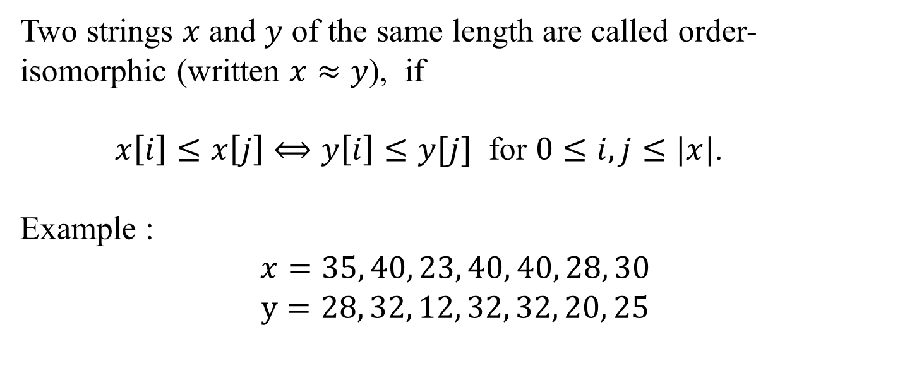
Order-isomorphism
Two strings $x$ and $y$ of the same length are called order-isomorphic (written $x≈y$), if
$x\left[i\right]≤x\left[j\right]⟺y\left[i\right]≤y[j]$ for $0≤i,j≤|x|$.
Example :
$$x=35, 40, 23, 40, 40, 28, 30$$
$$y=28, 32, 12, 32, 32, 20, 25$$

Slide 25
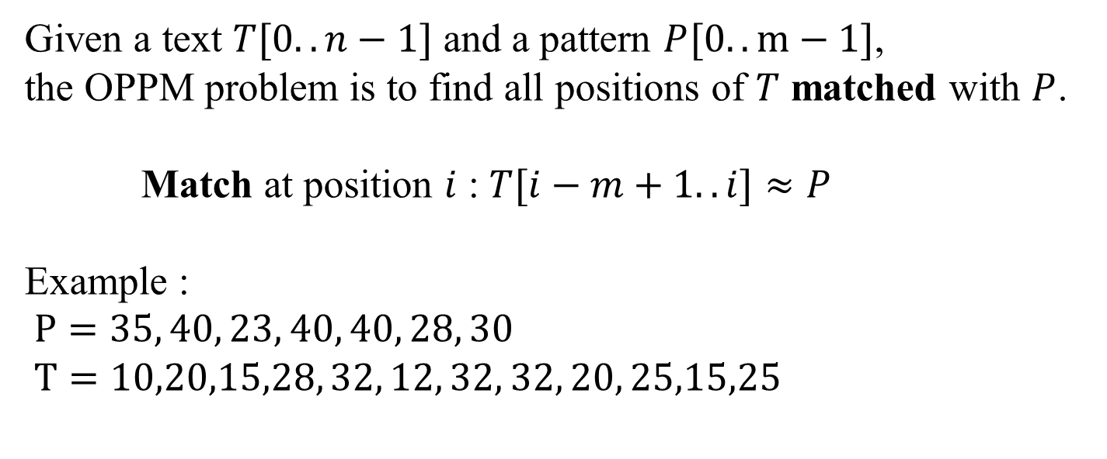
Order-preserving pattern matching problem (OPPM)
Given a text $T[0..n−1]$ and a pattern $P[0..m−1]$,
the OPPM problem is to find all positions of $T$ matched with $P$.
Match at position $i$ : $T[i−m+1..i]≈P$
Example :
$P=35, 40, 23, 40, 40, 28, 30$
$T=10,20,15,28, 32, 12, 32, 32, 20, 25,15,25$

Slide 26
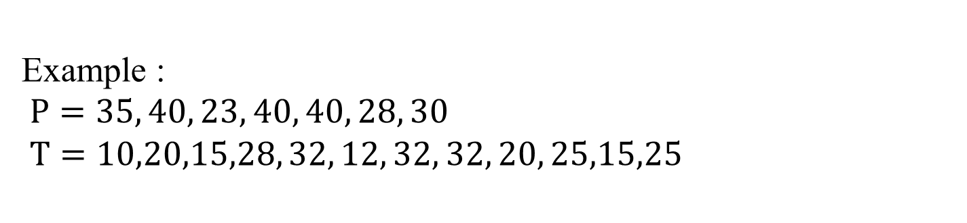
Order-preserving pattern matching problem (OPPM)
Example :
$P=35, 40, 23, 40, 40, 28, 30$
$T=10,20,15,28, 32, 12, 32, 32, 20, 25,15,25$

Slide 27
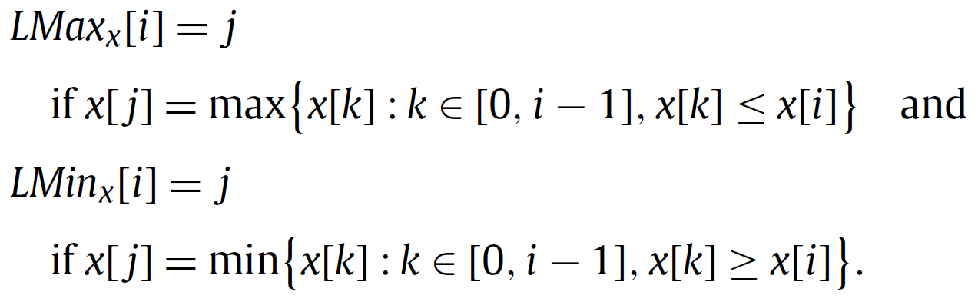
Kubinca et al.’s algorithm
Given a string $x$, we define the location table ${LMax}_{x}$ and ${LMin}_{x}$
$${LMin}_{x}[i]$$
$$LMax_{x}[i]$$
$$i$$
$$x$$
$${LMax}_{x}[i]≤x[i]{≤LMin}_{x}[i]$$

Slide 28



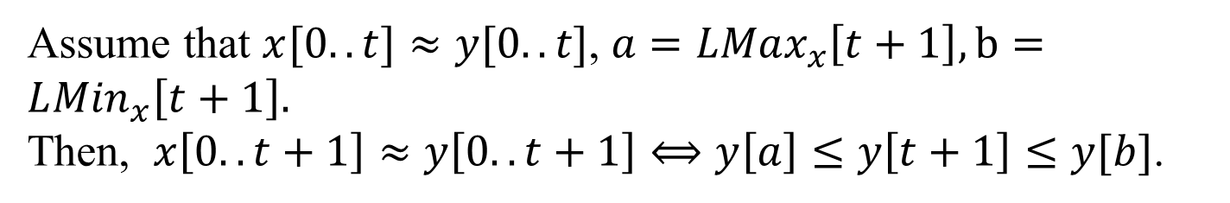





Kubinca et al.’s algorithm
Assume that $x[0..t]≈y[0..t]$, $a=LMax_{x}\left[t+1\right],b=L{Min}_{x}\left[t+1\right].$
Then, $x\left[0..t+1\right]≈y\left[0..t+1\right]⟺y\left[a\right]≤y\left[t+1\right]≤y[b]$.
$$a$$
$$b$$
$$t$$
$$x$$
$$a$$
$$b$$
$$t$$
$$y$$

Slide 29


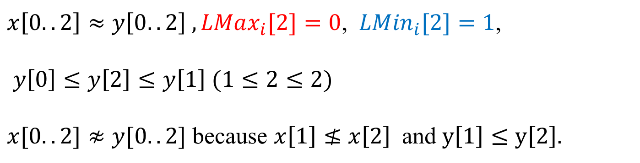
When there are same characters
$$x\left[0..t+1\right]≈y\left[0..t+1\right]⟺y\left[a\right]≤y\left[t+1\right]≤y[b]$$
$$x=1, 3, 2$$
$$y=1, 2, 2$$
$x\left[0..2\right]≈y\left[0..2\right] , LMax_{i}[2]=0$, $LM{in}_{i}[2]=1$,
$y\left[0\right]≤y\left[2\right]≤y\left[1\right] (1≤2≤2)$
$x[0..2]≉y[0..2]$ because $x\left[1\right]≰x\left[2\right]$and $y\left[1\right]≤y\left[2\right].$

Slide 30
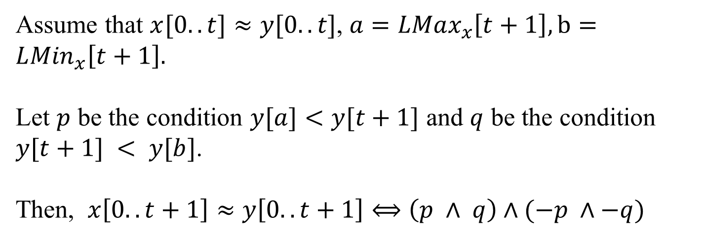
The new lemma
Assume that $x[0..t]≈y[0..t]$, $a=LMax_{x}\left[t+1\right],b=L{Min}_{x}\left[t+1\right].$
Let $p$ be the condition $y[a]<y[t+1]$ and $q$ be the condition $y[t+1] < y[b]$.
Then, $x\left[0..t+1\right]≈y\left[0..t+1\right]⟺\left(p ∧ q\right)∧(−p ∧−q)$

Slide 31
Horspool algorithm
It is an exact string matching algorithm.

