Slide 1
Univariate and Multivariate Time Series Classification with Parametric Integral Dynamic Time Warping
M. Łuczak
Journal of Intelligent & Fuzzy Systems, vol. 33, no. 4, pp. 2403-2413, 2017
Presenter : Bo-Xian Chen
Date : 2018/4/24

Slide 2
Abstract(1/2)
The dynamic time warping (DTW) distance measure is one of the popular and efficient distance measures used in algorithms of time series classification. It frequently occurs with different kinds of transformations of input data. In this paper we propose a combination of the DTW distance measure with a (discrete) integral transformation. This means that the new distance measure IDTW is simply calculated as the value of DTW on the integrated input time series. However, this design means that the distance cannot in itself give good classification results. We therefore propose to construct a parametric integral dynamic time warping distance measure IDDTW which is a parametric combination of the distances DTW and IDTW. Such a combined distance is used in the nearest neighbor (1NN) classification method in the case of both univariate and multivariate time series analysis.

Slide 3
Abstract(2/2)
Computational experiments performed on both one-dimensional and multidimensional datasets show that this approach reduces the classification error significantly in comparison with the component methods. The parametric approach allows the new distance to be adapted to each dataset, while showing no significant overfitting effects. The contribution and the main motivation of the paper is to show that the simple transformation as the integral transform can include a bit information about examined time series data and can be used to significantly improve performance of the classification process both for univariate and multivariate time series data. The results are confirmed by graphical and statistical comparisons.

Slide 4
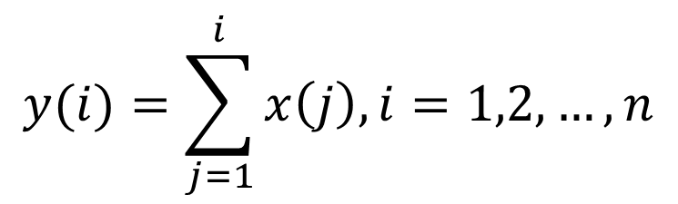
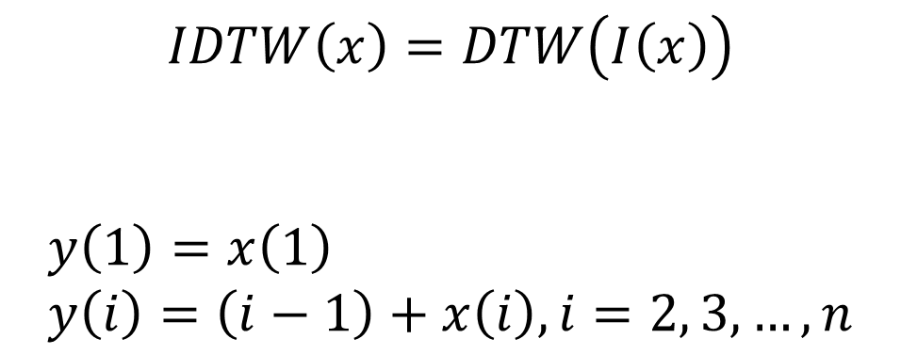
Integral dynamic time warping(IDTW)
$$IDTW\left(x\right)=DTW\left(I\left(x\right)\right)$$
$$y\left(1\right)=x\left(1\right) \\ y\left(i\right)=\left(i−1\right)+x\left(i\right), i=2, 3, …, n$$
$$y(i)=\sum_{j=1}^{i}{x\left(j\right), i=1,2,…,n}$$

Slide 5
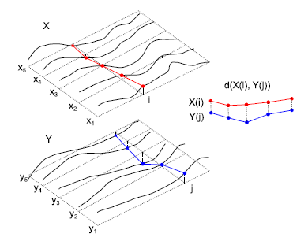
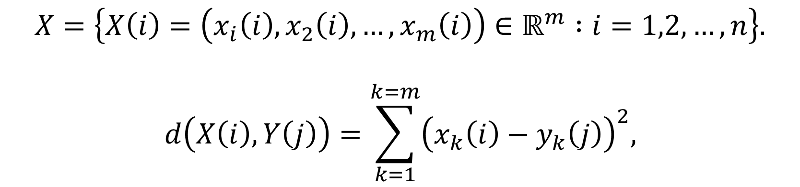
Multivariate dynamic time warping
$$X=\left\{X\left(i\right)=\left(x_{i}\left(i\right), x_{2}\left(i\right), …, x_{m}\left(i\right)\right)∈ℝ^{m} :i=1,2,…,n\right\}.$$
$$d\left(X\left(i\right), Y\left(j\right)\right)=\sum_{k=1}^{k=m}{{\left(x_{k}\left(i\right)−y_{k}\left(j\right)\right)}^{2},}$$

Slide 6

Normalization
$$N\left(x\right)=z_norm(x)$$
$$z_norm\left(x\right)=\frac{x−μ(x)}{σ(x)}$$
$$μ\left(x\right) :mean of time series$$
$$σ\left(x\right) :standard deviation x$$
Notes:
in the rest of the work we shall always use the symbols DTW and IDTW (instead of NDTW and NIDTW) with the assumption that the data is always normalized before computation of the distance measure.

Slide 7
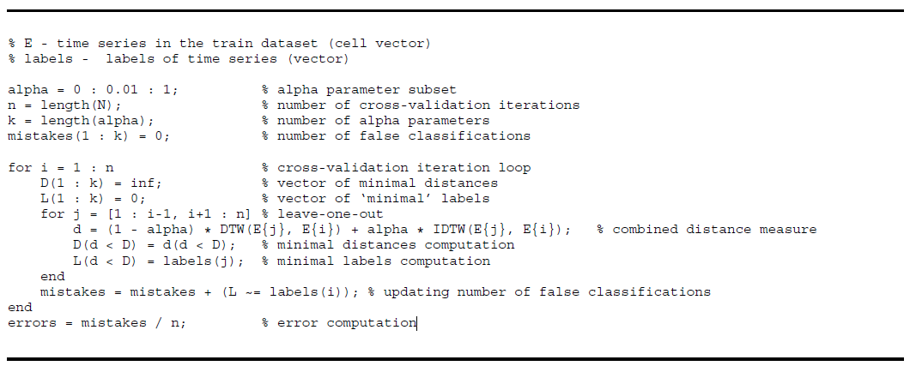
Combination of DTW and IDTW
$$ID_{DTW}\left(a, b\right)=\left(1−α\right)DTW\left(a, b\right)+α IDTW(a, b)$$

Slide 8
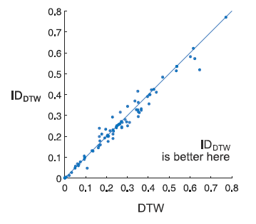
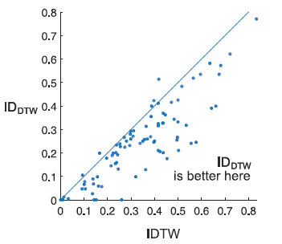
DTW vs. IDTW vs. ID_{DTW}

Slide 9
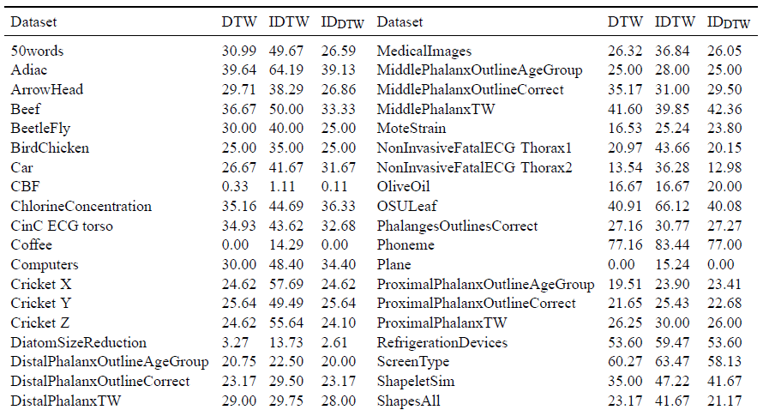
Experimental Results

Slide 10
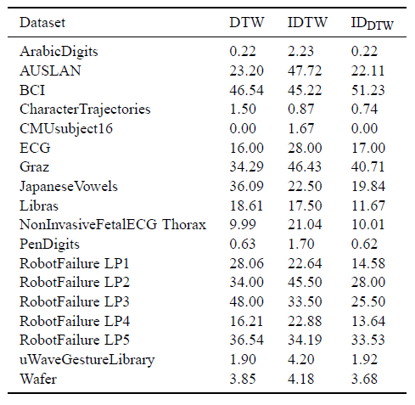
Experimental Results

