Slide 1
Computing a Longest Increasing Subsequence of Length k in Time O(nloglogk)
Maxime Crochemore and Ely Porat.
Proceeding VoCS'08 Proceedings of the 2008 international conference on Visions of Computer Science: BCS International Academic Conference Pages 69-74, London, UK , September 22 - 24, 2008.
Presenter: Kuo-Feng Huang
Date: 2018/04/24

Slide 2
Abstract
We consider the complexity of computing a longest increasing subsequence parameterised by the length of the output. Namely, we show that the maximal length k of an increasing subsequence of a permutation of the set of integers {1, 2, . . . , n} can be computed in time O(n log log k) in the RAM model, improving the previous 30-year bound of O(n log log n). The optimality of the new bound is an open question.

Slide 3
LIS
S0 = (12, 8, 9, 1, 11, 6, 7, 2, 10, 4, 5, 3)
(12), (8), (8, 9), (1, 9), (1, 9, 11), (1, 6, 11), (1, 6, 7), (1, 2, 7), (1, 2, 7, 10), (1, 2, 4, 10), (1, 2, 4, 5), (1, 2, 3, 5)
Use van Emde Boas trees, each operation is O(loglogn)
Time: O(nloglon)

Slide 4
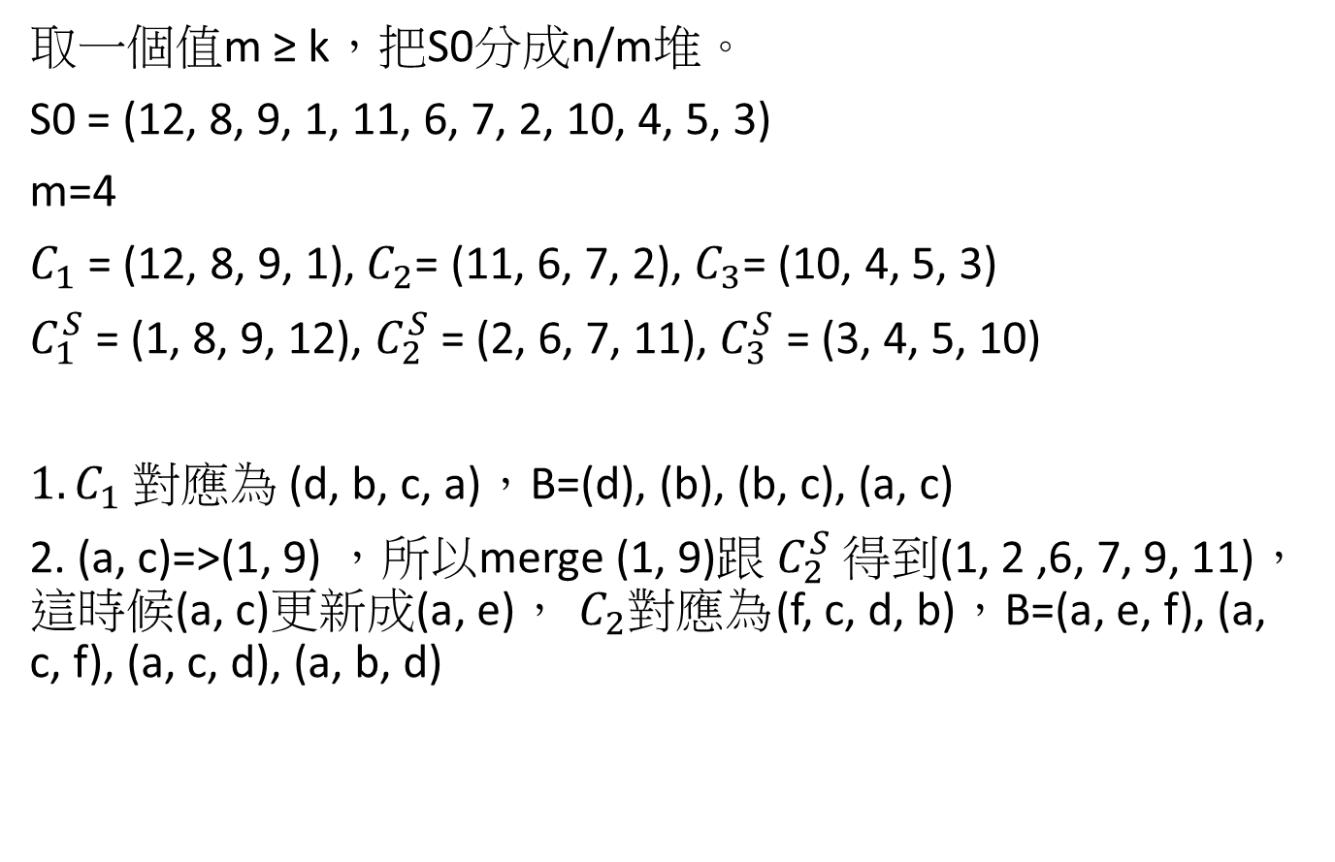
Renaming
取一個值m ≥ k，把S0分成n/m堆。
S0 = (12, 8, 9, 1, 11, 6, 7, 2, 10, 4, 5, 3)
m=4
$C_{1}$ = (12, 8, 9, 1),${ C}_{2}$= (11, 6, 7, 2), $C_{3}$= (10, 4, 5, 3)
$C_{1}^{S}$ = (1, 8, 9, 12), $C_{2}^{S}$ = (2, 6, 7, 11), $C_{3}^{S}$ = (3, 4, 5, 10)
${1. C}_{1}$ 對應為 (d, b, c, a)，B=(d), (b), (b, c), (a, c)
2. (a, c)=>(1, 9) ，所以merge (1, 9)跟$C_{2}^{S}$得到(1, 2 ,6, 7, 9, 11)，這時候(a, c)更新成(a, e)，${ C}_{2}對應為$(f, c, d, b)，B=(a, e, f), (a, c, f), (a, c, d), (a, b, d)

Slide 5
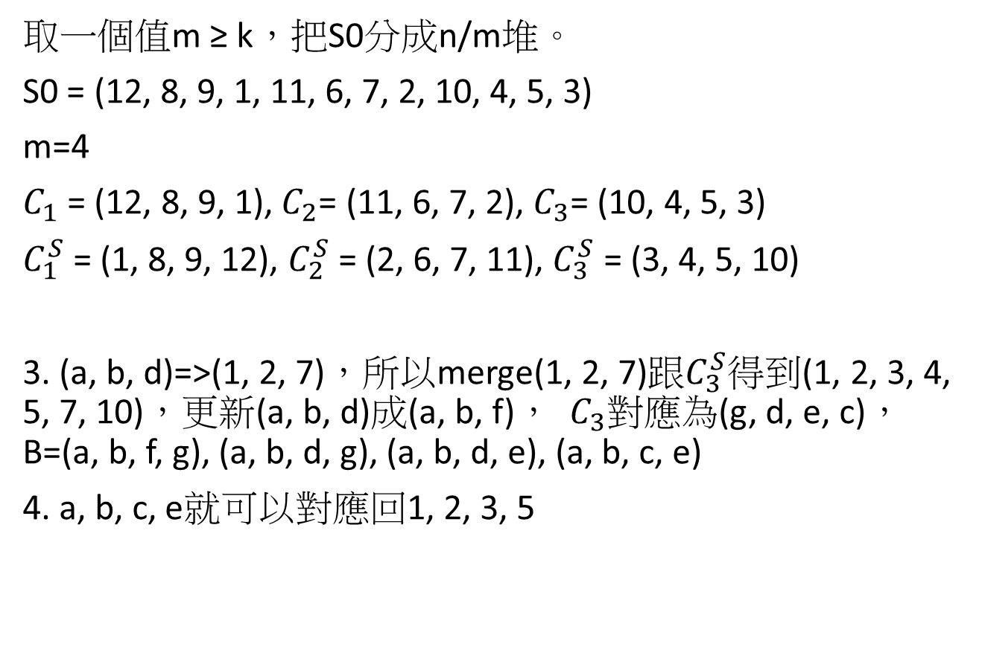
Renaming
取一個值m ≥ k，把S0分成n/m堆。
S0 = (12, 8, 9, 1, 11, 6, 7, 2, 10, 4, 5, 3)
m=4
$C_{1}$ = (12, 8, 9, 1),${ C}_{2}$= (11, 6, 7, 2), $C_{3}$= (10, 4, 5, 3)
$C_{1}^{S}$ = (1, 8, 9, 12), $C_{2}^{S}$ = (2, 6, 7, 11), $C_{3}^{S}$ = (3, 4, 5, 10)
3. (a, b, d)=>(1, 2, 7)，所以merge(1, 2, 7)跟$C_{3}^{S}得到$(1, 2, 3, 4, 5, 7, 10)，更新(a, b, d)成(a, b, f)， ${ C}_{3}對應為$(g, d, e, c)，B=(a, b, f, g), (a, b, d, g), (a, b, d, e), (a, b, c, e)
4. a, b, c, e就可以對應回1, 2, 3, 5

