Slide 1
Dynamic edit distance table under a general weighted cost function
Heikki Hyyrö, Kazuyuki Narisawa and Shunsuke Inenaga
Journal of Discrete Algorithms, vol. 34, pp. 2-17, 2015
Presenter：Hsiu-Chieh Hung
Date：2018/4/24

Slide 2
Abstract(1/2)
We discuss the problem of edit distance computation under a dynamic setting, where one of the two compared strings may be modified by single-character edit operations and we wish to keep the edit distance information between the strings up-to-date. A previous algorithm by Kim and Park (2004) [6] solves a more limited problem where modifications can be done only at the ends of the strings (so-called decremental or incremental edits) and the edit operations have (essentially) unit costs. If the lengths of the two strings are m and n, their algorithm requires O(m + n) time per modification.

Slide 3
Abstract(2/2)
We propose a simple and practical algorithm that (1) allows arbitrary non-negative costs for the edit operations and (2) allows the modifications to be done at arbitrary positions. If the latter string is modified at position j*, our algorithm requires O(min{rc(m + n), mn})time, where r = min{j*, n − j* + 1} and c is the maximum edit operation cost. This equals O(m + n) in the simple decremental/incremental unit cost case. Our experiments indicate that the algorithm performs much faster than the theoretical worst-case time limit O(mn) in the general case with arbitrary edit costs and modification positions. The main practical limitation of the algorithm is its Θ(mn) memory requirement for storing the edit distance information.

Slide 4
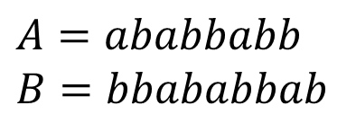
Edit Distance
$$A=ababbabb$$
$$B=bbababbab$$
 |  | b | b | a | b | a | b | b | a | b
 | 0 | 1 | 2 | 3 | 4 | 5 | 6 | 7 | 8 | 9
a | 1 | 1 | 2 | 2 | 3 | 4 | 5 | 6 | 7 | 8
b | 2 | 1 | 1 | 2 | 2 | 3 | 4 | 5 | 6 | 7
a | 3 | 2 | 2 | 1 | 2 | 2 | 3 | 4 | 5 | 6
b | 4 | 3 | 2 | 2 | 1 | 2 | 2 | 3 | 4 | 5
b | 5 | 4 | 3 | 3 | 2 | 2 | 2 | 2 | 3 | 4
a | 6 | 5 | 4 | 3 | 3 | 2 | 3 | 3 | 2 | 3
b | 7 | 6 | 5 | 4 | 3 | 3 | 2 | 3 | 3 | 2
b | 8 | 7 | 6 | 5 | 4 | 4 | 3 | 2 | 3 | 3
Insertion：1
Deletion：1
Substitution：1

Slide 5
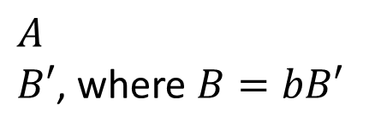
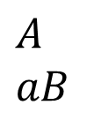
Kim and Park (2004)
Incremental edit distance：
$$A$$
$$aB$$
Decremental edit distance ： (以此為例)
$$A$$
$B′$, where $B=bB′$

Slide 6

Kim and Park (2004)
$$A=ababbabb$$
$$B=bbababbab$$
 |  | b | b | a | b | a | b | b | a | b
 | 0 | 1 | 2 | 3 | 4 | 5 | 6 | 7 | 8 | 9
a | 1 | 1 | 2 | 2 | 3 | 4 | 5 | 6 | 7 | 8
b | 2 | 1 | 1 | 2 | 2 | 3 | 4 | 5 | 6 | 7
a | 3 | 2 | 2 | 1 | 2 | 2 | 3 | 4 | 5 | 6
b | 4 | 3 | 2 | 2 | 1 | 2 | 2 | 3 | 4 | 5
b | 5 | 4 | 3 | 3 | 2 | 2 | 2 | 2 | 3 | 4
a | 6 | 5 | 4 | 3 | 3 | 2 | 3 | 3 | 2 | 3
b | 7 | 6 | 5 | 4 | 3 | 3 | 2 | 3 | 3 | 2
b | 8 | 7 | 6 | 5 | 4 | 4 | 3 | 2 | 3 | 3
Insertion：1
Deletion：1
Substitution：1
$D$-table

Slide 7

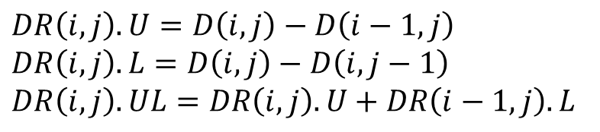
Kim and Park (2004)
$$A=ababbabb$$
$$B=bbababbab$$
$DR$-table
$$DR\left(i,j\right).U=D\left(i,j\right)−D\left(i−1,j\right)$$
$$DR\left(i,j\right).L=D\left(i,j\right)−D\left(i,j−1\right)$$
$$DR\left(i,j\right).UL=DR\left(i,j\right).U+DR\left(i−1,j\right).L$$

Slide 8
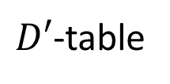
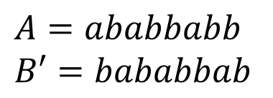
Kim and Park (2004)
$$A=ababbabb$$
$$B′=bababbab$$
 |  | b | a | b | a | b | b | a | b
 | 0 | 1 | 2 | 3 | 4 | 5 | 6 | 7 | 8
a | 1 | 1 | 1 | 2 | 3 | 4 | 5 | 6 | 7
b | 2 | 1 | 2 | 1 | 2 | 3 | 4 | 5 | 6
a | 3 | 2 | 1 | 2 | 1 | 2 | 3 | 4 | 5
b | 4 | 3 | 2 | 1 | 2 | 1 | 2 | 3 | 4
b | 5 | 4 | 3 | 2 | 2 | 2 | 1 | 2 | 3
a | 6 | 5 | 4 | 3 | 2 | 3 | 2 | 1 | 2
b | 7 | 6 | 5 | 4 | 3 | 2 | 3 | 2 | 1
b | 8 | 7 | 6 | 5 | 4 | 3 | 2 | 3 | 2
Insertion：1
Deletion：1
Substitution：1
$D′$-table

Slide 9
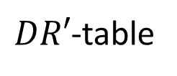
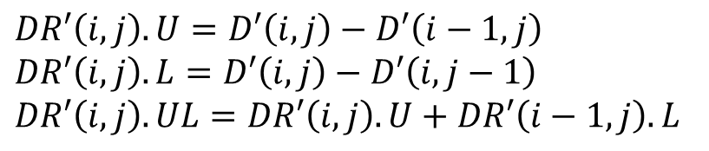
Kim and Park (2004)
$$A=ababbabb$$
$$B′=bababbab$$
$DR′$-table
$$DR′\left(i,j\right).U=D′\left(i,j\right)−D′\left(i−1,j\right)$$
$$DR′\left(i,j\right).L=D′\left(i,j\right)−D′\left(i,j−1\right)$$
$$DR′\left(i,j\right).UL=DR′\left(i,j\right).U+DR′\left(i−1,j\right).L$$

Slide 10

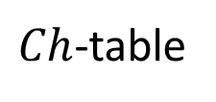
Kim and Park (2004)
$$Ch\left(i,j\right)=D^{′}\left(i,j\right)−D(i,j+1)$$
$Ch$-table
 |  | b | a | b | a | b | b | a | b
 | -1 | -1 | -1 | -1 | -1 | -1 | -1 | -1 | -1
a | 0 | -1 | -1 | -1 | -1 | -1 | -1 | -1 | -1
b | 1 | 0 | 0 | -1 | -1 | -1 | -1 | -1 | -1
a | 1 | 0 | 0 | 0 | -1 | -1 | -1 | -1 | -1
b | 1 | 1 | 0 | 0 | 0 | -1 | -1 | -1 | -1
b | 1 | 1 | 0 | 0 | 0 | 0 | -1 | -1 | -1
a | 1 | 1 | 1 | 0 | 0 | 0 | -1 | -1 | -1
b | 1 | 1 | 1 | 1 | 0 | 0 | 0 | -1 | -1
b | 1 | 1 | 1 | 1 | 0 | 0 | 0 | 0 | -1

Slide 11

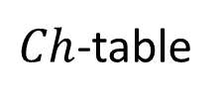
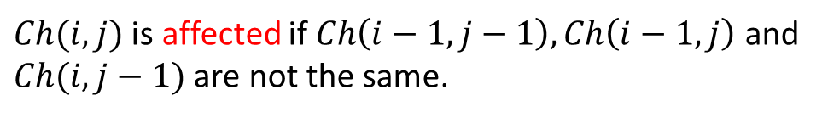
Kim and Park (2004)
$$Ch\left(i,j\right)=D^{′}\left(i,j\right)−D(i,j+1)$$
$Ch(i,j)$ is affected if $Ch\left(i−1,j−1\right), Ch\left(i−1,j\right)$ and $Ch(i,j−1)$ are not the same.
$Ch$-table
If $DR′(i,j)$ is not affected, then $DR^{′}\left(i,j\right)=DR\left(i,j+1\right).$
 |  | b | a | b | a | b | b | a | b
 | -1 | -1 | -1 | -1 | -1 | -1 | -1 | -1 | -1
a | 0 | -1 | -1 | -1 | -1 | -1 | -1 | -1 | -1
b | 1 | 0 | 0 | -1 | -1 | -1 | -1 | -1 | -1
a | 1 | 0 | 0 | 0 | -1 | -1 | -1 | -1 | -1
b | 1 | 1 | 0 | 0 | 0 | -1 | -1 | -1 | -1
b | 1 | 1 | 0 | 0 | 0 | 0 | -1 | -1 | -1
a | 1 | 1 | 1 | 0 | 0 | 0 | -1 | -1 | -1
b | 1 | 1 | 1 | 1 | 0 | 0 | 0 | -1 | -1
b | 1 | 1 | 1 | 1 | 0 | 0 | 0 | 0 | -1
O(m + n)

Slide 12

A simple algorithm under a general cost function
Unit cost function：
$$δ_{1}\left(ε,b_{j}\right)=1$$
$$δ_{1}\left(a_{i},ε\right)=1$$
$$δ_{1}\left(a_{i},b_{j}\right)=1$$
General cost function：
$$Σ：alphbet$$
$$δ：(\{ε\}×Σ)∪(Σ×\{ε\})∪(Σ×Σ)$$

Slide 13

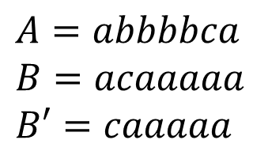
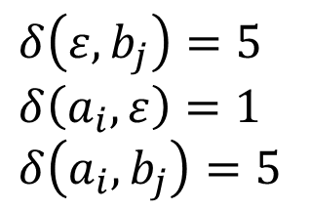
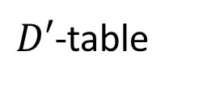
A simple algorithm under a general cost function
$$A=abbbbca$$
$$B=acaaaaa$$
$$B′=caaaaa$$
$$D\text{−}table$$
$D′\text{−}$table
 |  | a | c | a | a | a | a | a
 | 0 | 5 | 10 | 15 | 20 | 25 | 30 | 35
a | 1 | 0 | 5 | 10 | 15 | 20 | 25 | 30
b | 2 | 1 | 5 | 10 | 15 | 20 | 25 | 30
b | 3 | 2 | 6 | 10 | 15 | 20 | 25 | 30
b | 4 | 3 | 7 | 11 | 15 | 20 | 25 | 30
b | 5 | 4 | 8 | 12 | 16 | 20 | 25 | 30
c | 6 | 5 | 4 | 9 | 14 | 19 | 24 | 29
a | 7 | 6 | 5 | 4 | 9 | 14 | 19 | 24
 |  | c | a | a | a | a | a
 | 0 | 5 | 10 | 15 | 20 | 25 | 30
a | 1 | 5 | 5 | 10 | 15 | 20 | 25
b | 2 | 6 | 6 | 10 | 15 | 20 | 25
b | 3 | 7 | 7 | 11 | 15 | 20 | 25
b | 4 | 8 | 8 | 12 | 16 | 20 | 25
b | 5 | 9 | 9 | 13 | 17 | 21 | 25
c | 6 | 5 | 10 | 14 | 18 | 22 | 26
a | 7 | 6 | 5 | 10 | 14 | 18 | 22
$$δ\left(ε,b_{j}\right)=5$$
$$δ\left(a_{i},ε\right)=1$$
$$δ\left(a_{i},b_{j}\right)=5$$

Slide 14
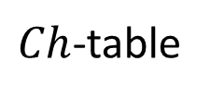
A simple algorithm under a general cost function
$Ch$-table
 |  | c | a | a | a | a | a
 | -5 | -5 | -5 | -5 | -5 | -5 | -5
a | 1 | 0 | -5 | -5 | -5 | -5 | -5
b | 1 | 1 | -4 | -5 | -5 | -5 | -5
b | 1 | 1 | -3 | -4 | -5 | -5 | -5
b | 1 | 1 | -3 | -3 | -4 | -5 | -5
b | 1 | 1 | -3 | -3 | -3 | -4 | -5
c | 1 | 1 | 1 | 0 | -1 | -2 | -3
a | 1 | 1 | 1 | 1 | 0 | -1 | -2
Kim and Park

Slide 15
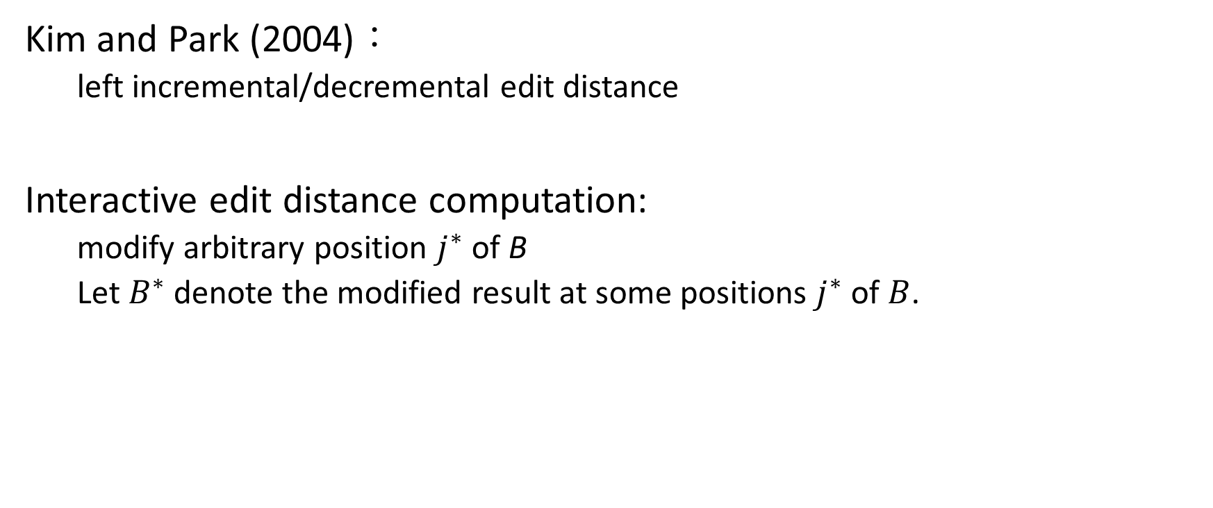
A simple algorithm under a general cost function
Kim and Park (2004)：
left incremental/decremental edit distance
Interactive edit distance computation:
modify arbitrary position $j^{∗}$ of B
Let $B^{∗}$ denote the modified result at some positions $j^{∗}$ of $B$.

Slide 16
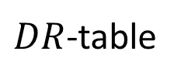
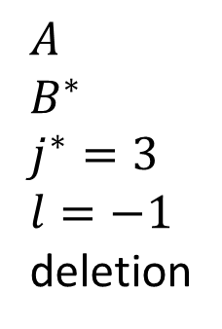

A simple algorithm under a general cost function
$$A$$
$$B^{∗}$$
$$j^{∗}=3$$
$$l=−1$$
deletion
$DR$-table
$DR^{∗}$-table

Slide 17
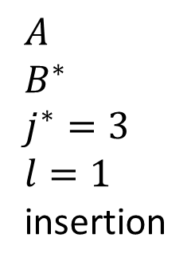
A simple algorithm under a general cost function
$$A$$
$$B^{∗}$$
$$j^{∗}=3$$
$$l=1$$
insertion
$DR$-table
$DR^{∗}$-table
copy
insert

Slide 18
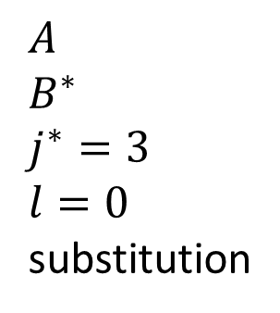
A simple algorithm under a general cost function
$$A$$
$$B^{∗}$$
$$j^{∗}=3$$
$$l=0$$
substitution
$DR$-table
$DR^{∗}$-table
equal

Slide 19
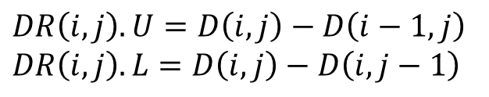
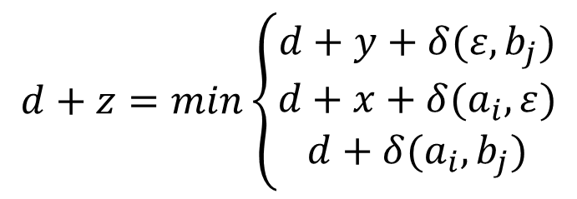

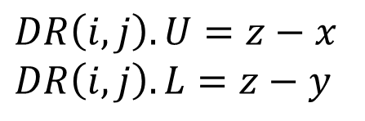
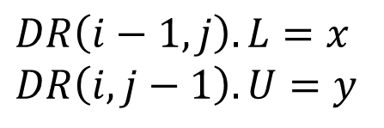

A simple algorithm under a general cost function
 | j - 1 | j
i – 1 | d | d + x
i | d + y | d + z
$$DR\left(i−1,j\right).L=x$$
$$DR\left(i,j−1\right).U=y$$
$$DR\left(i,j\right).U=z−x$$
$$DR\left(i,j\right).L=z−y$$
$D$-table
$$d+z=min\left\{\begin{aligned}d+y+δ(ε,b_{j}) \\ d+x+δ(a_{i},ε) \\ d+δ(a_{i},b_{j})\end{aligned}\right.$$
$DR$-table
$$DR\left(i,j\right).U=D\left(i,j\right)−D\left(i−1,j\right)$$
$$DR\left(i,j\right).L=D\left(i,j\right)−D\left(i,j−1\right)$$

Slide 20
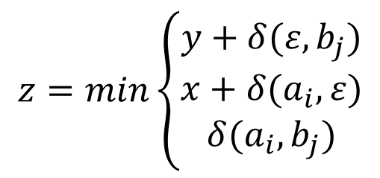
A simple algorithm under a general cost function
 | j - 1 | j
i – 1 | d | d + x
i | d + y | d + z
$$DR\left(i−1,j\right).L=x$$
$$DR\left(i,j−1\right).U=y$$
$$DR\left(i,j\right).U=z−x$$
$$DR\left(i,j\right).L=z−y$$
$D$-table
$$z=min\left\{\begin{aligned}y+δ(ε,b_{j}) \\ x+δ(a_{i},ε) \\ δ(a_{i},b_{j})\end{aligned}\right.$$
$DR$-table
$$DR\left(i,j\right).U=D\left(i,j\right)−D\left(i−1,j\right)$$
$$DR\left(i,j\right).L=D\left(i,j\right)−D\left(i,j−1\right)$$

Slide 21
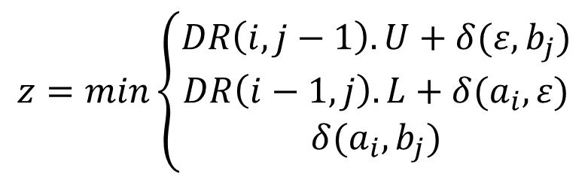
A simple algorithm under a general cost function
 | j - 1 | j
i – 1 | d | d + x
i | d + y | d + z
$$DR\left(i−1,j\right).L=x$$
$$DR\left(i,j−1\right).U=y$$
$$DR\left(i,j\right).U=z−x$$
$$DR\left(i,j\right).L=z−y$$
$D$-table
$$z=min\left\{\begin{aligned}DR\left(i,j−1\right).U+δ(ε,b_{j}) \\ DR\left(i−1,j\right).L+δ(a_{i},ε) \\ δ(a_{i},b_{j})\end{aligned}\right.$$
$DR$-table
$$DR\left(i,j\right).U=D\left(i,j\right)−D\left(i−1,j\right)$$
$$DR\left(i,j\right).L=D\left(i,j\right)−D\left(i,j−1\right)$$

Slide 22

A simple algorithm under a general cost function
$DR^{∗}(i,j)$ needs to be recomputed if and only if
$DR^{∗}\left(i−1,j\right).L≠DR\left(i−1,j−l\right).L$ or $DR^{∗}\left(i,j−1\right).U≠DR\left(i,j−1−l\right).U$

Slide 23
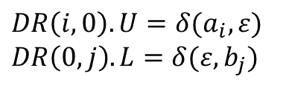
A simple algorithm under a general cost function
$$A$$
$$B^{∗}$$
$$j^{∗}=3$$
$$l=−1$$
deletion
$DR$-table
$DR^{∗}$-table
 | (1,6) | (8,2) | (5,6) | (13,3) | (7,9)
 | (3,4) | (9,1) | (4,2) | (6,4) | (9,4)
 | (6,3) | (7,3) | (7,1) | (8,4) | (4,3)
 | (8,2) | (3,1) | (3,4) | (7,8) | (6,8)
 | (4,1) | (3,2) | (3,5) | (4,4) | (3,7)
 | (7,3) | (8,3) | (2,2) | (2,7) | (1,5)
 | (1,6) | (8,2) | (13,3) | (7,9)
 | (3,4) | (9,1) | (6,4) | (9,4)
 | (6,3) | (7,3) | (8,4) | (4,3)
 | (8,2) | (3,1) | (7,8) | (6,8)
 | (4,1) | (3,2) | (4,4) | (3,7)
 | (7,3) | (8,3) | (2,7) | (1,5)
$$DR\left(i,0\right).U=δ(a_{i},ε)$$
$$DR\left(0,j\right).L=δ(ε,b_{j})$$

Slide 24

A simple algorithm under a general cost function
Recompute column $j^{∗}$ in $DR^{∗}$-table
$$A$$
$$B^{∗}$$
$$j^{∗}=3$$
$$l=−1$$
deletion
$DR$-table
$DR^{∗}$-table
 | (1,6) | (8,2) | (5,6) | (13,3) | (7,9)
 | (3,4) | (9,1) | (4,2) | (6,4) | (9,4)
 | (6,3) | (7,3) | (7,1) | (8,4) | (4,3)
 | (8,2) | (3,1) | (3,4) | (7,8) | (6,8)
 | (4,1) | (3,2) | (3,5) | (4,4) | (3,7)
 | (7,3) | (8,3) | (2,2) | (2,7) | (1,5)
 | (1,6) | (8,2) | (8,3) | (7,9)
 | (3,4) | (9,1) | (4,4) | (9,4)
 | (6,3) | (7,3) | (3,16) | (4,3)
 | (8,2) | (3,1) | (7,8) | (6,8)
 | (4,1) | (3,2) | (4,9) | (3,7)
 | (7,3) | (8,3) | (2,6) | (1,5)
$$DR\left(i,0\right).U=δ(a_{i},ε)$$
$$DR\left(0,j\right).L=δ(ε,b_{j})$$

Slide 25

A simple algorithm under a general cost function
$$DR^{∗}\left(i,j−1\right).U≠DR\left(i,j−1−l\right).U$$
$$A$$
$$B^{∗}$$
$$j^{∗}=3$$
$$l=−1$$
deletion
$DR$-table
$DR^{∗}$-table
 | (1,6) | (8,2) | (5,6) | (13,3) | (7,9)
 | (3,4) | (9,1) | (4,2) | (6,4) | (9,4)
 | (6,3) | (7,3) | (7,1) | (8,4) | (4,3)
 | (8,2) | (3,1) | (3,4) | (7,8) | (6,8)
 | (4,1) | (3,2) | (3,5) | (4,4) | (3,7)
 | (7,3) | (8,3) | (2,2) | (2,7) | (1,5)
 | (1,6) | (8,2) | (8,3) | (7,9)
 | (3,4) | (9,1) | (4,4) | (9,4)
 | (6,3) | (7,3) | (3,16) | (4,3)
 | (8,2) | (3,1) | (7,8) | (6,8)
 | (4,1) | (3,2) | (4,9) | (3,7)
 | (7,3) | (8,3) | (2,6) | (1,5)
$$DR\left(i,0\right).U=δ(a_{i},ε)$$
$$DR\left(0,j\right).L=δ(ε,b_{j})$$

Slide 26

A simple algorithm under a general cost function
$$DR^{∗}\left(i−1,j\right).L≠DR\left(i−1,j−l\right).L$$
$$A$$
$$B^{∗}$$
$$j^{∗}=3$$
$$l=−1$$
deletion
$DR$-table
$DR^{∗}$-table
 | (1,6) | (8,2) | (5,6) | (13,3) | (7,9)
 | (3,4) | (9,1) | (4,2) | (6,4) | (9,4)
 | (6,3) | (7,3) | (7,1) | (8,4) | (4,3)
 | (8,2) | (3,1) | (3,4) | (7,8) | (6,8)
 | (4,1) | (3,2) | (3,5) | (4,4) | (3,7)
 | (7,3) | (8,3) | (2,2) | (2,7) | (1,5)
 | (1,6) | (8,2) | (8,3) | (8,8)
 | (3,4) | (9,1) | (4,4) | (9,4)
 | (6,3) | (7,3) | (3,16) | (4,3)
 | (8,2) | (3,1) | (7,8) | (6,8)
 | (4,1) | (3,2) | (4,9) | (3,7)
 | (7,3) | (8,3) | (2,6) | (1,5)
$$DR\left(i,0\right).U=δ(a_{i},ε)$$
$$DR\left(0,j\right).L=δ(ε,b_{j})$$

Slide 27
A simple algorithm under a general cost function
$$DR^{∗}\left(i−1,j\right).L≠DR\left(i−1,j−l\right).L$$
$$A$$
$$B^{∗}$$
$$j^{∗}=3$$
$$l=−1$$
deletion
$DR$-table
$DR^{∗}$-table
 | (1,6) | (8,2) | (5,6) | (13,3) | (7,9)
 | (3,4) | (9,1) | (4,2) | (6,4) | (9,4)
 | (6,3) | (7,3) | (7,1) | (8,4) | (4,3)
 | (8,2) | (3,1) | (3,4) | (7,8) | (6,8)
 | (4,1) | (3,2) | (3,5) | (4,4) | (3,7)
 | (7,3) | (8,3) | (2,2) | (2,7) | (1,5)
 | (1,6) | (8,2) | (8,3) | (8,8)
 | (3,4) | (9,1) | (4,4) | (3,6)
 | (6,3) | (7,3) | (3,16) | (4,3)
 | (8,2) | (3,1) | (7,8) | (6,8)
 | (4,1) | (3,2) | (4,9) | (3,7)
 | (7,3) | (8,3) | (2,6) | (1,5)
$$DR\left(i,0\right).U=δ(a_{i},ε)$$
$$DR\left(0,j\right).L=δ(ε,b_{j})$$

Slide 28
A simple algorithm under a general cost function
$$DR^{∗}\left(i−1,j\right).L≠DR\left(i−1,j−l\right).L$$
$$A$$
$$B^{∗}$$
$$j^{∗}=3$$
$$l=−1$$
deletion
$DR$-table
$DR^{∗}$-table
 | (1,6) | (8,2) | (5,6) | (13,3) | (7,9)
 | (3,4) | (9,1) | (4,2) | (6,4) | (9,4)
 | (6,3) | (7,3) | (7,1) | (8,4) | (4,3)
 | (8,2) | (3,1) | (3,4) | (7,8) | (6,8)
 | (4,1) | (3,2) | (3,5) | (4,4) | (3,7)
 | (7,3) | (8,3) | (2,2) | (2,7) | (1,5)
 | (1,6) | (8,2) | (8,3) | (8,8)
 | (3,4) | (9,1) | (4,4) | (3,6)
 | (6,3) | (7,3) | (3,16) | (5,3)
 | (8,2) | (3,1) | (7,8) | (6,8)
 | (4,1) | (3,2) | (4,9) | (3,7)
 | (7,3) | (8,3) | (2,6) | (1,5)
$$DR\left(i,0\right).U=δ(a_{i},ε)$$
$$DR\left(0,j\right).L=δ(ε,b_{j})$$

Slide 29
A simple algorithm under a general cost function
$$DR^{∗}\left(i−1,j\right).L≠DR\left(i−1,j−l\right).L$$
$$A$$
$$B^{∗}$$
$$j^{∗}=3$$
$$l=−1$$
deletion
$DR$-table
$DR^{∗}$-table
 | (1,6) | (8,2) | (5,6) | (13,3) | (7,9)
 | (3,4) | (9,1) | (4,2) | (6,4) | (9,4)
 | (6,3) | (7,3) | (7,1) | (8,4) | (4,3)
 | (8,2) | (3,1) | (3,4) | (7,8) | (6,8)
 | (4,1) | (3,2) | (3,5) | (4,4) | (3,7)
 | (7,3) | (8,3) | (2,2) | (2,7) | (1,5)
 | (1,6) | (8,2) | (8,3) | (8,8)
 | (3,4) | (9,1) | (4,4) | (3,6)
 | (6,3) | (7,3) | (3,16) | (5,3)
 | (8,2) | (3,1) | (7,8) | (6,8)
 | (4,1) | (3,2) | (4,9) | (3,7)
 | (7,3) | (8,3) | (2,6) | (1,5)
$$DR\left(i,0\right).U=δ(a_{i},ε)$$
$$DR\left(0,j\right).L=δ(ε,b_{j})$$

Slide 30
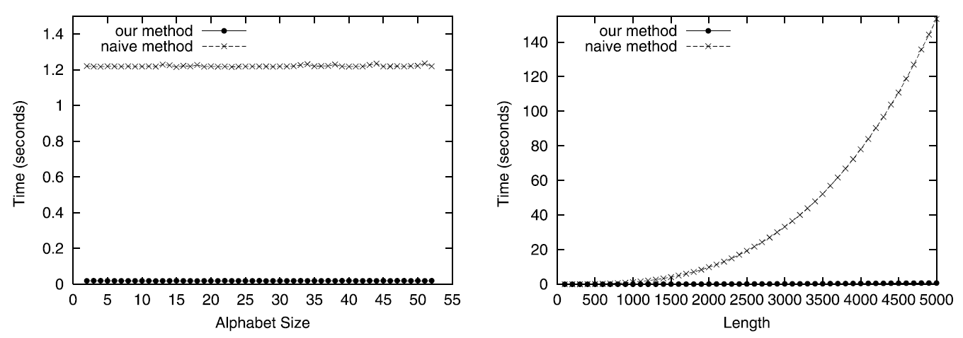
Experimental Result
Fixed length：1000
Fixed alphabet size：26

Slide 31
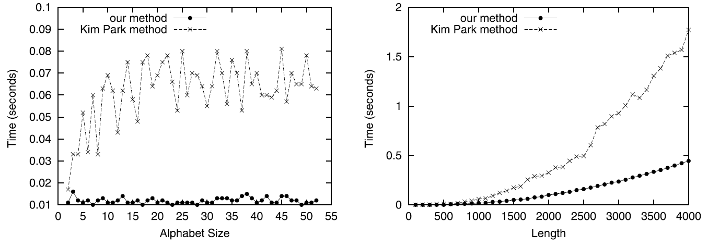
Experimental Result
Fixed length：1000
Fixed alphabet size：26

Slide 32
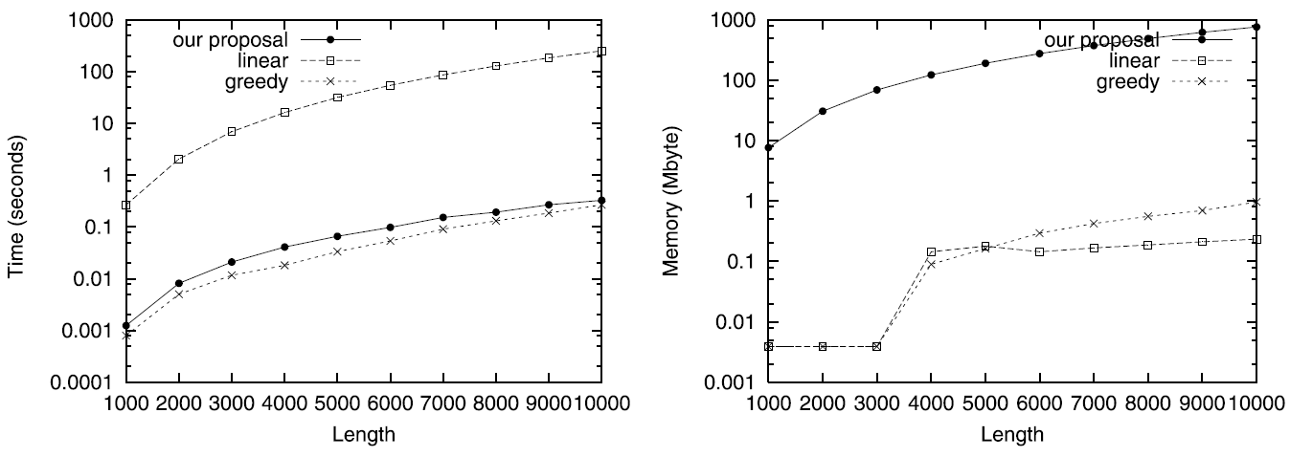
Experimental Result
Interactive edit distance computation

