Slide 1
Ed-Join: An Efficient Algorithm for Similarity Joins With Edit Distance Constraints
Chuan Xiao, Wei Wang and Xuemin Lin
Proceedings of the VLDB Endowment, vol. 1, pp. 933-944, Auckland, New Zealand, August, 2008
Presenter: Hsiu-Chieh Hung
Date: 2018/5/15

Slide 2
Abstract(1/2)
There has been considerable interest in similarity join in the research community recently. Similarity join is a fundamental operation in many application areas, such as data integration and cleaning, bioinformatics, and pattern recognition. We focus on efficient algorithms for similarity join with edit distance constraints. Existing approaches are mainly based on converting the edit distance constraint to a weaker constraint on the number of matching q-grams between pair of strings. In this paper, we propose the novel perspective of investigating mismatching q-grams. Technically, we derive two new edit distance lower bounds by analyzing the locations and contents of mismatching q-grams.

Slide 3
Abstract(2/2)
A new algorithm, Ed-Join, is proposed that exploits the new mismatch-based filtering methods; it achieves substantial reduction of the candidate sizes and hence saves computation time. We demonstrate experimentally that the new algorithm outperforms alternative methods on large-scale real datasets under a wide range of parameter settings.

Slide 4


S
T
database
database
Insertion: 1
Deletion: 1
Substitution: 1
Edit distance $≤τ$
$$\left(s_{1},t_{1}\right), \left(s_{1},t_{2}\right), \left(s_{3},t_{1}\right)⋯⋯$$

Slide 5

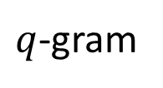


$q$-gram
$$q=2$$
$$s=abaabab$$
$$(ab,1)$$

Slide 6

$q$-gram
$$q=2$$
$$s=abaabab$$
$$\left(ab,1\right), (ba, 2)$$

Slide 7
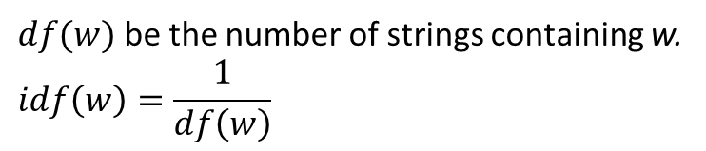
$q$-gram
$$q=2$$
$$s=abaabab$$
$$\left(ab,1\right), \left(ba, 2\right), \left(aa,3\right), \left(ab,4\right), \left(ba,5\right), (ab,6)$$
w
$df(w)$ be the number of strings containing w.
$$idf\left(w\right)=\frac{1}{df\left(w\right)}$$

Slide 8

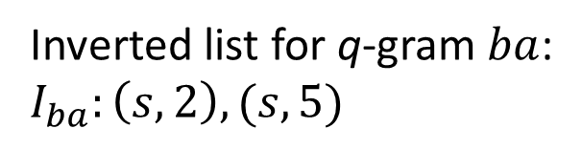
$q$-gram
$$q=2$$
$$s=abaabab$$
$$\left(ab,1\right), \left(ba, 2\right), \left(aa,3\right), \left(ab,4\right), \left(ba,5\right), (ab,6)$$
w
$df(w)$ be the number of strings containing w.
$$idf\left(w\right)=\frac{1}{df\left(w\right)}$$
If $idf(aa)≥idf(ab)≥idf(ba)$
Inverted list for q-gram $ba$:
$$I_{ba}:\left(s,2\right), (s,5)$$
sort
$$\left(aa,3\right), \left(ab, 1\right), \left(ab,4\right), \left(ab,6\right), \left(ba,2\right), (ba,5)$$

Slide 9
Count Filtering
Positional Filtering
Length Filtering
Prefix Filtering
Content-based Mismatch Filtering

Slide 10
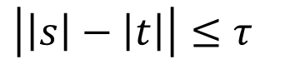
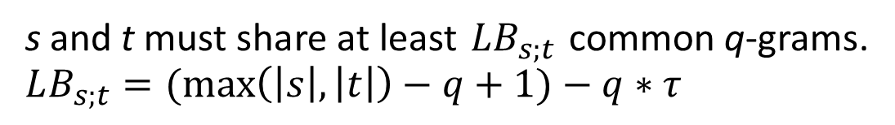
Count Filtering:
s and t must share at least $LB_{s;t}$ common q-grams.
$$LB_{s;t}=(\max\left(\left|s\right|,\left|t\right|\right)−q+1)−q∗τ$$
Positional Filtering:
The distance between the location of matching q-gram $≤τ$
Length Filtering:
$$\left|\left|s\right|−\left|t\right|\right|≤τ$$

Slide 11
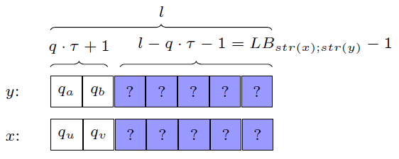

Prefix Filtering
$$l=\left|s\right|−q+1$$
$(q∗τ+1)$-prefix must have at least one matching q-gram

Slide 12




Prefix Filtering
$$s=abaabab$$
$$\left(ab,1\right), \left(ba, 2\right), \left(aa,3\right), \left(ab,4\right), \left(ba,5\right), (ab,6)$$
$$q=2$$
$$τ=1$$
$$\left(q∗τ+1\right)=3$$
$$\left(ab,1\right), \left(ba, 2\right), \left(aa,3\right)$$

Slide 13
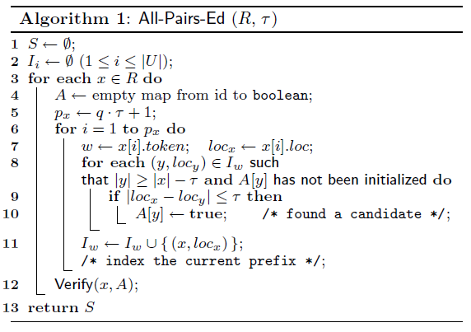

Slide 14
Positional Filtering
Length Filtering
Prefix Filtering

Slide 15

$$p_{x}←CalcPrefixLen\left(x\right);$$

Slide 16
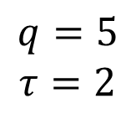
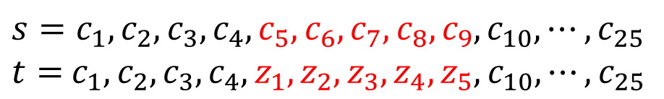

Content-based Mismatch Filtering
$$q=5$$
$$τ=2$$
$$s=c_{1}, c_{2},c_{3},c_{4},c_{5},c_{6},c_{7},c_{8},c_{9},c_{10},⋯,c_{25}$$
$t=$ $c_{1},c_{2},c_{3},c_{4},z_{1},z_{2},z_{3},z_{4},z_{5},c_{10},⋯,c_{25}$
$$LB_{s;t}=(\max\left(\left|s\right|,\left|t\right|\right)−q+1)−q∗τ$$
Counting Filtering requires $25−5+1−5∗2=11$ matching 5-gram
12 matching 5-gram between s and t
Pass Counting Filtering

Slide 17
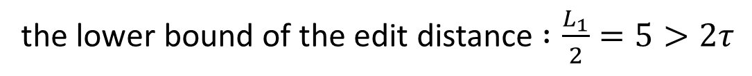

Content-based Mismatch Filtering
$$q=5$$
$$τ=2$$
probing window
$$s=c_{1}, c_{2},c_{3},c_{4},c_{5},c_{6},c_{7},c_{8},c_{9},c_{10},⋯,c_{25}$$
$t=$ $c_{1},c_{2},c_{3},c_{4},z_{1},z_{2},z_{3},z_{4},z_{5},c_{10},⋯,c_{25}$
$L_{1}$ distance in the probing window can not larger than $2τ$
$$L_{1}=10$$
the lower bound of the edit distance $:\frac{L_{1}}{2}=5>2τ$
Prune

Slide 18
$$p_{x}←CalcPrefixLen\left(x\right);$$
Counting Filtering
Content-based Mismatch Filtering

Slide 19
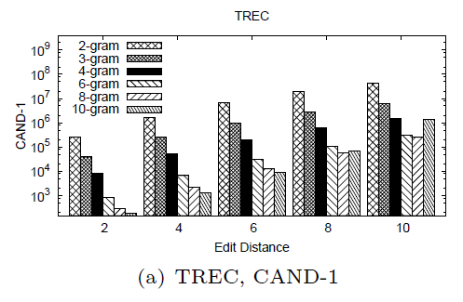
Experiment
TREC: author, title, abstract
N:271464
avg_len:1098.4

Slide 20
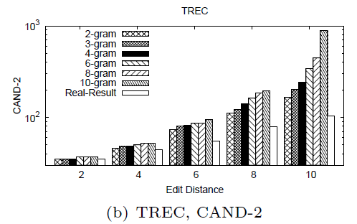
Experiment

Slide 21
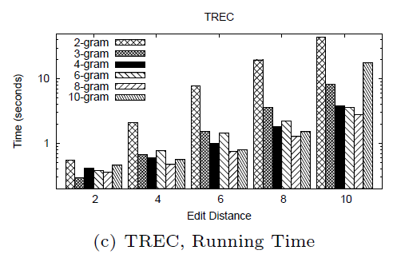
Experiment

